Slide 1
Causality, path analysis, and regression analysis
We often would like to try to go beyond simple descriptions of events, and attempt to infer causal relations among the variables under study. Conventional discussions of causality emphasize three conditions needed for causal relations to be judged present.
Association: If A causes B, we should find that A and B tend to go together in practice. Statistically, this means that A and B have an association (i.e., they are not independent).
Direction: Cause precedes effect; there is an asymmetry in the relations between cause and effect.
Isolation: If cause and effect are isolated from other influences, change in cause will directly lead to change in effects.

Slide 2










Regression analysis was not originally designed to capture causal relations among the variables in the analysis. Path analysis was originally meant to describe causal relations. To illustrate, we can consider the same three-variable relationship from both a regression and a path analytic perspective.
Assume:

Slide 3
Consider first the interpretation of the relations in terms of ordinary linear regression analysis.
In this case, is usually interpreted as “the expected change in , per unit change in , at any fixed value of .”
This interpretation does not necessarily carry any implication for what would happen if one manipulates . We can carry out a regression analysis between any set of quantitative variables, and estimate regression coefficients.
Example: regression of height on weight
The “expected change” terminology connotes some idea of changing one variable and watching the resulting effects on another variable, which is not necessarily relevant to regression analysis.

Slide 4
A better interpretation for the regression coefficient might be as follows:
Consider two groups of people who are one unit apart on , while everyone within each group shares a common value on
. Furthermore, assume that everyone in both groups share a common value on . Then we expect the people in the two groups to differ by on on average.
Example: = height
= weight
= gender
This way of stating the interpretation of a regression coefficient eliminates the idea of “changing” the values of the predictors, and highlights the descriptive nature of the method.

Slide 5
How does path analysis differ from the regression case?
The path coefficient is intended to tell us what would happen to if we fix and to particular values, not simply through observation but rather through manipulation. We also assume that the disturbance is independent of both of the variables , .
The independence assumption refers to the “isolation” condition that is part of any causal model. The influences on that are apart from the variables , must not be dependent on these variables.
Unfortunately, it is difficult to believe that the conditions required for the above interpretation will hold in observational data, where there is no randomization or manipulation.

Slide 6
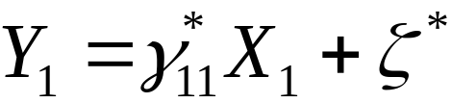


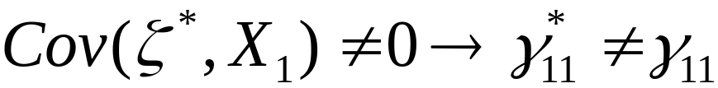
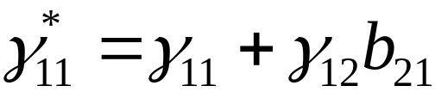
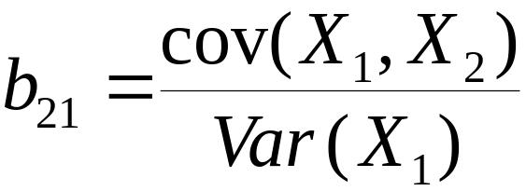
When isolation fails….the omitted predictor case.
Consider dropping from the earlier path model:
Now we have
Instead, we have with

Slide 7
We say that the omission of the predictor produces a misspecified model. In this case, our estimate for the path coefficient will be wrong, and the direction of the bias depends on (1) the relationship between the omitted and included predictors, and (2) the relationship between the omitted predictor and the outcome variable.
If the omitted predictor and the included predictor are unrelated, no bias results.
If the omitted predictor and the outcome variable are unrelated, no bias results.
In general, there is no certain method for detecting “omitted predictors” from the data on and alone.

Slide 8
SEM can be applied to data generated by observational or survey research, or to data generated through true experimental designs.
The causal interpretation of the results in all applications will depend largely on the research design that generated the data. The application of SEM to the data does not magically enable one to infer causality.
In observational or survey research, it will usually be difficult to have confidence in any strictly causal interpretation of the results. For example, it is difficult in such cases to believe that no predictors have been omitted, or that omitted predictors are either unrelated to the included predictors, or unrelated to the outcome variables.

Slide 9

Randomization within an experimental design serves to assign people to either or or both so that the association between these variables and the disturbance is eliminated.
Given that randomization occurs before is measured, and that randomization eliminates the above association, we are then on more firm ground for inferring a causal relation.
Quasi-experiments include some form of manipulation of the exogenous variables without complete randomization. For example, there might be a treatment and a control group, but without full control over who is assigned to these groups. An attempt may be made to reduce the disturbance association by including more exogenous covariates….

Slide 10
The use of longitudinal data is sometimes thought to enhance the strength of any causal interpretation placed on the data. The data then satisfy a temporal ordering, which is thought to be necessary for any causal account.
In purely observational data however, omitted predictors will still have the confounding influence described earlier even though the included predictor and the outcome are ordered in time.
Longitudinal data are useful for eliminating some rival models because any model that specifies a causal ordering that is inconsistent with the temporal ordering can be eliminated.

