Slide 1




Discrete endogenous variables in Mplus
For models in which any measured endogenous variable is either categorical or ordered-categorical with few (< 6) categories, there can be problems in applying the usual linear SEM.
Example: CFA model with indicators that are binary (e.g., true/false).
………….. Factor model not
bounded. This
also applies to path
models.
………..

Slide 2

The linearity of the traditional factor model creates problems when the measured variable is binary. In this case:
The model is saying that the item response function is linear, but the linear model is unbounded and will not fit the data properly. Exploratory factor analysis in SPSS, for example, will have this problem.
For the above reason, the traditional factor model is usually discarded in favor of a different factor model that adequately represents the binary item scores. This alternative model is a factor model for ordered-categorical data.

Slide 3


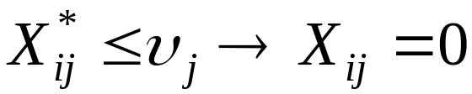
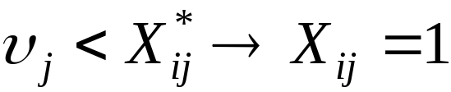
Factor model for ordered-categorical data
Under this approach, we assume that for the jth measured variable, there exists a latent response variate that determines the measured score. Given that is the measured score for the ith person on the jth variable, let
= latent response variate for jth variable and ith person
We then let the observed score be determined by the latent response variate in relation to a set of threshold parameters. We will focus on the binary case here:

Slide 4

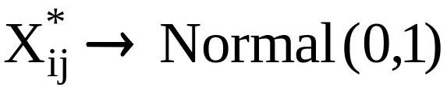

Here is a fixed threshold parameter for the jth item. We also assume something about the distribution of the latent response variates:
Under this assumption, it becomes relatively easy to estimate the threshold parameter by observing the values of the measured variable. For example…..
Consider next that we have two measured variables:
Latent response variates underlie both variables and determine their relationship.

Slide 5


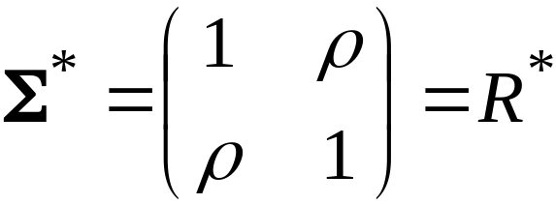
The correlation between the observed binary variables is just an ordinary Pearson correlation, called a phi coefficient. It can be calculated using the usual formula, or via simpler formulas that use proportions for various data outcomes. We usually use the Greek letter to denote the phi coefficient.
Hypothetically, there exists a second correlation coefficient between the latent response variates for the jth and kth measured variables: the tetrachoric correlation. This correlation is represented with the Greek letter . Under our model thus far, the covariance matrix for the pair of latent response variates can be written

Slide 6
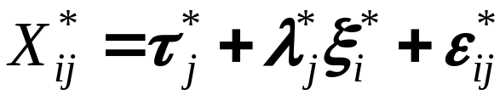

We now formulate the factor model for the latent response variates:
After invoking the usual assumptions about the factor model, we have the covariance matrix represented as
We usually assume that the latent intercepts in the factor model are all zero when using the ordered-categorical version of the model. Hence for each variable, there are three parameters: the threshold, the factor loading, and the unique variance.

Slide 7
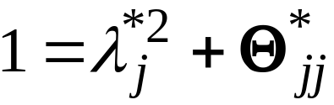
We can further reduce the parameters by realizing that
We can therefore eliminate the unique factor variance, and we have just a threshold and a factor loading to estimate for each measured variable. For binary indicators, the factor model thus reduces to a two-parameter model for each indicator.
The above restriction on the unique factor variances is the default in Mplus, and is known as the DELTA parameterization.
By default, the unique factor variances are not independent parameters in the model. For analyses of single groups (i.e., NOT multiple group models), this default is the best choice in most cases.

Slide 8
We can extend the model for the binary indicator case to indicators with more than two categories: the general ordered-categorical case or polytomous case.
The model is essentially the same, with one latent response variate for each measured indicator. The number of threshold parameters per indicator rises with the number of categories: for an m-category item, there will be m-1 threshold parameters.
The correlation between any pair of latent response variates in this case is called a polychoric correlation. These are estimated by default when you analyse ordered-categorical indicators using factor analysis in Mplus. Higher sample sizes may be needed for this case in comparison to the binary case.

Slide 9
CFA of ordered-categorical indicators in Mplus
The Mplus program will perform confirmatory factor analyses of ordered-categorical data. Raw data should generally be entered into Mplus when the data are ordered-categorical. Covariance matrix input will not permit the program to fit these models.
Several estimation approaches are available in Mplus for ordered-categorical indicators. For most samples (N<2000), the WLSM or WLSMV estimation methods are good choices. WLS can be used for truly large samples (say, N=2000 or more). Simulations have shown that the WLSM or WLSMV test statistics and standard errors are fairly accurate even down to sample sizes of 200.

Slide 10
CFA example: MMPI Phobia binary item data
TITLE: Phobia MMPI items
DATA: FILE IS phwnew.dat;
FORMAT IS 4X, 11(1X, F1.0);
VARIABLE: NAMES ARE ph1-ph11;
USEVARIABLES ARE ph1-ph6;
CATEGORICAL ARE ph1-ph6;
ANALYSIS: TYPE = GENERAL;
ITERATIONS=3000;
ESTIMATOR=WLSMV;
MODEL: F1 BY ph1-ph6;
OUTPUT: sampstat standardized residual mod(all);

Slide 11
CFA for polytomous TAI Worry items
TITLE: test anxiety(worry) items
DATA: FILE IS anxmf.dat;
FORMAT IS 21f2.0;
VARIABLE: NAMES ARE anx1-anx20 gender;
USEVARIABLES ARE anx3 anx4 anx5 anx6 anx7 anx14 anx17
anx20;
CATEGORICAL ARE anx3 anx4 anx5 anx6 anx7 anx14 anx17
anx20;
ANALYSIS: Type = GENERAL;
ESTIMATOR=WLSMV;
MODEL: F1 BY anx3 anx4 anx5 anx6 anx7 anx14 anx17 anx20;
OUTPUT: sampstat standardized residual mod(all);

