Slide 1
Path analysis with measured variables
We begin our study of SEM with models that include only measured variables, with no latent variables included in the model apart from disturbance variables. These models are sometimes known as path models, but because the phrase “path models” is sometimes used for models that include both measured and latent variables, we stipulate here that we include only measured variables.
We assume that all measured variables are measured without measurement error. In some cases, violations of this assumption will have few important consequences; in other cases, violations could significantly alter the meaning of the results. More on this later.

Slide 2
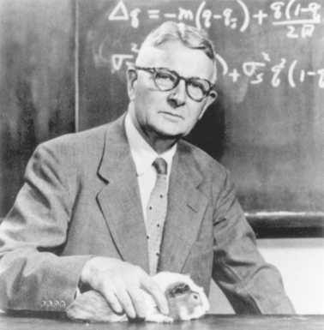
Sewell Wright (1889-1988)

Slide 3










We begin with model specification, learning about issues of notation and the interplay between path diagrams and equations.
In all cases, X variables will denote exogenous measured variables and Y variables will denote endogenous measured variables.
Example 1: Three-variable path model

Slide 4
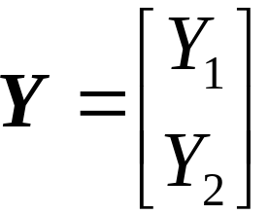
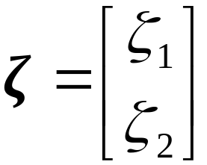

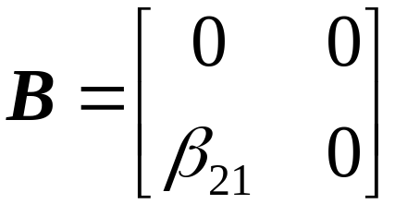
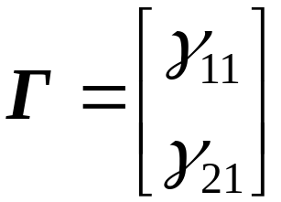
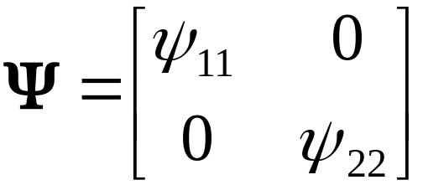

We can express the two equations simultaneously in matrix form using

Slide 5

















Example 2: Five-variable path model

Slide 6

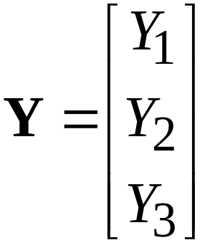
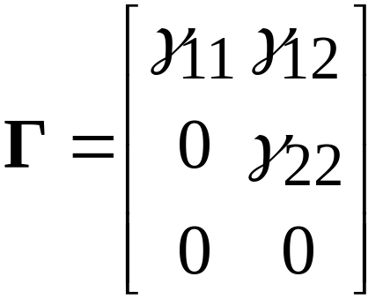
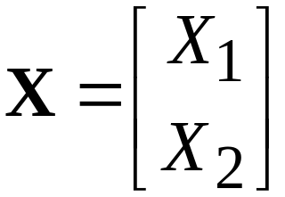
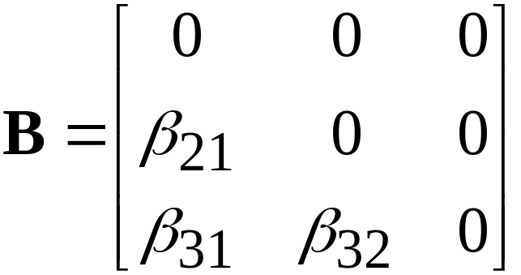
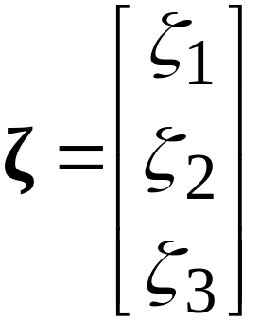
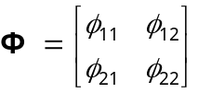
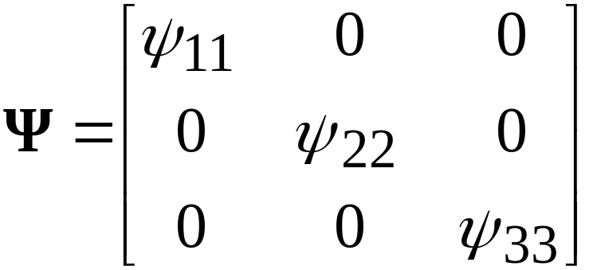
In matrix form:

Slide 7



Two types of path models:
Recursive path models have two features:
is lower triangular or
is a diagonal matrix
A “lower triangular” matrix is a square matrix (number of rows = number of columns) in which all nonzero elements are below the main diagonal of the matrix.
The above two criteria rule out models that contain loops, reciprocal causation, or correlated disturbance variables.

Slide 8


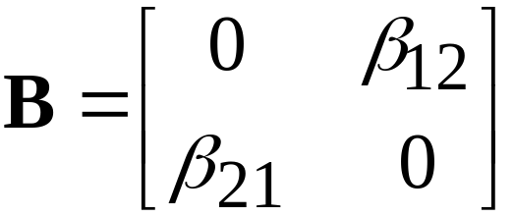


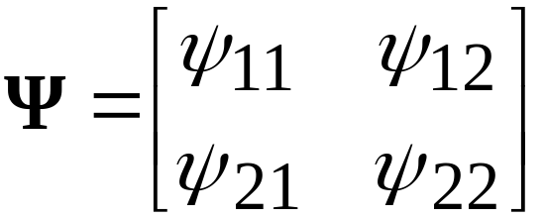
All other path models are non-recursive. Some examples are:
Reciprocal causation
Correlated disturbances

Slide 9


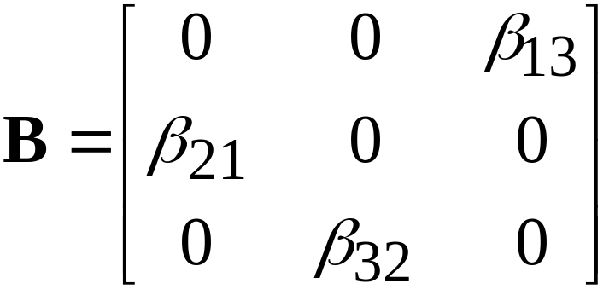
Loop model
cannot be rearranged to make it lower triangular

Slide 10
Path analysis example from Romney et al.
Variable abbreviations: SI=symptoms of illness
ND=neurological dysfunction
PR=poor interpersonal relations
LM=low morale
DS=diminished SES
First model
PR
SI
LM
ND
DS

Slide 11
Mplus program for the path model:
TITLE: Romney et al.'s (1992) QOL: Conventional Model
DATA: FILE IS Romney.dat;
TYPE IS corr;
NOBS IS 469;
VARIABLE: NAMES ARE LM SI ND PR DS;
ANALYSIS: TYPE IS general;
ESTIMATOR IS ml;
MODEL:
PR ON LM ND;
LM ON DS SI;
DS ON SI ND;
OUTPUT:
sampstat stand res mod;

Slide 12
External datafile Romney.dat:
1.00
.53 1.00
.15 .18 1.00
.52 .29 -.05 1.00
.30 .34 .23 .09 1.00

Slide 13
Alternative model
Variable abbreviations: SI=symptoms of illness
ND=neurological dysfunction
PR=poor interpersonal relations
LM=low morale
DS=diminished SES
ND
SI
LM
DS
PR

Slide 14
Mplus program for alternative model:
TITLE: Romney et al.'s (1992) QOL: Alternative Model
DATA: FILE IS Romney.dat;
TYPE IS corr;
NOBS IS 469;
VARIABLE: NAMES ARE LM SI ND PR DS;
ANALYSIS: TYPE IS general;
ESTIMATOR IS ml;
MODEL:
PR ON LM;
LM ON DS ND;
SI ON LM;
OUTPUT:
sampstat stand res mod;

Slide 15





Equations and matrices for first Romney model
PR
SI
LM
ND
DS

Slide 16
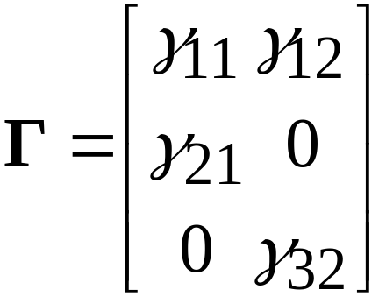
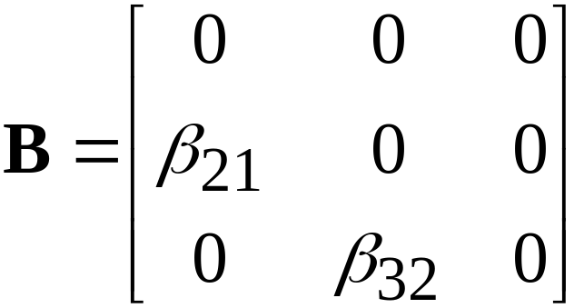
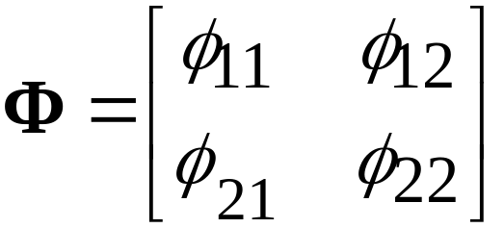
Matrices

Slide 17
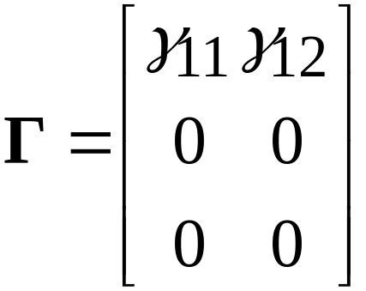

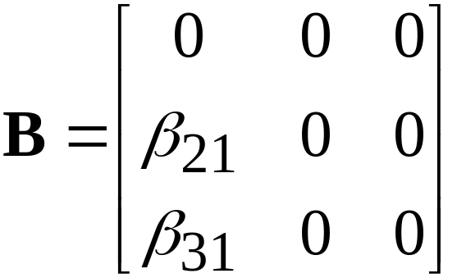

Alternative model
SI
ND
LM
DS
PR

Slide 18
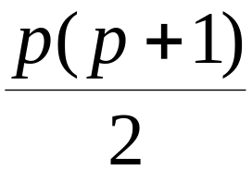
Degrees of freedom
For the chi-square test of exact fit, the degrees of freedom (df) are found as the difference between (1) the number of unique elements in the covariance matrix, and (2) the number of parameters to be estimated.
Suppose there are p observed variables. Then the number of unique elements in the covariance matrix is
To get the number of parameters, just count the number of elements in the parameter matrices that must be estimated.

Slide 19
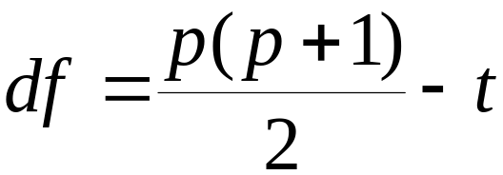
If the number of parameters to be estimated is equal to t, we have
As t increases (more parameters) the df becomes smaller. Highly complex models with many parameters to be estimated tend to have lower df.
As the model becomes simpler, with fewer parameters to be estimated, the df grows larger.
In general, models with larger df can be tested with more statistical power, all things being equal.

Slide 20


Chi-square test of exact fit
This test is a statistical test of the hypothesis of exact fit
(model fits in population)
The alternative hypothesis is
(model does not fit perfectly)
Under certain assumptions, and in large enough samples, the test statistic has a chi-square distribution under the exact fit hypothesis. Rejection of that hypothesis implies that the model does not fit perfectly. Failure to reject means that the evidence is insufficient to warrant rejection (but this does not prove fit).

Slide 21
The chi-square test has two drawbacks
It requires fairly stringent assumptions. We must have independent observations, multivariate normality for any endogenous variables, and reasonably large samples. We do have alternative test procedures for some violations of these assumptions.
Rejection of the exact fit hypothesis does not tell us very much. In sufficiently large samples, even the smallest deviation from perfect fit will lead to rejection of the exact fit hypothesis. Rejection of the hypothesis, by itself, does not tell us anything about how “far off” our model might be from the correct model.

