Slide 1
Identification in path analysis
Prior to working with a path model, it is best if one can determine whether the parameters of that model are identified. By “identified” we mean that it is possible to uniquely solve for the parameters in terms of data. If we cannot uniquely find a set of parameter values, it then becomes impossible to claim to have found “the values” of those parameters. It may then be impossible to work with the model.
Identification is something that can ordinarily be determined prior to having any actual data. It depends on the structure of the hypothesized model, and it is a mathematical property of the model. Under some conditions however, the nature of the data can also affect identification, as explained later.

Slide 2
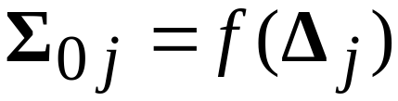
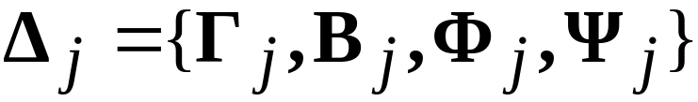




A formal definition of identification
Let be a covariance structure under a specified path model with a set of parameter values
Let and be two distinct sets of parameter values. Then the specified model is identified if and only if, for all and with
Different parameter values lead to different covariance structures.

Slide 3
There are two ways of checking whether a model is actually identified.
The first way is to check mathematically whether a unique solution for the parameters is possible. Methods for doing this range from brute force algebra to simply checking whether the model falls under certain conditions that are known to lead to identification. The use of these “rules of thumb” will not cover all possible cases, but it will cover many of them.
The other way is to get some data, attempt to fit the model to the data using Mplus or some other program, and let the computer check for identification. This method is not foolproof, but it is often accurate.

Slide 4
Types of identification conditions
Necessary conditions: These are conditions that must be true if the model is to be identified. If one of these conditions fails to hold, we know that the model is NOT identified.
But if all necessary conditions hold, we still have not proven that the model is identified.
Sufficient conditions: These are conditions that, if they hold, prove that the model IS identified.
If the sufficient conditions do NOT hold, we don’t know whether the model is identified.
It is difficult to find conditions that are easily verified, and are both necessary AND sufficient.

Slide 5
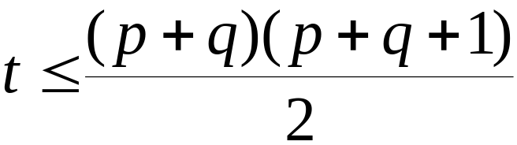
The “t-rule”
Let p=number of Y variables
q=number of X variables
t=number of independent parameters to be estimated
Then a necessary condition for identification is that
This rule is simple to apply, and can be used as a quick check on identification. If the rule fails, you know that the model is not identified: too many parameters to be estimated.

Slide 6








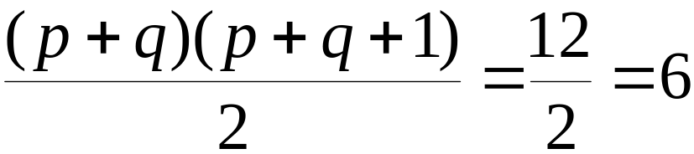





A t-rule example
p=2 q=1
so t=6 parameters to be estimated
t-rule is fulfilled

Slide 7

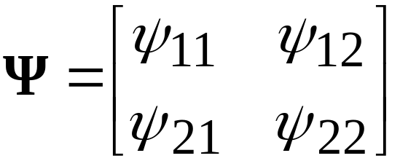
Null Beta rule
The null beta rule is a sufficient condition for identification. It goes as follows:
Any path model in which is identified, regardless of the configuration of other parameter matrices.
This rule holds when there are no directional paths among the endogenous variables (i.e. the Y variables).

Slide 8


The recursive rule
This is another sufficient rule. It goes as follows:
If is triangular, and is diagonal, the model is identified.
A model that meets the above two conditions is recursive.
It may be necessary to permute rows and/or columns in .
This condition rules out any covariances among the disturbance terms in the model.
There are identified path models that do NOT meet either the null beta rule or the recursive rule.

Slide 9

More complex rules
There are an additional set of rules that are more difficult to verify, but that cover some cases not covered by the earlier sufficient rules. The only one we will discuss is the order condition, which evaluates the identification of each equation separately.
Assume that is nonsingular, and is full and unconstrained (i.e. all disturbances covary).
For each equation, a necessary condition for identification is that at least p-1 variables must be excluded from the equation to make the parameters in that equation identified.
Note that p=number of Y variables.

Slide 10

Order condition example
P-1=1 but no variables are excluded: the order condition is not met. We know that the parameters are not identified.

