Slide 1


Parameter Estimation
A number of approaches to parameter estimation exist for SEM, depending on what assumptions one is willing to accept for the data. Some common estimation methods are:
Maximum likelihood (ML)
Unweighted least squares (ULS)
Generalized least squares (GLS)
Weighted least squares (WLS)
In all of these cases, parameter estimates are sought that minimize a fitting function, which in some way measures the discrepency between the sample covariance matrix and the fitted sample covariance matrix . Different methods use different fitting functions.

Slide 2
We have different criteria for judging whether any given estimation method is performing well. These different criteria need not always agree; it is often true that a given estimation method will excel by one criterion, but fail at a different criterion.
No single parameter estimation method is optimal under all conditions. Different conditions demand different estimation methods.
All estimation methods to be reviewed here assume independent observations in the data. Methods for data that violate this assumption are available, but we won’t address this problem at present.

Slide 3


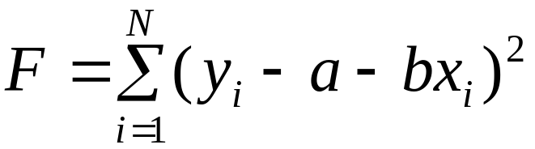
Example: OLS bivariate regression
Model
Estimation method: Select to minimize:
“least-squares”
To solve this problem, we take the first partial derivative of F with regard to each parameter, and set the resulting expressions equal to zero. We then solve algebraically for the parameter estimates.

Slide 4
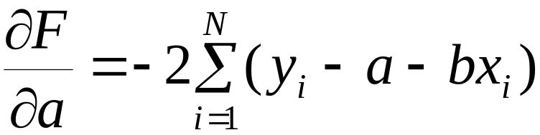
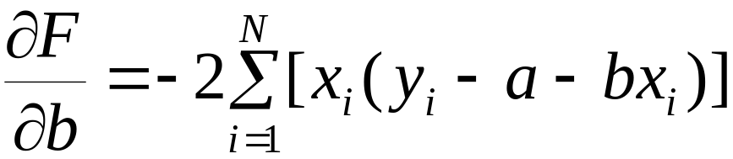
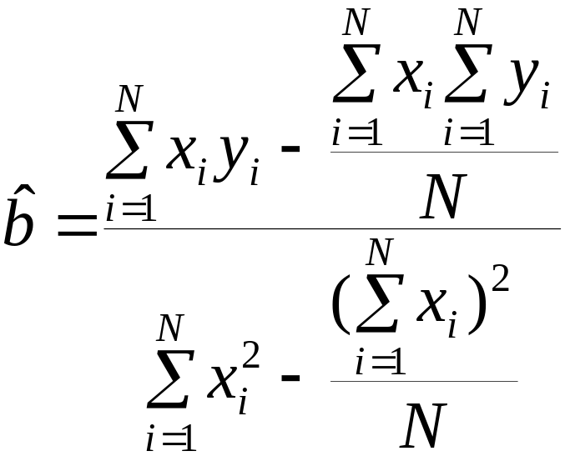
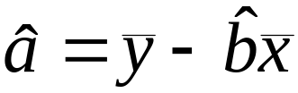
The derivative expressions are:
These equations can be solved for the unknown parameters

Slide 5
Likelihood functions
The least squares principle in regression is only one way of obtaining parameter estimates. A different approach is via the likelihood function, which expresses the likelihood of the data under an assumed model. The likelihood is built under distributional assumptions for the data as part of the model. The principle of maximum likelihood says, briefly, that we should choose parameter values that make the likelihood function have the greatest value, given the data. In this sense, the data are fixed and the function is really a function of the parameter values.
Maximum likelihood (ML) estimation is used throughout statistics, and it was the starting point for SEM estimation.

Slide 6





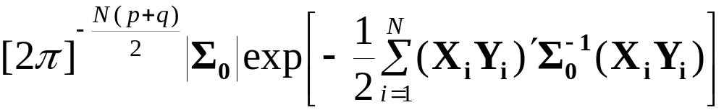
ML under standard normal theory
Suppose that we have our exogenous and endogenous vector variables: for the ith individual, i=1,…,N. Here we have as qx1 and as px1.
We assume that the observations are independent, and that the variables have a multivariate normal distribution with and a covariance matrix under the path model.
Under these assumptions, the joint probability for a random sample of N observations (the sample likelihood function) is

Slide 7
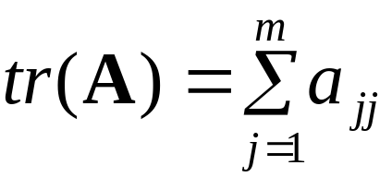

The standard way of working with the likelihood function is to use calculus to find the parameter values that maximize the function, using the data at hand.
For the multivariate normal case, there is a simpler function that can be minimized, and that will lead to the same solution for the unknown parameters as the preceding (more complicated) function. This simpler function is the ML fitting function:
Here we have the sample covariance matrix and “tr” is the matrix trace operator, defined as
Here is an mxm matrix.

Slide 8


We want to minimize the fitting function by choosing values for the parameters that lead to a minimum. Note that
Also, only if the sample and model covariance matrices are identical.
Our task in estimation is to select parameter values that would lead to a to minimize the fitting function. The resulting parameter estimates are called maximum likelihood estimates.
Why do it this way? It turns out that ML estimates have all kinds of nice statistical properties, assuming they can be found.

Slide 9
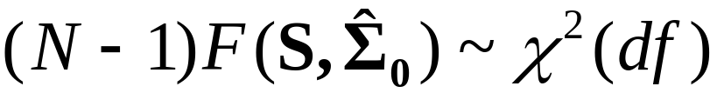
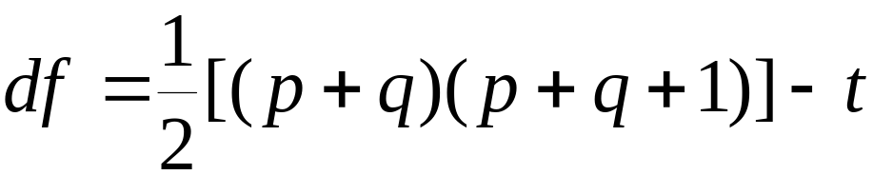
Properties of ML estimators
Consistency: As N increases, the probability that the estimator is far from the true value gets smaller and smaller.
Unbiased: On average, the estimator is equal to the true value.
Minimum variance: Sampling variance is smallest among consistent estimators.
Normal sampling distribution for estimator
Test of exact fit:

Slide 10
Iterative numerical estimation
Unlike regression analysis, there are in general no simple algebraic solutions for the parameter estimates under ML in the SEM case. Instead, we use iterative, numerical methods to find solutions to the ML equations. These methods are computationally intensive “trial and error” methods, but ones that have known properties for arriving at solutions.
To understand what is going on, imagine that we have some function f(x), and we want to find the value of x that minimizes f(x). Suppose also that we cannot directly solve for the value of x that minimizes f(x).
What should we do?

Slide 11




We could engage in a trial and error process….
Start with , an initial guess.
Evaluate and perhaps the first derivative of
Using this information, pick a new value for x, call it .
Evaluate and perhaps the first derivative of
Repeat, until the function no longer changes much and the derivative is close to zero.
In theory this will work, but the key thing is to make it work in a short amount of time, with few iterations. That is where the art comes in.

Slide 12
Operations research is an entire field devoted to finding efficient ways of doing these searches. An optimization algorithm is a step-by-step method of conducting the search. These algorithms generally have at least three components.
Start value routine: There is usually some systematic way of coming up with that initial guess . In Mplus, the program generally takes care of this for you, but you can input your own start values if you wish.
Rules for generating new values: There must be some method for generating new values at each iteration. One must find a direction to go in, and a distance to go. One collection of such rules, known as gradient methods, tries to approximate the function with a low-order polynomial.

Slide 13
Stopping rule: Quit iterating when either the function value doesn’t change much, or the estimate doesn’t change. Quitting means convergence; we like the process to converge, because if it does not, either an iteration limit will be reached or we will wait a long, long, time…..
In Mplus, a successful search will result in a message saying that the “model estimation terminated normally”. An unsuccessful search may lead to a message about an iteration limit being exceeded. The default limit on the number of iterations is 1000 in Mplus.
In the unsuccessful case, one can try new start values, or one can raise the iteration limit (it is under your control), or one can conclude that the model is inappropriate for the data.

Slide 14
In Mplus, the start values provided by the program are generally good for most models, but not all. For path analytic models in observed variables, the start values are nearly always ok.
You can increase the interation limit by setting
ITERATIONS = ______;
in the ANALYSIS section of the syntax.
It is possible that for some models, there are “local minima”, meaning that the program would converge on a less-than-optimal solution. You might never know this as a user of the program, and the only way to detect it is to try different start points and see if the program converges to different final solutions. Just keep in mind that “convergence” does not necessarily mean that the solution is unique or optimal.

Slide 15
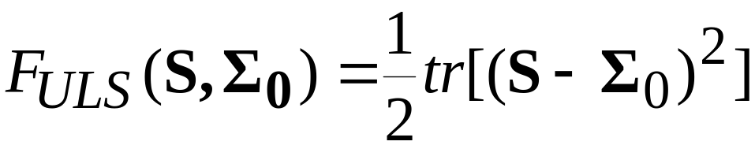

Unweighted Least Squares (ULS)
This estimation approach is not based on any distributional assumptions for the measured variables apart from independence and identical distributions. The ULS fitting function is
In this case we seek parameter values that minimize the residuals directly.
ULS estimators are consistent, but they do not have the nice large-sample properties of ML. Also, they depend on the scaling for the measured variables in a complex way.

Slide 16
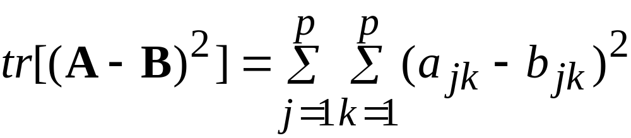
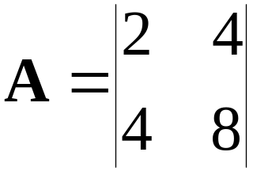
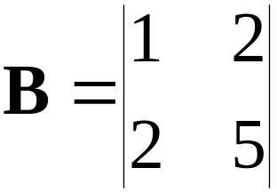
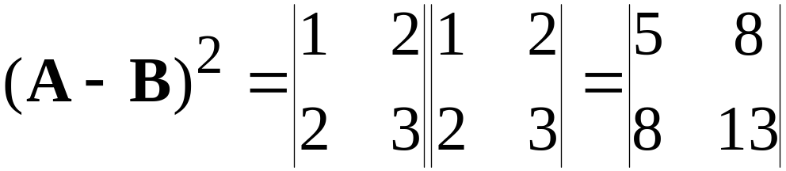
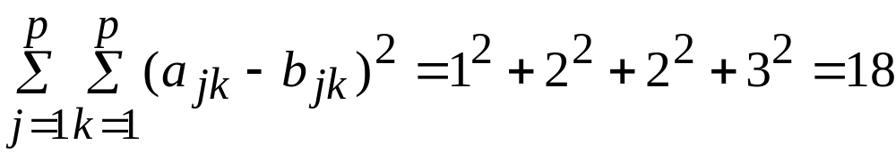
Trace of a matrix squared…..
For two pxp matrices A and B
This gets the sum of squared differences between corresponding elements of the two matrices.

Slide 17
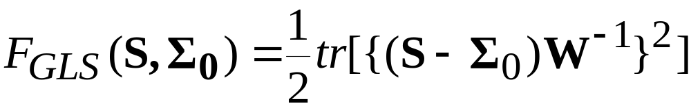


Generalized Least Squares (GLS)
This approach expands on ULS to permit differential weighting of the residuals in the minimization. The fitting function is
Here is a square weight matrix. There are many possible choices for this matrix.
For we get the Mplus choice. In this case, the GLS estimator has all of the nice properties of the ML estimator even when the data are not strictly normal. The distributions should not be too kurtotic (not too peaked, not too flat).

Slide 18


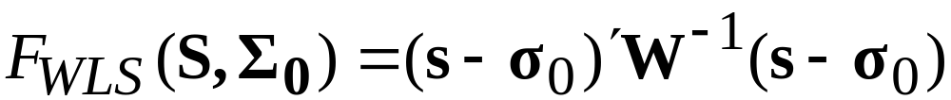

Weighted Least Squares (WLS)
This method resembles GLS, but uses more general weight matrices. We also write it differently….
String out the elements of the following matrices into vectors:
Here k=p+q. Then the WLS fitting function is
In theory, the weight matrix should be chosen as the covariance matrix for the elements of the vector .

Slide 19
The advantage of WLS is that in large enough samples, the resulting estimator has properties much like those of ML estimators, but without assuming normality.
The disadvantage of WLS is that in the most general case in which no normality assumptions are needed, the required sample size is very, very large. Simulations have shown that N’s of several thousand cases are needed in order to provide accurate tests of fit and standard errors. In modest samples of a few hundred cases, the fit test tends to work improperly. The problem lies in the large size of the weight matrix, coupled with inaccurate estimation of its elements.

Slide 20
For the non-normal case, a more recent approach to estimation is to rely on ML for estimation, but modify the test of fit and the standard errors to be accurate even in non-normal data and modest (but not small) samples. These robust fit statistics are an active area of research, with a number of different methods proposed and given as options in current software. Mplus offers a number of these alternatives, and we will meet them later.
The use of robust fit statistics provides a useful alternative to the non-normal WLS because it appears that the robust statistics perform well even in modest samples, unlike WLS.
Another term for the non-normal WLS estimator is the Asymptotically Distribution-Free (ADF) estimator. You will see references to ADF in published research.

