Slide 1
Model fit evaluation
The chi-square test provides a test of exact fit. If we reject exact fit, we typically pursue two further issues:
How poor is the fit? This question is usually answered using a combination of global and local fit indices.
What is the explanation for the lack of fit? This question is addressed using local fit information and background theory.
Global fit indices summarize the degree of model fit with a single number, reflecting the fit of the entire model.
Local fit indices measure the degree of fit at specific locations within the model (e.g., model residuals).

Slide 2




Degree of fit versus “correctness”
The degree of model fit as measured by available global fit indices concerns the “closeness” of to , or the closeness of to .
In other words, these indices ask “How close is the reproduced covariance structure to the covariance structure found in the sample (or population)?”
Degree of fit is NOT necessarily the same thing as the “correctness” or “truth” of the model. The truth issue asks whether the hypothesized model is the same or different from the real or true model that generated the data. This “truth” may not be the same as how well the model reproduces the covariance structure.

Slide 3


To explain this point, consider a true model M and the true covariance structure . Then consider two different hypothesized models M1 and M2, with their associated implied covariance structures and .
Degree of fit, in the population, would be assessed by comparing the covariance matrices implied by each model to the true covariance structure: compared to , and compared to . In this comparison, we may find that M1 is “better” than M2 because it implies a matrix that is closer to the true structure.
In contrast, if we want to ask about the “degree of correctness” of the two models, this implies comparing M1 to M, and M2 to M, and then deciding which of the two models is more similar to M. It may turn out that M2 is more similar, yet does not have the best “degree of fit” as defined above.

Slide 4
The lesson here is that we must be aware of what we are doing when we evaluate the fit of the model to the data. Automated fit assessment via global or local fit indices cannot replace thought.
Model comparisons are useful whenever we have more than one model in mind, and we want to evaluate them relative to each other.
In the simplest case, the two models being compared are nested logically, meaning that one model can be derived from the other model by constraining parameters in that second model. We say that model A is nested within model B if we can create model A by constraining parameters in model B. We often evaluate nested sequences of models.

Slide 5










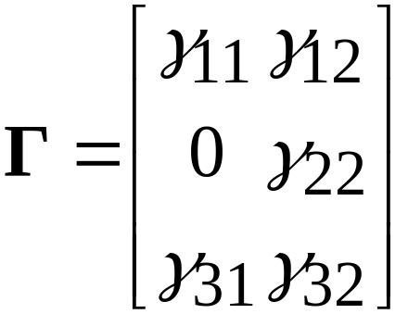
Example
Model B

Slide 6
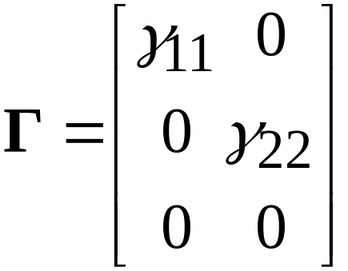
Model A
Four parameters constrained to zero.

Slide 7
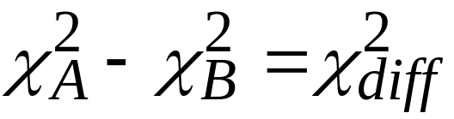
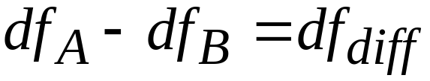
When A is nested within B, we can test whether A fits as well as B using a chi-square difference test:
We evaluate this difference in chi-squares using the difference in df for the two models. Assuming that B fits well, if we do not reject the null for the difference in chi-squares, we conclude that A is preferable because it is simpler and fits as well as B. Note that the test is sensitive to sample size.
If B itself shows substantial lack of fit, this difference test should not be used as a chi-square test.

Slide 8


Use of the “null model”
One group of fit indices is based on the idea that a model can be evaluated relative to a much more constrained model that will serve as a standard for comparison. The “more constrained model” is usually taken to be the most restricted model that would be of interest.
An example of such a constrained model is the “null model” or “independence model” in which , with being a diagonal matrix. This model simply says that all measured variables are mutually uncorrelated.
Other choices for the constrained model might be of interest, but do not seem widely used.

Slide 9
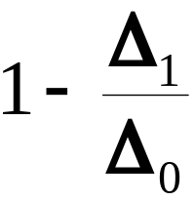
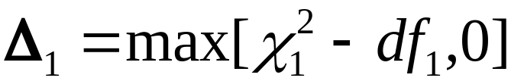
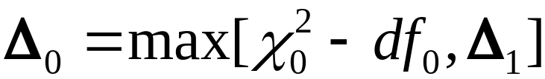


The Comparative Fit Index (CFI)
This index ranges between 0 and 1, with values near 1 indicating a better fit. CFI is calculated as
CFI =
The chi-square for the model of interest is , and the chi-square for the null model is . CFI values above .95 are considered to indicate good fit. This cutpoint is essentially ad hoc and is based on experience rather than mathematical theory.

Slide 10
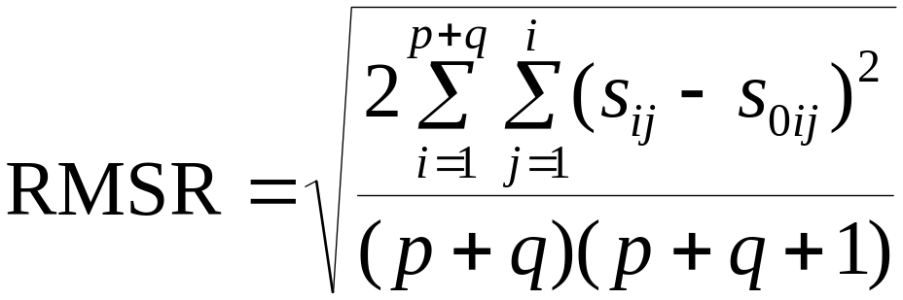

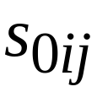
The root mean square residual
Another goodness of fit index is the root mean square residual:
= ijth element of sample covariance matrix
=ijth element of fitted sample covariance matrix

Slide 11
The RMSR gives the “average” absolute size of the discrepency between the sample and fitted covariance matrix. We typically prefer to use the standardized version (SRMSR) of the index, which puts the index on a correlation metric. Values of the SRMSR below .05 are considered good.
It is possible for the RMSR to be adequate, yet there might exist portions of the covariance structure that are not well-represented by the model. These local discrepencies can be found by directly examining the matrix of residuals between the sample covariance matrix and the fitted matrix.
Even if the proposed model provides a perfect fit in the population, we don’t expect the sample RMSR to be zero.

Slide 12
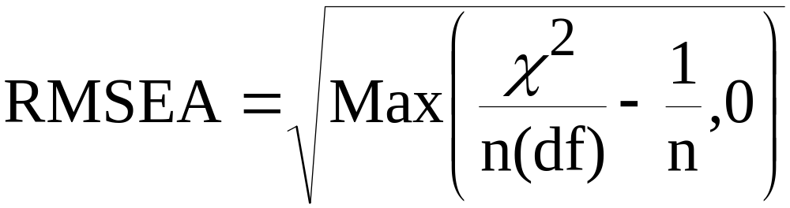
The root mean square error of approximation (RMSEA)
The RMSEA is defined as
n=N-1, with N being the sample size
df=degrees of freedom for hypothesized model
Values of the RMSEA that are below .05 are considered to be indicative of good fit. Values between .05 and .08 are indicative of fair fit. Above .08, the fit is poor (these are just rules of thumb however).

Slide 13
The key difference between the RMSR and the RMSEA is that the RMSR applies to the sample covariance matrix and fitted sample matrix. The RMSEA attempts to gauge the discrepency in the population, representing lack of fit apart from sampling error.
A further feature of the RMSEA is that it includes an adjustment for parsimony in the model. Given two models that fit equally well in relation to the sample covariance matrix, the one with fewer parameters to estimate will have the better RMSEA.
In addition to estimating the RMSEA, it is possible to create a confidence interval for the RMSEA, and also to conduct hypothesis tests on the RMSEA. The assumptions needed are the same as those needed for ML estimation.

Slide 14


To illustrate the hypothesis test idea, we could test the hypothesis
If we reject the null, we conclude that the population RMSEA is larger than .05, or larger than our (arbitrary) cutpoint for adequate fit. It is possible to test other hypotheses also.
For the confidence interval, one issue would be whether the interval includes .05. If the entire interval lies above .05, we would conclude that the fit is fair at best, and possibly worse. If the interval includes .05, we would be unable to reject the null hypothesis above, depending on the confidence and alpha levels.
Most software programs print out the interval and the test of the above hypotheses.

Slide 15
Inconsistencies among fit indices
When the exact fit test suggests lack of fit, the different global fit indices do not necessarily agree on the degree of lack of fit.
The CFI is affected by the degree of association among the measured variables. High correlations among the measured variables lead to higher CFI values, all things being equal. This happens because the “null model” is less plausible in this case.
The SRMSR is affected by sampling error to a greater degree than is the RMSEA. But the RMSEA may look poor in small samples. Always examine the confidence interval for the RMSEA.

Slide 16
Local fit information
Regardless of the global fit conclusions, it is always worthwhile to look at local fit information also. In a large model for example, the global fit might be good, but there may be areas within the model that show greater lack of fit. The local fit information can tell you about this.
A problem with the local fit information, of all kinds, is that there are many such indices (e.g., many locations), and some of these by chance may indicate poor fit. For example, there is a residual for each element of the covariance matrix. In a 20 x 20 matrix, this would mean 210 unique residuals. Some of these might take on large values simply by chance. Keep this in mind.

Slide 17

Residuals
These residuals are the differences between the sample covariance matrix elements and the fitted or reproduced elements based on the model. In other words, these are
The decision on whether a residual is “large” generally depends on the sizes of the elements in the sample covariance matrix. These vary in size, and so there is no rule of thumb regarding cutpoints for large residuals.
Some programs print “standardized residuals” which are on a more common metric. In Mplus, these can be interpreted as z-scores, and judged accordingly.

Slide 18
Modification indices
A modification index (MI) value is produced for every parameter in the model that is subject to a constraint (as opposed to being freely estimated). For example, parameters that are fixed to specific values, or are forced to equal other parameters, would yield modification indices. The MI estimates the expected reduction in the global chi-square if that parameter was freed from the constraint, holding all other features of the model constant. Under the assumptions needed for chi-square, we would interpret the MI as a chi-square statistic with df=1.
A significant value (e.g., MI>4) would indicate that the constraint contributes to significant lack of fit for the model.

Slide 19
The cutpoint for “significance” can be adjusted up or down depending on how careful one wants to be about detecting lack of fit.
MI values have the same property in relation to sample size that the chi-square itself has: in large enough samples, even very small departures from perfect fit will lead to large MI values. Hence the size of the MI may not map well on to the practical significance of the lack of fit.
Also, the MI does not reflect what will happen if you simultaneously relax many parameter constraints. Each MI refers to a single constraint, and the impact of releasing that single constraint.

Slide 20

Expected parameter change statistics
The expected parameter change (EPC) estimates the change to be expected in a parameter estimate once the constraint on that parameter is relaxed. If the EPC is small, the idea is that the constraint did not have much impact on fit. If the EPC is large, the constraint did have an impact on fit. The metric for the EPC is that of the parameter under study.
Example: Suppose that we constrain
If the EPC = .8 for this parameter it would mean that once we remove the constraint, we expect the parameter value to move from 0 to .8. If this change is considered meaningful, it suggests that the original constraint was too stringent.

Slide 21
EPC values are not systematically affected by sample size in the same way that the MI values are. For this reason, in large samples any consideration of MI values should also consider the EPC values. A large value for the MI may not indicate a large value for the corresponding EPC.
Like the MI values, EPC values only reflect the impact of releasing single parameter constraints, and do not necessarily indicate what will happen when multiple constraints are relaxed.

