Slide 1
Standardized Path Solutions
When the covariance matrix is analyzed, the resulting path coefficient estimates are in raw metric. The interpretation of the coefficients is done in terms of the original units of measurement for the variables being related. When the different variables are on very different metrics, it becomes difficult to compare coefficients across variables.
One can request that standardized path coefficient estimates be given in the output by placing STAND on the OUTPUT line of the program. For standardized estimates, the interpretation is done in terms of standard deviation units on each of the variables being related.

Slide 2
Mplus offers three sets of standardized solutions:
STDXY: This solution standardizes the parameters in terms of X, Y, and any latent variables. This might be considered the “completely standardized solution”, in that each parameter now reflects standardized units: one unit = one standard deviation.
STDY: This solution is standardized only in terms of Y and any latent variables. The X variable standardization is omitted. This would apply to a situation where the X variables are already measured in a familiar metric, and so standardization on those is unnecessary.
STD: This solution is standardized only with respect to the latent variables. If there are no latent variables, this is the same as the unstandardized solution.

Slide 3


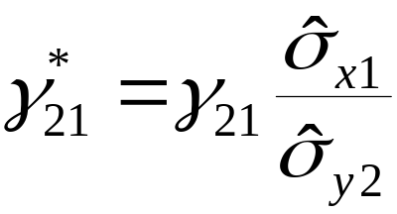
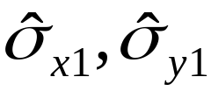
For a path analysis with no latent variables, the STDXY and raw metric solutions are related in the following way:
= raw metric parameter
= standardized parameter
are the fitted standard deviations for Y and X. The fitted standard deviation for X will ordinarily be just the sample estimate.

Slide 4






Total, Direct, and Indirect Effects
In path analysis, we can decompose the effects in the model into direct, indirect, and total components.
Consider the relation of to .
The direct effect is and the indirect effect is .

Slide 5

The total effect is just the sum of the direct and indirect effects. In the example:
Total effect =
When the direct and indirect effects have opposite signs, the total effect may be close to zero even though the direct and indirect are not zero.
For simple path models, we can find the indirect and total effects using path tracing rules, but more complicated path models are sometimes better handled using formulas. In some cases, indirect and total effects may be undefined.

Slide 6




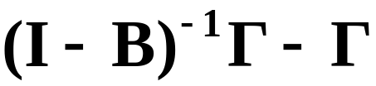
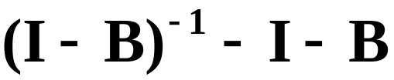
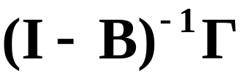
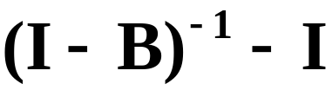
Formulas for indirect and total effects
Direct
Indirect
Total
The values of determine whether the indirect effects exist.

Slide 7



Mediation models
Mediation models incorporate both direct and indirect effects, with the “mediator” variable being the variable through which the indirect effects operate.
Here M is the mediator, with X the independent and Y the dependent variable. The independent variable X is often manipulated or is a randomized group variable. The mediator M is usually measured but not controlled or manipulated.

Slide 8



The total effect of X on Y can be divided into two portions: an indirect effect through M, and a direct effect.
When the direct effect is zero, we have “total” mediation. If the direct and indirect effects are both nonzero, we have “partial mediation”.
In LISREL notation:

Slide 9

Direct effect =
Indirect effect =
-----------------------------------
Total effect =
We can test the significance of the direct effect using standard procedures. The test of significance for the indirect effect is more complicated because it is the product of two parameters, and the distribution of the product of the estimates of the two parameters is somewhat complex.
Current software offers tests for the indirect effect as part of the output when indirect effects are requested. There are multiple test procedures available, and not all of them are equally good.

Slide 10
A useful method for testing the indirect effect in mediation is based on the PRODCLIN software program, which produces a confidence interval for the indirect effect.
If the confidence interval does not include zero, you would reject the null hypothesis that the indirect effect is zero, using an alpha level that matches the confidence level (e.g., 95% confidence implies alpha of .05 or 5%).
An online calculator for this purpose can be found at:
http://www.amp.gatech.edu/RMediation?destination=node%2F11
You input the two path coefficient estimates and their SE’s. It provides the confidence interval estimate.

Slide 11

What causal interpretation can we place on the mediation model results?
First, the causal interpretation is difficult unless there is a temporal ordering to the three variables, with outcome ordered last. This ordering helps rule out the possibility that the causal direction actually goes from “outcome” to mediator.
Second, even with a temporal ordering, the possibility of an omitted causal factor can be a problem:
(not measured)

Slide 12
Model Equivalence
Given any path model, it is generally possible to find other path models that reproduce the covariance structure equally well.
These two path models are equivalent, and they will reproduce the data equally well. In that sense, we cannot distinguish them in real data.

Slide 13

Definition of model equivalence
Two models A and B are equivalent if the implied covariance structures for the two models are identical:
It should be possible to verify that the above equality holds for equivalent models by running both models on the same set of data and then comparing the fitted covariance matrices.
There are rules for generating models that are equivalent to a given model. We won’t learn these rules, but you can find them in the literature.

Slide 14
There are 81 other path models that are equivalent to the above model. The four variables on the left form a saturated system because all paths are already in the diagram. Any path within this block can be reversed, producing an equivaluent model.
In testing fit, you are really testing not just your model, but all other models that are equivalent to your model.

Slide 15
We can sometimes rule out certain equivalent models using either theoretical considerations or by design.
Example: Temporal ordering to the variables would rule out any equivalent model in which the causal flow is backwards.
Randomization eliminates some alternatives by making the randomized variables uncorrelated with other variables.
If some equivalent models remain after efforts to eliminate them have failed, you should simply acknowledge the existence of the equivalent models, and explain why your model is of more interest.

