Slide 1





Measurement error
The assumption that our measured variables are free of measurement error is usually only an approximation. In some cases, the presence of error can have important effects. We therefore need to expand our models to include such errors.
= score on measured variable
= latent variable score
= measurement error score
We assume that (mean error is zero)
(error uncorrelated with latent)

Slide 2






The observed score is the sum of the latent and error:
When we have

Slide 3
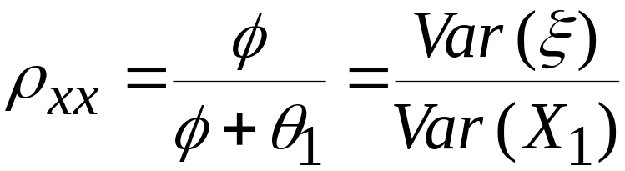

Reliability of the observed variable
As an index for the amount of measurement error in , we define
This is the reliability coefficient. It is the proportion of variance in that is due to . Note also that
It can be shown that the reliability is also the squared correlation between and .

Slide 4












How does measurement error affect bivariate regression?
Suppose that we have two observed variables X and Y, each measured with error, and we consider the regression of Y on X.

Slide 5

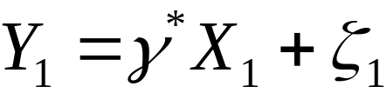

We cannot actually do the regression involving latent variables, but we can do the regression using the observed measures:
What is the relation between and ? This question is asking whether we get the same path coefficient value when the observed measures have error versus when they are error-free.
The answer is that measurement error will usually alter the value of the path coefficient.

Slide 6
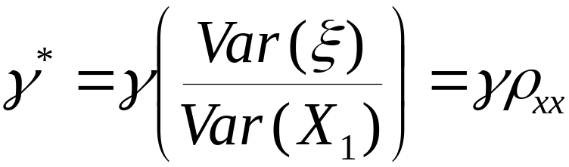
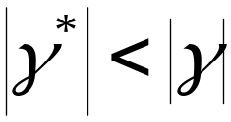
The relation between the two coefficients is
Unless the reliability is perfect, we will find that
The coefficient for the observed predictor is closer to zero. This is attenuation due to measurement error: measurement error shrinks regression coefficients toward zero.
Measurement error also shrinks correlations toward zero.

Slide 7
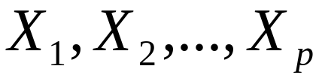
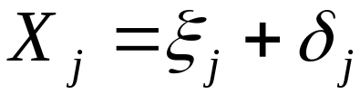



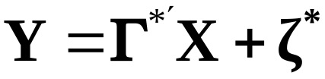
What happens in the multivariate case when error is present?
We have p predictor variables and we assume that error is present:
j=1,2,…,p
The structural regression equation is
Here is a px1 vector and is also px1.
Now consider what happens when Y is regressed on X:

Slide 8
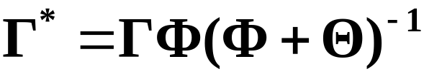





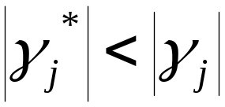
What is the relation between the path coefficients in this case? It can be shown that
If then (no error)
If is diagonal, then the predictor latent variables are uncorrelated. In this case, for j=1,…,p,
The measurement error attenuates the path coefficients, as in the bivariate case.

Slide 9

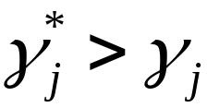
When and is not diagonal, anything goes. We could have
Here measurement error actually inflates the size of the path coefficient on the measured variables. This result contradicts the effect of measurement error in the bivariate case.
Why is there an inflation of the coefficient? The reason is that in the multiple predictor case, each path coefficient adjusts for the other predictors with which it is correlated. But measurement error tends to reduce these adjustments, leading to a larger path coefficient for the single predictor.

Slide 10






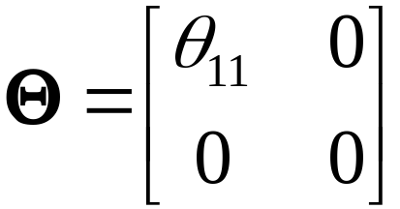

Example: The p=2 case.
Here we have measured without error, with no direct relationship to

Slide 11
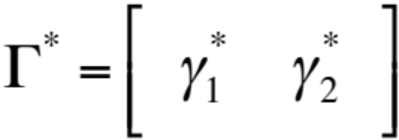
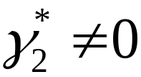


It can be shown that for this p=2 case:
Here so it appears that is related to Y, even though we know that this is not true.
is an increasing function of , implying that greater measurement error in will create a stronger (but mistaken) coefficient for .
This example illustrates the under-adjustment phenomenon.

Slide 12





Numerical example
= reliability of
---------------------------------------------
.90 1.66 4.35
.80 1.73 4.17
.70 4.15 3.27
.60 4.41 2.99
.50 5.19 2.61

