Slide 1
The Factor Analysis Model
The factor analysis model forms the basis for considering measurement error in SEM. Factor analysis as a method has a long history as an independent technique, used prior to the development of SEM. Factor analysis has two goals:
First, the analysis tries to explain the associations among the measured variables in terms of a smaller number of latent variables, termed “common factors”.
Second, the method attempts to clarify the relationship between the measured variables and the common factors, identifying which variables belong to which factor(s).

Slide 2
Common factors are simply latent variables that have paths going to more than one measured variable. Note that in factor analysis, paths always go from latent to measured variables (not the other way).
In factor analysis jargon, the communality of a measured variable is simply the proportion of variance in that variable that is determined by the common factor(s) that underlie the variable.
If there are no common factors, the measured variables are mutually uncorrelated in the factor analysis model.
A central goal in exploratory factor analysis (EFA) is to decide on the number of common factors needed for a set of measured variables.

Slide 3
Unique factors account for variance in the measured variables that is unique to each variable, and unrelated to other variables.
There is one unique factor for each measured variable.
In EFA and in most confirmatory factor analysis (CFA) models, the unique factors are specified to be mutually uncorrelated. A CFA model may depart from this assumption under some circumstances, as we will see later.
The unique factor includes what we would define as “random measurement error”, but it also may include a reliable component that is unique to the variable but is not random measurement error.
Example: item wording effect

Slide 4
The common factor model implies a variance partitioning that operates for each measured variable:
Total Measured = Common Factor + Unique Factor
Variance Variance Variance
This is similar to, but not identical to, the variance partitioning in psychometrics between “true score variance” and “error variance”. In the factor model, “error variance” all belongs in the unique factor variance, but true score variance may span both common and unique factor variance.
In Mplus, we can find communality estimates as squared multiple correlations for the measured variables.

Slide 5





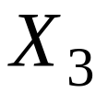



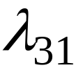


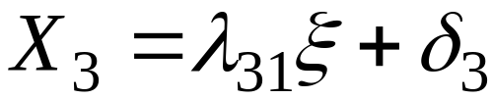
Example: Single factor, three indicators

Slide 6


The factor analytic equation is much like an ordinary path model equation.
The factor loading is much like a path coefficient or even regression coefficient. It can be positive or negative, and its size is related to the strength of relation between the measured variable and the common factor.
The unique factor scores are much like residual scores in path analysis or regression analysis. They denote deviations from the linear relation between the measured variable and the common factor, or “scatter” around the regression line that defines the relation between the measured variable and common factor.

Slide 7
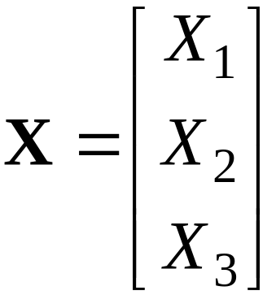
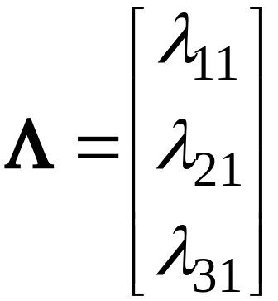
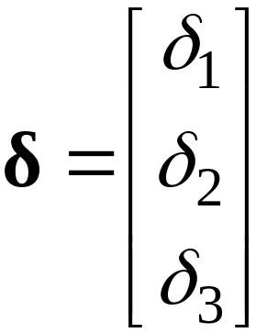



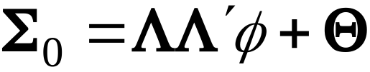
We can write matrix versions of the equations as follows:
We ordinarily assume that common and unique factors are mutually uncorrelated, leading to

Slide 8
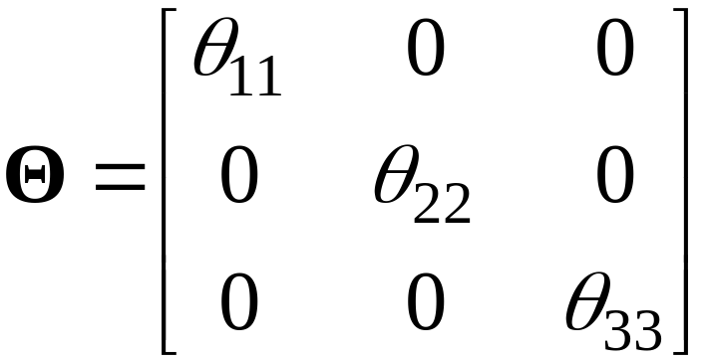

The covariance matrix for the unique factors is diagonal:
Unique factors are mutually uncorrelated unless otherwise indicated.
If there is more than one common factor, the common factor covariance matrix will be a symmetric, full matrix of variances and covariances among the common factors. In CFA, this matrix is ordinarily unconstrained.

Slide 9

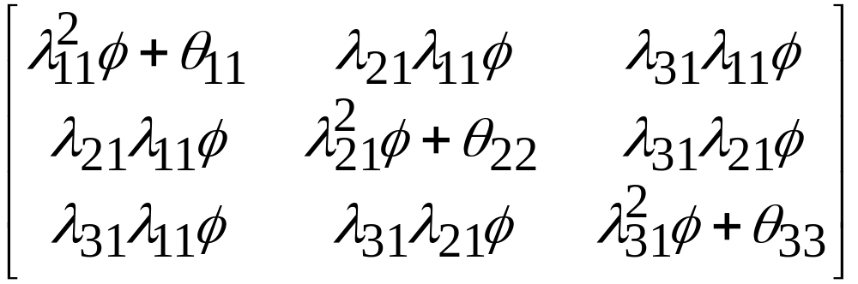

For the three-indicator example, the fitted population covariance matrix is written as
The sample fitted matrix is obtained by replacing the parameters in the above with their estimates.
Note that the unique variances only affect the diagonal elements (the variances of the measured variables), not the off-diagonal elements. The covariances are fully explained by the common factor.

Slide 10
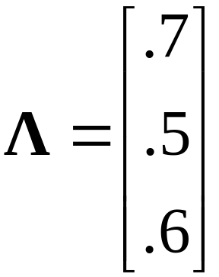
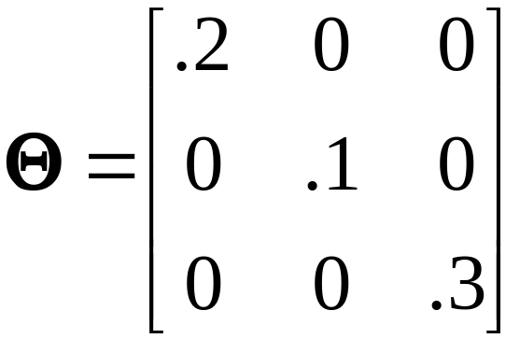

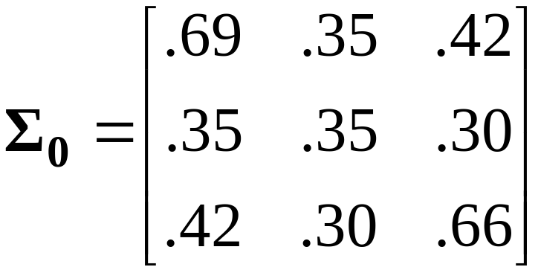
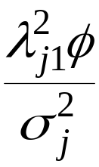
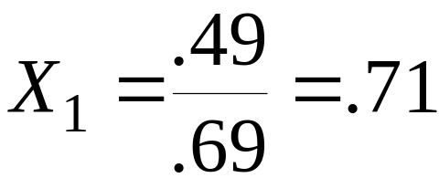

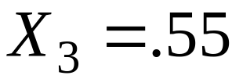
Numerical example
Then:
Communality values are

Slide 11
Exploratory vs. confirmatory factor analysis
In exploratory factor analysis, you can specify the number of common factors (or let the software pick the number), but the pattern of loadings is unrestricted, apart from identification constraints.
We usually examine many different factor solutions with different numbers of common factors. The emphasis lies with the interpretation of each solution; the ideal case is a solution with few factors, but ones that are interpretable.
Interpretation is improved by rotating the sample solution. Rotation involves choosing a different orientation for the common factors (must have more than one) so that interpretation is enhanced.

Slide 12
In confirmatory factor analysis we choose a specific number of common factors, and we can also restrict the pattern of loadings to represent our theory about the factor structure.
We ordinarily fit only a small number of factor models, possibly only one. Each model is structured to represent some hypothesis about the factor structure.
Evaluation of model fit is emphasized to a greater extent here than in EFA.
The analysis requires special software that is now widely available, such as LISREL, Mplus, EQS, Mx, Amos.
Rotation of the solution is generally not possible in CFA software, although it could be easily done outside of the software.

Slide 13




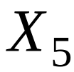
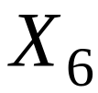






Example: six indicators, two factors
Note that the common factors are correlated by default.

Slide 14
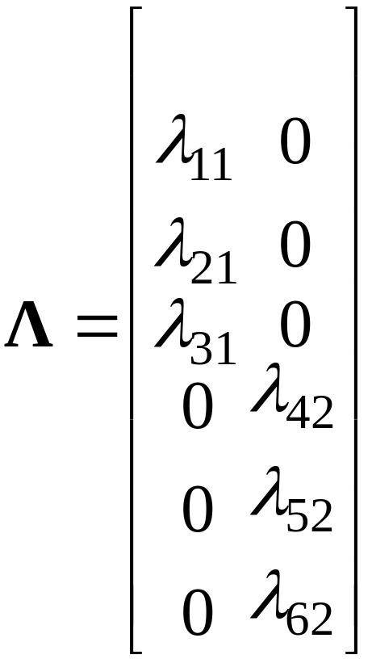


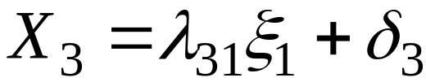

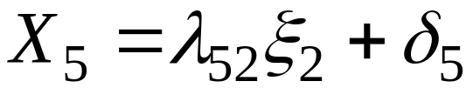
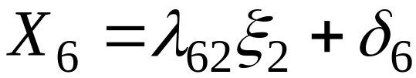
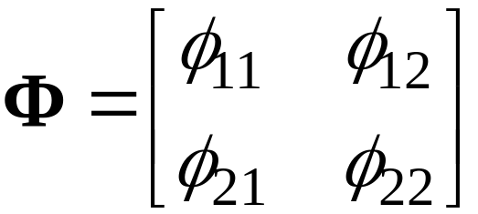
Equations and matrices are

Slide 15
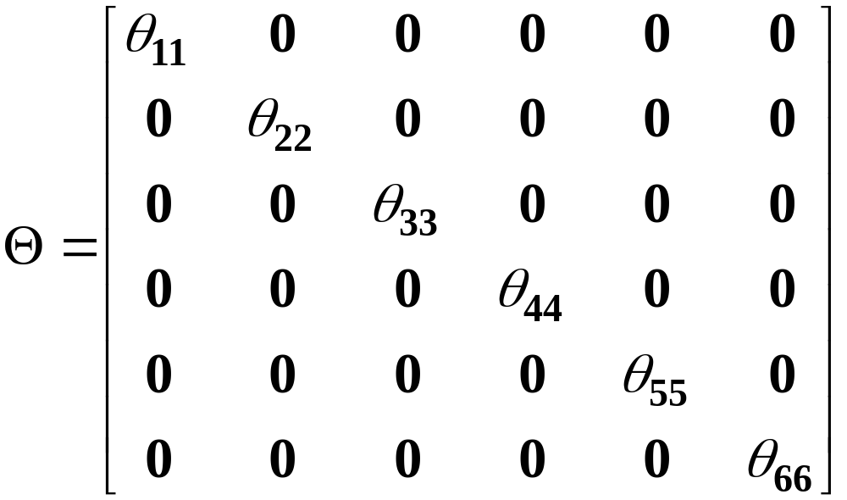
The covariance matrix for the unique factors is:
Note that this structure reflects the lack of correlation between any pair of unique factors.

Slide 16
CFA Specification in Mplus
First, one should create a name for the common factor (or names, if there is more than one common factor). Naming rules follow the general naming rules in Mplus (8 characters max).
The factor model is then invoked by using the “BY” keyword in the MODEL statement. Suppose that measured variables A, B, and C are supposed to load on a common factor called “fac1”. Then the syntax should be
fac1 BY A B C;
The default practice in Mplus is to fix the loading of the first named variable (A, in the above example) to a value of 1.0 for identification. You may or may not want this to happen…

Slide 17
If you have additional factors, you just add more lines to describe which variables load on those additional factors. For example, with additional variables D, E, F to load on the second factor “fac2”, add the line
fac2 BY D E F;
Measured variables can load on more than one factor. Just repeat the name of the measured variable on the separate lines for each factor.
In general, covariances among the common factors will be estimated by default. You do not need to include “WITH” statements to get these covariances or correlations.

