Slide 1
CPSC 521 Portfolio overview
W. Evan Durno

Slide 2
What have I done?
Speed Gage (MPI)
N-Body simulation on a ring (MPI)
Random forest training (CUDA)
Random forest classification (CUDA)

Slide 3
Speed Gage
mpiexec -np N ./speed Lambda
N nodes in ring
Each worker must count primes below X, where X ~ Poisson(Lambda)

Slide 4
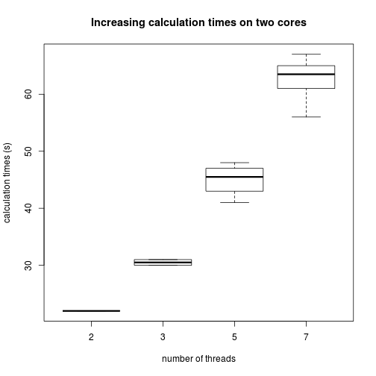
Speed Gage

Slide 5

N Body Simulation

Slide 6
N Body Simulation Algorithm
1. Pass initial coordinates around ring
2. Run root node (0), send updated coordinates to node 1, wait for updated coordinates.
3. For all non-root nodes at X, update positions, receive coordinates (or wait until they arrive), update coordinates, send coordinates to (X+1)^{th} node (or 0th node if last node).
All nodes run for pre-specified iterations.

Slide 7
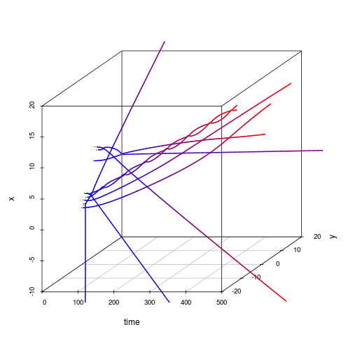
Some N Body simulations

Slide 8
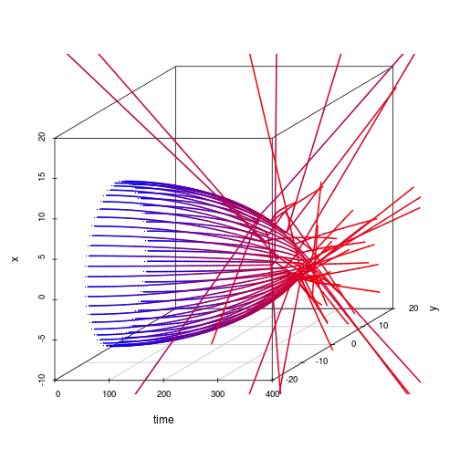
Some N Body Simulations

Slide 9
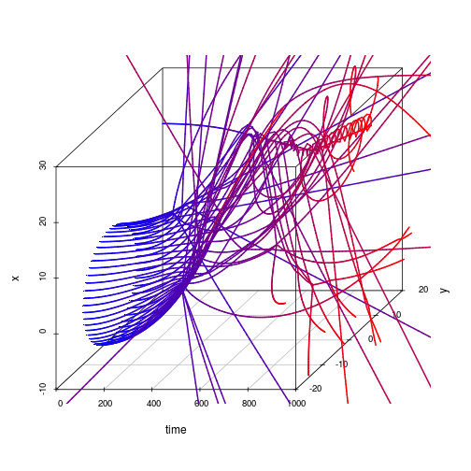
Some N Body Simulations

Slide 10
Simulation on a ring
TODO Speedup, efficiency, calculation time

Slide 11
Random Forests Overview
A random forest is a classifier (others use it for regression)
Classification trees vote on classification outcome.
Classification trees are sometimes described as unbiased and high-variance.
Their votes, on average, out-perform individual trees
To train a random forest, train each tree on its own random subset of the data.

Slide 12
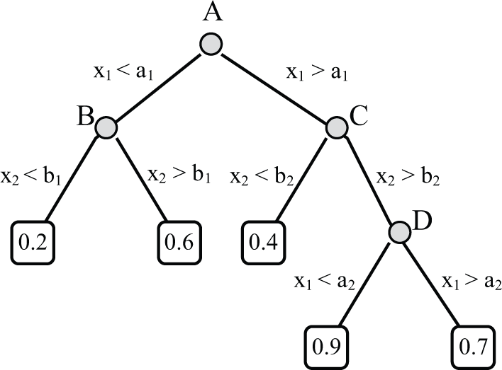
Classification tree

Slide 13
Classifier usage
Get data with known labels (y_{label}, x₁, x₂, ... , x_{dim})
Train the classifier with the labelled data
Use the classifier to label unlabelled data
(x₁, x₂, ... , x_{dim})

Slide 14
Advantages of working with CUDA
Many cores for cheap!
$185 on Ebay gets you 480 CUDA cores (GTX 570), even with 10% efficiency you could get a 48X speedup in ideal situations.
P-RAM! Communication costs between workers has never been cheaper!

Slide 15
Caveats of working with CUDA
CPU and GPU communicate via the PCI bus (slow! 10 – 100 microseconds), encouraging pipeline usage.
Streaming MultiProcessors (SMPs) do not allow for alternate execution paths.
Thread synchronization occurs at block or CPU levels.
RAM is often limited to 1GB.

Slide 16
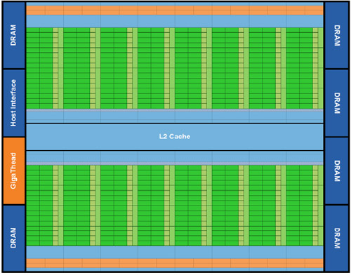
CUDA Architecture

Slide 17
CUDA under ideal circumstances
Task: CUDA Core-independent summation of values. Sum N numbers on N threads.
Ignore communication time, assuming a pipeline context.
Hardware:
  CPU: Single thread i7
  GPU: 96 thread (small!)

Slide 18
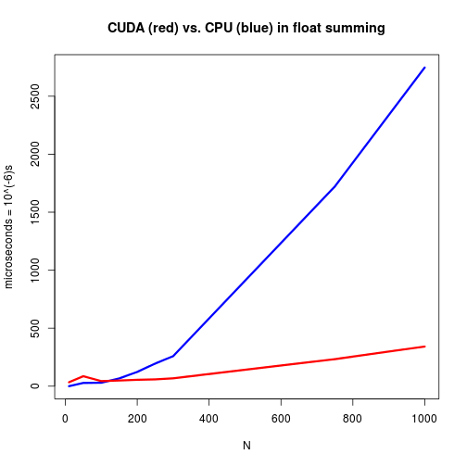
CUDA under ideal circumstances:
Computation time

Slide 19
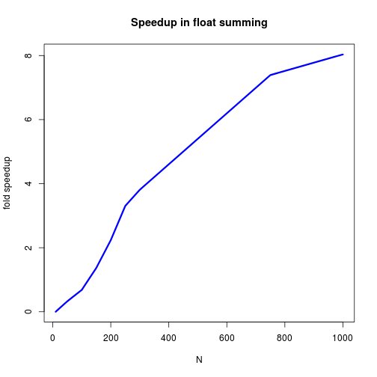
CUDA under ideal circumstances:
Speed up

Slide 20
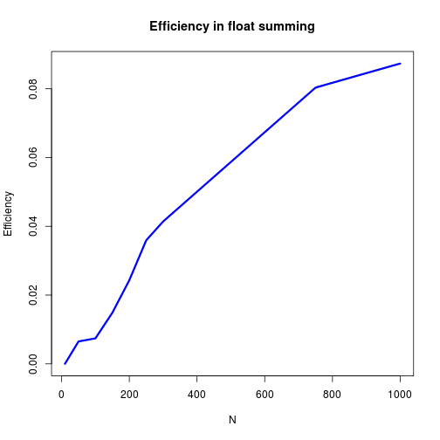
CUDA under ideal circumstances:
Efficiency

Slide 21
CUDA in non-ideal circumstances:
Random forest training
Algorithm:
  1. Move all data to GPU
  2. Instruct GPU to make all root nodes
  3. Nodes are made in parallel, one per CUDA Core
  4. Each node may request children
  5. CPU schedules child nodes to be made, one per CUDA core.
  6. Continue until no child requests exist

Slide 22
CUDA in non-ideal circumstances:
Random forest training
This algorithm has
  Fewer execution path bifurcations than assigning one thread per tree
  A small amount of GPU-CPU communication for low tree depth
  A slower execution time than the CPU

Slide 23
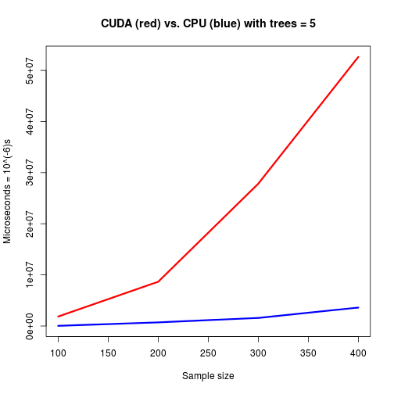
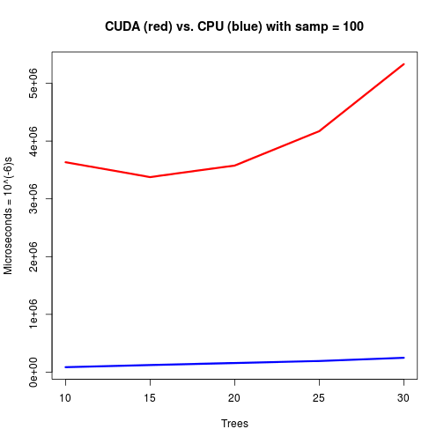
CUDA in non-ideal circumstances:
Random forest training

Slide 24
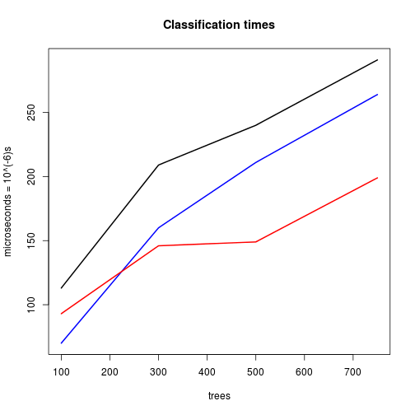
CUDA under decent circumstances:
Random forest classification
GPU kernel (red) vs CPU (blue)
vs GPU kernel and communication (black)

Slide 25
Random Forest Classification is faster on GPU in a pipeline context!

Slide 26
What's next?
Do random forest classification with a better GPU.
Compare N Body simulation on a CPU ring against N Body simulation on GPU?

