Slide 1
PyPy – an Agile F/OSS project funded by the EU
  Jacob Hallén (jacob@strakt.com)
  Alastair Burt (burt@dfki.de)
  http://pypy.org/
  http://codespeak.net/pypy

Slide 2
History
A grass root effort from within the Python Community
  Core Python developers on mailinglists
  Based on experiences from Psycho and Stackless
  Project started with a one week long “sprint” in Germany (Feb 2003)

Slide 3

What is Python?
Executable pseudo-code.
Guido van Rossum - Benevolent Dictator for Life (BDFL).
One of the five most used programming languages used today.

Slide 4
Typical aspects of the Python Community?
Lively community.
Lots of different python implementation projects (CPython, Jython, IronPython, PyPy).
Good contacts between the projects.
Maybe less fragmented than other OSS communities?

Slide 5
Why EU-funding?
Complex project – research aspects as well as practical usage.
Proposal for the 2nd call, 6th Framework Program – submitted 31 Oct 2003.
Negotiations mainly regarding how to leverage the Python community (combining consortium structure with OSS community)
Contract signed, project started 1 Dec 2004

Slide 6
PyPy: Technical Objective
The Technical objective of the PyPy project is to build an implementation of the Open Source Programming Language in the Python language itself.
By employing novel combinations of knowntechniques for building optimized compilers and interpreters the project will build an implementation of Python that is easier to read and understand than the existing implementations, while only paying a small performance penalty.

Slide 7
PyPy: Research Objective
The Scientific objectives of the project are to investigate a number of novel techniques based on Aspect Oriented Programming code generation and abstract interpretation for the implementation of practical dynamic languages
The goal is to break the compromise between flexibility, simplicity and performance trade-offs and to expand the range of directly supportable runtime platforms.

Slide 8
PyPy: Methodology Obejctive
The Method objective is to showcase a novel software engineering process: Sprint Driven Development. This is an Agile methodology, providing a dynamic and adaptive environment, suitable for co-operative and distributed development.

Slide 9
PyPy Project Facts
8 partners ( 7 companies, 1 university) and 4 physical persons.
14 workpackages and 58 deliverables.
2 years – project ends November 2006.
3 phases
Amount of funding recieved: 1,3 Million Euro

Slide 10
The PyPy Consortium
DfKI, Ab Strakt, Change Maker, merlinux GmbH, tismerysoft GmbH, impara GmbH, Logilab, Heinrich-Heine Universität Düsseldorf
Consortium strive to work with same/similar workstyle as the OSS community:
  IRC and mailinglists (information, communication)
  Version control on documents
  Open & transparent process (managing/tracking)

Slide 11
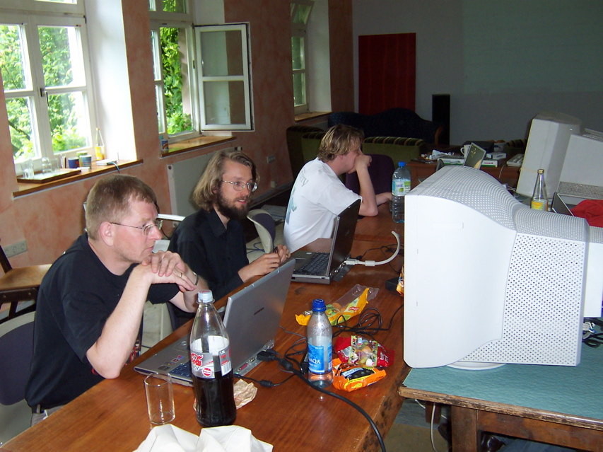
Sprints
One-week intense work-meetings with one break day.

Slide 12
Sprints
Consortium and community (non-funded) researchers/developers get together.
Daily planning sessions.
Pair programming.
Evolving and adapting to more attendants.
Organisational/management tasks happen also on sprints.

Slide 13
What is going on in PyPy?
Successfully passed mid term review in Jan 2006
Tackling challenging technical goals: JIT Specializer in Python etc
Conferences: PyCon, EuroPython, Agile 2006, OOPSLA
Sprints: PyCon/Dallas, Tokyo, EuroPython/CERN, Ireland/Limerick.
Workshops: Calibre, companies, researchers

Slide 14
Interested?
  Agile Development

Slide 15
Agile Development
Need to handle rapid change in commercial software development.
How do agile approaches fit distributed, open-source projects?

Slide 16
Core of Agile Practices: the People Factor
Agile processes are designed to capitalize on each individual and each team´s unique strengths
(Cockburn, Highsmith, 2001)
OSS nature of teams: self-organized, intensely collaborative - fit the agile approach.
OSS teams are an unique implementation of agile practices.

Slide 17
Agile Approaches
Aim at:
  Reducing "cost of information",distance from decision-making
  By physical location, unorthodox dissemination.
  Resulting in improved sense of community, team "morale"

Slide 18
Agile Teams
Agile teams are characterized by self-organization and intense collaboration, within and across organizational boundaries
(Cockburn, Highsmith, 2001)

Slide 19
PyPy
How do one structure an agile OSS community into a consortium of 7 partners?
  Create developer driven organization.
  Roles and responsibility (management team + tehnical board).
  Uses IRC channels, version control (SVN)on consortium level.

Slide 20
Sprints
Sprinting is central to the PyPy project:
  Funded as well as non-funded work.
  Dissemination (talks, tutorials, pairprogramming).
  Consortium activities (meetings, planning, coordinating wp work).
  Contribution from community via "physical persons" structure.

Slide 21
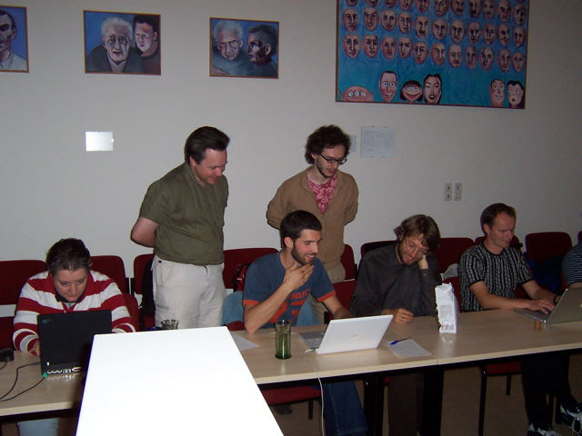
Sprints

Slide 22
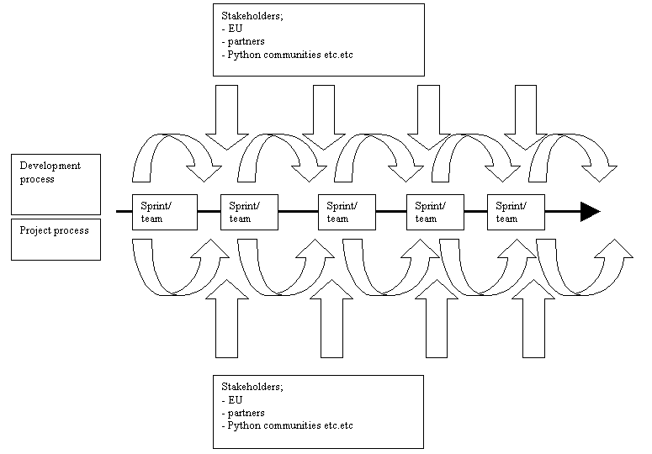
Sprint Process

Slide 23
Evolution of PyPy Sprints
Evaluations are done with "external" participants.
Different forms of sprints with different focus.
Sprints at conferences are growing into workshops.

Slide 24
Results of the Sprints
More people knowing and understanding the vision of PyPy.
More people "recruited" into the community.
People "recruited" into the consortium (physical persons).
People "recruited" into PyPy companies.

Slide 25
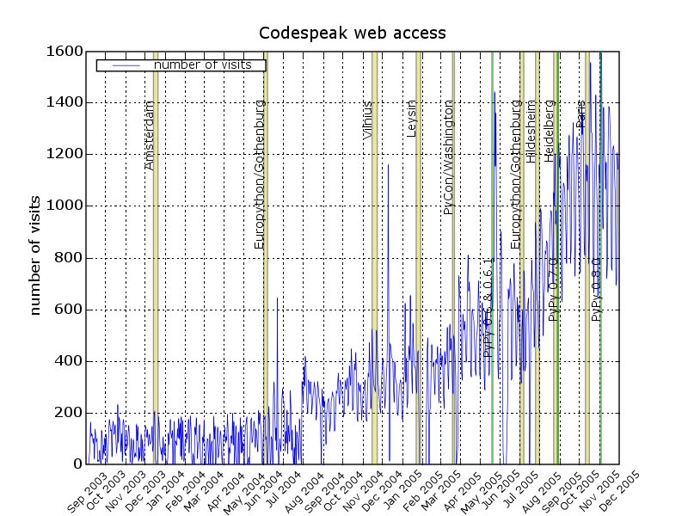
The Effects of Sprints

