Slide 1

Nagare uses stackless
Europython 2012
Hervé Coatanhay – herve.coatanhay@net-ng.com
Notes:
My name is Hervé Coatanhay, I’m a core developer on Nagare project and siftware engineer at my company, Net-NG.
Nagare is a continuation-based web framework which enables to code a web application like a desktop application, with no need to split its control flow.
We are a going to illustrate that point and how we use Stackless to achieve this

Slide 2

Guess the number
Pick a random number
While the player hasn’t guessed the number
Let the player guess
Congratulate the player
Simple algorithm!
Notes:
To illustrate how we use stackless in our framework I’ll use this little game as example « Guess the number ».
As shown here the algorithm picked from (Python® Programming for the Absolute Beginner) is very simple.
Should lead to simple code

Slide 3
Simple code!
Notes:
So here is simple the code of the whole application.
URL and client-server communications are abstracted in Nagare, as you can notice on each comp.call a roundtrip between server and client is done.
It is handled seemlessly in Nagare with very much help from stackless features.
A lot is done under the hood.

Slide 4
Under the hood
Stackless needed!
Create and block a tasklet
Serialize the blocked tasklet
On next request deserialize tasklet
Unblock tasklet and resume execution
Provides continuations like capabilities!
Notes:
To achieve this we use stackless, in the following manner:
Initially a tasklet is created
On each comp.call nagare does:
Block the tasklet on a channel, waiting for an answer
Object graph is serialized and saved for later use
Blocked tasklets are killed (they are saved and we don’t have any use for them)
A web page is sent to the client
An action is send back to the server
Object graph is deserialized (tasklet are resumed in their blocked state), an answer is send on the channel so execution can resume

Slide 5
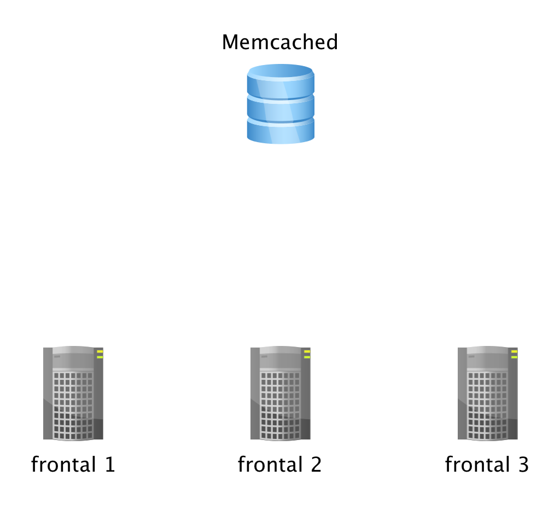
Clustering
Notes:
As object graphs are serialized and unserialized, those states can be stored anywhere:
- in memory
- in fast in memory database like memcached
- whatever can store string preferably in a fast manner
This offers us a major beneficail side affects as a Nagare web application can simply be put in a cluster environment

