Slide 1
PyPy – A Case Study of a F/OSS Community
  Alastair Burt (burt@dfki.de)
  Beatrice Düring (bea@netg.se)
  Holger Krekel (hpk@trillke.net)
  http://pypy.org/
  http://codespeak.net/pypy

Slide 2
World Domination
Quote from Linus Torvalds, when he first asked for help in building Linux.

Slide 3
Talk Structure
Introduction
  Free / Open Source Software.
  Python programming language
  Elements of typical F/OSS development.
View from the Trenches
  Typical Python development.
  PyPy - building a better Python.
  A F/OSS community and the EU.
Agile Programming Practices
  Best practice in software engineering.
  Agile methods and the typical F/OSS project.
  Agile methods and PyPy - sprints.
Discussion

Slide 4
Free and Open Source Software
Four freedoms.

Slide 5
What is Python?
Executable pseudo-code. Example.
Guido van Rossum - Benevolent Dictator for Life (BDFL).
The typical Pythonista.
Not the most popular F/OSS language, but has many dedicated fans:
  Google.
  Tim Berners-Lee - plane flight coding projects.

Slide 6
Python Principles - What Shapes the Community
Priorities and principle - Gabriel "Worse is better”
Python principles - highlight the interesting ones.

Slide 7
F/OSS Community Practices
Mailing list - no email, no community.
Source code management - read / write access.
Bug / feature request tracking.
Newsgroups, forums - users and developers.
Web page:
  About, News, Screenshots
  Download - often stable and development branches.
  Support - Documentation, FAQ, Wiki, archives of mailing lists.
  Related projects.
IRC - chat.
Developer weblogs.
Newsletters.

Slide 8
F/OSS Community Practices - Formal Structure
Sub-communities in larger projects - special interest groups.
Regular meetings and conferences.
Non-proft organisations:
  Organise meetings and marketing.
  Hold copyright.
  Parallel to technical structure.
Semi-formal decision processes:
  Python PEPS - proposed changes in the language and development.
  - BDFLs and the art of saying "no".

Slide 9
Personal Background
Worked in gaming companies, banks and car companies for several years.
Studied computer science.
Left well paid job and went into open-source scenes (2001).
Various project involvements, started PyPy? 2003 by inviting people to the first "sprint".

Slide 10
What makes Open Source Communities like Python Work: the People Factor
Collaborative - driven by interest.
Communication - quite transparent to everyone involved.
Email / IRC / version-control.
Organization - rather informal.

Slide 11
Technical Production Factors
Automated test driven development.
Specific expertise/special interest.
Version control (Subversion).
Releases.

Slide 12
Typical aspects of the Python Community?
Lively community.
Lots of different python implementation projects.
Good contacts between the projects.
Maybe less fragmented than other OSS communities?

Slide 13
PyPy: the Vision
Founders came from the Python community.
Sprints were the inital factor.
What is PyPy / Python - one of the five most used programming languages today.
Grass root approach.

Slide 14
OSS and EU funding: PyPy? as a Case Study
Driven by partially EU funded and non-EU funded parties.
Focus on avoiding friction and turning PyPy? into a long term project.
IBM or Sun have done similarly challenging projects in more time and with more funding.
Yet not found completely satisfying "funding" interactions with communities.

Slide 15
PyPy Technical Status
Three public releases in 2005, well received by the community.
Core deliverables fulfilled.
Contributors add different directions.

Slide 16
PyPy: It's all about Communication
Pypy-sync meetings, 30 minutes IRC .
Day-to-day IRC discussions.
"This week in PyPy".
Mailing lists: pypy-svn/eu-tracking tracks code and document changes.
Around 20000 visitors per month on website.
Lots of blogs and pypy-dev (developer/researcher list).
300-500 people across the world following the project.

Slide 17
All Good and Well but the Main thing are: Sprints
One-week intense work-meetings with one break day.
EU and non-EU researchers/developers get together.
Daily planning sessions.
Pair programming.
Evolving and adapting to more attendants.
Organisational/management tasks happen also on sprints.

Slide 18
Next
Tackling research and technical goals (challenging!).
Mid-term EU review planned for 20th january.
Looking into adjusting some work planning.
Increased dissemination, attending conferences (movie features?).
Start talking to and interact with commercial stakeholders.

Slide 19
Agile Development
Need to handle rapid change in commercial software development.
How do agile approaches fit distributed, open-source projects?

Slide 20
Core of Agile Practices: the People Factor
Agile processes are designed to capitalize on each individual and each team´s unique strengths (Cockburn, Highsmith, 2001).
OSS nature of teams: self-organized, intensely collaborative - fit the agile approach.
OSS teams are an unique implementation of agile practices.

Slide 21
Agile Approaches
Aim at:
  Reducing "cost of information",distance from decision-making
  By physical location, unorthodox dissemination.
  Resulting in improved sense of community, team "morale"

Slide 22
Agile Teams
Agile teams are characterized by self-organization and intense collaboration, within and across organizational boundaries
(Cockburn, Highsmith, 2001)

Slide 23
PyPy
How do one structure an agile OSS community into a consortium of 7 partners?
  Create developer driven organization.
  Roles and responsibility (management team + tehnical board).
  Uses IRC channels, version control (SVN)on consortium level.

Slide 24
Sprints
Sprinting is central to the PyPy project:
  Funded as well as non-funded work.
  Dissemination (talks, tutorials, pairprogramming).
  Consortium activities (meetings, planning, coordinating wp work).
  Contribution from community via "physical persons" structure.

Slide 25
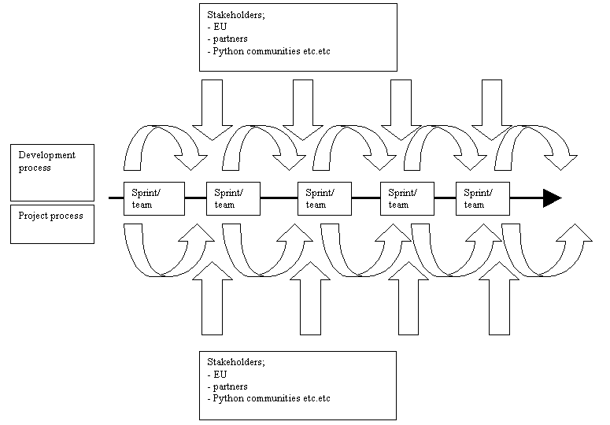
Sprint Process

Slide 26
Evolution of PyPy Sprints
Evaluations are done with "external" participants.
Different forms of sprints with different focus.
Sprints at conferences are growing into workshops.

Slide 27
Results of the Sprints
More people knowing and understanding the vision of PyPy.
More people "recruited" into the community.
People "recruited" into the consortium (physical persons).
People "recruited" into PyPy companies.

Slide 28
Discussion
In what way has the Internet enabled new forms of peer production? Can this be extended beyond software development?
How far has the informal, anarchic world of F/OSS development influenced software engineering and vice versa?
How can the F/OSS communities help the EU achieve its goals?
How could the EU potentiate F/OSS development?

