Slide 1
Kill-1: process refactoring in the PyPy project
  Europython 2006, CERN, Switzerland
  Beatrice Düring (bea@changemaker.nu)
  http://pypy.org/
  http://codespeak.net/pypy

Slide 2
PyPy: project facts 1/2
A F/OSS community within the Python community (350 subscribers,150 000 LOC)
A consortium of 12 partners managing a fixed prize contract with the European Union
3 objectives – mainly to produce a fast and flexible Python implementation written in Python

Slide 3
PyPy: project facts 2/2
Work divided into 14 work packages and 58 deliverables (code, reports, tools, “work”)
Work divided into 3 phases over 2 years (1/12 2004-30/11 2006)
Sprint driven development is used: the project meets and sprints ca every 6th week

Slide 4
Organizational structure year 1
Formal structure of consortium work/coordination was centered around the management board and technical board
Regular consortium meetings (monthly) mostly on IRC – coordinating consortium level work between partners
Regular development meetings “sync-meetings” (IRC) – coordinating development work
Tracking of time and costs among partners

Slide 5
Organizational structure year 2
Still a technical board coordinating work (more people added though), still “sync-meetings”
Refactored the management board into a more agile structure: agile management team
“Identify issue, create suitable team, prepare the issue, recommend to the consortium, decide, implement”
Regular consortium meetings replaced by singular decision meetings

Slide 6
Why? Our reasoning then...
Although the work in the later phases seemed more segmented there was no need for centralized, ongoing coordination on project level
Year 1 structure started to feel “artificial” - not fitting the reality of the project in some senses
The project process needed to be more be “quicker” in answering the “right” questions – a Just-in-Time approach

Slide 7
But really, why?
  My own personal reflections looking back
  Three driving factors besides the operative justifications:
    The group factor/FIRO
    The situational leadership factor/SLM
    The agile vs plan-driven factor/Boehm

Slide 8
1. The group factor
FIRO model shows the development stages of a group:
  First phase: inclusion
    Short “honeymoon” period
  Second phase: control
    Short “honeymoon” period
  Third phase: affection
By end year one the group gone through the phases and needed another style of structure

Slide 9
2. The situational leadership factor
The leadership within a group should balanced - suiting the situational needs of the group
4 cathegories of development of a group performing a result
  Directing (low competence/low commitment)
  Coaching (some competence/low commitment)
  Supporting (high competence/variable commitment)
  Delegating (high competence/high commitment)

Slide 10
3. The agile vs plan-driven factor
“ Agile development requires agile organizations” (Barry Boehm, keynote XP 2006 Finland)
"Agile teams are characterized by self-organization and intense collaboration, within and across organizational boundaries" (Cockburn, Highsmith, 2001)

Slide 11
Summary of driving factors
The group had oriented itself towards the project environment, had “conquered it” - thus creating a change to minimalize the “scaffolding”
The leadership needed to change to fit the nature of the group – enforcing more of the self-organizing workstyle, decentralized, Just in Time management
The change was created by the group, the need was visible, the developers had shown the way

Slide 12
Conclusion
Do not overdesign the process, as with coding – requirements do change
Create change based on the nature of work, as opposed to patching onto something that does not match the needs of reality anymore
Be clear about the difference between project process and development process
Involve your team in refactoring – the are key stakeholders (needs, wants?)

Slide 13
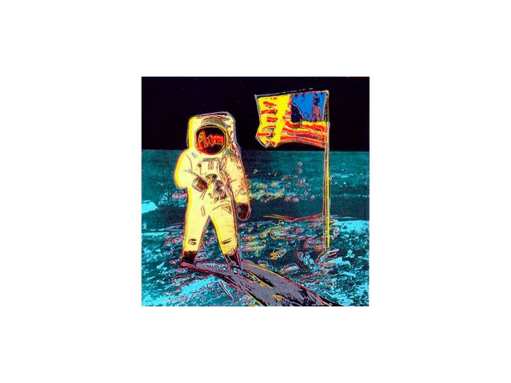
Conclusion

