Slide 1
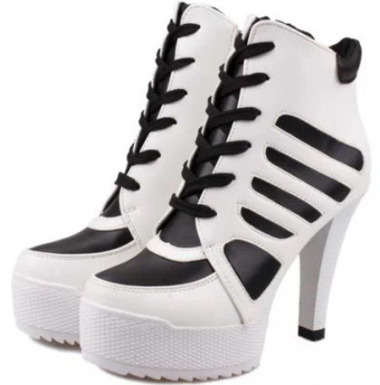
Image Classification of Fashion Products
Authors:
Ufuk Umut Şentürk
21427435
Muhammet Emin Özgür
21427229

Slide 2
Problem Definition
Basically aim is, like any other classification problem, is to classify un-labeled samples which are images contains fashion products.
However specifically, there are so much noise(like multiple angles in one image) in dataset and great class variations. Also, another challenge is dataset is multi-labeled.

Slide 3
Dataset
Training dataset consists of 25.000 multi-labeled images(1.57 GB). Test dataset consists of 9891 images(627 MB) and subset of Kaggle iMaterialist Challenge Fashion.
Validation dataset is created by splitting randomly training dataset into validation dataset and training dataset.

Slide 4
Convolutional Neural Networks
First, we tried to get best optimal solution. So using pre-trained and proven CNNs and applying fine-tuning on this network.
We prefer CNNs for our classification model. Because, they are created for especially image classification. We can feed them raw images and can get really good results.
Because, they can learn their own filters which is parameters and can extract features with those kernels or filters.
VGG, ResNet, SquezeeNet and Alexnet models are used which is trained on ImageNet.

Slide 5
Method
We fine-tune our models by changing last layer according to number of classes. Also, we can freeze top-layers to prevent them learning and use pre-trained weights.
Basic data augmentation is used that is method flipping the image horizontally with probability of 0.5.
We use sigmoid function for lost layer and binary cross entropy function which special case of cross entropy function.
Because, dataset is multi-labeled so the output sums up to the number of labels per input. In this case, we would like to know the percentage on how likely sample has a given class.

Slide 6
Stochastic gradient descent is used for weight optimizations and multi label soft margin loss function is used for loss computation.
Multi label soft margin loss is just combination of sigmoid function and binary cross entropy function so it fits case of our dataset.
For inference which is testing and validation, sigmoid is used for as final decision layer.
We introduce the threshold for response of the sigmoid function. It is 0.5 for default.

Slide 7
For evaluation, hamming score and f1 score are used.
We used hamming score because to see whether network is clueless or just misses some of the labels. Because generally accuracy term means exact match and for multi labeled case this cannot give us full insight about our predictions.
In Hamming Score, we just basically calculate average of intersection over union. That means for each predictions we take intersection of predicted labels and target labels then divide them by union of predicted labels and target labels.

Slide 8
Actually, fine-tuning is used for limitations and effect on this dataset.
After obtaining model that is trained on ImageNet, we change last layer according to our dataset classes.
Then, there are 2 possible ways to go. First one is freezing all layers except final layer then keep training. Seconds one is training without freezing layers.

Slide 9
Implementation is based on PyTorch framework for Python. Basically we build our models top of PyTorch models and wrap them with our classes.
For data set loading, we used lazy loader implementation which is data is loaded on the fly. That means just batches are loaded when they are needed.

Slide 10
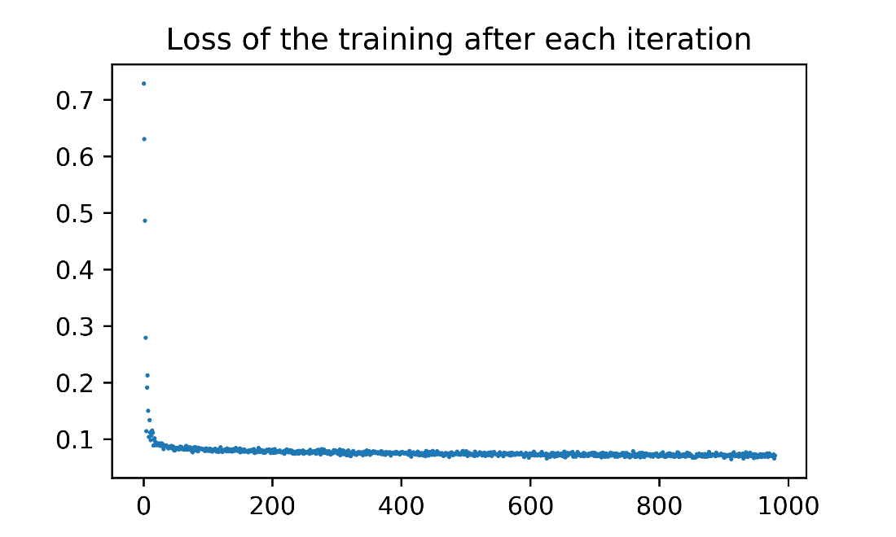
Analysis
We have tried AlexNet, ResNet18, SqueezeNet, VGG16 pre-trained models. As you can see, on this problem this 3 models gives similar scorsand loss on training phase whether they are fine-tuned or not. This makes us think that it stuck in local-maxima point and oscillates around same point which is a problem that many neural networks suffer. Because loss and training accuracy do not increase as epoch goes. Thus we even tried greater learning rates and different optimizers such as adam (however due to lack of memory, we used adam for just AlexNet), it gives similar accuracies and loss. It differs just convergence time and number of batches. For greater learning rates it convergences faster.
AlexNet loss plot

Slide 11
Different thresholding methods have been tried. Best thresholding method as we discussed in Method section, .5 , .6, .7, .8, .9 thresholds are used. 0.5 threshold gives best results as we expected. Because sigmoid function is used for loss layer that it convergences or learns according to that function.
Generally, results are not satisfactory. VGG16 really runs slow even with cuda(Nvidia 850GTX, 4GB VRAM). It took about 20 hours for 20 epochs. AlexNet and SqueezeNet are really pretty fast, however both of them converges so slow.

Slide 12
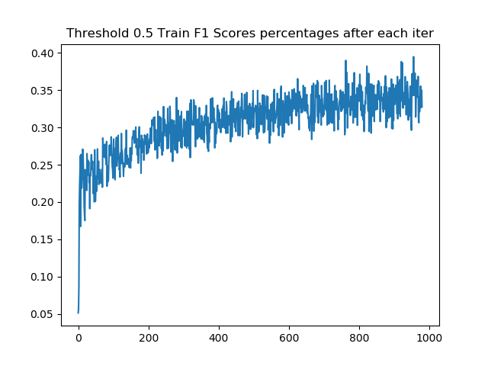
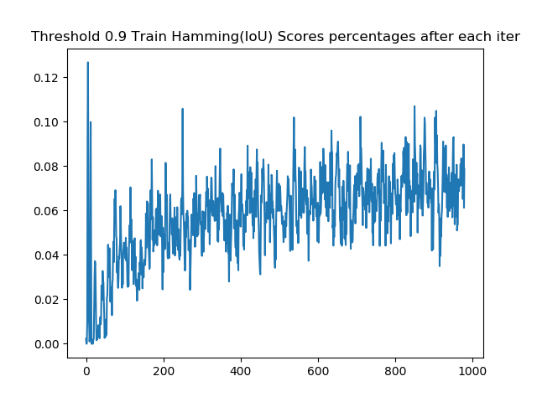
AlexNet with SGD

Slide 13
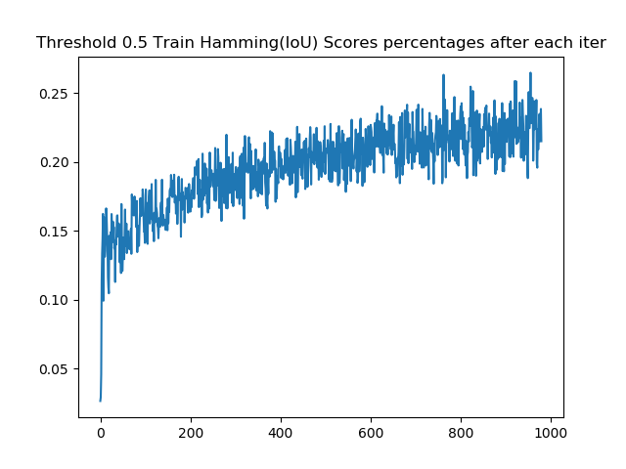

Slide 14
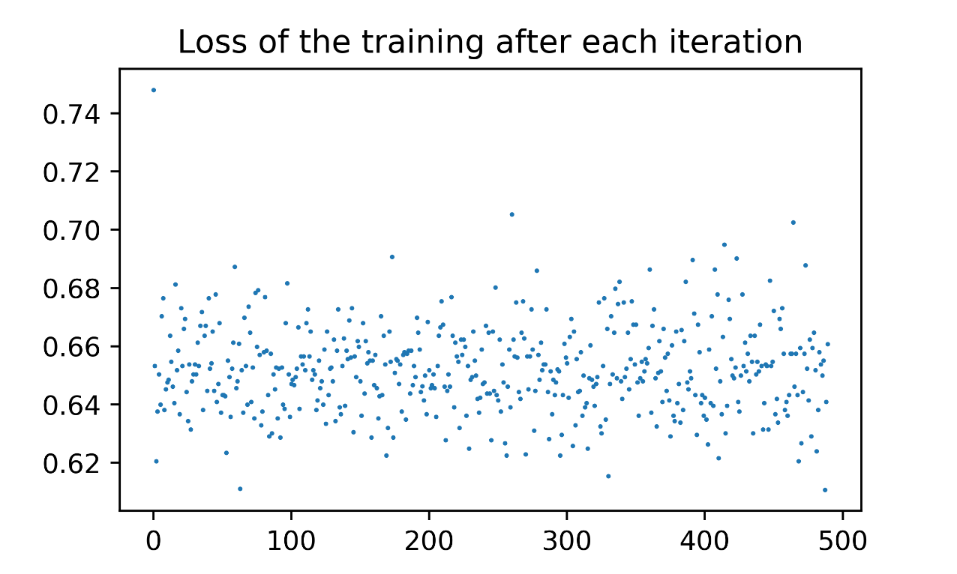
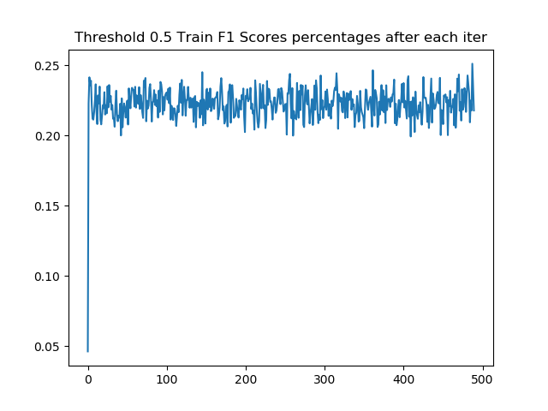
AlexNet with Adam

Slide 15
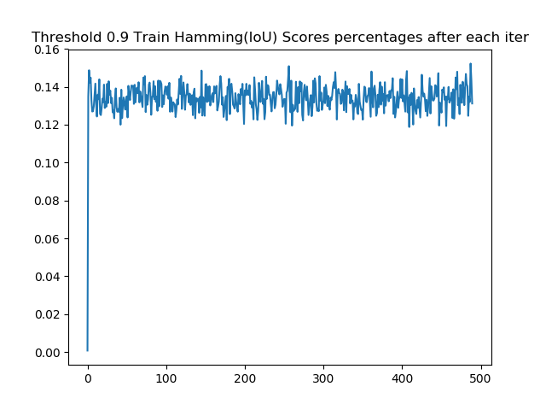

Slide 16
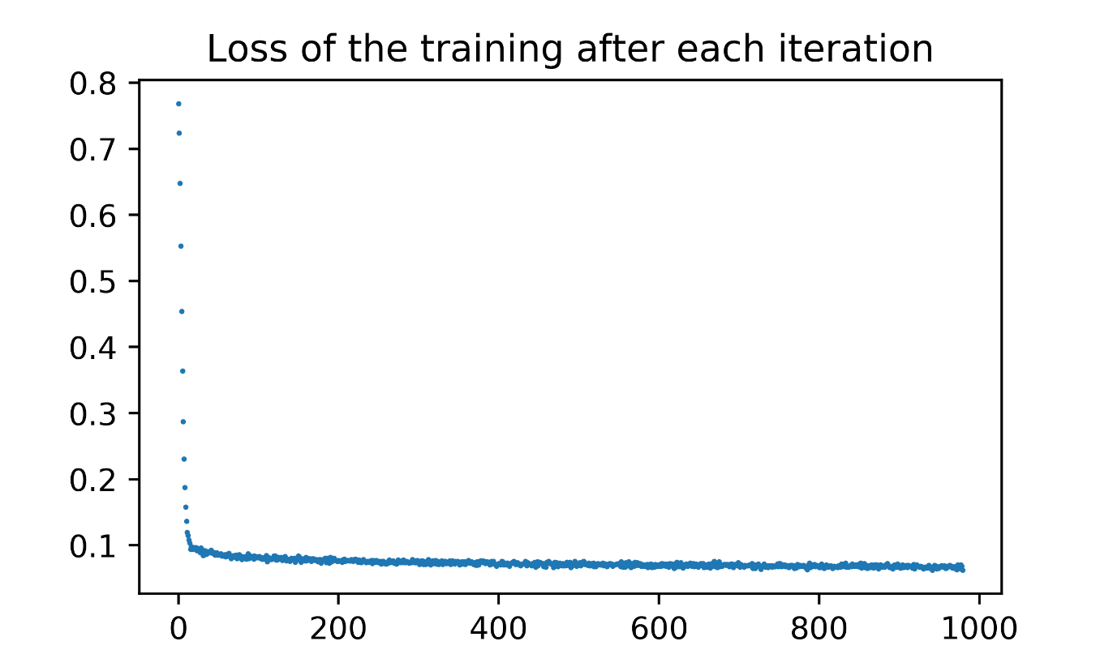
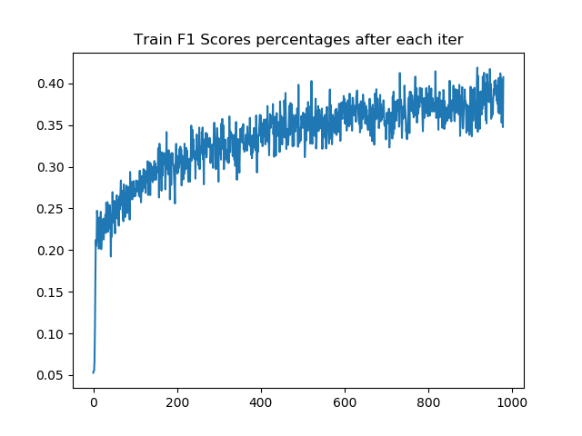
ResNet18 with SGD

Slide 17
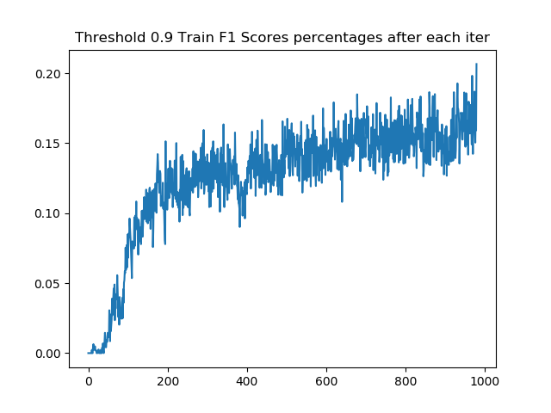
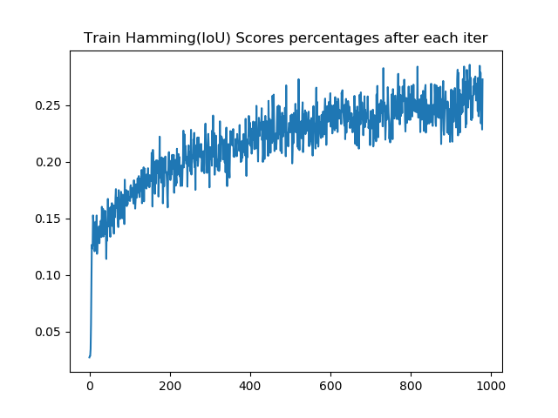

Slide 18
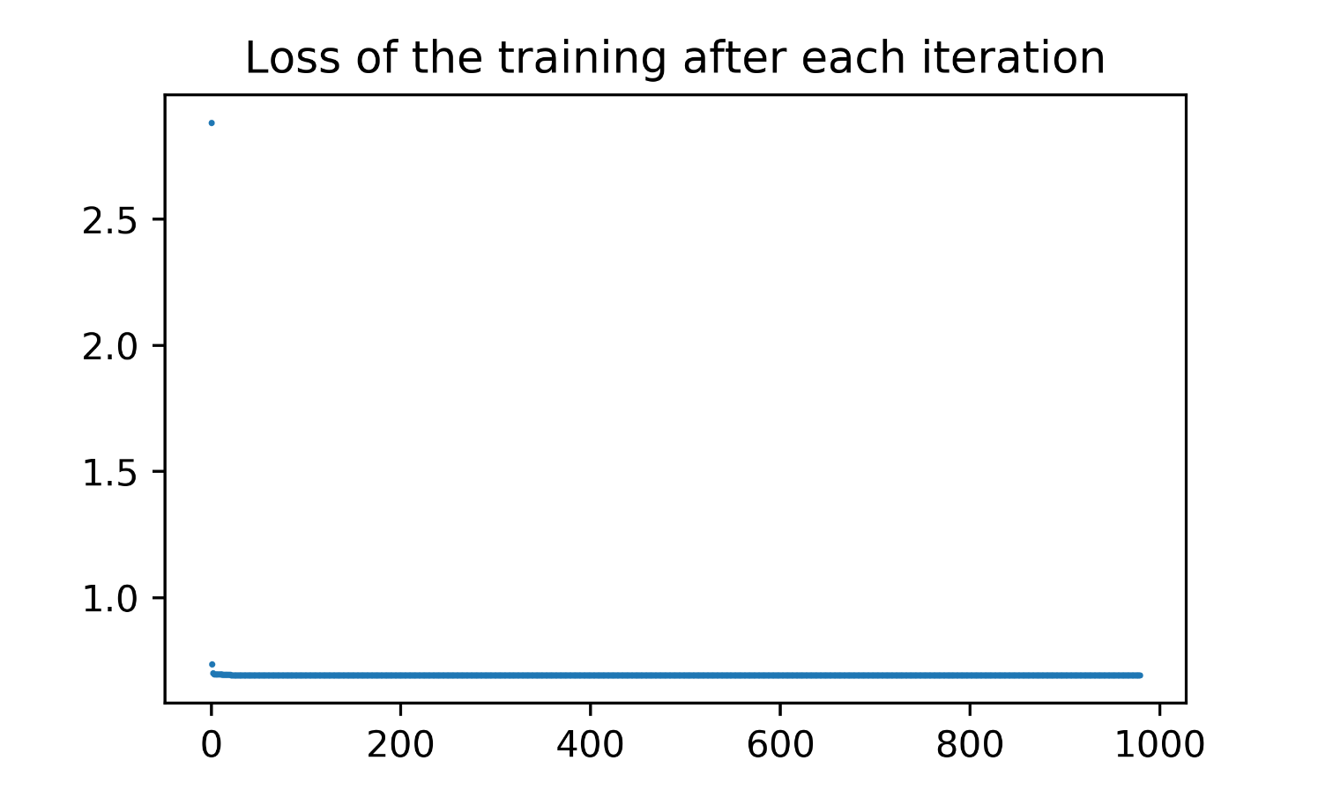
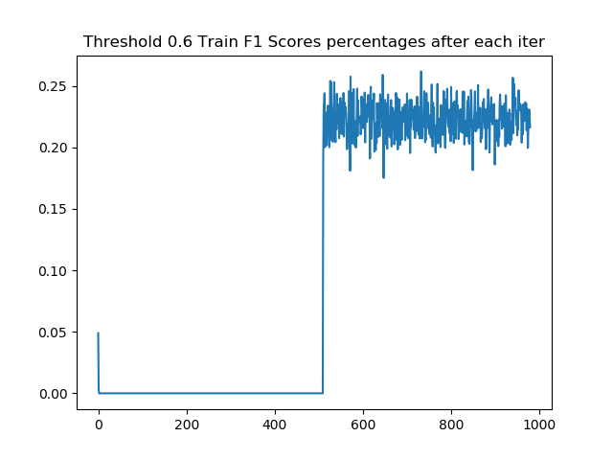
SqueezeNet with SGD

Slide 19
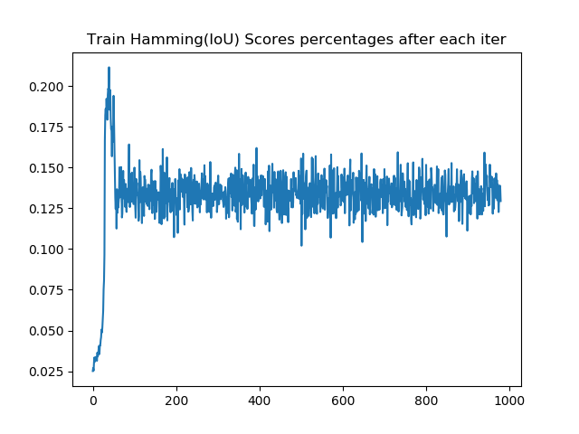
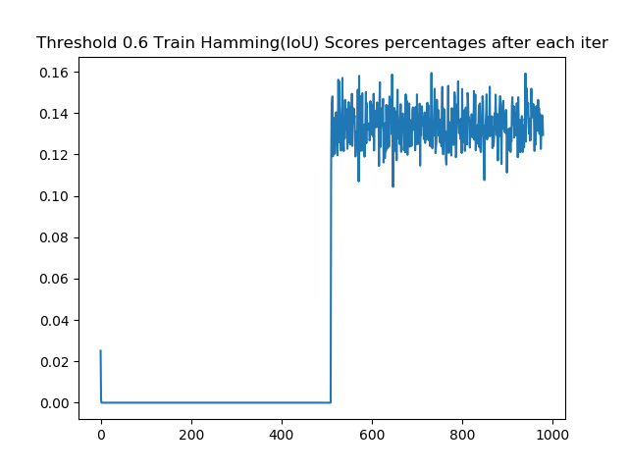

Slide 20
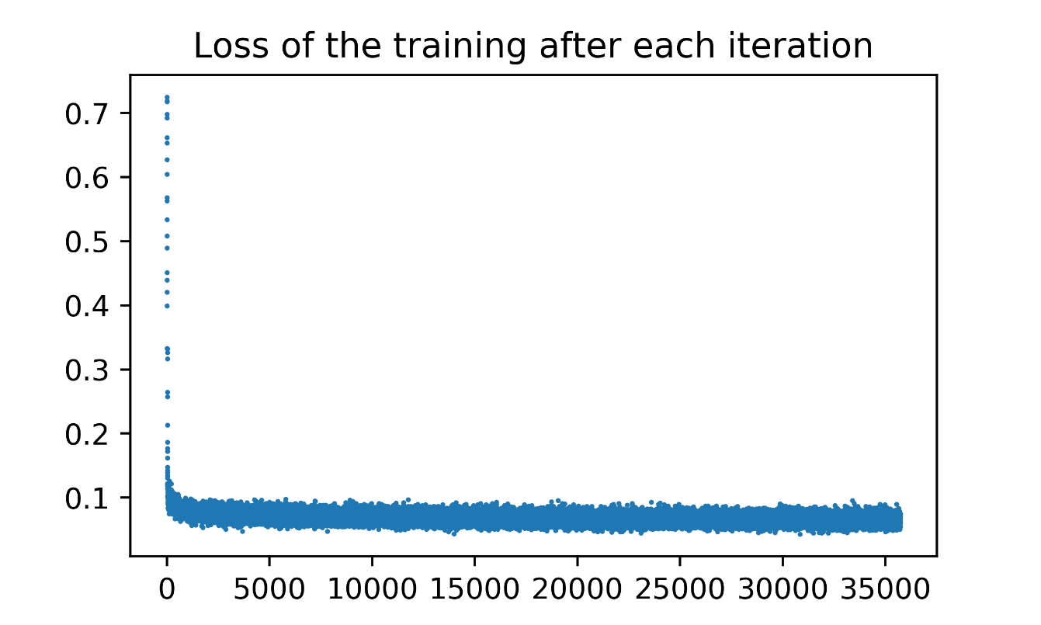
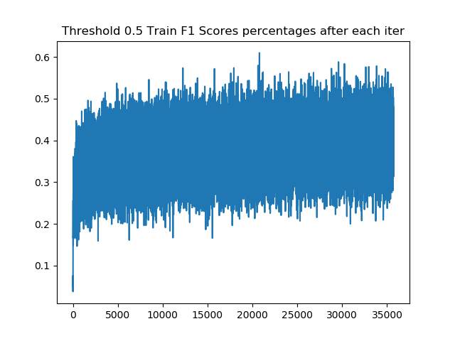
VGG16 with Freezing

Slide 21
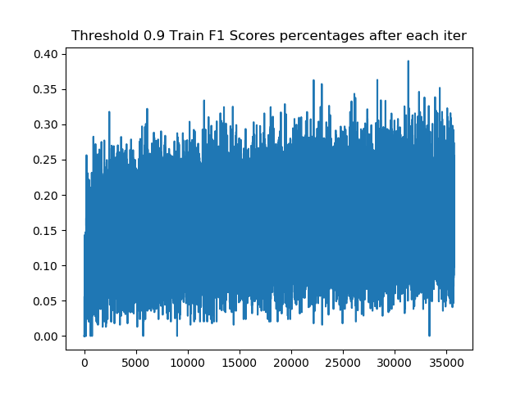
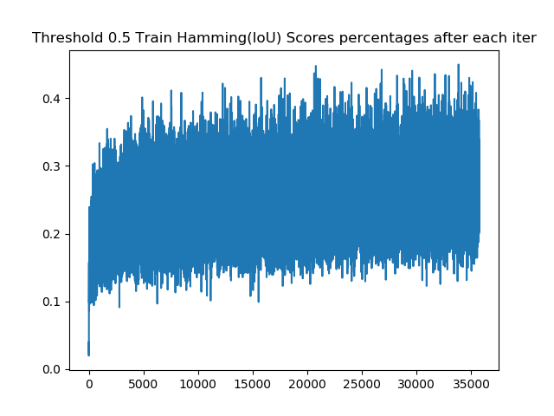

Slide 22
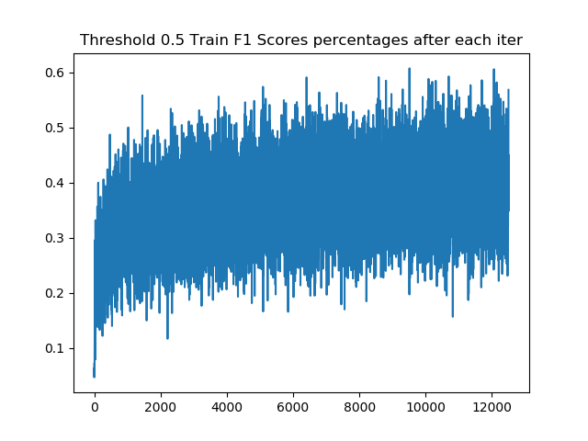
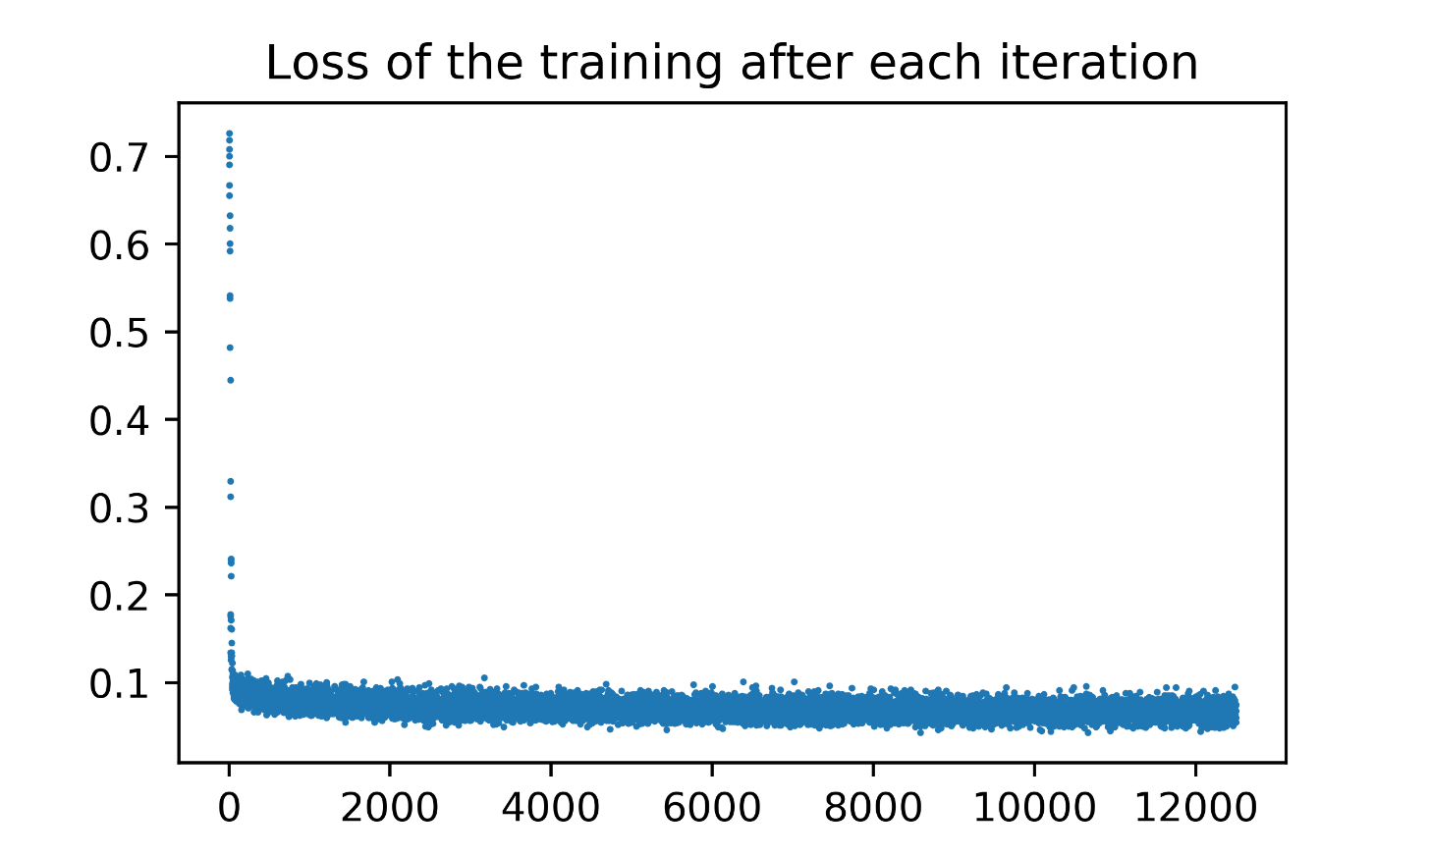
VGG16 without Freezing

Slide 23
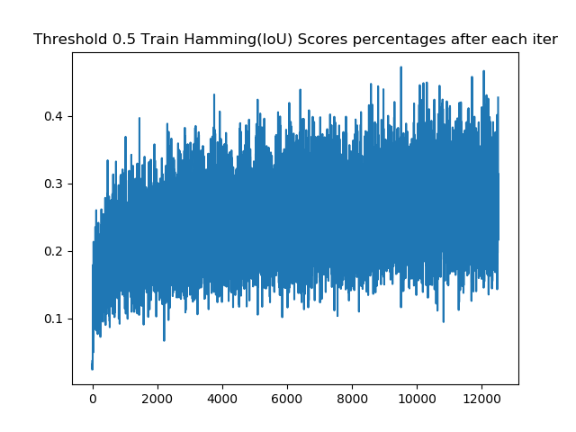
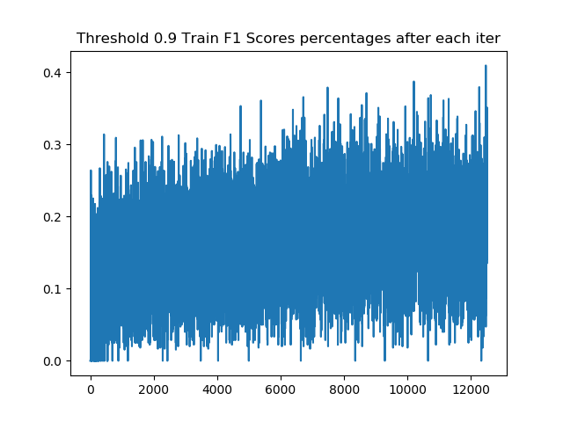

Slide 24
Discussion
Those results are not satisfactory. We expected at least \%70-\%80 in training scores. One of the reason why it did not happened to be those kind of scores is to probably stuck at some local-maxima point.
Besides, using SVM on top of models that would be used for feature extraction in this case could be another solution because SVM finds always global minimum in its case. Also, for this dataset different approaches should be taken into account. Because, original dataset has about 1 million images and it has enough variance. However, for this kind of unbalanced dataset, model has really great bias while having low variance.

Slide 25
Another thing could be done is finding threshold for all labels instead of global threshold. It is actually implemented, but we could not try for analysis. In our implementation, we tried thresholds 0.1 to 0.9 with step size 0.1, then after applying this threshold to predictions calculates Matthews correlation coefficient which is a measure of the quality of binary classifications.
As a result, there are many machine learning and computer vision solutions and techniques to be applied on this problem as we discussed before. Therefore using CNNs is one the possible easiest and effective solution, even though it needs many resources.

