Slide 1
DISCIPLINE AND IDEAS IN APPLIED SOCIAL SCIENCES
2nd Semester, A.Y. 2024-2025

Slide 2
Differentiating Applied from Pure Social Sciences and Understanding the Discipline of Counseling Module 1

Slide 3

LEARNING OBJECTIVES
clarify the relationship between the social sciences and the applied social sciences;
identify the goals and scope of counseling; and
explain the principles of counseling.

Slide 4


21ST CENTURY
Brought challenges to humanity due to changing phenomenon
scholars strongly considered balancing people’s views about conforming to it by analyzing its ideas through the help of
Make a timeline of the important historical events or list historical contributions made by people of African heritage.
Considering the drastic effects of the 21st Century, people resort to seeking professional assistance that aims to assist them to cope again with their lives and be back to their normal selves, counseling.
People are encouraged to be involved and participate in various engagements which are pertinent to the promotion of critical thinking and the formation of cultural consciousness and values formation.
SOCIAL SCIENCES
Counseling provides views about how mental health preservation is equivalent to maintaining a manageable life (Cherry, 2020).
INTRODUCTION

Slide 5
Differentiating the Applied from Pure Social Sciences
The core of all the issues in the 21st Century because it propagation new ideas which demanded a careful examination of these emerging ideas because it is the source of complication as there are adjustments that happened within the periphery of society itself (Dzisah & Etzkowitz, 2011).
GLOBALIZATION
There was a demand for finding new methods that would cater to these observations which will systematically determine how developments themselves are unfolding which people should be aware of (Wouters, Beaulieu, Scharnhorst, & Wyatt, 2012).
SOCIAL SCIENCE
Social Sciences became interdisciplinary with an aim to connect people to society which by itself is apparently dependent on (Alvesson, Gabriel, & Paulsen, 2017).
Social Scientists should closely monitor any social phenomenon because inconsistencies may blatantly shape people’s lives considering the presence of unpleasant outcomes like inequality (Sinha, 2020).

Slide 6


PURE SOCIAL SCIENCES
These are academic disciplines that are focused mostly on theories that aim to examine people and society (Alvesson, Gabriel, & Paulsen, 2017).

Slide 7
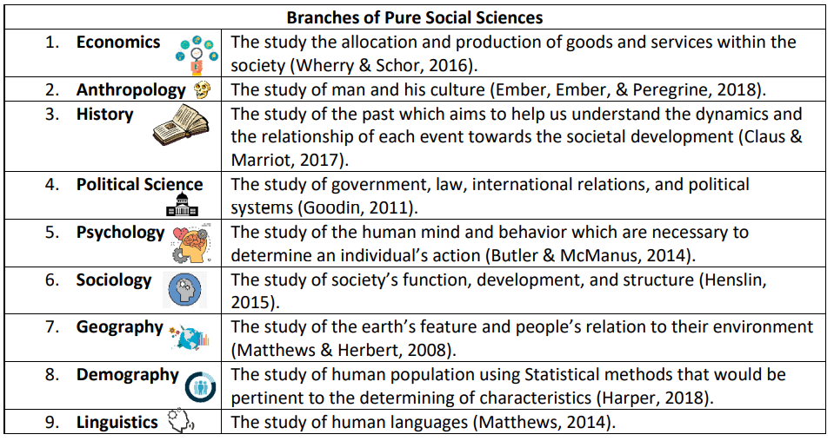

Slide 8

APPLIED SOCIAL SCIENCES
Intended for the application of concepts, models, and theories to assist people in dealing with societal issues involving its dynamics so as to provide alternatives that would alleviate people’s suffering (Giddens & Sutton, 2014).

Slide 9
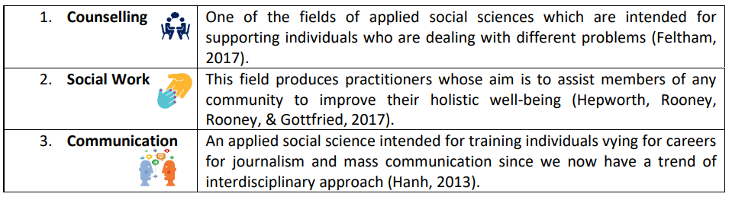

Slide 10
Understanding the Nature of Counselling
Counselling has a common stigma,
For ordinary people, it is for mentally-ill individuals who evade having one to avoid being labeled as crazy or retarded (Caddell, 2022).
Students it is troubled individuals who need to be restrained to control their unwanted behaviors (Larrier & Ratner, 2017).

Slide 11
Closely associated with therapy because it is a talking therapy that is intended for an individual having an emotional issue (Madeson, 2021).
COUNSELLING
End Cause?
Self-actualization of individuals because it is here that stigma can be determined and how anxiety and depression can be dealt with (Haddad & Haddad, 2015).
Counselling is a helping profession whose aim therapy to assist clients to express themselves regardless of their background (McLeod, 2013).
American Counselling Association defined counselling as professional relationship that aims to empower families, groups, and individuals with diverse background to achieve a balanced life in aspects such as career, education, mental, and physical wellness (McLeod, 2013).
Counselling is all about generating new possibilities that aim to resolve issues that are painful and worrisome (McLeod, 2013).

Slide 12

GOALS, PRINCIPLES, AND SCOPE OF COUNSELLING

Slide 13

INTRODUCTION
Regardless of profession, setting expectations, goals, and objectives is important to know the cause of its existence. In this case, counseling, its main thrust is to develop the client’s social awareness (Locke, Myers,& Herr, 2001). Hence, such a premise supports the notion that counselling is centered on to the enhancement and improvement of an individual because there are goals that underscore the role of counselling no matter how demanding it is.

Slide 14

According to Leslie Riopel (2019), there are five common goals of counseling:
Facilitating behavioral change;
help improve client’s ability to establish and maintain relationships;
help enhance client’s ability and effectiveness to cope up;
help promote client’s potential by centering on to the improvement with the decision-making process; and
development

Slide 15

Counselling is considered tedious because the most common if not usual aspect that we can possibly notice among people seeking this professional help is demotivation (Riopel, 2019). That is why, it is important that we get to acknowledge the significance of recovery that can help us improve ourselves (Riopel, 2019).

Slide 16
The acronym GROW can provide us with a meaningful discussion about demonstrating what recovery is:

Slide 17

Goal- the main end cause of recovery must be determined not just by the counselor itself but also by the client (Riopel, 2019). Such an endeavor is recommended because it provides a sense of direction to people seeking professional help (Riopel, 2019).

Slide 18

Reality- a goal may just become a dream (Riopel, 2019). For an individual to make it happen, one has to consider becoming realistic in dealing with it (Riopel, 2019). That is why, it is recommended for counselling professionals to be practical in terms of their own thinking or else everything will be a waste of time (Riopel, 2019).

Slide 19

Options- counselling requires the provision of possibilities to clients because no matter how we look at things, we need to reach an understanding so as to achieve recovery (Riopel, 2019).

Slide 20

Way Forward- there are no easy steps in life. That is why, self-sustainability should be inculcated so as to pursue the certainty of an achievement (Riopel, 2019).

Slide 21

Five foundational principles of counselling:
Autonomy- it advocates the respect for an individual to have control over oneself (Miller & Davis, 2016).
Justice- it advocates the need to be justifiable in all aspects including the explanation of why counsellors treat differently their clients (Miller & Davis, 2016).
Beneficence- it advocates the promotion of the client’s welfare that aims to achieve their betterment (Miller & Davis, 2016).
Non-maleficence- it advocates the non-infliction of harm to others which secures the idea of avoiding any further conflict (Miller & Davis, 2016).
Fidelity- it advocates the faith and trust of clients in their counselor regardless if there are no improvements (Miller & Davis, 2016).

Slide 22

Counselling has become a safe haven for acquiring personal support, reflection, and renewal in response to the emerging changes in society (McLeod, 2013). As a result, a wide variety of groups regardless of background come into action in availing this type of professional help (Chao, 2015). That is why it is important to get to know the scope of counselling to determine how encompassing such a profession is.

Slide 23

Scope of Counselling
Educational- exposing students to the counselling profession would enable them to determine the possible barriers that can allow them to be aware of the issues that surround everything (Chao, 2015).
Vocational- it is through here that individuals may get to know their true capabilities as counselling offers guidance on how they would qualify for a specialized job (Feltham, Hanley, & Winter 2017).

Slide 24

Scope of Counselling
3. Social- being part of a community or society may not be that easy for an individual to adjust to. That is why, counselling may also play an active role in shaping the client’s understanding which can help them understand certain types of constructs which has meanings attached to them (Feltham, Hanley, & Winter, 2017).
4. Moral- having a strong character foundation does not take a single day for it requires rigorous build-up. As a result, what seems to be necessary is to hone the client’s skills in making sound judgments where conflict can be avoided (Feltham, Hanley, & Winter, 2017).

Slide 25
Questions & answers

Slide 26
Resources
Discipline and Ideas in Applied Social Sciences Learning Module
PHOTO REFERENCES
istockphoto.com
uschamberfoundation.org
vox.com
differencebetween.net
localrootchicago.com
umanitoba.ca
counselling-directory.org.uk
sites.google.com
monday.com
jdsmultiservices.com

