Slide 1
Pytest tutorial

Slide 2
Scope of this tutorial

Slide 3
When and where to use Pytest
If you are developing a python code that you are using to study some models or do some data analysis
If you are building a python package that you want to disseminate and make others use it
If you are building complex functionality that spans multiple packages

Slide 4
Examples
Non-comprehensive use-cases
Suppose you are building a regression model to analyze how some parameters influence on outcome variable
You are building a small module that will soon be integrated into a big package

Slide 5
Why test our code?

Slide 6
Why test our code?
Save you hours of debugging
You will start writing modular and efficient code while developing
Your code will be trusted by others
You would know which part is breaking as you implement complex structure and models

Slide 7
Code writing methodology

Slide 8
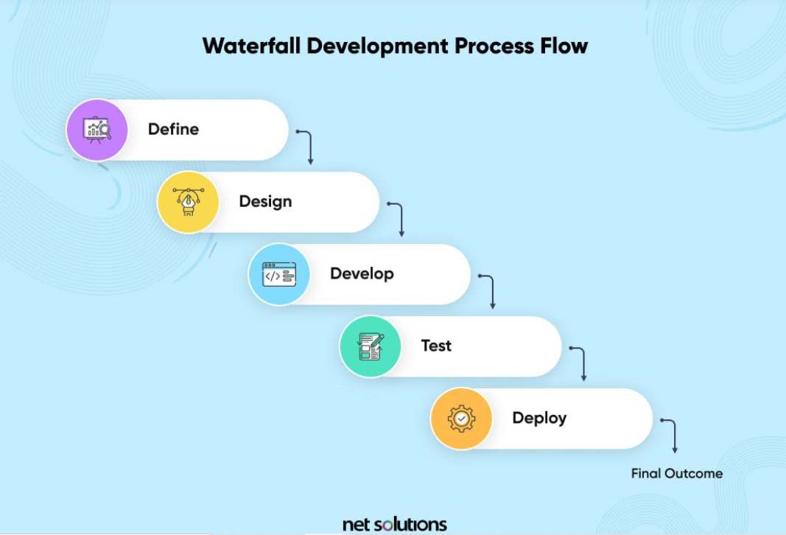
Almost all researchers use waterfall flow

Slide 9
Testing framework

Slide 10
Testing framework
Arrange – preparing objects, connecting to services, defining URL
Act – the function that kicks off the behavior we want to check
Assert – see if the result from the behavior is as expected
Cleanup – like removing objects, disconnecting from services so that other tests are not influenced by other

Slide 11
How to write pytest functions

Slide 12
Where to place Pytest test cases
Same file
Under tests/
Under package/tests/

Slide 13
Writing Pytest functions
Establish the scope of tests
Use pytest like normal classes
If creating the same class instance for testing different aspects, write them into fixtures

Slide 14
pytest Fixtures

Slide 15
Pytest fixtures
Used in setting up part of the pytest
Declared as a function with @fixture decorator
Can be reused multiple times
Can have different results based on different input arguments

Slide 16
pytest Marks parametrize

Slide 17
Pytest mark parameterize
Used when you want to parameterize different test cases
Arguments as tuples and list of test cases
Can be reused for different tests functions

Slide 18
Example

Slide 19
Tips for writing Pytest functions
Just use test_* or *_test as the name for pytest to find the function or class
Use –k to focus on single test without altering code
Use id to give more information for each parameterized use cases for testing
You can test for raising exceptions

Slide 20
THANK YOU
Adhithyan Sakthivelu
618-7674314
adhiths@stanford.edu

