Slide 1
Final Project Azure Machine Learning
Klonicki, Steve
Deep Azure@McKesson
Dr. Zoran B. Djordjević

Slide 2
Problem statement
In 2017, around 5.57 million existing homes were sold in the US
If priced too low, the seller leaves money on the table.
If priced too high, the house will sit on the market unsold.
A negative perception can result when a house is on the market for a considerable amount of time, or when the price is reduced often.

Slide 3
Goal
How accurately can we predict the selling price of a home before it is put onto the market?
Build a system to predict housing prices using Azure Machine Learning.

Slide 4
Install/Configure/Set up
Data set
https://www.kaggle.com/c/house-prices-advanced-regression-techniques/data
consists of 1,460 rows of data of house sales, each with 81 attributes.
Microsoft Azure Machine Learning Studio (https://studio.azureml.net/)
Anaconda 5.0 distribution of Python 64 bit (https://www.anaconda.com/), which includes:
Python 2.7.14
Jupyter (visualization tool)

Slide 5
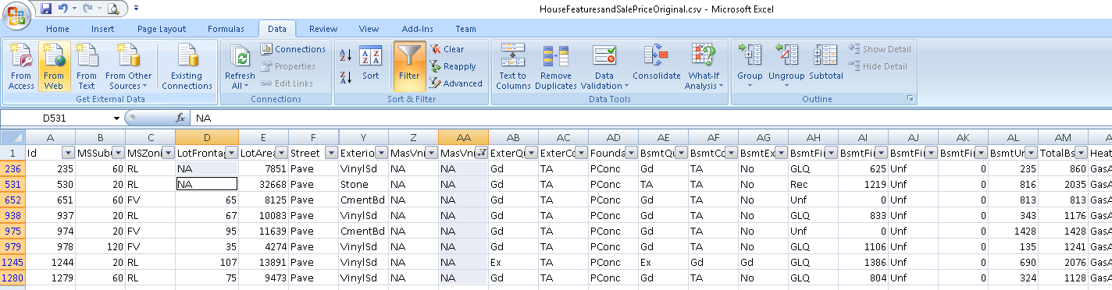
Install/Configure/Set up
Data cleaning
Columns LotFrontage and MasVnrArea are numeric. The creators of the data used the value 'NA' to denote no value. In these cases, I replaced NA with '0'. Cleansing is necessary to supply correct values to the machine learning algorithms.

Slide 6
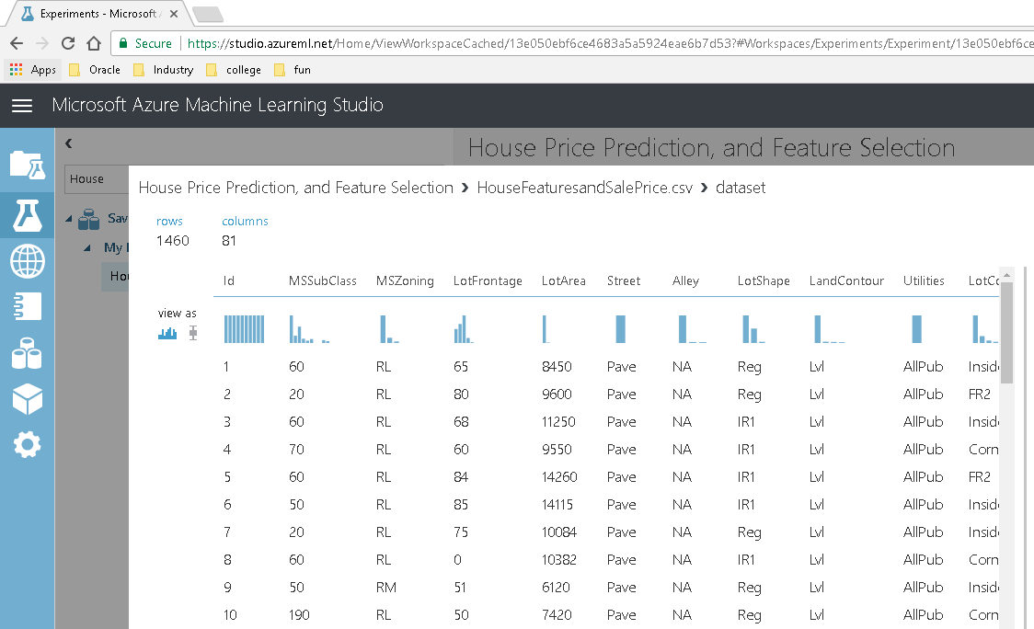
Demonstration
Out of the box, Azure Machine Learning offers basic visualizations

Slide 7
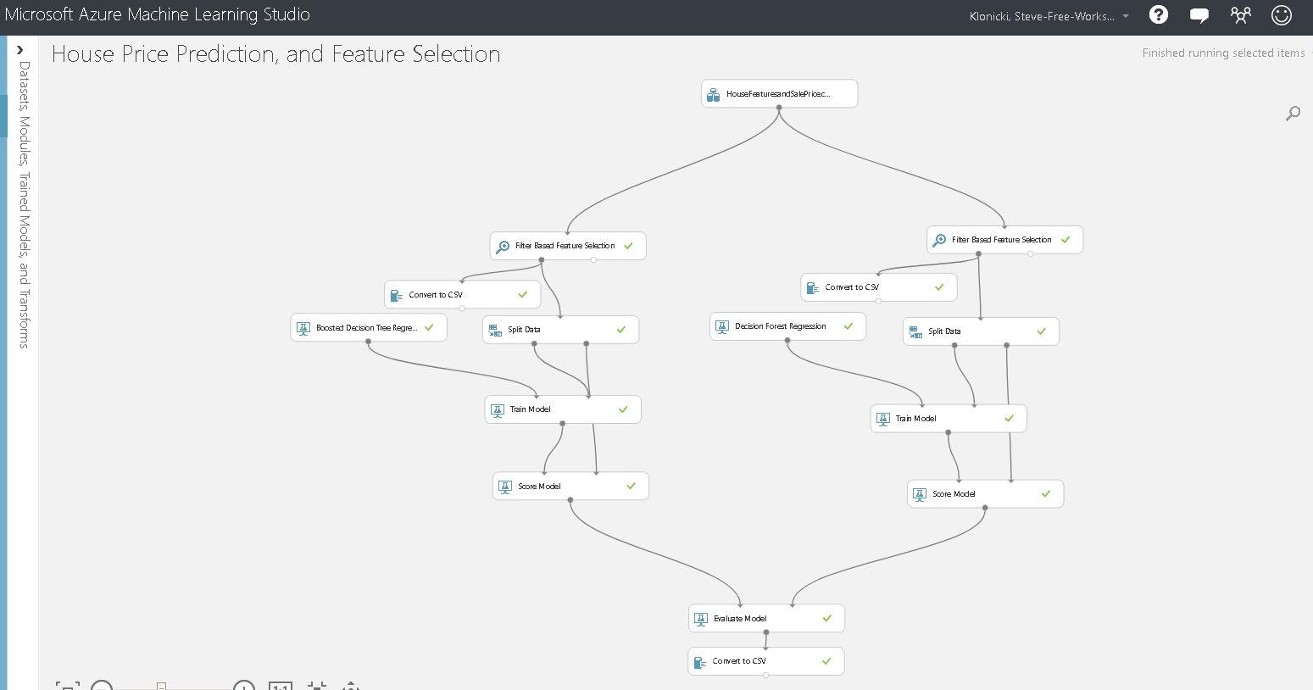
Demonstration
Machine Learning is accomplished through a series of interconnected modules

Slide 8
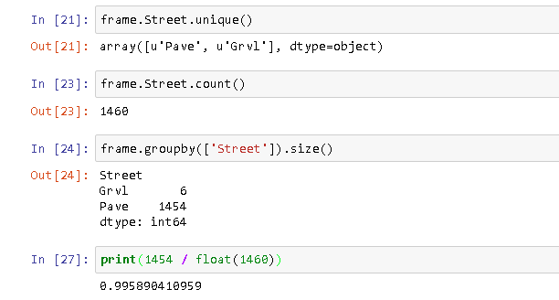
Demonstration
Not all data features are correlated with SalesPrice

Slide 9
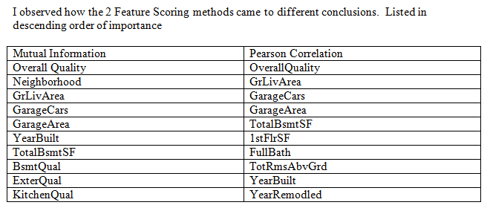
Demonstration
Filter Based Feature Selection module attempts to identify the most relevant attributes.

Slide 10
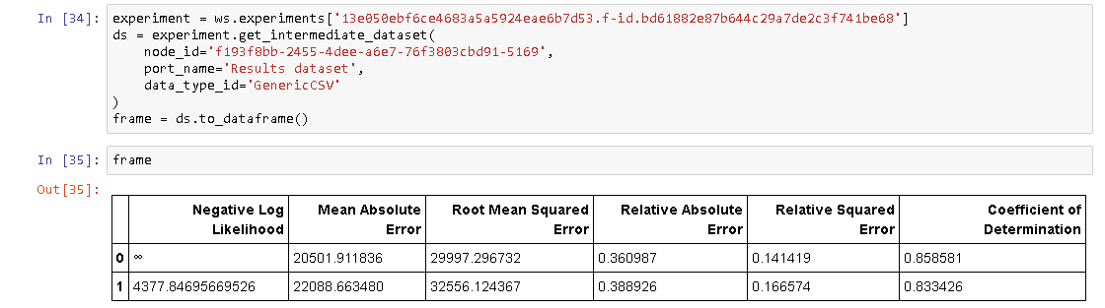
Demonstration
Split the data, use 75% to train the algorithm.
The remaining 25% was used to determine the accuracy of the model.
Not all Regression algorithms are equal. Compare the accuracy of the 2 models against each other.
Boosted Decision Tree Regression outperformed Decision Forest Regression. Coefficient of Determination closest to 1 wins.

Slide 11
Summary
Pros
Cons
Quickly generate an experiment that, in theory, could predict the price of a house with 85% accuracy
Limited ways Azure Machine Learning can be used programmatically.
Not possible to configure or execute the machine learning modules through a programming language.

Slide 12
YouTube URLs, GitHub URL, Last Page
Two minute (short): https://youtu.be/kb44rs7QztQ
15 minutes (long): https://youtu.be/GQZ3NAmyNxA
GitHub Repository with all artifacts: https://github.com/we814/AMLDeepDive

