Slide 1
Column
Generation
Jacques Desrosiers
Ecole des HEC & GERAD

Slide 2
Contents
The Cutting Stock Problem
Basic Observations
LP Column Generation
Dantzig-Wolfe Decomposition
Dantzig-Wolfe decomposition vs Lagrangian Relaxation
Equivalencies
Alternative Formulations to the Cutting Stock Problem
IP Column Generation
Branch-and- ...
Acceleration Techniques
Concluding Remarks

Slide 3





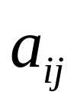

A Classical Paper :
The Cutting Stock Problem
P.C. Gilmore & R.E. Gomory
A Linear Programming Approach to the Cutting Stock Problem.
Oper. Res. 9, 849-859. (1960)
: set of items
: number of times item i is requested
: length of item i
: length of a standard roll
: set of cutting patterns
: number of times item i is cut in pattern j
: number of times pattern j is used

Slide 4
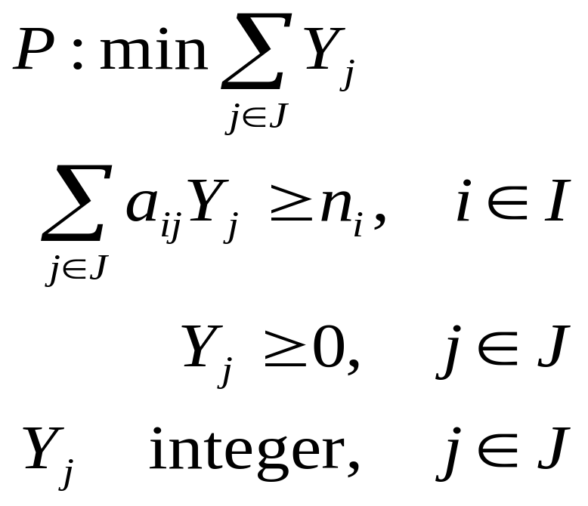

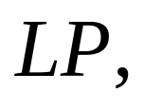

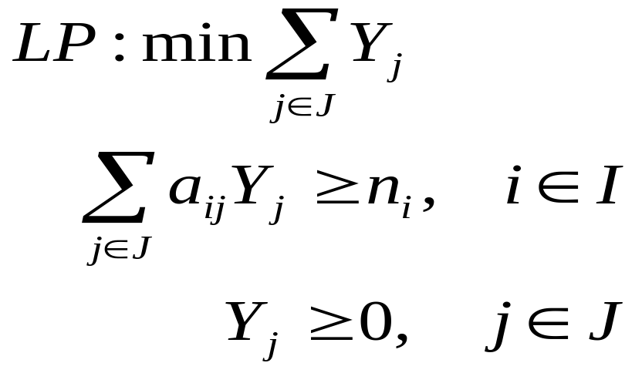
The Cutting Stock
Problem ...
Set can be huge.
Solution of the linear relaxation of by column generation.
Minimize the number of standard rolls used

Slide 5

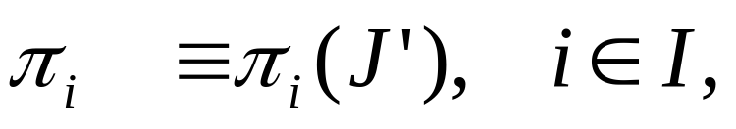



The Cutting Stock
Problem ...
Given a subset
and the dual multipliers
the reduced cost of any new patterns must satisfy:
otherwise, is optimal.

Slide 6


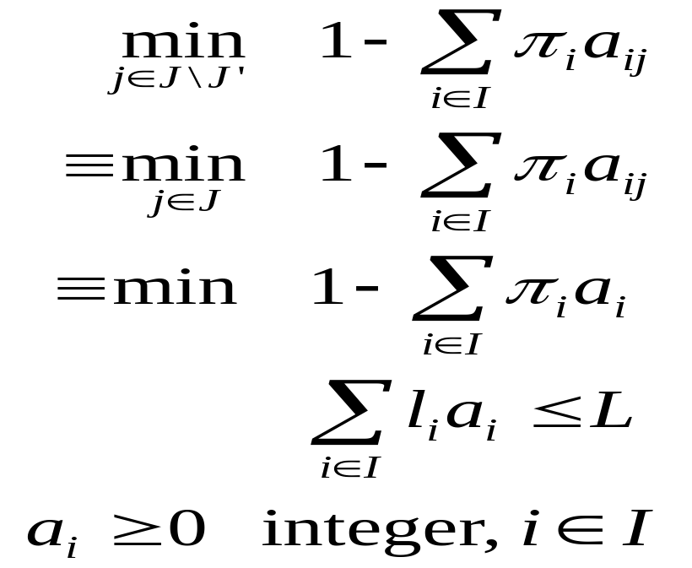
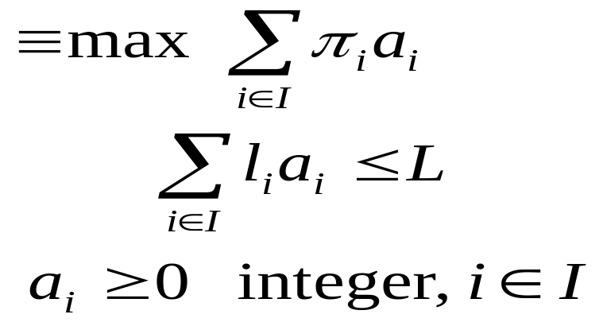
The Cutting Stock
Problem ...
Reduced costs for are non negative, hence:
is a decision variable: the number of times item i is selected in a new pattern.
The Column Generator is a Knapsack Problem.

Slide 7
Basic
Observations
Keep the coupling constraints at a superior level, in a Master Problem;
this with the goal of obtaining a Column Generator which is rather easy to solve.
At an inferior level,
solve the Column Generator, which is often separable in several independent sub-problems;
use a specialized algorithm that exploits its particular structure.

Slide 8
LP
Column Generation
MASTER PROBLEM
Columns Dual Multipliers
COLUMN GENERATOR (Sub-problems)
Optimality Conditions: primal feasibility complementary slackness
dual feasibility

Slide 9
Historical
Perspective
G.B. Dantzig & P. Wolfe
Decomposition Principle for Linear Programs.
Oper. Res. 8, 101-111. (1960)
Authors give credit to:
L.R. Ford & D.R. Fulkerson
A Suggested Computation for Multi-commodity flows.
Man. Sc. 5, 97-101. (1958)

Slide 10
Historical Perspective : a Dual Approach
DUAL MASTER PROBLEM
Rows Dual Multipliers
ROW GENERATOR (Sub-problems)
J.E. Kelly The Cutting Plane Method for Solving Convex Programs.
SIAM 8, 703-712.
(1960)

Slide 11
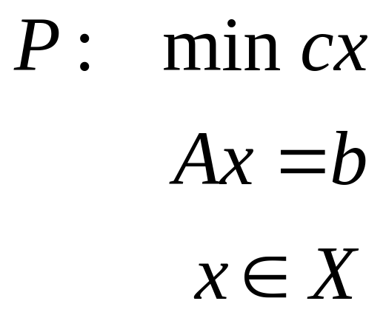
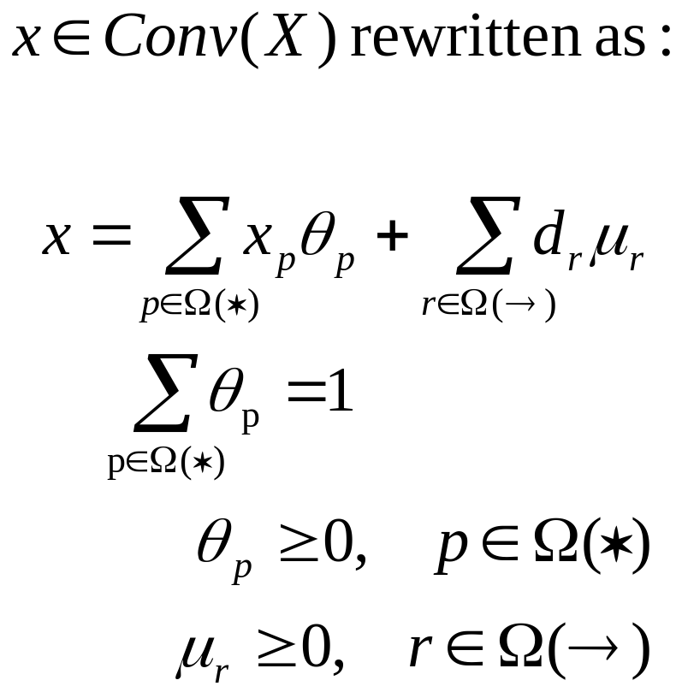
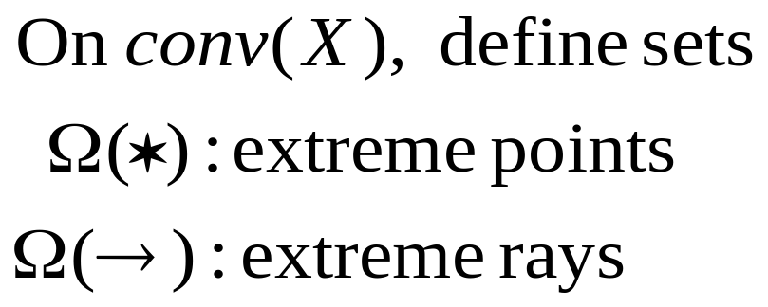
Dantzig-Wolfe Decomposition : the Principle

Slide 12
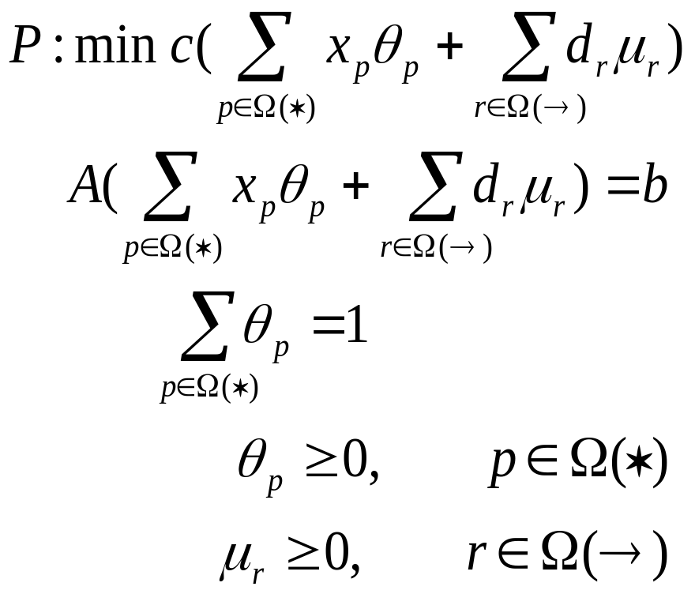
Dantzig-Wolfe Decomposition : Substitution

Slide 13
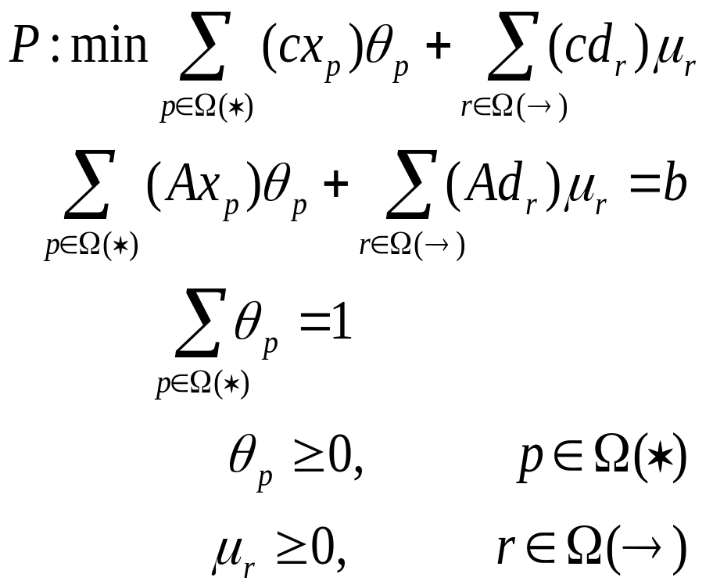

Dantzig-Wolfe Decomposition : The Master Problem
The Master Problem

Slide 14
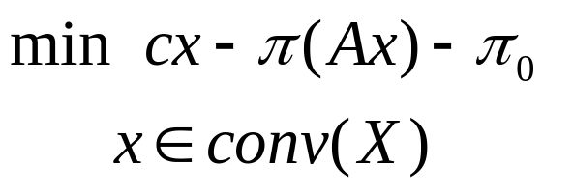

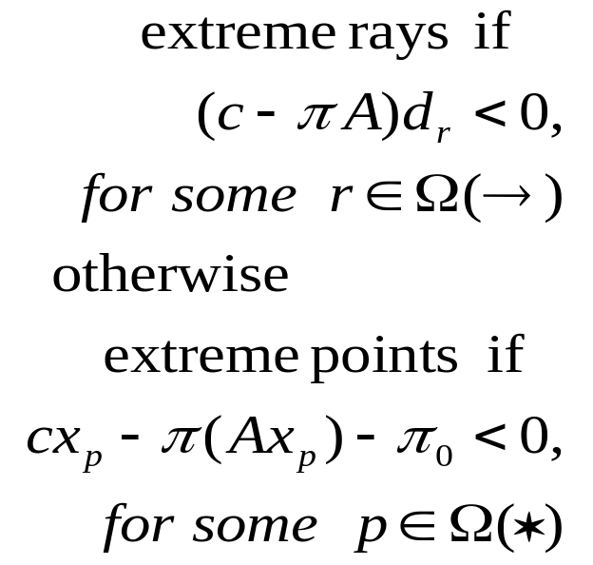
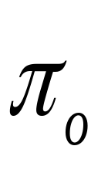
Dantzig-Wolfe Decomposition : The Column Generator
Given the current dual multipliers for a subset of columns :
coupling constraints convexity constraint
generate (if possible) new columns with negative reduced cost :

Slide 15
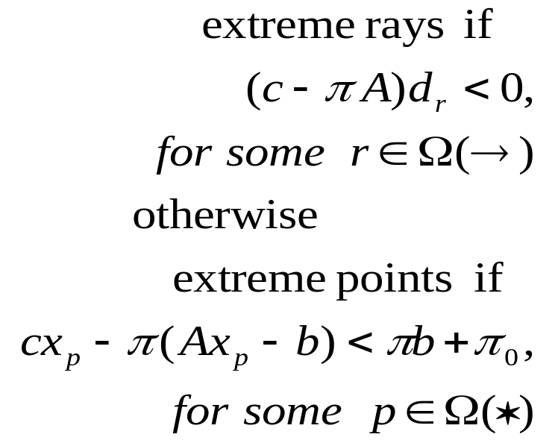
Remark

Slide 16
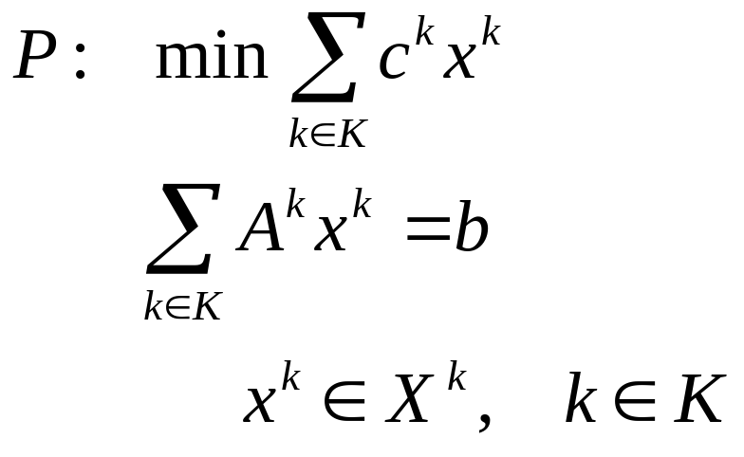
Dantzig-Wolfe Decomposition :
Block Angular Structure
Exploits the structure of many sub-problems.
Similar developments & results.

Slide 17
Dantzig-Wolfe Decomposition : Algorithm
MASTER PROBLEM
Columns Dual Multipliers
COLUMN GENERATOR (Sub-problems)
Optimality Conditions: primal feasibility complementary slackness
dual feasibility

Slide 18
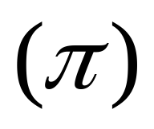
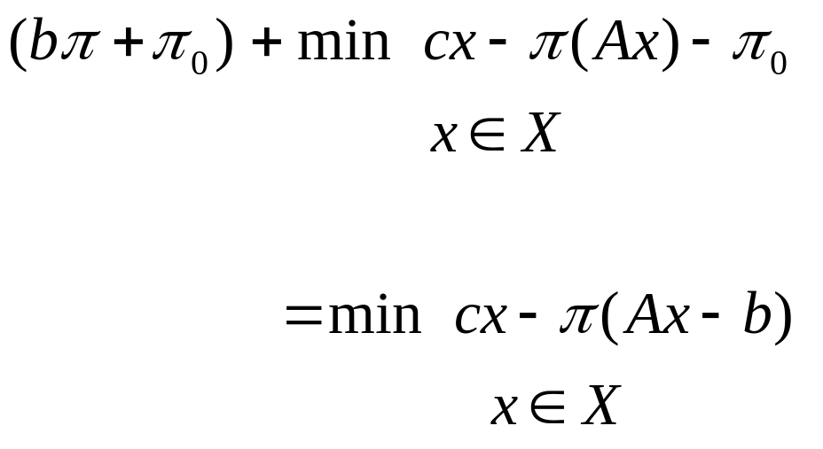
Dantzig-Wolfe Decomposition : a Lower Bound
Given the current dual multipliers (coupling constraints) (convexity constraint),
a lower bound can be computed at each iteration, as follows:
Current solution value
+ minimum
reduced cost column

Slide 19
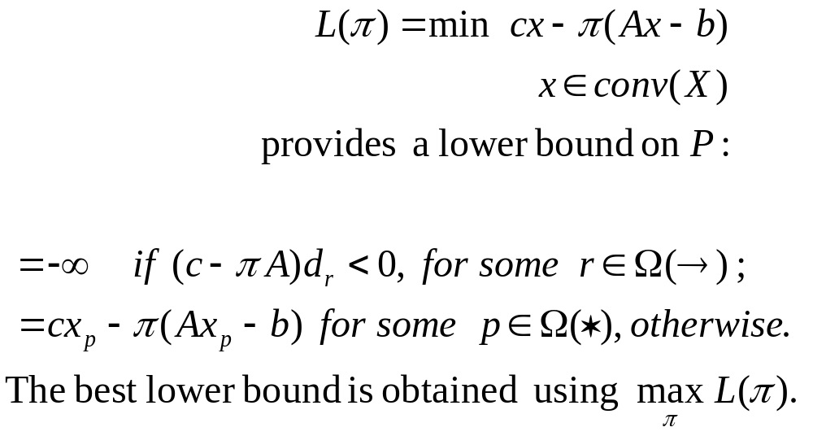
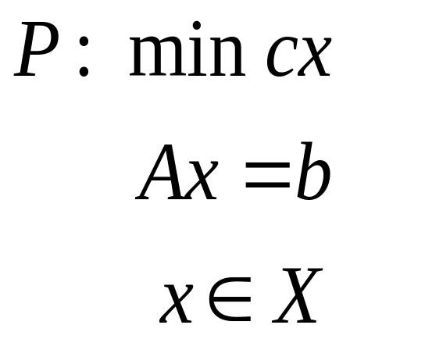

Lagrangian Relaxation Computes the Same Lower Bound

Slide 20
Dantzig-Wolfe vs Lagrangian Decomposition Relaxation
Essentially utilized for Linear Programs
Relatively difficult to implement
Slow convergence
Rarely implemented
Essentially utilized for Integer Programs
Easy to implement with subgradient adjustment for multipliers π
No stopping rule !
≅ 6% of OR papers

Slide 21
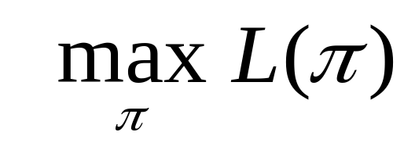
Equivalencies
Dantzig-Wolfe Decomposition &
Lagrangian Relaxation
if both have the same sub-problems
In both methods, coupling or complicating constraints go into a
DUAL MULTIPLIERS ADJUSTMENT PROBLEM :
in DW : a LP Master Problem
in Lagrangian Relaxation :

Slide 22
Equivalencies ...
Column Generation corresponds to the solution process used in Dantzig-Wolfe decomposition.
This approach can also be used directly by formulating a Master Problem and sub-problems rather than obtaining them by decomposing a Global formulation of the problem. However ...

Slide 23
Equivalencies ...
… for any Column Generation scheme, there exits a Global Formulation that can be decomposed by using a generalized Dantzig-Wolfe decomposition which results in the same Master and sub-problems.
The definition of the Global Formulation is not unique.
A nice example:
The Cutting Stock Problem

Slide 24

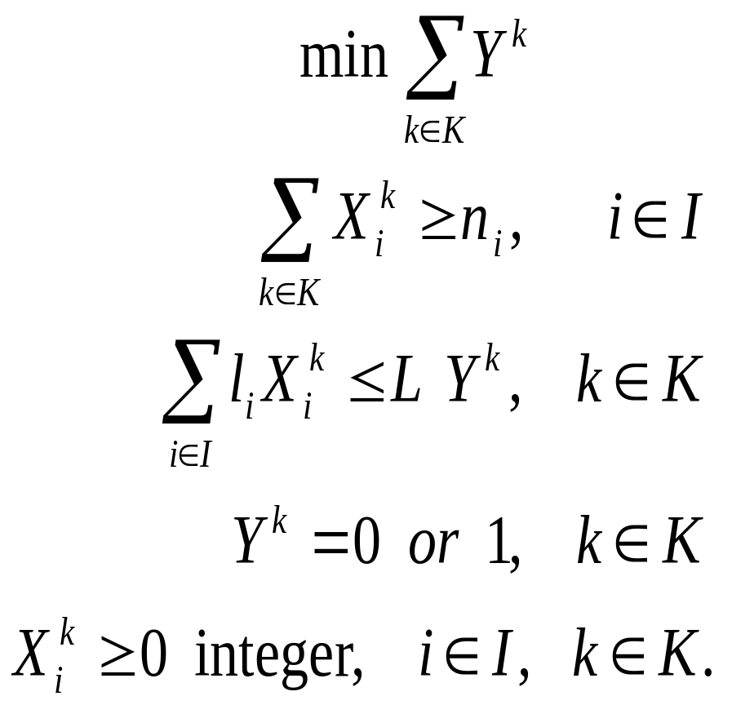
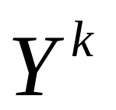

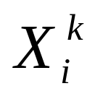
The Cutting Stock Problem : Kantorovich (1960/1939)
: set of available rolls
: binary variable, 1 if roll k is cut, 0 otherwise
: number of times item i is cut on roll k

Slide 25

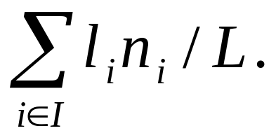
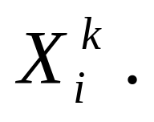
The Cutting Stock Problem : Kantorovich ...
Kantorovich’s LP lower bound is weak:
However, Dantzig-Wolfe decomposition provides the same bound as the Gilmore-Gomory LP bound if sub-problems are solved as ...
integer Knapsack Problems, (which provide extreme point columns).
Aggregation of identical columns in the Master Problem.
Branch & Bound performed on

Slide 26

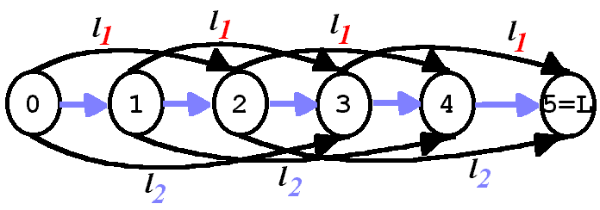

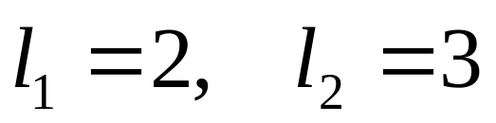
The Cutting Stock Problem : Valerio de Carvalhó (1996)
Network type formulation on graph
Example with , and

Slide 27
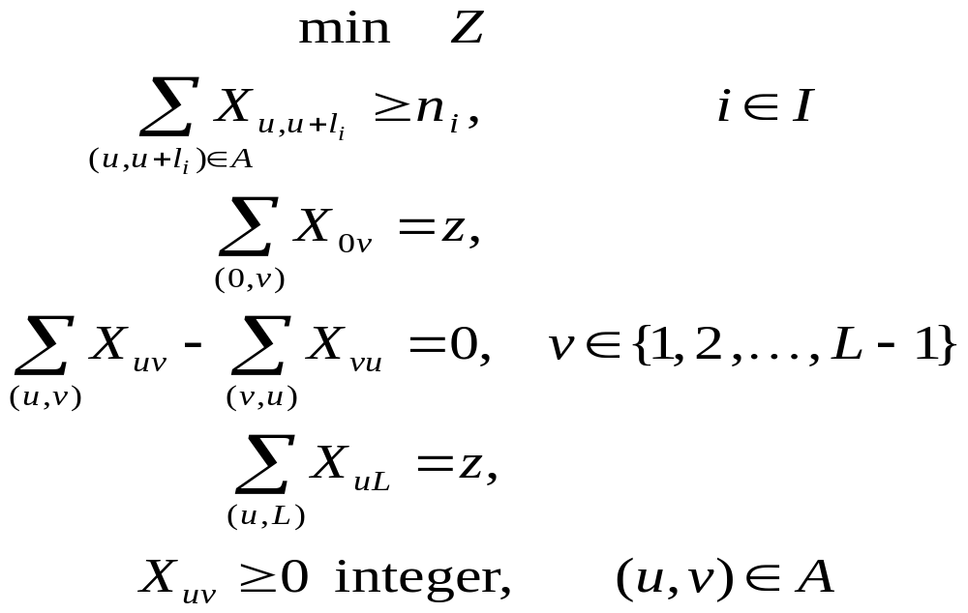
The Cutting Stock Problem : Valerio de Carvalhó ...

Slide 28
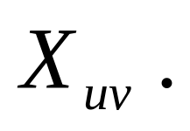
The Cutting Stock Problem : Valerio de Carvalhó ...
The sub-problem is a shortest path problem on a acyclic network.
This Column Generator only brings back extreme ray columns,
the single extreme point being the null vector.
The Master Problem appears without the convexity constraint.
The correspondence with Gilmore-Gomory formulation is obvious.
Branch & Bound performed on

Slide 29
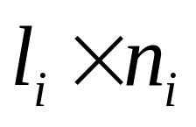

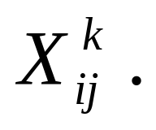
The Cutting Stock Problem : Desaulniers et al. (1998)
It can also be viewed as a Vehicle Routing Problem on a acyclic network (multi-commodity flows):
Vehicles Rolls Customers Items
Demands
Capacity
Column Generation tools developed for Routing Problems can be used.
Columns correspond to paths visiting items the requested number of times.
Branch & Bound performed on

Slide 30
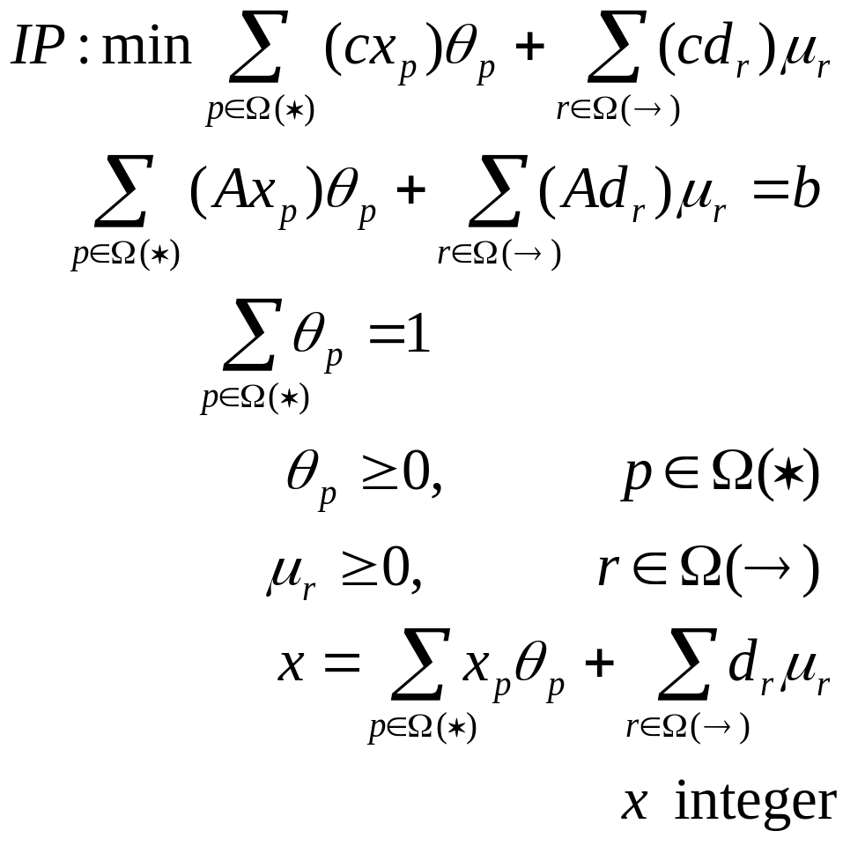
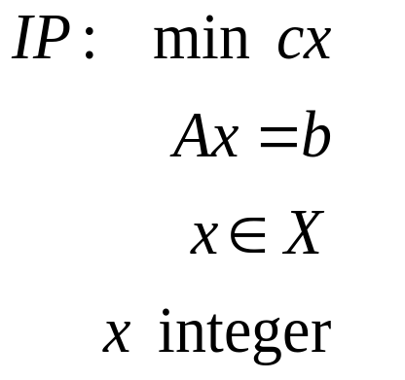
IP
Column Generation

Slide 31
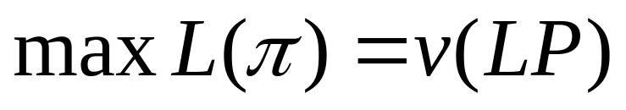

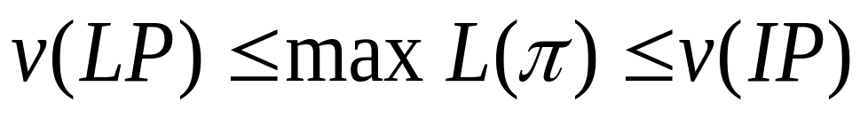
Integrality
Property
The sub-problem satisfies the Integrality Property
if it has an integer optimal solution for any choice of linear objective function,
even if the integrality restrictions on the variables are relaxed.
In this case,
otherwise
i.e., the solution process partially explores the integrality gap.

Slide 32
Integrality
Property ...
In most cases, the Integrality Property is a undesirable property!
Exploiting the non trivial integer structure reveals that ...
… some overlooked formulations become very good when a Dantzig-Wolfe decomposition process is applied to them.
The Cutting Stock Problem Localization Problems Vehicle Routing Problems ...

Slide 33
IP Column Generation :
Branch-and-...
Branch-and-Bound :
branching decisions on a combination of the original (fractional) variables
of a Global Formulation on which Dantzig-Wolfe Decomposition is applied.
Branch-and-Cut :
cutting planes defined on a combination of the original variables;
at the Master level, as coupling constraints;
in the sub-problem, as local constraints.

Slide 34
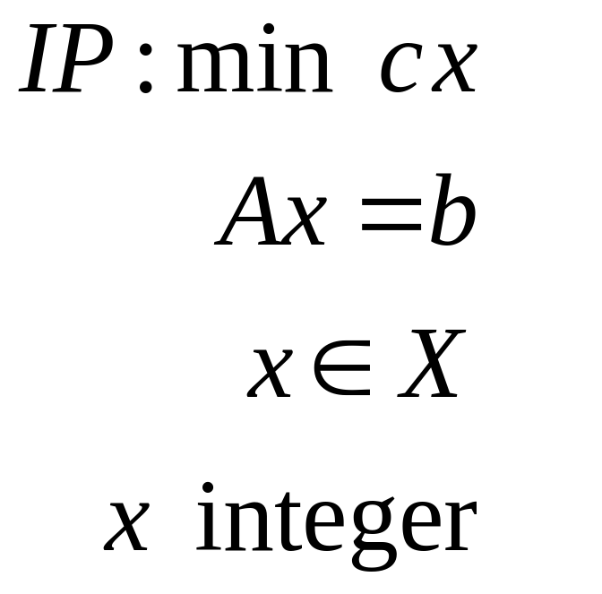


IP Column Generation :
Branch-and-...
Branching &
Cutting decisions
Dantzig-Wolfe decomposition applied at all decision nodes

Slide 35
IP Column Generation:
Branch-and-...
Branch-and-Price :
a nice name
which hides a well known solution process relatively easy to apply.
For alternative methods, see the work of
S. Holm & J. Tind
C. Barnhart, E. Johnson, G. Nemhauser, P. Vance, M. Savelsbergh, ...
F. Vanderbeck & L. Wolsey

Slide 36
Application to Vehicle Routing and Crew Scheduling Problems (1981 - …)
J. Desrosiers, Y. Dumas, F. Soumis & M. Solomon Time Constrained Routing and Scheduling Handbooks in OR & MS, 8 (1995)
G. Desaulniers et al. A Unified Framework for Deterministic Vehicle Routing and Crew Scheduling Problems T. Crainic & G. Laporte (eds) Fleet Management & Logistics (1998)
Global Formulation : Non-Linear Integer Multi-Commodity Flows
Master Problem : Covering & Other Linking Constraints
Column Generator : Resource Constrained Shortest Paths

Slide 37
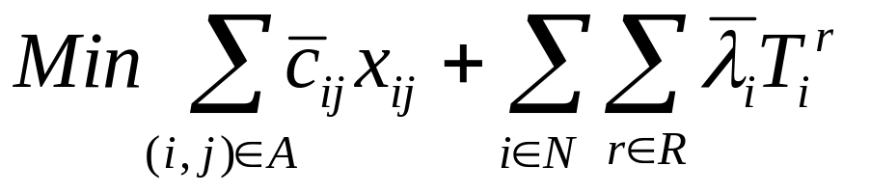
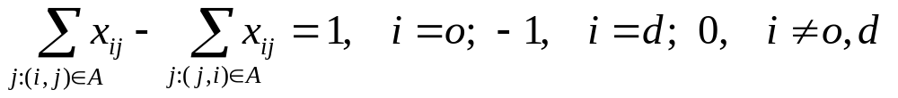
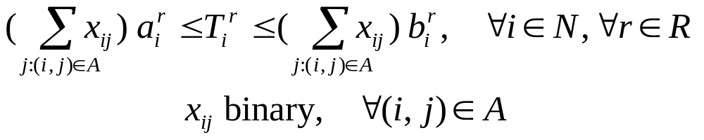
Resource Constrained
Shortest Path Problem on G=(N,A)
P(N, A) :

Slide 38
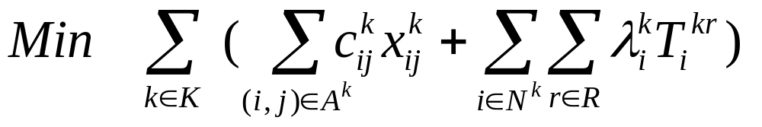
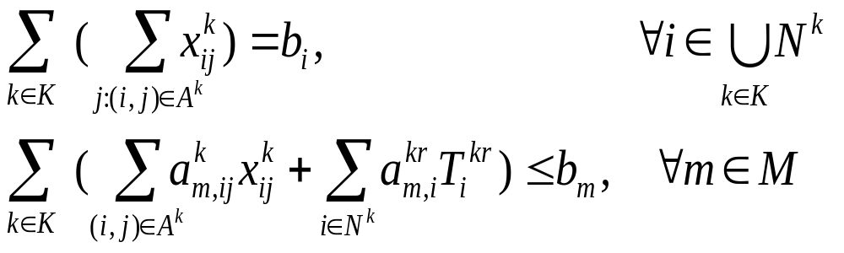
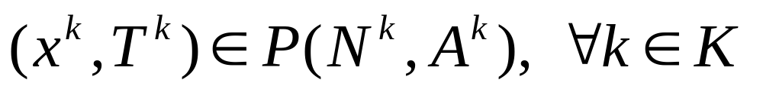
Integer Multi-Commodity
Network Flow Structure

Slide 39
Vehicle Routing and Crew Scheduling Problems ...
Sub-Problem is strongly NP-hard
It does not posses the Integrality Property
Paths ≡ Extreme points
Master Problem results in Set Partitioning/Covering type Problems
Branching and Cutting decisions are taken on the original network flow, resource and supplementary variables

Slide 40
IP Column Generation :
Acceleration Techniques
Exploit all the Structures
on the Column Generator
Master Problem
Global Formulation
With Fast Heuristics
Re-Optimizers
Pre-Processors
To get Primal
& Dual Solutions

Slide 41
IP Column Generation :
Acceleration Techniques ...
Link all the Structures
Be Innovative !
Multiple Columns : selected subset close to expected optimal solution
Partial Pricing in case of many Sub-Problems :
as in the Simplex Method
Early & Multiple Branching & Cutting : quickly gets local optima
Primal Perturbation & Dual Restriction : to avoid degeneracy and convergence difficulties
Branching & Cutting : on integer variables !
Branch-first, Cut-second Approach :
exploit solution structures

Slide 42
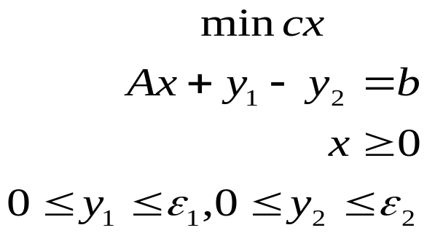
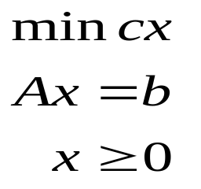
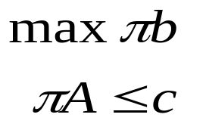
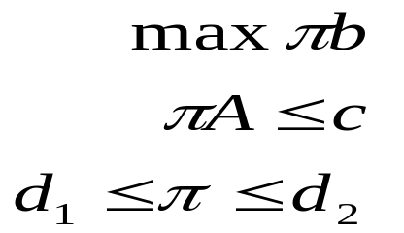
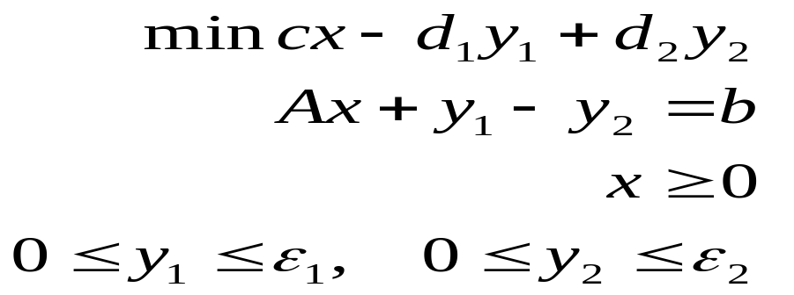
Stabilized Column Generation
Perturbed Primal
Restricted Dual
Stabilized Problem

Slide 43
Concluding Remarks
DW Decomposition is an intuitive framework that requires all tools discussed to become applicable
“easier” for IP
very effective in several applications
Imagine what could be done with theoretically better methods such as
… the Analytic Center Cutting Plane Method
(Vial, Goffin, du Merle, Gondzio, Haurie, et al.)
which exploits recent developments in interior point methods,
and is also compatible with Column Generation.

Slide 44
“Bridging Continents and Cultures”
F. Soumis
M. Solomon
G. Desaulniers
P. Hansen
J.-L. Goffin
O. Marcotte
G. Savard
O. du Merle
O. Madsen
P.O. Lindberg
B. Jaumard
M. Desrochers
Y. Dumas
M. Gamache
D. Villeneuve
K. Ziarati
I. Ioachim
M. Stojkovic
G. Stojkovic
N. Kohl
A. Nöu
… et al.
Canada, USA, Italy, Denmark, Sweden, Norway, Ile Maurice, France, Iran, Congo, New Zealand, Brazil, Australia, Germany, Romania, Switzerland, Belgium, Tunisia, Mauritania, Portugal, China, The Netherlands, ...

