Slide 1
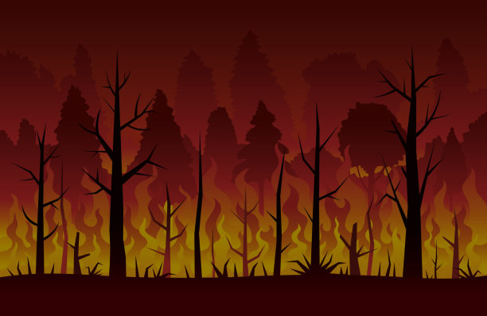
WILDFIRE DETECTION AND ALERT SYSTEM
Rajdeep Patel
Agrim Sharma
Shivam Patel
Rushabh Jain
Contributors
weR_infiKinights

Slide 2
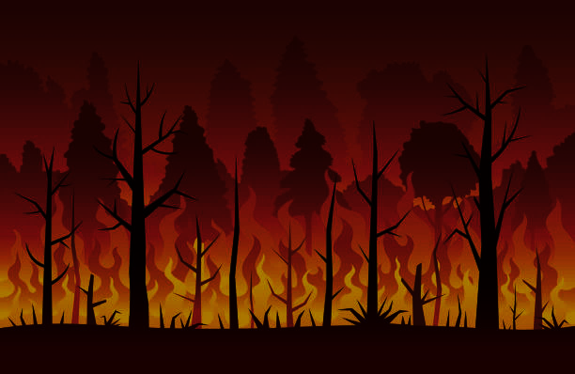
What is the Idea ?
We are building a webpage which is the combination of both the themes, including the space technology, as the satellite imaging, and wildfire detection, that is protecting the agricultural fields.
The objective of the project is to develop a wildfire detection model that can analyse satellite images and detect the areas prone to wildfire. We aim to detect and predict wildfire at certain places.
The image will be analysed thoroughly, which will work by detecting pixels for fire color.
After studying the image, the system will output weather the image processed has a threat for a major fire alert or is already a major fire.
This will eventually help the people to evacuate on time and proper measurements can be taken.

Slide 3
Frontend Display
On the screen we will be displaying the basic and understanding structure of wildfire detection page.
There will be an image upload option on the screen on which the user can upload the image which will eventually go through the analyser and hence will eventually give out the result as per the fire detection.
There are 3 types of display –
If the fire probability is more than 10% then it is a huge fire,
If it is in the range 5-10% then it is low fire,
And if it below 5% then no fire would be detected.

Slide 4
Now what will be there in the Backend?
Our main job that the program will perform is the process of image recognition.
Below is the process which it will process in order of –
Deploying the model using flask.
We can upload images to the deployment and it will predict if wildfire occurs or not and provides a prediction percentage.

Slide 5
Thank
You!

