Slide 1

Navigating the Digital Workspace

Slide 2



Navigating the Digital Workspace
This video will show how a mechanic uses digital job cards, service records, and scan reports safely in a workshop.

Slide 3
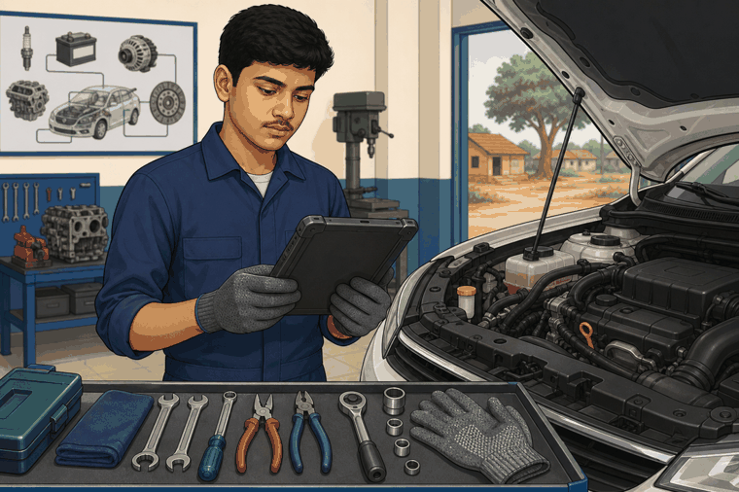
Navigating the Digital Workspace

Slide 4
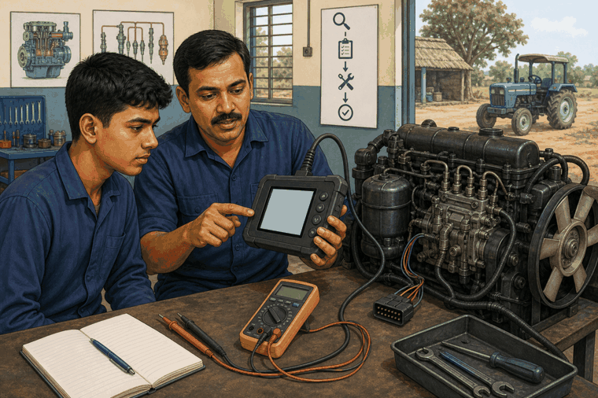
What You Will See
Navigating the Digital Workspace
1
Digital job cards help you know the customer concern, vehicle details, and work to be done.
2
Service history and part records help you avoid repeat mistakes and choose the correct next step.
3
Diagnostic reports are clues. A good mechanic verifies them before repairing or replacing parts.

Slide 5


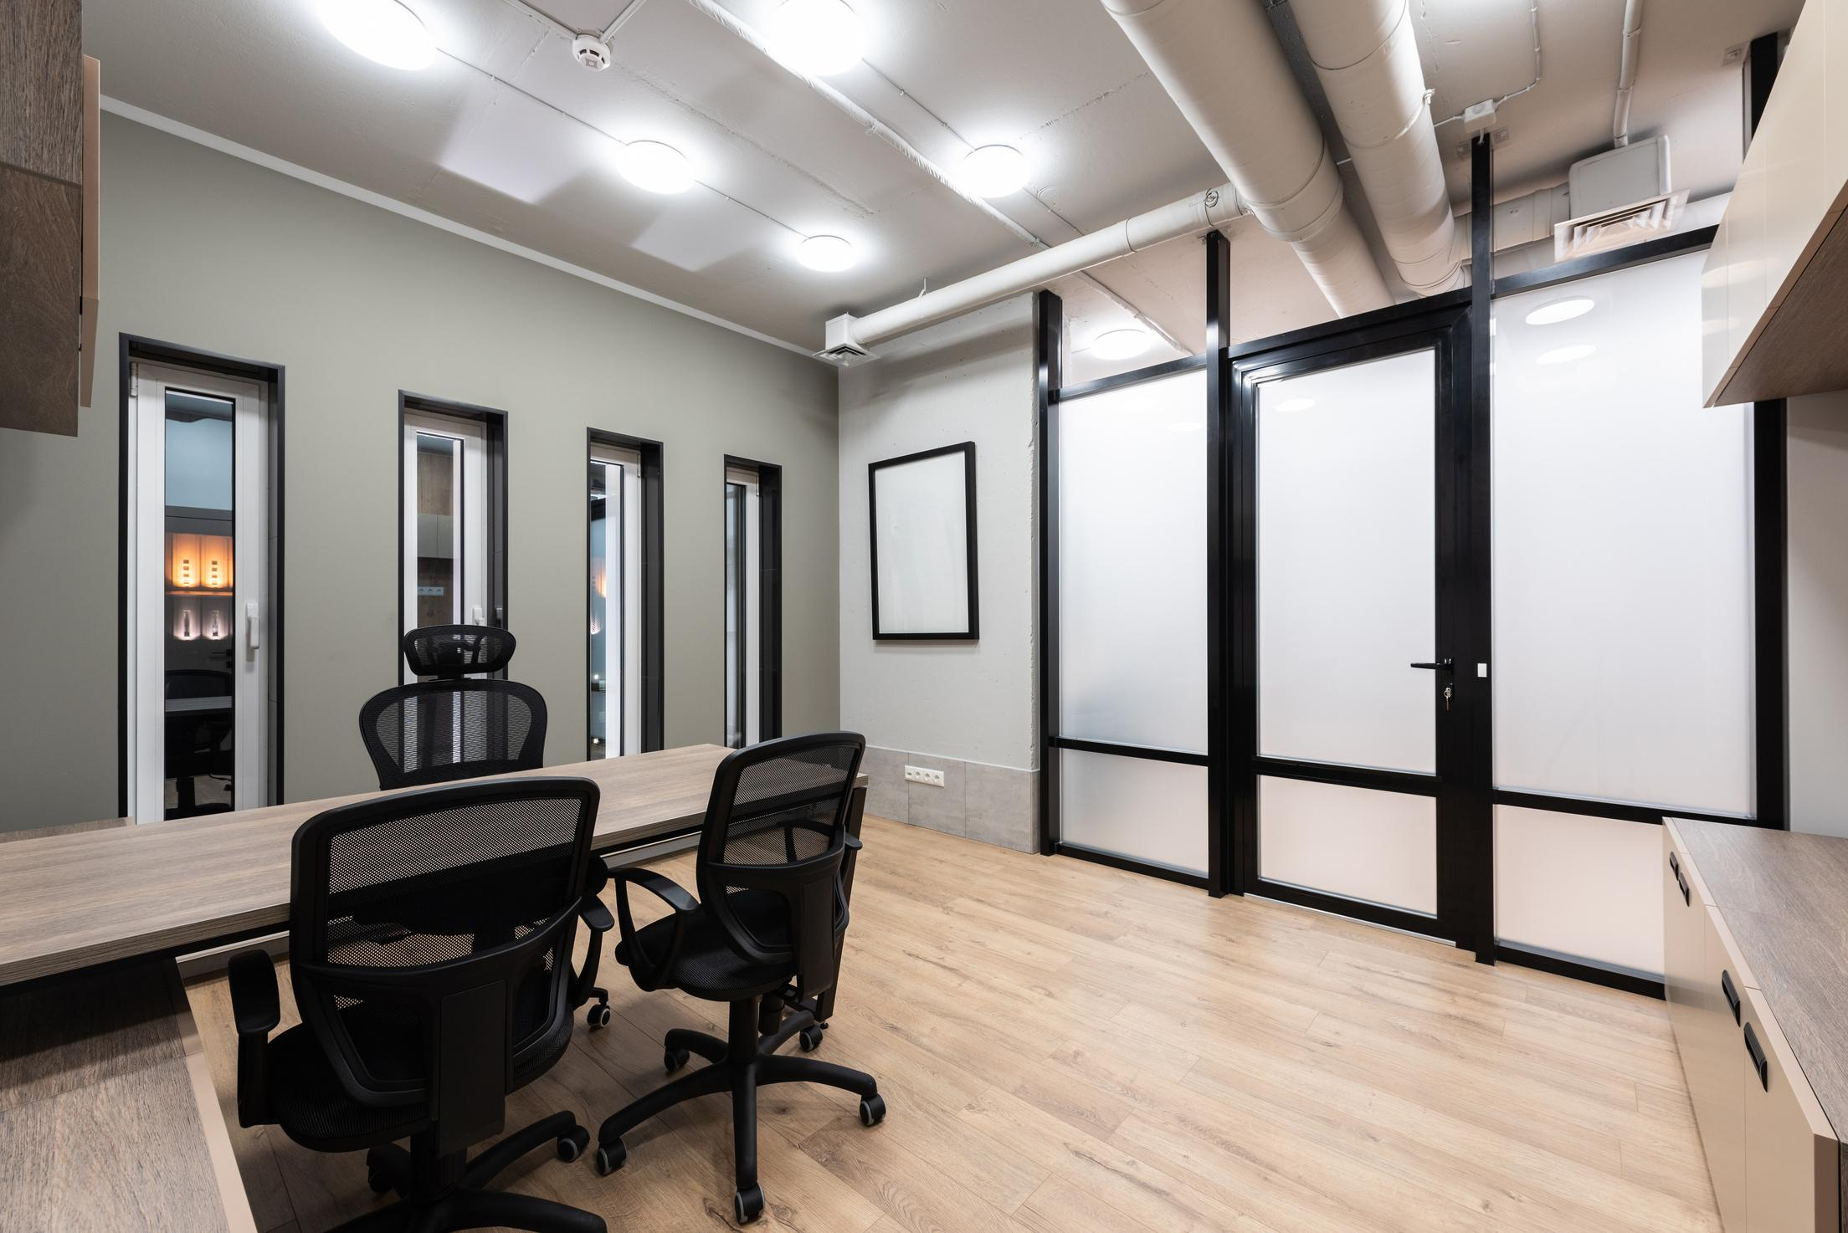
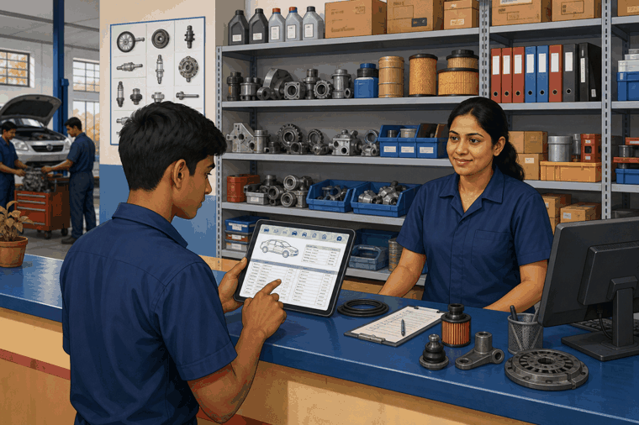
Navigating the Digital Workspace
Use folders and file names so photos, reports, and notes are easy to find later.
Write clear job notes: what you checked, what you found, and what action was taken.
Protect customer information. Share only with the right person in the workshop.

