Slide 1

B2T1 - Navigating the Digital Workspace
Summary

Slide 2

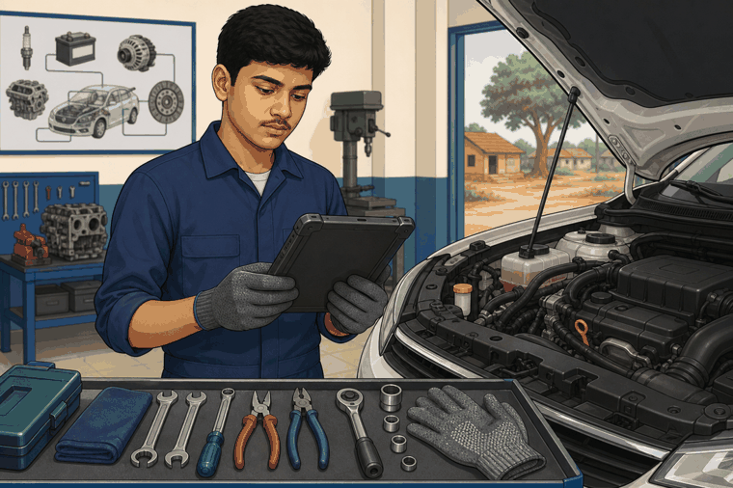
Let’s Recap
You have now reached the end of this topic.
Here is what you learned:
• A digital workspace is a place where workshop information is created, saved, found, and shared.
• A mechanic may use job cards, service history, scan reports, part details, photos, and checklists.
• Good file names and folders help you find information quickly during service work.
• Always verify digital information with the instructor, service manual, machine reading, or workshop supervisor.
Notes:
Here are the key points that you have learned in this topic.

Slide 3
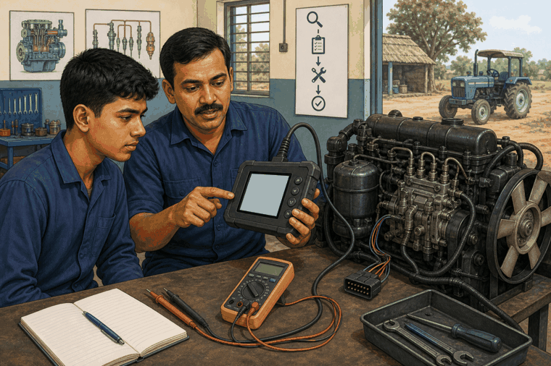
Let’s Recap
Some more key points:
• A diagnostic scan report gives clues. It is not a final answer by itself.
• Clear job notes help the next person understand what was checked and what was done.
• Do not share customer or workshop information carelessly.
My Update Habit:
1. One new digital term/tool/output I noticed today: ________
2. One thing I will always verify before acting: ________
3. One reliable place I can check when unsure: ________

