Slide 1

GOPOMELO PPT STYLE
A presentation system that feels unmistakably GoPomelo
Clean, precise and practical — with brand color used as a signature, not a field.
GoPomelo
01

Slide 2
STORY ARCHITECTURE
01
Start with the outcome
One visual language, built for different stories
Give the audience a reason to care before adding detail.
02
Make the evidence visual
Use scale, contrast and imagery to expose the important signal.
The system stays recognizable while the layout changes with the job of each slide.
03
Show how delivery works
Turn complex operating models into a sequence people can follow.
04
Close with a decision
End on one clear action, not a crowded summary.
GoPomelo
02

Slide 3
DESIGN PRINCIPLE
The brand should feel credible before it feels colorful.
White and near-black carry the deck; pink and orange supply controlled energy.
GoPomelo
03

Slide 4
VISUAL CHARACTER
Three qualities hold the system together
01
02
03
B2B confidence
Practical clarity
Visual momentum
White and near-black create credibility; selective pink and orange accents keep the brand recognizable.
Large headings, short copy and generous space make the message easy to scan.
Contrast, soft gradients and changing silhouettes keep the story moving.
GoPomelo
04

Slide 5
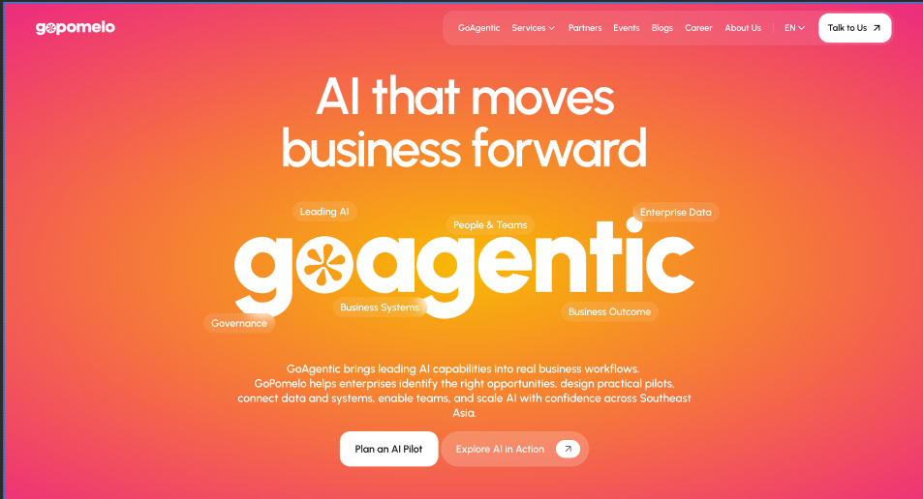
SOURCE LANGUAGE
Landing-page energy, disciplined for a 16:9 canvas
Oversized typography and translucent labels remain. The landing-page gradient is reserved for moments of transition, not repeated across the deck.
Landing-page warmth, selectively translated
GoPomelo
05

Slide 6
SYSTEM IN MOTION
02
From visual language to repeatable delivery
The style becomes useful when it can turn source material into a coherent deck again and again.
GoPomelo
06

Slide 7
CREATION WORKFLOW
A simple path from source material to a finished deck
01
02
03
04
Discover
Structure
Design
Validate
Extract the audience, outcome, evidence and constraints.
Build a narrative arc before deciding which layout to use.
Apply the three page states and the right visual silhouette.
Check content, rhythm, overflow and output parity.
GoPomelo
07

Slide 8
DESIGN TEST
Variety comes from layout, not extra themes
10
3
tested pages in the first sampler
8
distinct layout silhouettes in use
Three page states create a consistent rhythm across every GoPomelo deck.
2
matched outputs: HTML and editable PPTX
GoPomelo
08

Slide 9

STRESS TEST
A visual system should survive real content
CHALLENGE
Stay recognizable
Keep GoPomelo visible without turning every page into a homepage.
APPROACH
Use selective signals
Pink and orange accents, large type and translucent cards do the branding work.
OUTCOME
Carry different stories
A system ready for proposals, keynotes and business reviews.
GoPomelo
09

Slide 10
NEXT STEP
Build the next story in GoPomelo style
Use clean light and dark fields across proposals, keynotes and business reviews — with color reserved for emphasis.
Start with a layout
GoPomelo
10

