Slide 1




Linux File Permissions Task

Slide 2
🔐 Understanding File Permissions
The permission string `rwxrwxr-x` means:
• Owner: rwx → read, write, execute (7)
• Group: rwx → read, write, execute (7)
• Others: r-x → read, execute (5)
This equals octal 775.

Slide 3

🔄 Flowchart Steps
1. Start
2. Choose permission
3. Convert to octal (e.g., 775)
4. Use chmod command
5. Permissions applied
6. End

Slide 4
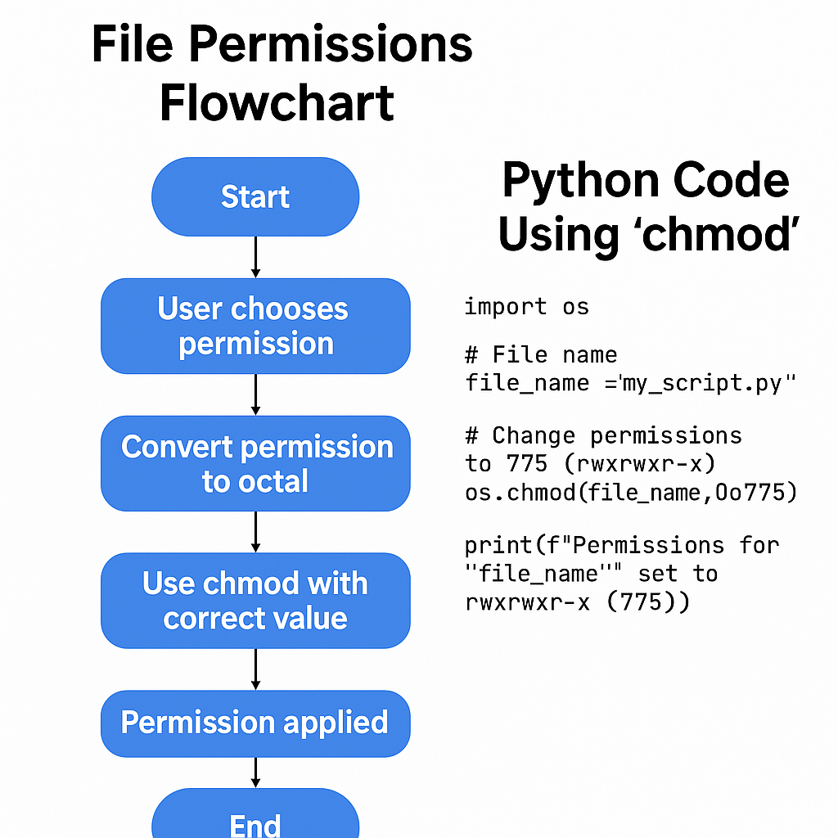
📊 Flowchart

Slide 5
🐍 Python Code to Set Permissions
import os
file_name = "my_script.py" # Change as needed
os.chmod(file_name, 0o775)
print(f"Permissions for '{file_name}' set to rwxrwxr-x (775)")

