Slide 1
Chapter 1: Introduction to Business Analytics
Business Analytics: Methods, Models,
and Decisions, 1st edition
James R. Evans

Slide 2
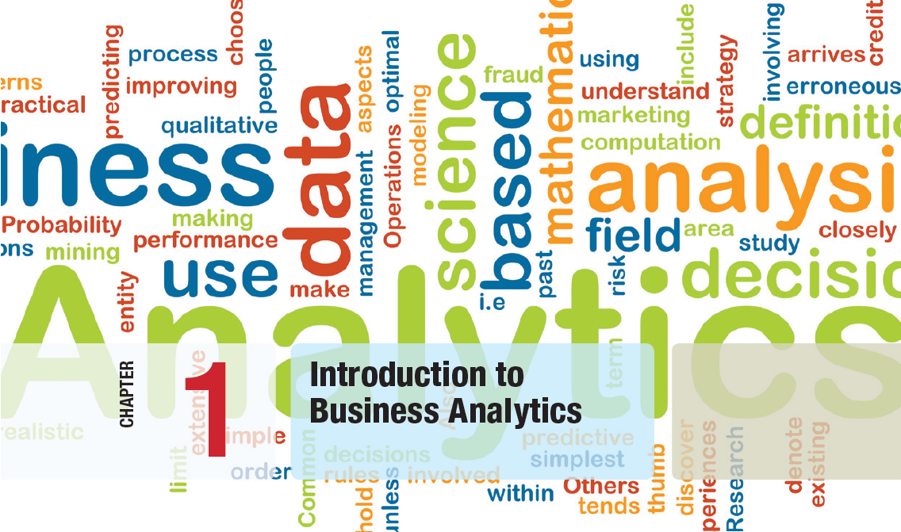

Slide 3
Chapter 1 Topics
What is Business Analytics?
Evolution of Business Analytics
Scope of Business Analytics
Data for Business Analytics
Decision Models
Problem Solving and Decision Making
Fun with Analytics

Slide 4
What is Business Analytics?
Analytics is the use of:
data,
information technology,
statistical analysis,
quantitative methods, and
mathematical or computer-based models
to help managers gain improved insight about their business operations and
make better, fact-based decisions.

Slide 5
What is Business Analytics?
Business Analytics Applications
Management of customer relationships
Financial and marketing activities
Supply chain management
Human resource planning
Pricing decisions
Sport team game strategies

Slide 6
What is Business Analytics?
Importance of Business Analytics
There is a strong relationship of BA with:
- profitability of businesses
- revenue of businesses
- shareholder return
BA enhances understanding of data
BA is vital for businesses to remain competitive
BA enables creation of informative reports

Slide 7
Evolution of Business Analytics
Operations research-It is defined as the scientific process of transforming data into insights to making better decisions. Analytics is the application of scientific & mathematical methods to the study & analysis of problems involving complex systems.
Management science- to identify meaningful patterns in business data, understand cause and effect, and help organizations reduce risk, make better decisions, and secure a competitive advantage.

Slide 8
Evolution of Business Analytics
Operations research-It is defined as the scientific process of transforming data into insights to making better decisions. Analytics is the application of scientific & mathematical methods to the study & analysis of problems involving complex systems.
Business intelligence- is the process of collecting, storing and analyzing data from business operations. BI provides comprehensive business metrics, in near-real time, to support better decision making.

Slide 9
Evolution of Business Analytics
Decision support systems- is a computerized program used to support determinations, judgments, and courses of action in an organization or a business. A DSS sifts through and analyzes massive amounts of data, compiling comprehensive information that can be used to solve problems and in decision-making.
Personal computer software

Slide 10
Scope of Business Analytics
Descriptive analytics
- uses data to understand past and present
Predictive analytics
- analyzes past performance
Prescriptive analytics
- uses optimization techniques

Slide 11
Scope of Business Analytics
Example 1.1 Retail Markdown Decisions
Most department stores clear seasonal inventory by reducing prices.
The question is:
When to reduce the price and by how much?
Descriptive analytics: examine historical data for similar products (prices, units sold, advertising, …)
Predictive analytics: predict sales based on price
Prescriptive analytics: find the best sets of pricing and advertising to maximize sales revenue

Slide 12
Scope of Business Analytics
Analytics in Practice:
Harrah’s Entertainment
Harrah’s owns numerous hotels and casinos
Uses analytics to:
- forecast demand for rooms
- segment customers by gaming activities
Uses prescriptive models to:
- set room rates
- allocate rooms
- offer perks and rewards to customers

Slide 13
Data for Business Analytics
DATA
- collected facts and figures
DATABASE
- collection of computer files containing data
INFORMATION
- comes from analyzing data

Slide 14
Data for Business Analytics
Examples of using DATA in business:
Annual reports
Accounting audits
Financial profitability analysis
Economic trends
Marketing research
Operations management performance
Human resource measurements

Slide 15
Data for Business Analytics
Metrics are used to quantify performance.
Measures are numerical values of metrics.
Discrete metrics involve counting
- on time or not on time
- number or proportion of on time deliveries
Continuous metrics are measured on a continuum
- delivery time
- package weight
- purchase price

Slide 16
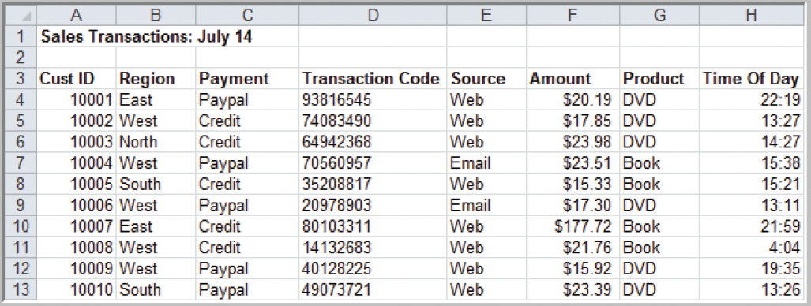
Data for Business Analytics
Example 1.2 A Sales Transaction Database File
Records
Figure 1.1
Entities
Fields or Attributes

Slide 17
Data for Business Analytics
Four Types Data Based on Measurement Scale:
Categorical (nominal) data
Ordinal data
Interval data
Ratio data

Slide 18
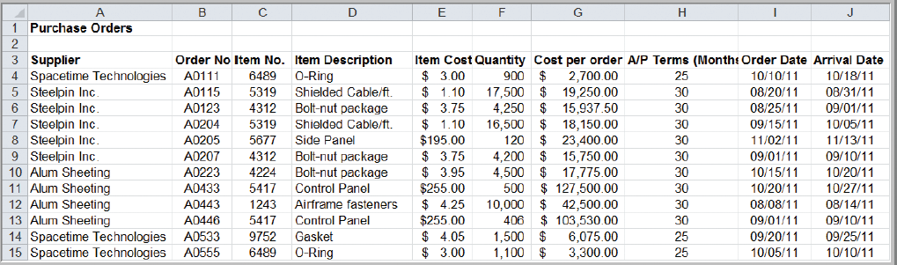
Data for Business Analytics
Example 1.3
Classifying Data Elements in a Purchasing Database
Figure 1.2

Slide 19
Data for Business Analytics
Example 1.3 (continued)
Classifying Data Elements in a Purchasing Database
Figure 1.2
Ratio
Ratio
Ratio
Ratio
Categorical
Categorical
Categorical
Interval
Interval
Categorical

Slide 20
Data for Business Analytics
Categorical (nominal) Data
Data placed in categories according to a specified characteristic
Categories bear no quantitative relationship to one another
Examples:
- customer’s location (America, Europe, Asia)
- employee classification (manager, supervisor,
associate)

Slide 21
Data for Business Analytics
Ordinal Data
Data that is ranked or ordered according to some relationship with one another
No fixed units of measurement
Examples:
- college football rankings
- survey responses
(poor, average, good, very good, excellent)

Slide 22
Data for Business Analytics
Interval Data
Ordinal data but with constant differences between observations
No true zero point
Ratios are not meaningful
Examples:
- temperature readings
- SAT scores(Scholastic Assessment Test)

Slide 23
Data for Business Analytics
Ratio Data
Continuous values and have a natural zero point
Ratios are meaningful
Examples:
- monthly sales
- delivery times

Slide 24
Decision Models
Model:
An abstraction or representation of a real system, idea, or object
Captures the most important features
Can be a written or verbal description, a visual display, a mathematical formula, or a spreadsheet representation

Slide 25
Decision Models
Example 1.4 Three Forms of a Model
The sales of a new produce, such as a first-
generation iPad or 3D television, often follow a
common pattern.
Sales might grow at an increasing rate over time
as positive customer feedback spreads.
(See the S-shaped curve on the following slide.)
A mathematical model of the S-curve can be
identified; for example, S = ae^{bect}, where S is
sales, t is time, e is the base of natural logarithms,
and a, b and c are constants.
Copyright © 2013 Pearson Education, Inc.
publishing as Prentice Hall
1-23

Slide 26
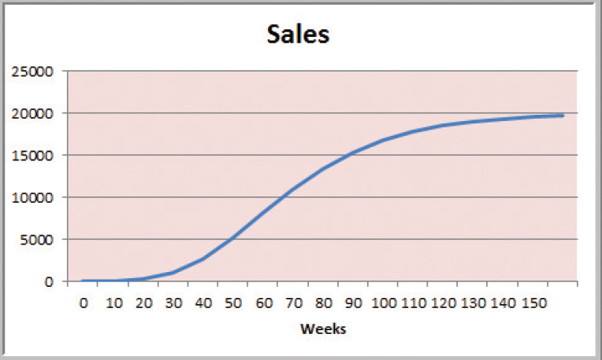
Decision Models
Figure 1.3

Slide 27
Decision Models
A decision model is a model used to understand, analyze, or facilitate decision making.
Types of model input
- data
- uncontrollable variables
- decision variables (controllable)
Types of model output
- performance measures
- behavioral measures

Slide 28
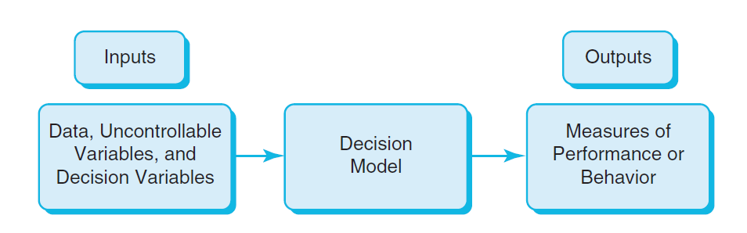
Decision Models
Nature of Decision Models
Figure 1.4

Slide 29
Decision Models
Example 1.5 A Sales-Promotion Model
In the grocery industry, managers typically need to know how best to use pricing, coupons and advertising strategies to influence sales.
Using Business Analytics, a grocer can develop a model that predicts sales using price, coupons and advertising.

Slide 30
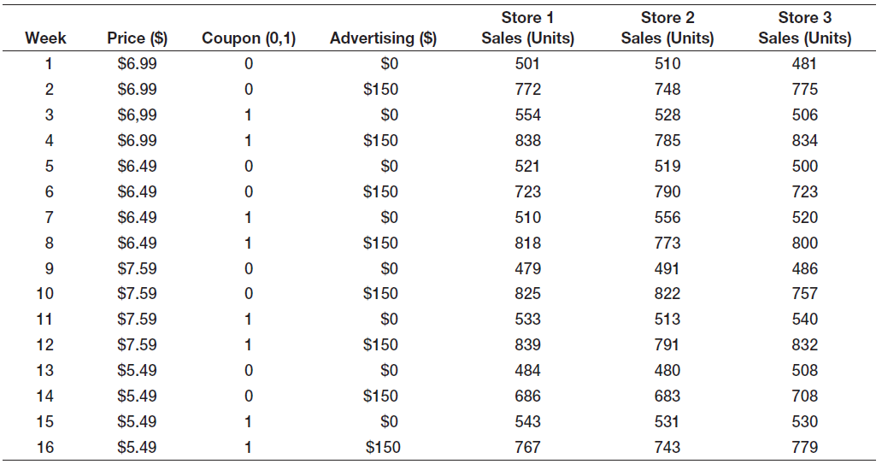
Decision Models
Sales = 500 – 0.05(price) + 30(coupons)
+0.08(advertising) + 0.25(price)(advertising)

Slide 31
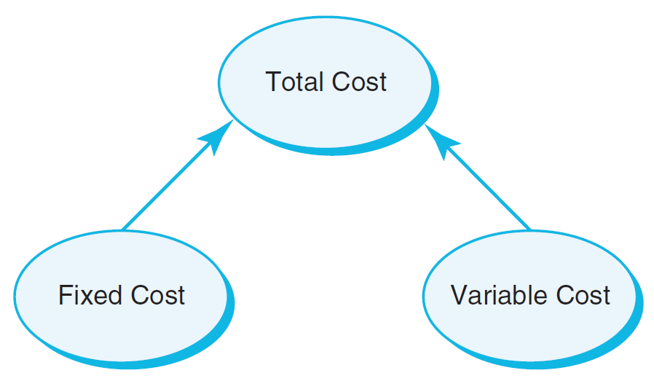
Decision Models
Descriptive Decision Models
Simply tell “what is” and describe relationships
Do not tell managers what to do
Example 1.6 An Influence Diagram for Total Cost
Influence Diagrams visually show how various model elements relate to one another.
Figure 1.5

Slide 32
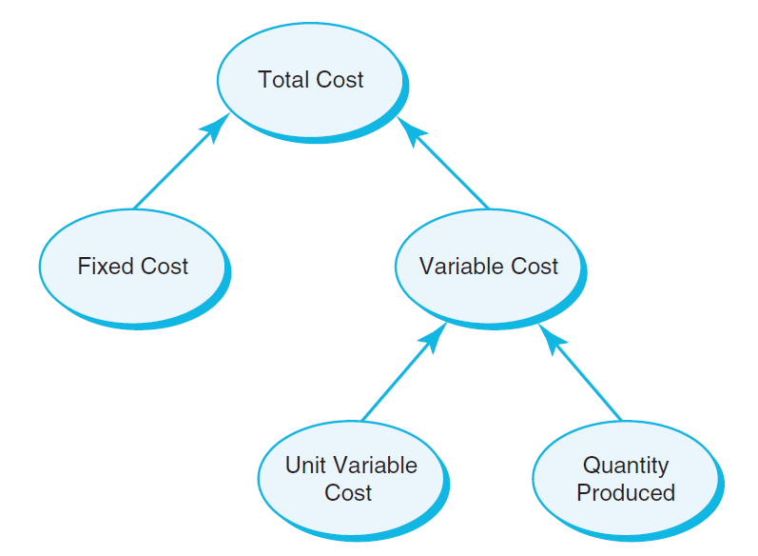
Decision Models
Example 1.7 A Mathematical Model for Total Cost
TC = F +VQ
TC is Total Cost
F is Fixed cost
V is Variable unit cost
Q is Quantity produced
Figure 1.6

Slide 33
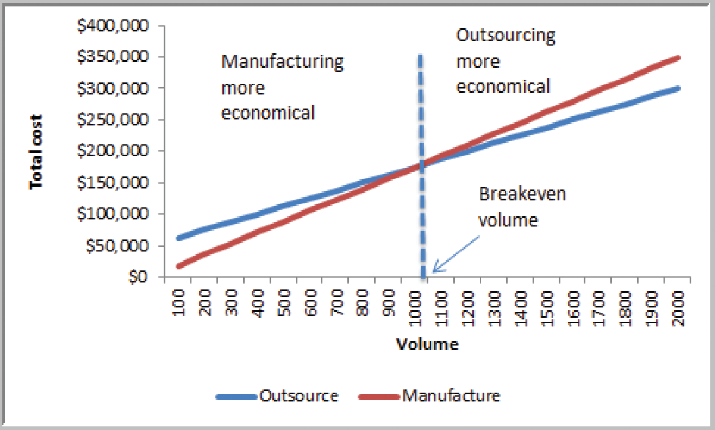
Decision Models
Example 1.8 A Break-even Decision Model
TC(manufacturing) = $50,000 + $125*Q
TC(outsourcing) = $175*Q
Breakeven Point:
Set TC(manufacturing)
= TC(outsourcing)
Solve for Q = 1000 units
Figure 1.7

Slide 34
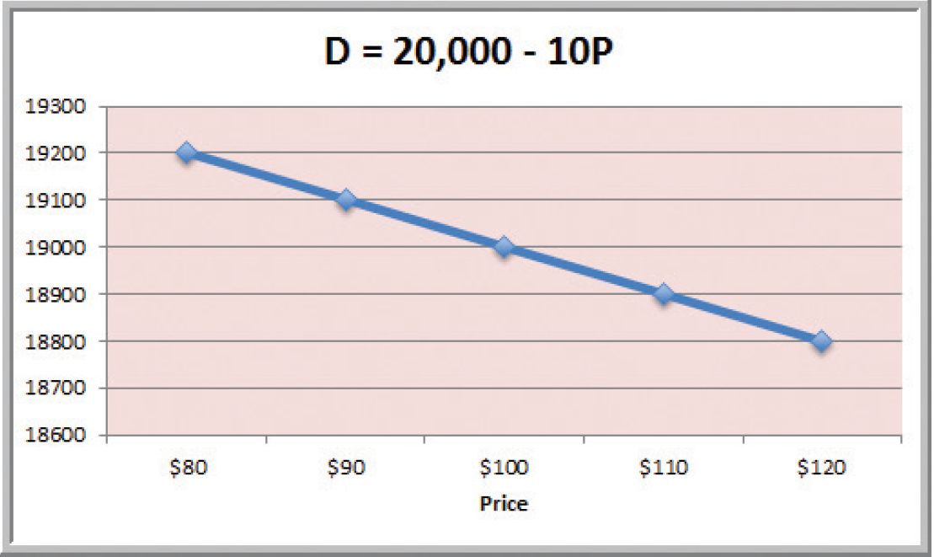
Decision Models
Example 1.9 A Linear Demand Prediction Model
As price increases, demand falls.
Figure 1.8

Slide 35
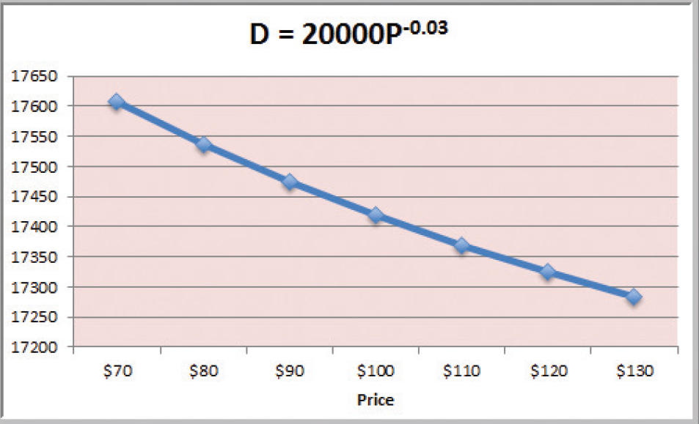
Decision Models
Example 1.10 A Nonlinear Demand Prediction Model
Assumes price elasticity (constant ratio of % change in demand to % change in price)
Figure 1.9

Slide 36
Decision Models
Predictive Decision Models often incorporate uncertainty to help managers analyze risk.
Aim to predict what will happen in the future.
Uncertainty is imperfect knowledge of what will happen in the future.
Risk is associated with the consequences of what actually happens.

Slide 37
Decision Models
Prescriptive Decision Models help decision makers identify the best solution.
Optimization - finding values of decision variables that minimize (or maximize) something such as cost (or profit).
Objective function - the equation that minimizes (or maximizes) the quantity of interest.
Constraints - limitations or restrictions.
Optimal solution - values of the decision variables at the minimum (or maximum) point.

Slide 38
Decision Models
Example 1.11 A Pricing Model
A firm wishes to determine the best pricing for one of its products in order to maximize revenue.
Analysts determined the following model:
Sales = -2.9485(price) + 3240.9
Total revenue = (price)(sales)
Identify the price that maximizes total revenue, subject to any constraints that might exist.

Slide 39
Decision Models
Deterministic prescriptive models have inputs that are known with certainty.
Stochastic prescriptive models have one or more inputs that are not known with certainty.
Algorithms are systematic procedures used to find optimal solutions to decision models.
Search algorithms are used for complex problems to find a good solution without guaranteeing an optimal solution.

Slide 40
Problem Solving and Decision Making
BA represents only a portion of the overall problem solving and decision making process.
Six steps in the problem solving process
1. Recognizing the problem
2. Defining the problem
3. Structuring the problem
4. Analyzing the problem
5. Interpreting results and making a decision
6. Implementing the solution

Slide 41
Problem Solving and Decision Making
1. Recognizing the Problem
Problems exist when there is a gap between what is happening and what we think should be happening.
For example, costs are too high compared with competitors.

Slide 42
Problem Solving and Decision Making
2. Defining the Problem
Clearly defining the problem is not a trivial task.
Complexity increases when the following occur:
- large number of courses of action
- several competing objectives
- external groups are affected
- problem owner and problem solver are not the
same person
- time constraints exist

Slide 43
Problem Solving and Decision Making
3. Structuring the Problem
Stating goals and objectives
Characterizing the possible decisions
Identifying any constraints or restrictions

Slide 44
Problem Solving and Decision Making
4. Analyzing the Problem
Identifying and applying appropriate Business Analytics techniques
Typically involves experimentation, statistical analysis, or a solution process
Much of this course is devoted to learning BA techniques for use in Step 4.

Slide 45
Problem Solving and Decision Making
5. Interpreting Results and Making a Decision
Managers interpret the results from the analysis phase.
Incorporate subjective judgment as needed.
Understand limitations and model assumptions.
Make a decision utilizing the above information.

Slide 46
Problem Solving and Decision Making
6. Implementing the Solution
Translate the results of the model back to the real world.
Make the solution work in the organization by providing adequate training and resources.

Slide 47

Problem Solving and Decision Making
Analytics in Practice
Developing Effective Analytical Tools
at Hewlett-Packard
Will analytics solve the problem?
Can they leverage an existing solution?
Is a decision model really needed?
Guidelines for successful implementation:
Use prototyping.
Build insight, not black boxes.
Remove unneeded complexity.
Partner with end users in discovery and design.
Develop an analytic champion.

Slide 48
Chapter 1 - Key Terms
Algorithm
Business analytics
Business intelligence
Categorical (nominal) data
Constraint
Continuous metric
Data set
Database
Decision model
Decision support systems
Descriptive statistics
Deterministic model
Discrete metric
Entities
Fields (attributes)
Influence diagram
Interval data
Management science (MS)

Slide 49
Chapter 1 - Key Terms (continued)
Measure
Measurement
Metric
Model
Objective function
Operations research (OR)
Optimal solution
Optimization
Ordinal data
Predictive analytics
Prescriptive analytics
Problem solving
Ratio data
Risk
Search Algorithm
Stochastic model
Uncertainty

Slide 50
Fun with Analytics
www.puzzlOR.com
Maintained by an analytics manager at ARAMARK.
Each month a new puzzle is posted.
Many puzzles can be solved using techniques you will learn in this course.
The puzzles are fun challenges.
A good one to start with is SurvivOR (June 2010).
Have fun!

Slide 51
Case Study Performance Lawn Equipment (PLE)
PLE is headquartered in St. Louis and produces lawnmowers as well as a recently added a medium size diesel power lawn tractor.
The Excel workbook Performance Lawn Equipment contains performance data that is used by managers to evaluate business performance.
As chief analyst to the productions and operations manager, you need to review all of the Excel worksheets and prepare a report summarizing the sources of the data, the types of data measures used, and the characteristics of the metrics used.

