Slide 1
Scaled Online clustering welcome to distclusv2

Slide 2
Scaled online clustering
Can online clustering be processed on all infrastructure ?
  Yes if :
    Respect of hardware capabilities
      Safe memory, time processing, etc.
    Fine-grain control on clustering life-cycle
      State machine
      Business data concerns (data update frequency, ...)
    ..?

Slide 3
Do not read this slide if you are not a golang developer !!!
The past...
Today... is the past with dynamic concerns
And no OVERHEAD !
Implementation require
loop control + init process + iteration
Implementation requires only
Init process + Iteration
No generic configuration or mechanism
Generic configuration and control loop
State machine
Less code to maintain

Slide 4
The past...
Algo()
run(true)
run(false)
Close
1. Spaghetti code
2. Duplicated code
3. Gap between theory and executive
4. Use all available CPU

Slide 5
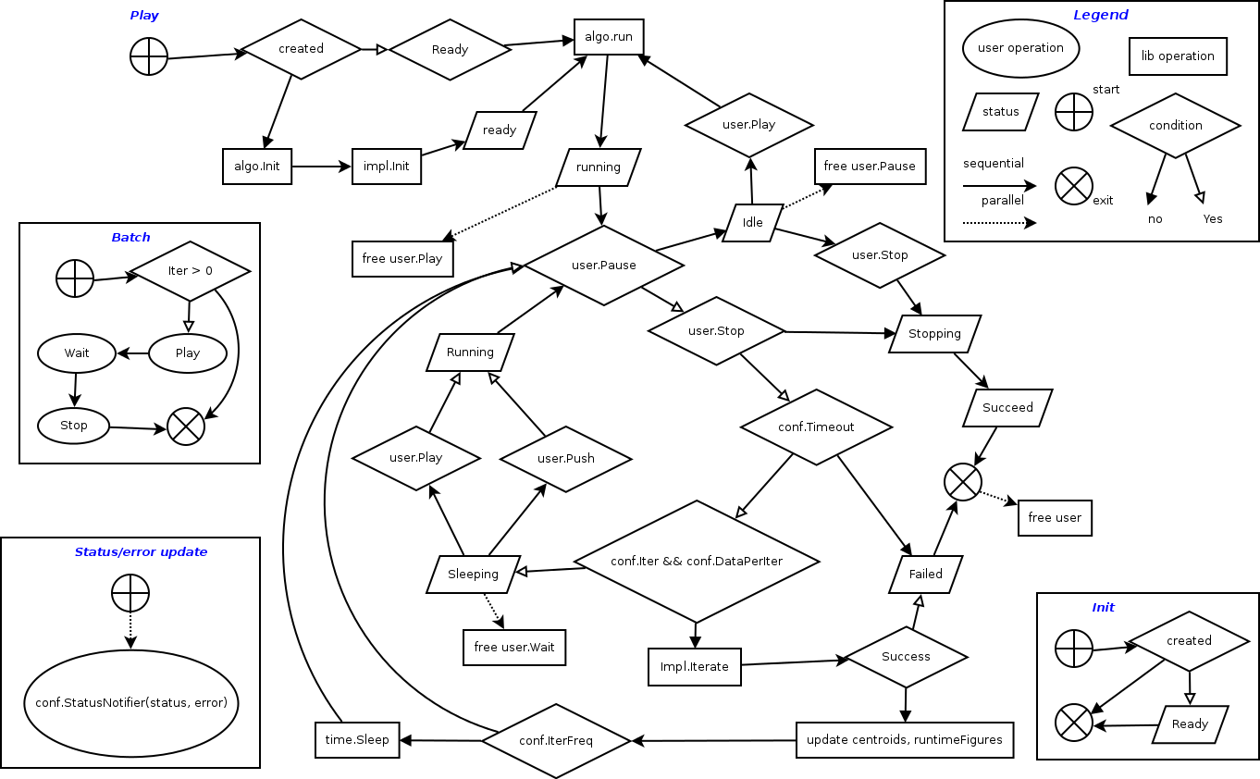
Today... is the past with dynamic concerns
The past...
And no OVERHEAD !
Algo()
run(true)
run(false)
Close
1. Spaghetti code
2. Duplicated code
3. Gap between theory and executive
4. Use all available CPU
Batch is not a special case, it juste a degraded mode
of online clustering with sequence of methods:
- play // play the algorithm
- wait // wait for convergence
- stop // stop the algorithm
Right now, you do online clustering or you do downgraded online clustering (batch)

Slide 6
State machine : created, ready, running, idle, sleeping, stopping, succeed, failed
Control : run/play, pause, wait, close/stop, callback

Slide 7
Changes Improvements in distclus4py (and derivatives)
Today... is the past with dynamic concerns
The past...
Backward-compatible and less user code !
algo = Algo(iter=0)
algo.run(false)
algo.centroids()
Init
algo = Algo()
centroids = algo.init()
algo = Algo()
algo.run(false)
algo.centroids
Algo = Algo()
centroids = algo.batch()
Batch
algo = Algo(IterFreq, dataperiter, callback, ...)
# call stop when leaving “with” enclosure,
# even if an error occures
with algo(): // same as algo.play() or algo.run()
centroids = algo.wait() // wait convergence or end
centroids = algo.Pause() // pause execution
algo.Play() // go back to execution after pause
algo.centroids, algo.status, algo.iterations, ...
try:
algo = Algo()
algo.run()
algo.push(...)
Time.sleep(5)
algo.close()
algo.centroids
except:
pass
Online

Slide 8
Changes Improvements in distclus4py (and derivatives)
Today... is the past with dynamic concerns
The past...
Backward-compatible and less user code !
algo = Algo(iter=0)
algo.run(false)
algo.centroids()
algo = Algo()
Centroids = algo.init()
UT in progress this week
in branch “realtime”
Init
algo = Algo()
algo.run(false)
algo.centroids()
Algo = Algo()
Centroids, _ = algo.batch()
Batch
def callback(status, err): # react when status/err
if err:
notifyError(err)
# play and stop when leaving the “with” enclosure
with Algo(IterFreq, dataperiter, callback):
# do push/centroids/wait/pause/…
algo.wait() // wait convergence or end
algo.Pause() // pause execution
algo = Algo()
algo.run(true)
algo.push(...)
Time.sleep(5)
algo.close()
algo.centroids()
Online

Slide 9
Cluserve and evclus ?
Final user environment ecological concerns
from large-scale application to embedded platform
(Do we need a mace to solve all problems ?)
Improve
- lakelady availability (yeah, SLA rules baby !)
- final user control and pricing providing
the less they pay, the more they will enjoy…

Slide 10
Cluserve and evclus ?
Integration in progress this week,
in branches “realtime”
Final user environment ecological concerns
from large-scale application to embedded platform
(Do we need a mace to solve all problems ?)
Improve
- lakelady availability (yeah, SLA rules baby !)
- final user control and pricing providing
the less they pay, the more they will enjoy…

Slide 11
Perspectives and questions ?
1 - finalizing integration this week
2 - change algo configuration at runtime (framesize, ...) ?
3 - workshop/conference paper
4 - distributed computing
5 - time to address Internet of Things (sample in red-node) ?
6 - ..?

