Slide 1
OUR PROCESS
First impressions matter - and that’s why it’s important your website clearly communicates relevant information in a clean, attractive and easy to navigate format. Our team of dedicated web developers are here to support you in this process.
Whether you’re looking for a simple landing page, a robust WordPress site built on beautiful templates customized to your brand, or a completely custom site with complex application features, we can make your presence on the web shine!
BENEFITS INCLUDE
A professional, in-house development team experienced in front-end and back-end skills and responsive web design
A focus on SEO to ensure your website is optimally built for search engine rankings
Templated and fully-customizable solutions available based on your needs
Hosting (including maintenance and software/security updates) available
Access to make your own updates through WordPress
HOW THE PROCESS WORKS
First, we’ll want to know what you’re looking for in a new site, and will ask for examples of websites you really like. Next we’ll hold a conference call with our web team to talk through the project and get a feel for how the site should be designed. You’ll provide photos and content and we’ll get to work!

Slide 2
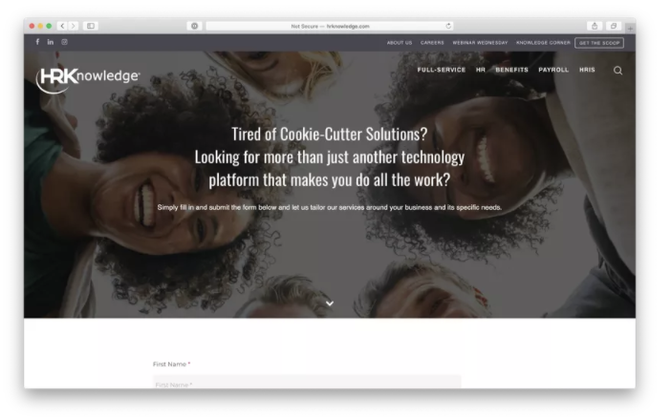
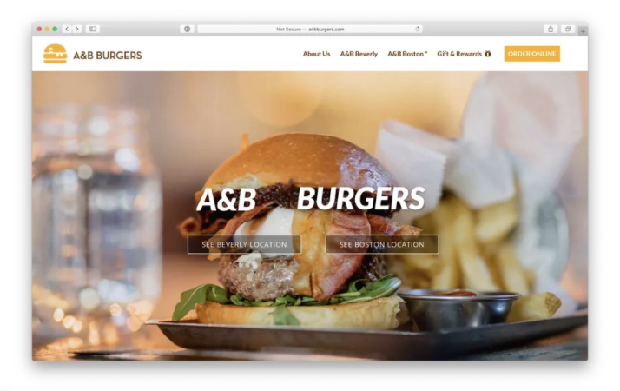
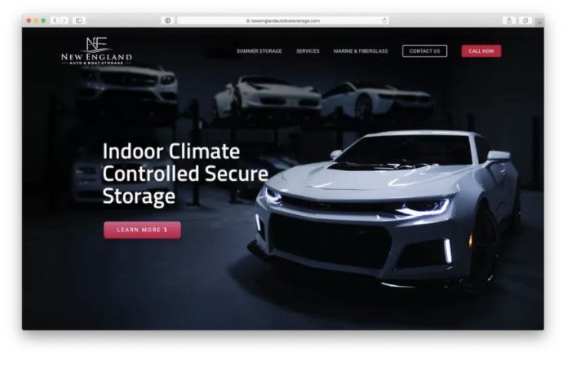
OUR WORK
Our team has years of experience building beautiful, responsive websites that range from simple informational/promotional sites to complex e-commerce or web application platforms. See a sample of our work below:

Slide 3
SCOPE OF WORK - WEBSITE
Website Address - TBD
Project Overview
This is a new build of a website based on current flagship site.​
WEBSITE - One-time Investment | GB Price | Price
Website Build – Up to 12 pages | $999 | $1999
SSL Certificate | $199 | $199
Total |  | $2198
WEBSITE – Recurring Costs | Price
Website Hosting | $69 per/mo
Not included in this proposal*:
The following items are not included in this proposal, but can be quoted and added at a later date
1. Shopping or eCommerce
2. Logo or Brand Design
3. Development of any functionality beyond the aforementioned specifications. ( Example – Shopping Cart) 4. Video Production
5. Stock or Professional Photography - Client will provide photos and imagery
6. Integration from their party software
7. online booking system is stand alone and does not integrate with outside applications

Slide 4
SCOPE OF WORK – WEBSITE – Add Ons
Website Address - TBD
Project Overview
Client requests assets such as professional photography, stock photography, and banners. These will be priced out based on needs.
Add-On’s | GB Price | Price
Banners, stock photography | TBD | TBD

