Slide 1





CUMULUS DIGITAL
Working with Radio for Better Results

Slide 2
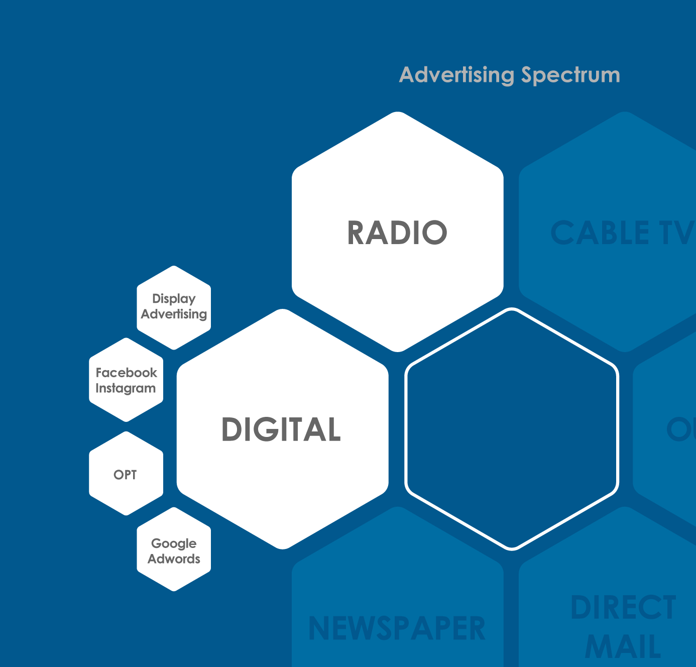
Our Process:
Finding and Targeting Your Audience
The goal of digital marketing is to reach people, and there are a lot of companies offering digital marketing.
Our philosophy is that the money is wasted if you’re not getting it to the right people.
We specialize in Radio and Digital Marketing but that’s not what sets us apart.
We have the tools and experience to get your campaign in front of the right people.
YOUR CAMPAIGN
Notes:
Who we are and what we excel at. The goal of this first block of slides is to inform our audience of exactly why they should be listening to us. And to make sure we understand their needs.

Slide 3




Three teams working for you
Local Marketer
The boots on the ground making sure you have someone to call when you have a need.
Digital Strategist
A specialized Digital Marketing Consultant that works in US markets focused on your industry. Every campaign is unique and so is our approach.
Support + Fulfillment
A team that’s there for you to make sure changes you need are completed and you’re achieving the results you want in a competitive market.

Slide 4



Your Website
Our Benefits:
An in-house development team experienced in front-end and back-end skills and responsive web design
A focus on SEO to ensure your website is optimally built for search engine rankings
Templated and fully-customizable solutions available based on your needs
Hosting (including maintenance and software/security updates) available
Access to make your own updates through WordPress

Slide 5
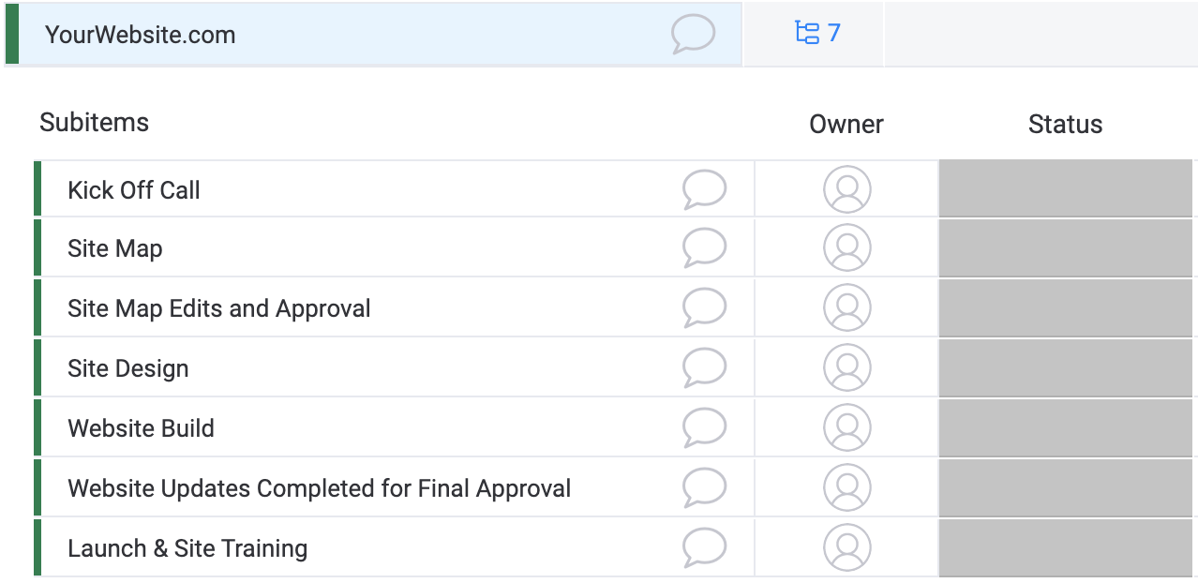
Your Website
How it works:
Gathering Information: we’ll want to know what you’re looking for in a new site, and will ask for examples of websites you really like.
Kick off call: we’ll hold a conference call with our web team to talk through the project and get a feel for how the site should be designed.
Structural Sign off: We will provide a site map to be approved.
Design Sign off and Build: We deliver your website design to be approved, then we build and deliver!

Slide 6
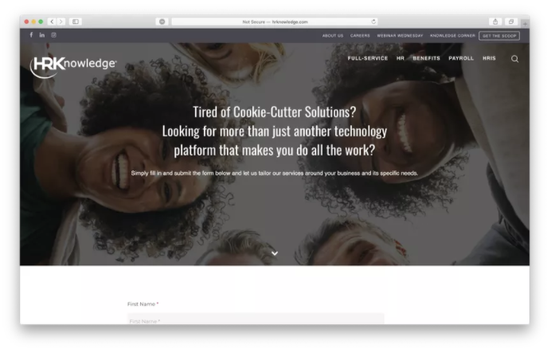
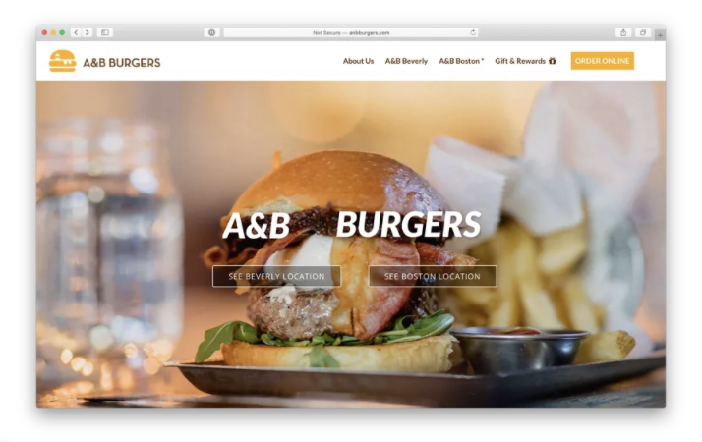
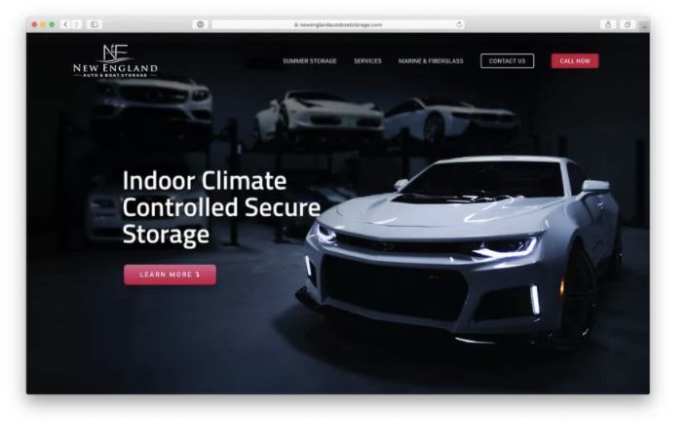
Your Website
Some of Our Work:
Our team has years of experience building beautiful, responsive websites that range
from simple informational/promotional sites to complex e-commerce or web application platforms. See a sample of our work below:

Slide 7
Website Proposal
WEBSITE - One-time Investment | Price
Website Build – Up to 12 pages | $1999
SSL Certificate (If need but recommended) | $199
Total | $6848
WEBSITE – Recurring Costs | Price
Website Hosting | $69 per/mo
WEBSITE – Misc | Price
Copywriting | $150 per/page
Not included in this proposal*: 1. Shopping or eCommerce 2. Logo or Brand Design 3. Development of any functionality beyond the aforementioned specifications. ( Example – Shopping Cart) 4. Video Production | 4. Stock or Professional Photography - Client will provide photos and imagery 5. Integration from their party software 6. Content and Copywriting are separate costs
Client Name____________________________ Campaign Dates________________________
Monthly Investment Client Signature_________________________________ Date________________

Slide 8

NEXT STEPS
Name: <YOUR NAME HERE>
Phone: <YOUR PHONE HERE>
Email: <YOUR EMAIL HERE>

