Slide 1

PRESENTS

Slide 2



Slide 3





Efficiency
Atmosphere
Simplicity
Smart-office

Slide 4
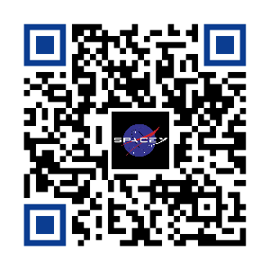
JOIN US TODAY
TO MARS AND BEYOND

