Slide 1
GMAT-Monte Model Sharing
18 September 2020
Darrel J. Conway, Thinking Systems, Inc.
John McGreevy, Emergent Space Technologies, Inc.
Notes:
Good Morning. In this presentation John and I are going to showcase a new feature of the General Mission Analysis Tool, GMAT, that enables interactions with GMAT from Python, Java, and MATLAB.

Slide 2
Overview
GMAT
  Project Started in 2002
  Open Source Releases, Apache 2.0
    Initial Release, August 2007
    Roughly annual release on SourceForge
    Developed behind the GSFC Firewall
  Current Release, R2020a, July 2020
  Widely Used in Academia, Industry, Government (US and International)
  Controlled Components managed as unreleased plugins
Operational Use, GSFC FDF
  Mission Design
  Maneuver Planning
  Orbit Determination
Windows, Linux, Mac
Part of NESC Tools Interoperability Effort
GMAT API
  Beta Functionality in R2020a
    Beta → Release via testing
    Release includes Python, MATLAB, and Jupyter examples
  Access to
    GMAT Classes
    GMAT Scripting
Tools Interoperability Work
  OSIRIS-REx Based Use Cases
  Data Sharing with Monte
    Monte 140.1, GMAT R2020a
    Ephemeris Round trip Sharing, April 2020
    Maneuver Plan Sharing, In Development
  Model Sharing with Monte
    Matched Dynamics in GMAT and Monte
    Enabling Technology: GMAT Collocation and Monte Orbit Determination

Slide 3
Use Case Progression
Data Sharing
Ephemeris Sharing (Complete)
  Monte writes ephem
  GMAT ingests, and plans a maneuver
  GMAT Writes ephem
  Monte ingests, and works with planned data
Maneuver Sharing (Underway)
  Monte writes ephem
  GMAT ingests, and plans a maneuver
  GMAT Passes Mnvr Data to Monte
  Monte ingests Mnvr and works with it
Model Sharing
Issue: GMAT and Monte Models may be inconsistent
Goal: Use Monte Dynamics during GMAT maneuver planning
Next Slide: NESC Plan Update
  Flight Mechanics Analysis Tools Interoperability and Component Sharing (TI-18-01313)
  October 17, 2019

Slide 4
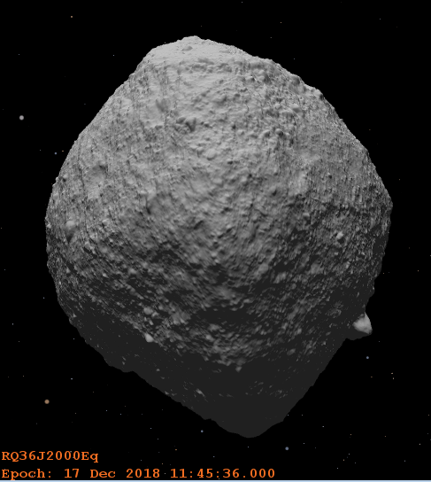
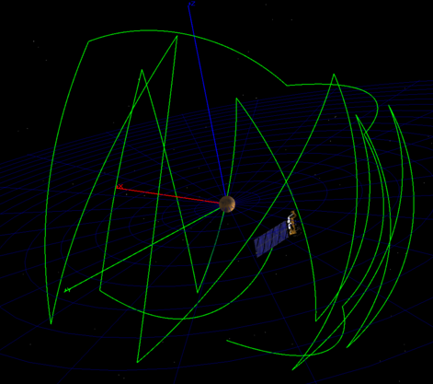
GMAT API Updated Subtask Details
Phase 1: Subtask 1.2 Data Interoperability
O-REx use case definition
MONTE setup and GSFC training
Ephemeris sharing
Maneuver plan sharing
Re-targeting
Phase 2: Subtask 1.3 Component Integration
C++ interface definition
Dynamics interface coding
GMAT Monte dynamics model integration
O-REx demonstration configuration
Demonstrate OD in Monte and Optimization
in GMAT using shared dynamics
Note that subtask 1.3 is a tighter integration than originally planned as it will use C++ rather than Python APIs.

Slide 5
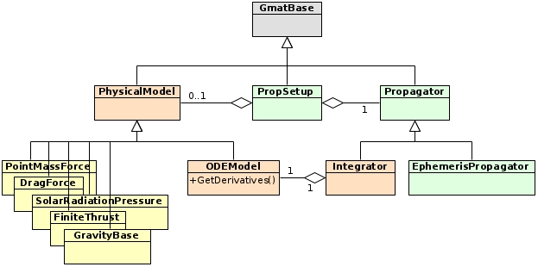
Model Sharing: GMAT Approach
GMAT Dynamics
  Part of Propagation Subsystem
  Consolidated in ODEModel class
  Derivatives Calculated in GetDerivatives()
Proposed Approach for Monte Dynamics

Slide 6
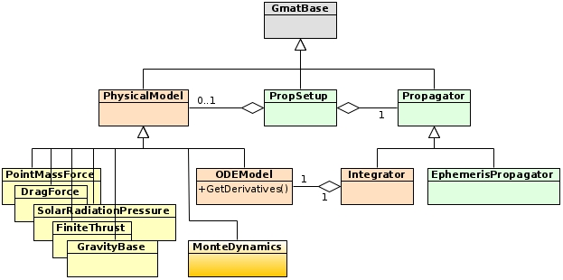
Model Sharing: Adding Monte Dynamics
GMAT Dynamics
  Part of Propagation Subsystem
  Consolidated in ODEModel class
  Derivatives Calculated in GetDerivatives()
Proposed Approach for Monte Dynamics
  Add a class that wraps Monte Dynamics
  Implement GetDerivatives() in Wrapper, compatible with GMAT
Requires
  Monte C++ headers
  Libraries compatible with the headers
  Help figuring it all out

Slide 7
Discussion
Compiler Compatibility
  GMAT uses
    GCC 8.3.1 on Red Hat
    Visual Studio 2017 on Windows
  Monte?
Access Help
  JM and DJC need help understanding how Monte Dynamics work
Other Items/Issues/Concerns?

