Slide 1
NESC Review Board
Assessment Plan Update
Flight Mechanics Analysis Tools Interoperability and Component Sharing TI-18-01313
Daniel G. Murri
October 17, 2019

Slide 2
Outline
Acronyms
Background
Scope
Key Stakeholders
Team List
Special Requirements
Technical Activities
Plan Update
Deliverables
Disengagement Criteria
Resources

Slide 3
Acronyms
SoS System of Systems
GMAT General Mission Analysis Tool
MONTE Mission-Analysis Operations Navigation Toolkit Environment
NESC NASA Engineering and Safety Center
ODTBX Orbit Determination Toolbox
POST Program to Optimize Simulated Trajectories
SEP Solar Electric Propulsion
API Application Programming Interface
O-REx OSIRIS-REx Mission

Slide 4
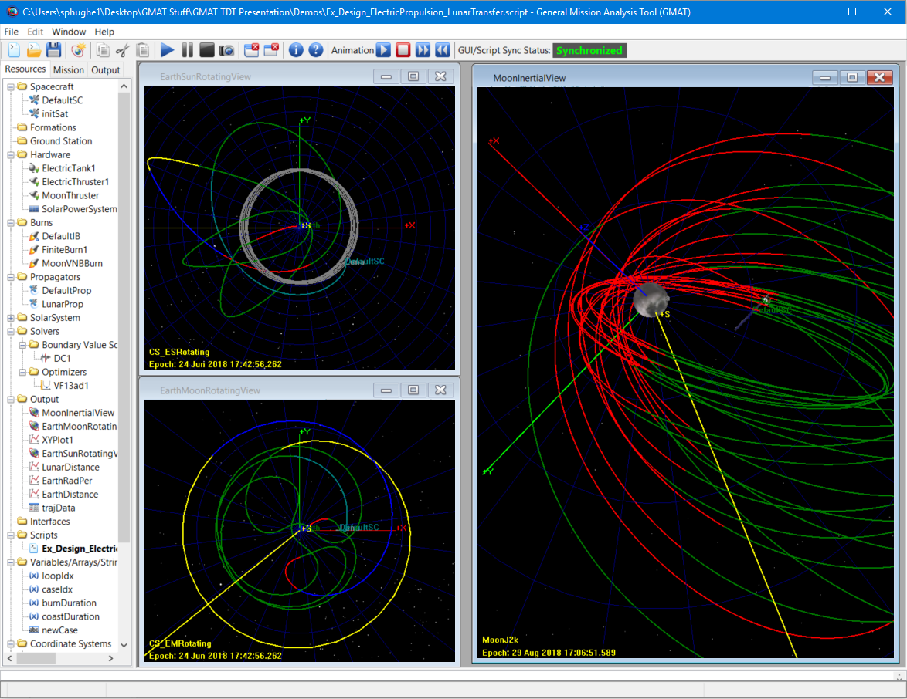
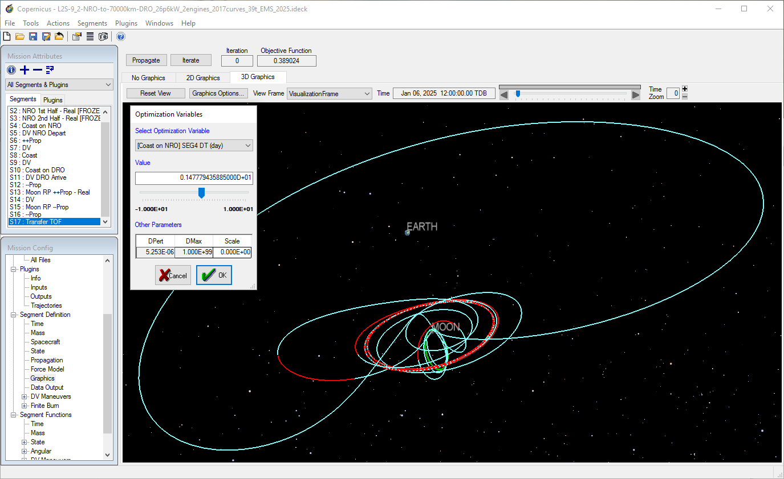
Background: GMAT, Monte, Copernicus
Legacy, Enterprise Systems
Customers
Together support 30+ flight projects and development efforts
Mission Lifecycle:
Design
Analysis
Ops
Applications
Orbit Determination
Error Analysis
Trajectory Optimization
Flight Products
Development
Many others
Monte: Landing Site Statistical Hazard Avoidance
GMAT: Lunar Ice Cube EM1 Launch,
through Lunar Flyby, to Lunar
Capture using SEP
Copernicus: NRHO to DRO Transfer in the Earth Moon System

Slide 5
Scope
Focus on Three Key Areas
Enterprise SoS Integration: Develop and mature API and system interfaces to allow enterprise applications to share information and/or capability with each other and with other programming environments.
Component Sharing: Complete integration of OpenFrames graphics component originally developed for Copernicus into GMAT and deprecate GMAT’s legacy graphics component.
Lessons Learned: Develop technical and legal lessons learned for integration of NASA’s flight mechanics systems.
Interface standards/protocols
Legal/policy lessons to enable sharing of source and binaries among centers/projects
Strategy
Focus SoS integration on use cases that tools cannot currently support.
Focus on low hanging fruit to eliminate duplicative graphics components between GMAT and Copernicus.

Slide 6
Key Stakeholders
Flight mechanics analysts and engineers
Chief engineers and project managers for existing and future programs, projects, and/or tasks that involve mission analysis, navigation, trajectory optimization, and mission operations to any destination
Key individual stakeholders:
John Lynch, Director of the Flight Dynamics Facility at NASA Goddard Space Flight Center (GSFC)
Rich Burns, Director Space Science Missions Operations (SSMO) at NASA GSFC
Melissa McGuire, Deep Space Gateway (DSG) trajectory design lead at NASA Glenn Research Center
O-REx Analysts
Europa Clipper Analysts

Slide 7
Team List
Name | Discipline | Organization | Contact Number | Email
Core Team
Daniel Murri | NESC Lead | LaRC | 757-864-1160 | daniel.g.murri@nasa.gov
Steven Hughes | Technical Lead, GMAT Lead | GSFC | 301-281-0145 | steven.p.hughes@nasa.gov
Gerald Condon | Copernicus Lead | JSC | 281-483-8173 | gerald.l.condon@nasa.gov
Roby Wilson | Monte-Copernicus Task Lead | JPL | 818.393.5301 | roby.s.wilson@jpl.nasa.gov
Ricardo Restrepo | Monte-Copernicus Analyst | JPL | 818-354-1951 | ricardo.l.restrepo@jpl.nasa.gov
Ted Drain | Monte Lead Programmer | JPL | 818-354-1149 | theodore.r.drain@jpl.nasa.gov
Scott Evans | Monte Task Manager | JPL | 818-393-6462 | scott.e.evans@jpl.nasa.gov
Anubhav Kamath | Copernicus Developer | JSC/Jacobs Technology | 301-286-4026 | anubhav.h.kamath@nasa.gov
Jacob Williams | Copernicus Developer | JSC/Jacobs Technology | 281-461-5921 | jacob.williams-1@nasa.gov
Noble Hatten | GMAT Analyst | GSFC | 301.286.4026 | noble.hatten@nasa.gov
Ravishankar Mathur | GMAT Developer | GSFC/Emergent Space Technologies, Inc. | 301-345-1535 | ravishankar.mathur@nasa.gov
Darrel Conway | GMAT Developer | GSFC/Thinking Systems Inc. | 623-298-4530 | djc@thinksysinc.com
John McGreevy | GMAT Developer | GSFC/Emergent Space Technologies, Inc. | 301-345-1535 | john.mcgreevy@emergentspace.com

Slide 8
Team List, cont.
Name | Discipline | Organization | Contact Number | Email
Consultants
Michael Aguilar | NASA Technical Fellow for Software | LaRC | 757-864-2810 | michael.l.aguilar@nasa.gov
Steve Slojkowski | FDF Analyst | GSFC | 301-286-1957 | steven.e.slojkowski@nasa.gov
Joel Parker | ODTBX Lead | GSFC | 301-286-3604 | joel.j.k.parker@nasa.gov
Business Management
Linda Moore | Program Analyst | LaRC/MTSO | 757-864-9293 | linda.j.moore@nasa.gov
Assessment Support
Missy J. Strickland | Project Coordinator | LaRC/AMA | 757-864-2528 | melissa.j.strickland@nasa.gov
Linda I. Burgess | Planning and Control Analyst | LaRC/AMA | 757-864-9139 | linda.i.burgess@nasa.gov
Leanna S. Bullock | Technical Editor | LaRC/AMA | 757-864-2512 | leanna.s.bullock@nasa.gov

Slide 9
Technical Activities: Executive Summary of Status
Task | Name/Description | Status
Task 1 | GMAT API Interface/ Monte Interfaces | On track, only behind schedule by the duration of the furlough.
Task 2 | OpenFramesInterface Integration in GMAT | Late due to furlough and long lead time in getting contract in place. There is no significant impact, and this task will be completed November 2019, well before the completion of the overall effort.
Task 3 | Monte-Copernicus Interfaces | Significantly behind schedule; we will discuss updated plan in later slides.
Task 4 | Lessons Learned | Largely dependent on Tasks 1 and 3. Will be completed on schedule at the end of the assessment.

Slide 10
Task 1 GMAT API: Summary
Task Overview: Implement an API for GMAT
Goals:
Make GMAT components available to Python, MATLAB, and JAVA
Interface GMAT with other NASA tools through the API developed in this assessment
Completed Deliverables
Design complete: 3/30/2019 (planned: 12/31/2018)
Alpha releases: May and August 2019
Use case 1 (Beta release)
Goal: Access to force models, propagation, measurements, scripting
Packaging complete: October 2019 (planned: September 2019)
Furlough delayed the design review by 3 months; now caught up
Future Deliverables:
Use case 2 (production release)
Goal: Interoperability with MONTE and ODTBX
Final assessment

Slide 11
Task 1 GMAT API Accomplishments
Exposed highest priority system interfaces
Strategic enhancements
System-level help
Simplified attribute access
Code updates for found issues
User documentation
Current application at GSFC
Measurement modeling for the FDF*
Dynamics modeling for LISA optimization
Planning for JAT replacement in ODTBX
“This application of the API is something we’ve been trying to do in the FDF for years. Thanks to the API, it’s now easy for us to compute real-time residuals versus live incoming tracking data.”
—S. Slojkowski, GSFC

Slide 12
Task 2 OpenFramesInterface: Summary
Task Overview: Test, debug, and document the OpenFramesInterface plugin for GMAT
Goal: Eliminate duplication of graphics components in GMAT and Copernicus and use a single graphics engine in both tools.
High-level deliverable status:
Deliverable | Planned Date | Actual Date
Create test plan document | June 2019 | July 2019
Develop system & regression tests | Sep 2019 | Oct 2019
End-user documentation | Nov 2019 | In Progress
Critical bug fixes | Oct 2019 | Oct 2019
Note: Furlough and contract initiation delayed start, but this task is no longer at risk and will finish in November.

Slide 13
Task 2 OpenFramesInterface: Accomplishments
Testing – Incorporated tests into GMAT GUI test system
Verification: Created 12 system tests against OFI use cases
Validation: Created >20 functional tests (e.g., range checks)
Bug fixes
Fixed several usability issues uncovered during formal testing
Started fixing GMAT-console startup crash on Linux
OFI integration into GMAT
Released OFI with GMAT R2019a Beta (May 2019)
Added OFI to GMAT nightly build
Documentation
Contains build documentation (for developers) and end-user documentation
GMAT contains stub pointers to OFI Wiki-based docs

Slide 14
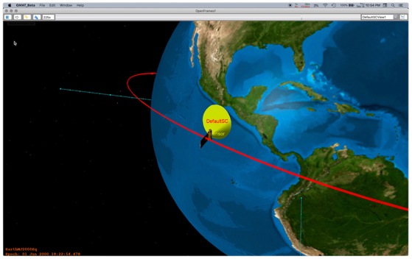
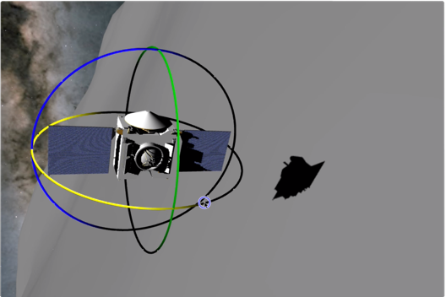
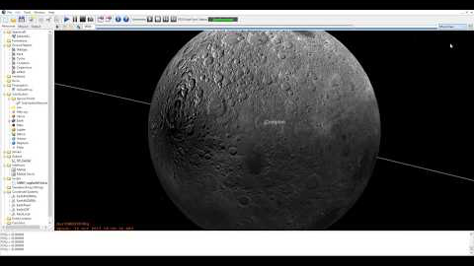
Task 2 OpenFramesInterface: Impact
Graphics capability funded by multiple projects is already shared between tools!
Sensor Cones: CATALYST
Shadows: COPERNICUS
High Fidelity Terrain

Slide 15
Task 3 Monte-Copernicus Integration: Summary
Task Overview: Implement an interface between Monte and Copernicus.
Goal: Improve interoperability between the JPL Monte and JSC Copernicus software sets to perform analysis that incorporates error analysis in the trajectory optimization process.
Issue: Integration of MONTE and Copernicus is significantly behind schedule due to furlough; increased demands of Gateway; and return to the Moon, EM1, Europa Clipper, Mars Insight, and Mars 2020.
Updated plan: Presented in the next slides.

Slide 16
Updated Plan Executive Summary
Core Strategy: Focus the second half of the assessment on the integration of MONTE and GMAT using OD and maneuver planning/optimization for O-REx as the driving use case. Monte-Copernicus work will focus on Europa Clipper.
Task 1: O-REx is using MONTE in backup mode for orbit determination and has GMAT setups for alternative maneuver planning options. We will start from those configurations and focus efforts on a flight project that is already using these tools in backup mode with the goal of demonstrating readiness for future projects at the completion of this effort.
Task 2: On track to be completed November 30, 2019. No planning update needed.
Task 3: Continue with progress on integration of Copernicus* and MONTE, but with decreased scope from the original plan, focusing efforts on Europa Clipper applications.
Task 4: On track to be completed at the end of assessment. No planning update needed.
*Note: While JSC contribution is de-scoped, Copernicus-MONTE integration is enabled via previous investments made to Copernicus by the NESC.

Slide 17
Updated Plan: Key New Subtasks
Subtask | Subtask Name | Participants | Summary
Task 1.2 | Data Integration between Monte-GMAT | GMAT Developers Monte Developers | Share key data between systems, including ephemerides, covariance, and maneuver solutions, among others.
Task 1.3 | Component Integration between Monte-GMAT | GMAT Developers Monte Developers | Integrate core components (dynamics models/propagation) between systems requiring interfaces at the C++ level (previous plan would use Python interfaces between systems).
Task 3.1 | Integration of Monte-Copernicus | Monte Developer/ Analyst Copernicus Analyst/Developer | Share solutions between Monte and Copernicus to allow trajectories in computed in Monte to be visualized in Copernicus.

Slide 18
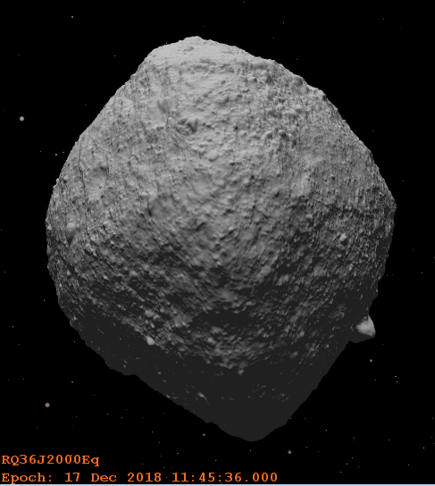
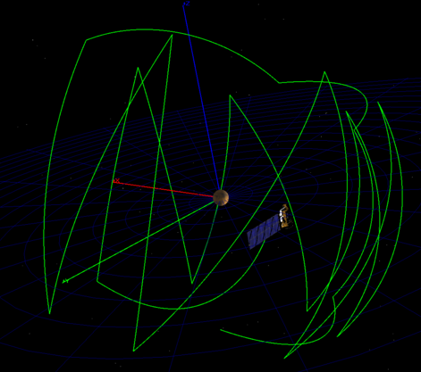
GMAT API Updated Subtask Details
Phase 1: Subtask 1.2 Data Interoperability
O-REx use case definition
MONTE setup and GSFC training
Ephemeris sharing
Maneuver plan sharing
Re-targeting
Phase 2: Subtask 1.3 Component Integration
C++ interface definition
Dynamics interface coding
GMAT Monte dynamics model integration
O-REx demonstration configuration
Demonstrate OD in Monte and Optimization in GMAT using shared dynamics
Note that subtask 1.3 is a tighter integration than originally planned as it will use C++ rather than Python APIs.

Slide 19
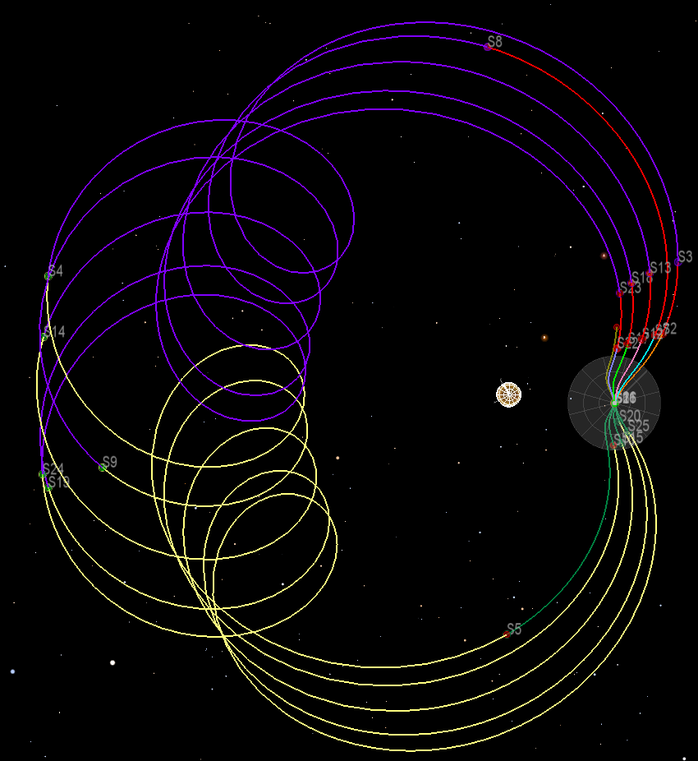
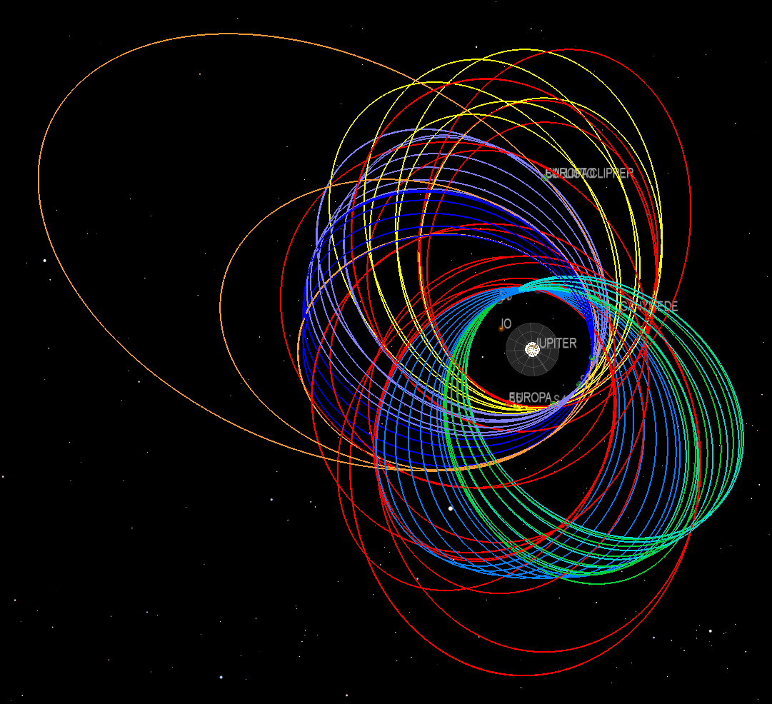
Monte-Copernicus Integration Updated Task Details
MonteCop interface development (Phase I, 4 months)
Use Copernicus 3D visualization environment to visualize Monte trajectories.
Use Copernicus visual optimization tools to tweak/improve pre-optimized Monte trajectories.
MonteCop interface development (Phase II, 4 months)
Implement continuous state function in Copernicus to use as a cost (or constraint) function via plugins, making use of Monte pre-existing complex state functions.
Implement bi-directional integration with the Cosmic high-fidelity optimization program.

Slide 20
Assumptions
GMAT developers will perform majority of integration between GMAT and Monte, but will work with Monte developers for training and guidance.
The product of this work will not be used in the operational tool chain for O-REx; it will be used in shadow mode only.
This effort will not affect the O-REx schedule of operations.
Code level integration of dynamics models will require calls through C++ interfaces (as opposed to Python interfaces) for performance reasons.

Slide 21
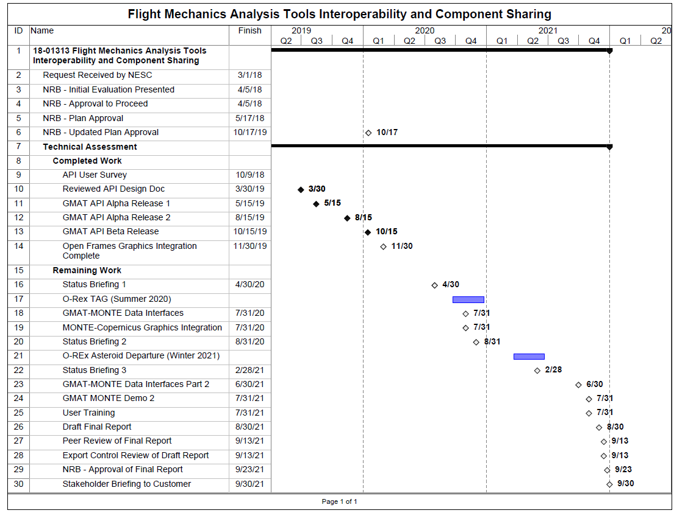
Schedule
PoP changes by ~1 year due to late start on key tasks, and increased scope of targeting return phase of O-REx.

Slide 22
Deliverables
Deliverable | Content | Recipient/Availability
Monte Plugin | Software Application/Executable, Documentation | Government/Contractors, Commercial Use, Academia
GMAT API | Software Application/Executable, Documentation, Source Code | Open Source
Open Frames Shared Library | Software Application/Executable, Documentation, Source Code | Open Source
Best Practices | Documentation/Lessons Learned | NASA Projects

Slide 23
Disengagement Criteria
The assessment will be complete when:
All software development and documentation tasks have been completed and demonstrated.
The flight dynamics systems have been validated with all changes completed.
The NESC final report has been written, presented, and approved.
Agency stakeholder users have been briefed on the new capabilities.

Slide 24
Plan Approval
Approved:
 | NESC Director |  | Date

Slide 25
Revision History
(Updated Assessment Plan)
Version | Description of Revision | Office of Primary Responsibility | Effective Date
1.0 | Initial release | Daniel G. Murri, NASA Technical Fellow for Flight Mechanics, LaRC | 05/17/2018
2.0 | Updated plan focusing on O-REx and Europa Clipper | Daniel G. Murri, NASA Technical Fellow for Flight Mechanics, LaRC | Awaiting NRB approval

Slide 26
Backup Slides

Slide 27



Solution: SoS Integration
Start from prototype API/Integration efforts.
Develop version 1.0 of API interfaces and integration components allowing tools to make low-level system calls.
Demonstrate interoperability on key use case, integrated orbit determination, and path planning optimization.
Allow enterprise systems to:
Communicate with each other to avoid duplication.
Communicate with common programming environments to enable integration with new applications, such as ground test environments and simulators.
Copernicus, OD Toolbox, Others
Programming Environments
Monte Core
GMAT Core
Python API
SWIG API
GMAT C++ API

Slide 28
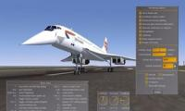
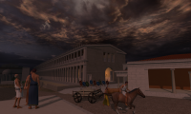
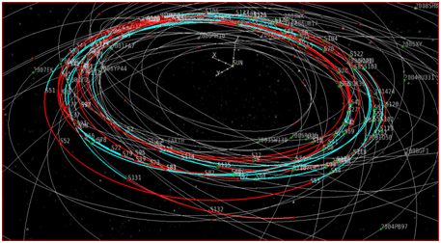
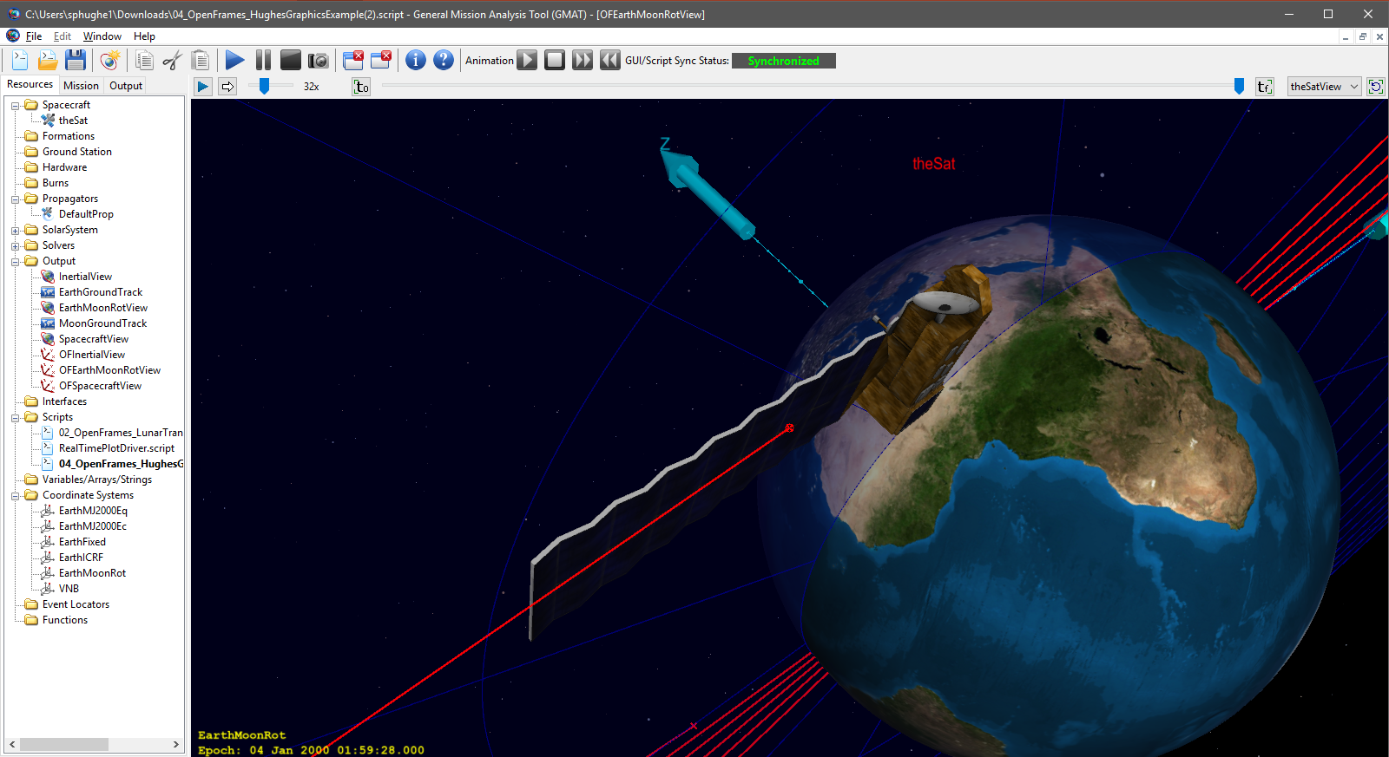
Solution: Duplicate Component Elimination
Embrace existing graphics capability: OpenSceneGraph is an off-the-shelf, open source 3D graphics toolkit, used by application such as visual simulation, games, virtual reality, scientific visualization and modelling.
Extend the OpenFrames flight mechanics graphics API for trajectory visualization.
Complete integration of GMAT-plugin that employs OpenFrames.
Integrate new functionality into Copernicus.
Deprecate GMAT’s heritage 3D graphics component.
Copernicus
GMAT
OpenFrames: open source API for trajectory graphics originally developed for Copernicus
OpenSceneGraph: open source high performance 3D graphics library
Generic OpenSceneGraph Applications
OpenSceneGraph Applications in Copernicus and GMAT

Slide 29
Special Requirements
There is no need for access to proprietary servers and/or databases and no need for non-disclosure agreements for non-NASA team members.
Software Usage Agreements (SUA) are already in place that allow sharing of Monte, GMAT, and Copernicus between the software development teams and users of these systems.
There are no special requirements for facilities or tools to perform this assessment.

Slide 30
Constraints
Integration efforts will employ Python inter-tool for interfaces as Monte and Copernicus already interface with Python (and GMAT does now, too).
GMAT API testing will be performed by extending the existing MATLAB-based test system and will employ the MATLAB-Python interface and the MATLAB-JAVA interface.

