Slide 1
GMAT Collocation Subsystem Design Review
S. Hughes
Dec., 2014
NASA Goddard Space Flight Center

Slide 2
Outline
Review Overview
Goals
Team
Agenda
Products and RID Process
GMAT Overview
Software Overview
Development Methodology
Management Overview
Design Context
Business/Technical Goals
User Stories/Scenarios
Requirements
Drivers

Slide 3
Outline… cont.
Design
Demo/Walkthrough
Architectural Design
Detailed Design
What next?
User interface
New components

Slide 4
Review overview
Goals
Team
Agenda
Products and RID Process

Slide 5
Review Goals
Ensure quality subsystem architecture that is designed for long-term
Ensure key design areas are addressed
Ensure on a path to implementation

Slide 6
Review Team

Slide 7
Review Agenda

Slide 8
Products/RID Process

Slide 9
GMAT overview
Software Overview
Development Methodology
High Level Schedule

Slide 10
Software Overview

Slide 11
Development Methodology

Slide 12
Management Overview

Slide 13
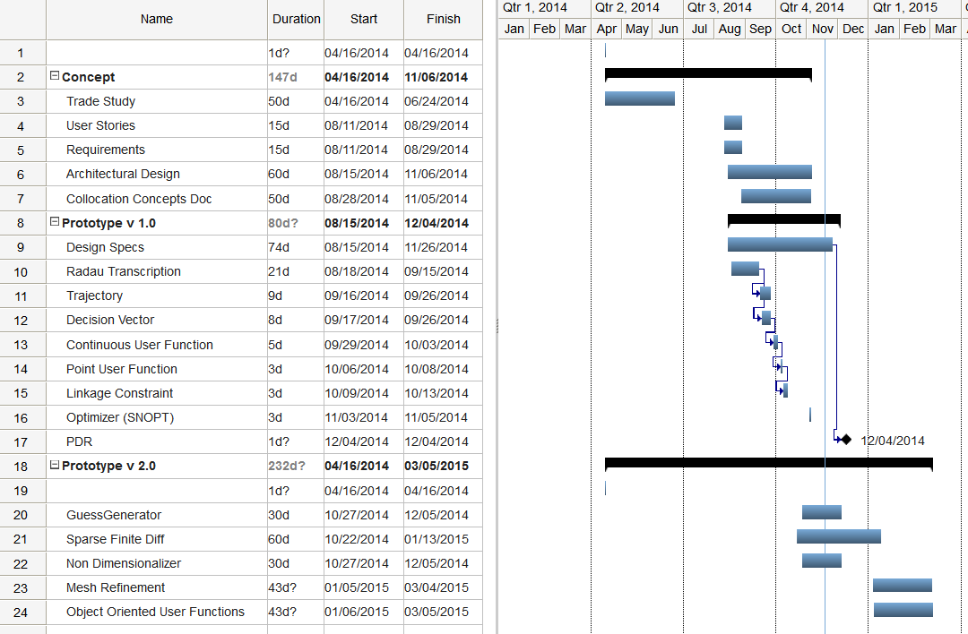
Schedule

Slide 14
Design Context
Business Goals
User Stories/Scenarios
Requirements
Drivers

Slide 15
Business/Technical Goals
Business goals
Enables low thrust mission support.
Technical Goals
Extends applicability of GMAT optimization to finite maneuvers.
Dramatically improve scalability for missions like TESS where many segments are required. Currently the user interfaces make it quite difficult to configure missions like this.
Dramatically improve convergence properties for complex problems
Eliminate sensitivity to user-defined segment definitions, as mesh refinement algorithm will determine required segmentation to meet user tolerance
Dramatically improve targeting and optimization in multi-body regimes as collocation methods elegantly handle the sensitivity of those regimes.

Slide 16
User Stories: Types
Trajectory Regimes: Trajectory Regime user stories focus on particular trajectory regimes that have special modelling and analysis intricacies. Often the nominal or desired trajectory is not known and the solution of the trajectory is part of the analysis and design process and is usually coupled tightly with the control.
Control Modes: Maneuver design user stories focus on areas where the nominal is well known, and the maneuver to maintain the trajectory is the end result of the optimization run. These often have very good guesses. These are more operational or late design stage use cases.
Execution Modes: Execution Mode user stories focus on different ways a user may need to use the optimal control infrastructure.

Slide 17
User Stories: Trajectory Regimes
ID | Description
CO.TD-1 | Basic Orbit Transfer: I need to design an optimal maneuver to transfer to a nearby orbit.
CO.TD-2 | Body to body transfer: I need to design a trajectory that does a direct transfer from one body to another, in my case, from Earth to Moon.
CO.TD-3 | Interplanetary Multiple flyby: I need to design a trajectory that leaves Earth, performs multiple gravitational flybys, and arrives at a final target celestial body. I have a guess at the flyby times, order, and flyby conditions at each body.
CO.TD-4 | Spiral: I need to design a trajectory that spirals into and/or away from a celestial body requiring many (100s) of revolutions.
CO.TD-5 | Libration point maintenance: I need to use collocation to improve the robustness and quality of libration stationkeeping solutions.

Slide 18
User Stories: Trajectory Regimes
ID | Description
CO.TD-6 | Weak stability transfer: I need to use collocation to find trajectory transfers in a weak stability, multi-body environment.
CO.TD-7 | Formation: I need to use collocation to optimize maneuvers of multiple spacecraft.
CO.TD-8 | Rendezvous/Prox Ops: I need to use collocation to optimize rendezvous and docking operations and proximity operations.
CO.TD-9 | Probe Separation: I need to use collocation to determine optimal trajectories for probe release and spacecraft separation planning.
CO.TD-10 | Launch: I need to use collocation to optimize a launch vehicle ascent trajectory. (SPH: Not sure this is really a use case but leaving it in for consideration)
CO. TD-11 | Landing,

Slide 19
User Stories: Control Modes
ID | Description
CO.MD-1 | Finite chemical orbit maneuver: I need to optimize a maneuver sequence that employs finite burns from a chemical thrust system.
CO.MD-2 | Finite electric orbit maneuver: I need to optimize a maneuver sequence that employs finite burns from an electric thrust system.
CO.MD-3 | Impulsive maneuver: I need to optimize a maneuver sequence that employs an impulsive maneuver approximation.
CO.MD-4 | Hybrid Maneuver. I need to optimize a maneuver sequence that employs both impulsive and finite (chemical/electric) maneuver models.
CO.MD-5 | Piecewise continuous thrust: I need to optimize a maneuver sequence that employs piecewise continuous finite thrust.
CO.MD-6 | Multiple thruster set maneuver: I need to optimize a maneuver sequence that employs multiple thruster sets/configurations firing simultaneously.
CO.MD-7 | Solar Sail:

Slide 20
User Stories: Execution Modes
ID | Description
CO.EM-1 | Feasible Solution: I need to use collocation to find a feasible trajectory for my mission.
CO.EM-2 | Optimal Solution: I need to use collocation to find an optimal trajectory for my mission.
CO.EM-3 | Parametric runs: I need to perform parametric scans of optimal solutions given different mission configurations/requirements.
CO.EM-4 | Monte Carlo: I need to perform Monte-Carlo for optimal solutions given error models for system components.
CO.EM-5 | Re-optimize: My requirements changed a little, I need to reoptimize my trajectory given the initial optimal solution as an initial guess.
CO.EM-6 | Products: I need to generate plots and reports that describe the optimal trajectory to our mission systems engineer and for reviews. This includes 3-D graphics, and data reports on orbit parameters and events.

Slide 21
Design
Demo/Walkthrough
Architectural Design
Detailed Design

Slide 22
Demo Walkthrough

Slide 23
What Next?

