Slide 1

Community Detection in Complex Networks Using Leader Knowledge
IT-752 Final Project Presentation on
3 June, 2021
Presented By
Abhishek Kumar - 001
Mohd Asif Khan Khaishagi - 013
Nitin Sharma - 017
Presented to
Dr. Sowmya Kamath S

Slide 2

AGENDA
INTRODUCTION
PROBLEM STATEMENT AND OBJECTIVES
METHODOLOGY
ENHANCEMENT
RESULTS AND ANALYSIS
INDIVIDUAL CONTRIBUTION
CONCLUSION AND FUTURE WORK
IT-752 WSC - Mini-Project Mid Sem Evaluation [Feb-May, 2021] 03 June, 2021

Slide 3
INTRODUCTION
The tendency of people with similar tastes, choices, and preferences to get associated in a social network leads to the formation of virtual clusters or communities
Finding communities in networks helps us in understanding certain behavior of a group of people
Most of the algorithms out there do not find the leaders as they just focus on finding the communities in a network
Basic idea behind leader aware communities is to identify some particular nodes in the target network, called leader nodes, around which local communities can be computed.
Mining community leaders is very meaningful in the field of information distribution. We can inform each leader of some urgent news , so that everyone in the corresponding community can know about it as soon as possible
IT-752 WSC - Mini-Project Mid Sem Evaluation [Feb-May, 2021] 03 June, 2021

Slide 4
INTRODUCTION
The reference paper proposes an algorithm to detect communities and their leaders. Contribution involves :
Some new metrics are introduced to evaluate the node leadership and identify local leaders of each node. We take full advantage of the neighborhood information, which is easy to be parallelized for large-scale networks.
Based on the leadership, each node points to its local leader in a cascade way, forming original community structures spontaneously. Dependence trees are built, and the community leaders are obtained during the process of forming communities.
We compare the performance of our algorithm with several state-of-the-art community detection approaches on real-world and synthetic datasets. The results show that this method achieves comparable performance.
IT-752 WSC - Mini-Project Mid Sem Evaluation [Feb-May, 2021] 03 June, 2021

Slide 5
PROBLEM STATEMENT
“Understanding what community in real world networks are and finding these communities using clustering algorithms. Leader of these communities are also to be identified as they have the highest influence on these communities”
Research Objectives :
Understand what communities in real world network are and implement the proposed clustering algorithm to find them.
Find leaders in these communities who have the highest influence(node leadership) in the cluster based on neighborhood information.
Compare this algo with some state-of-the-art algorithm to see how it performs based on performance metrics like Normalized Mutual Information (NMI), Adjusted Rand Index (ARI) and Cluster Purity.
IT-752 WSC - Mini-Project Mid Sem Evaluation [Feb-May, 2021] 03 June, 2021

Slide 6
METHODOLOGY : DATASET
Datasets | # of vertices | # of edges | Avg. degree | # of True clusters | # of triangles | Diameter
Zachary karate club | 34 | 78 | 4.59 | 2 | 45 | 5
American college football network | 115 | 613 | 10.66 | 12 | 810 | 4
Political books dataset | 105 | 441 | 8.44 | 3 | 560 | 7
IT-752 WSC - Mini-Project Mid Sem Evaluation [Feb-May, 2021] 03 June, 2021

Slide 7





METHODOLOGY : FORMULA
Structural Neighborhood
Unique Neighbors
Jaccard Similarity
Jaccard Distance
Leadership
IT-752 WSC - Mini-Project Mid Sem Evaluation [Feb-May, 2021] 03 June, 2021

Slide 8


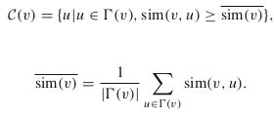

METHODOLOGY : FORMULA
Edge Compactness
where,
Attractive Force
Merging of branches
> Calculation of Candidate set > Updating Local leaders
IT-752 WSC - Mini-Project Mid Sem Evaluation [Feb-May, 2021] 03 June, 2021

Slide 9
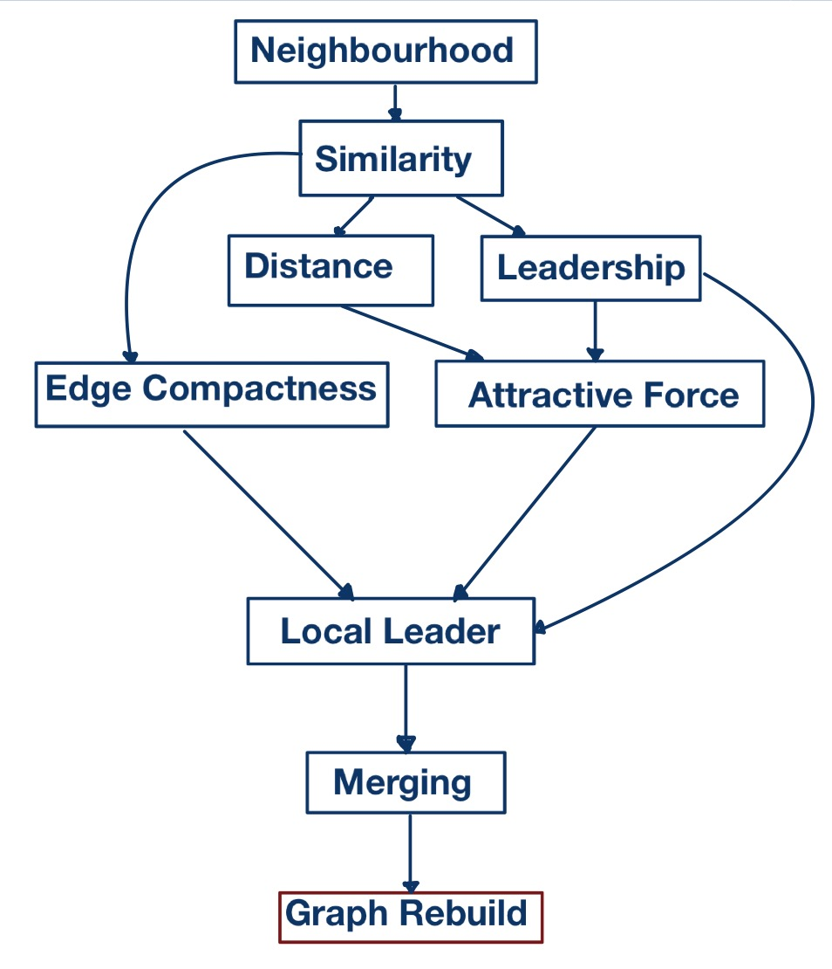
METHODOLOGY : ALGORITHM
Autoleader Algorithmic Steps :
Compute Neighborhood and Leadership for all nodes
Calculate Structural Neighborhood for each node
Find Jaccard similarity and Jaccard distance
Calculate leadership for each node based on similarity.
Find local leaders for each node
Calculate edge compactness for each edge
Calculate attractive force between adjacent nodes
Find local leaders for each node using above two.
Perform merging operation based on local leaders details.
Integrate above three steps to complete Auto leader algorithm.
Recreate the graph based on this newly learned information.
Compare performance of algo with some state of the art algos.

Slide 10
ENHANCEMENT
Recreate the graph instead of performing the update on existing graph.
Keeps existing graph preserved for comparisons
Reduces extra computation of finally deleting the edges from graph.
Reduces memory requirement for saving what edges are needed to be deleted and what are to be preserved for future
Handling case of leaders having leaders as followers as it increases a step in information transfer to followers : Transitive Property.
Coming up with strategy to re-elect the leader in case an existing leader goes down.We had 2 options for this :
Re-run the algorithm to compute clusters again OR
Use existing leadership scores of nodes
IT-752 WSC - Mini-Project Mid Sem Evaluation [Feb-May, 2021] 03 June, 2021

Slide 11
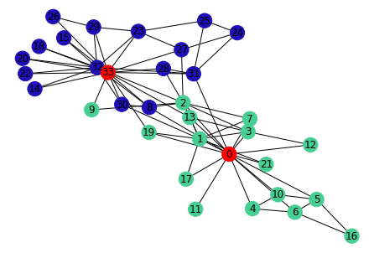
RESULT : Zachary Karate Club
Dataset | Zachary Karate Club
Metrics | # clusters | NMI | ARI | Purity
Auto Leader | 2 | 0.837 | 0.882 | 0.971
Our | 2 | 0.8371 | 0.882 | 0.9705
SCAN | 4 | 0.3836 | 0.1901 | 0.8235
Girvan Newmann | 4 | 0.6516 | 0.6446 | 0.9705
IT-752 WSC - Mini-Project Mid Sem Evaluation [Feb-May, 2021] 03 June, 2021

Slide 12
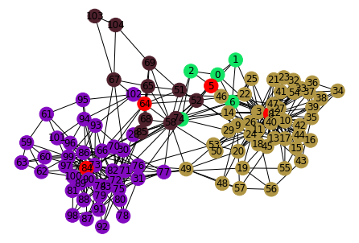
RESULT : Political Books Dataset
Dataset | Political Books Network
Metrics | # clusters | NMI | ARI | Purity
Auto Leader | 4 | 0.553 | 0.664 | 0.810
Our | 4 | 0.5629 | 0.6805 | 0.8476
SCAN | 5 | 0.4238 | 0.5314 | 0.8095
Girvan Newmann | 3 | 0.5754 | 0.6795 | 0.8476
IT-752 WSC - Mini-Project Mid Sem Evaluation [Feb-May, 2021] 03 June, 2021

Slide 13
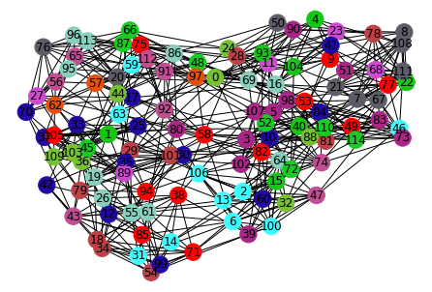
RESULT : American Football Network
Dataset | American College Football Network
Metrics | # clusters | NMI | ARI | Purity
Auto Leader | 12 | 0.902 | 0.814 | 0.835
Our | 12 | 0.9268 | 0.8893 | 0.9304
SCAN | 11 | 0.9204 | 0.8595 | 0.9043
Girvan Newmann | 12 | 0.9213 | 0.8846 | 0.9304
IT-752 WSC - Mini-Project Mid Sem Evaluation [Feb-May, 2021] 03 June, 2021

Slide 14
OBSERVATIONS
Here are the observations from the results obtained :
It can be observed that in case of Zachary dataset, both Autoleader and our implementation provide similar or better results than SCAN and Girvan-Newmann.
In case Football and Polbook dataset, our implementation, if not better, is at least as good as any of the other algorithm including original Autoleader algorithm.
IT-752 WSC - Mini-Project Mid Sem Evaluation [Feb-May, 2021] 03 June, 2021

Slide 15
INDIVIDUAL CONTRIBUTION
Abhishek Kumar
Perform merging operation based on local leaders details obtained
Integrate above all steps to complete Autoleader algorithm
Recreate the graph based on this newly learned information
Mohd Asif Khan Khaishagi
Calculate Structural Neighborhood for each node
Find Jaccard similarity and Jaccard distance
Calculate leadership for each node based on similarity
Nitin Sharma
Calculate edge compactness for each edge
Calculate attractive force between adjacent nodes
Find local leaders for each node using above two
We will also do a comparative analysis of Autoleader algorithm with some state of the art algo.
IT-752 WSC - Mini-Project Mid Sem Evaluation [Feb-May, 2021] 03 June, 2021

Slide 16
CONCLUSION AND FUTURE WORK
We explored some state-of-the-art algorithms and did a comparative analysis of their performance with an altered version of Autoleader algorithm.
We used details of auto leader algorithm to calculate neighbor information and local leaders using their concept of edge compactness and attractive force.
During merging phase of Autoleader, we changed it to handle case when a leader is present in follower list of another leader which was the main reason for the changes reflected in metrics.
Autoleader algorithm has already shown very promising results when applied on real world networks and always seems to out-perform SCAN and Girvan-Newman algorithm.
What we also proved that our implementation of algorithm after tweaking gives results at least as good Autoleader algorithm.
Future work may focus on testing performance of our implementation on bigger datasets. What we can also work on is to do a comparative analysis based on other algorithmic metrics like extra space required and time taken for execution of our algorithm.
IT-752 WSC - Mini-Project Mid Sem Evaluation [Feb-May, 2021] 03 June, 2021

Slide 17
REFERENCES
Community Detection Based on Girvan-Newman Algorithm and Link Analysis of Social Media : https://link.springer.com/chapter/10.1007/978-981-10-3274-5_18
A Density-Based Algorithm for Discovering Clusters in Large Spatial Databases with Noise : https://www.aaai.org/Papers/KDD/1996/KDD96-037.pdf
LICOD: A Leader-driven algorithm for community detection in complex networks : https://link.springer.com/article/10.1007/s40595-014-0025-6
Leader-aware community detection in complex networks : https://link.springer.com/article/10.1007/s10115-019-01362-1
IT-752 WSC - Mini-Project Mid Sem Evaluation [Feb-May, 2021] 03 June, 2021

Slide 18
THANK YOU!!!

