Slide 1


weathered.
Personalized disaster plans powered by agentic AI.

Slide 2
Imagine…

Slide 3
1 in 3 North Americans experience a weather disaster

Slide 4
fewer than 1 in 10 have a real preparation plan

Slide 5
46 Million
800,000
displaced globally in 2024
without power during Hurricane Fiona

Slide 6
Introducing weathered.

Slide 8
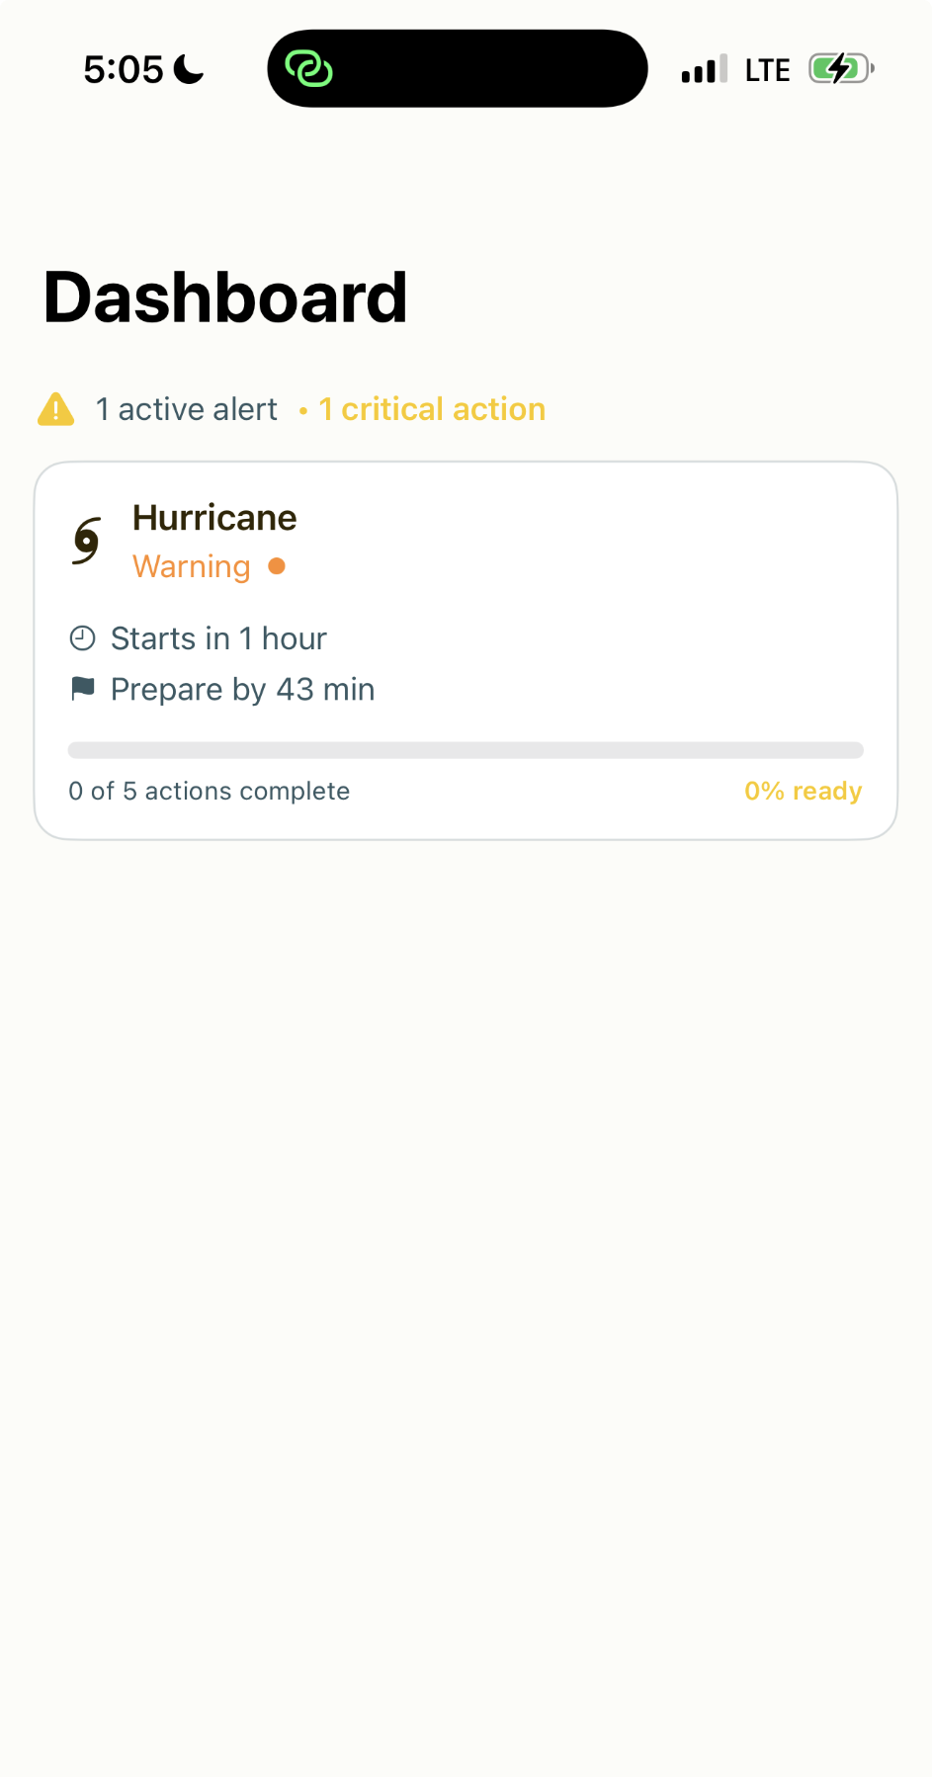
How it Works
3-5 min onboarding
Monitors weather
Personalized plan
Save time + energy

Slide 9
Consider…

Slide 10
What About You?

Slide 11
weathered.
does

Slide 12
weathered.
Personalized
Climate Resilience
for Everyone
CREDITS: Slidesgo, Flaticon, Freepik for slide template, Smashicons for app logo

Slide 13








Team
SustAInable
Asif
Reese
Aryaman
Raphael
Roni

