Slide 1
WEATHORA
Weather Dashboard with API
Project Presentation
Web Development Internship
Submitted By: Sanika Sanjay Dhavale
B.Sc. Computer Science-Final year
MES Abasaheb Garware College, Pune

Slide 2
Project Overview
Weathora-Weather Dashboard with API
Weathora is a web-based application that allows users to check the current weather of any city.
Main Objectives:
To fetch live weather data using an API.
To display weather details in a user-friendly interface.
To store search history in MongoDB.
To allow users to view their previous city searches.

Slide 3
Problem Statement & Objectives
Problem Statement:
Checking weather information for different cities can be time-consuming when users need to visit different websites.
Objectives:
To provide real-time weather information for any city.
To display temperature, humidity, and wind speed.
To store city search history using MongoDB.
To create a simple and user-friendly web application.

Slide 4
Technology Stack
Frontend: HTML, CSS, JavaScript
Backend: Python, Flask
Weather Data: OpenWeather API
Database: MongoDB
Development Tool: Visual Studio Code

Slide 5
System Workflow
User enters a city name.
Flask processes the request.
OpenWeather API fetches current weather data.
MongoDB stores the search history.
Weather results are displayed on the website.

Slide 6
Main Features of Weathora
Weather information using OpenWeather API.
Temperature, humidity and wind speed details.
Search history stored in MongoDB.
User-friendly and responsive interface.
Separate Home, Weather, History and About pages.

Slide 7
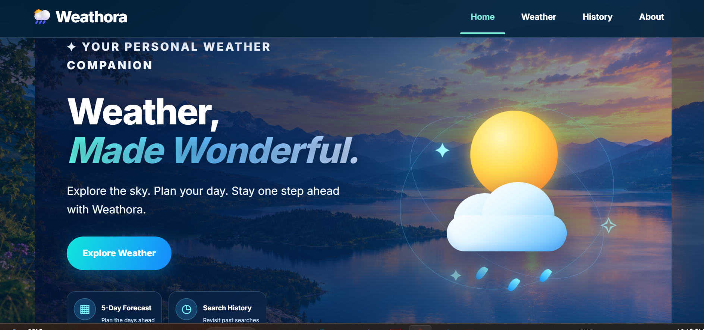
Home Page

Slide 8
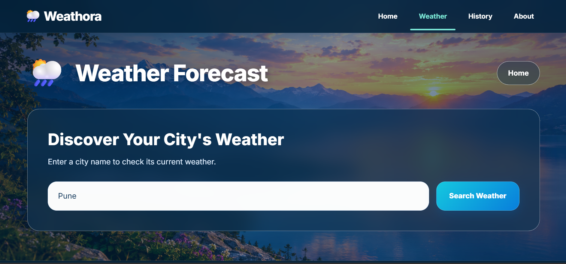
Weather Forecast Page

Slide 9
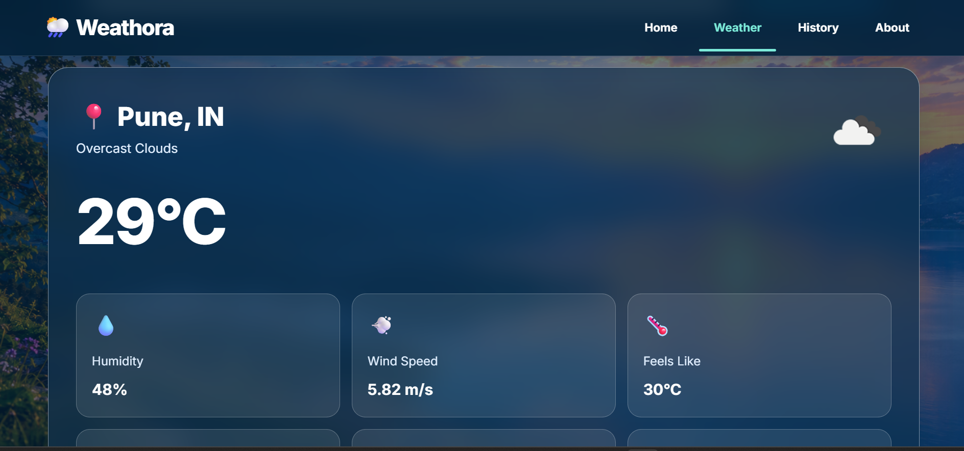
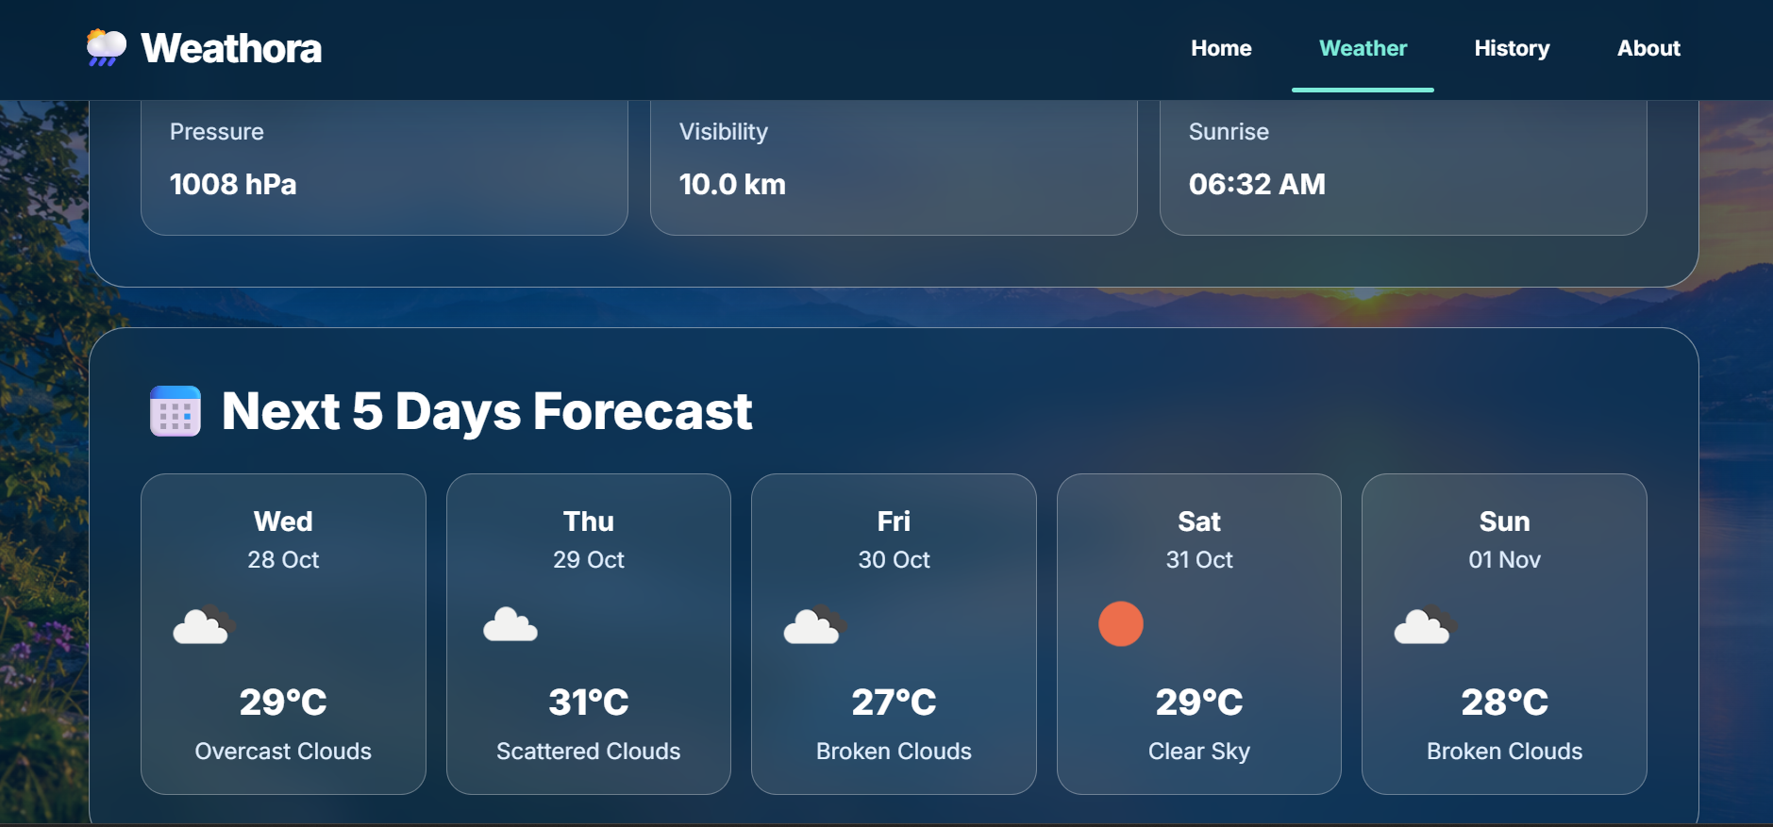

Slide 10
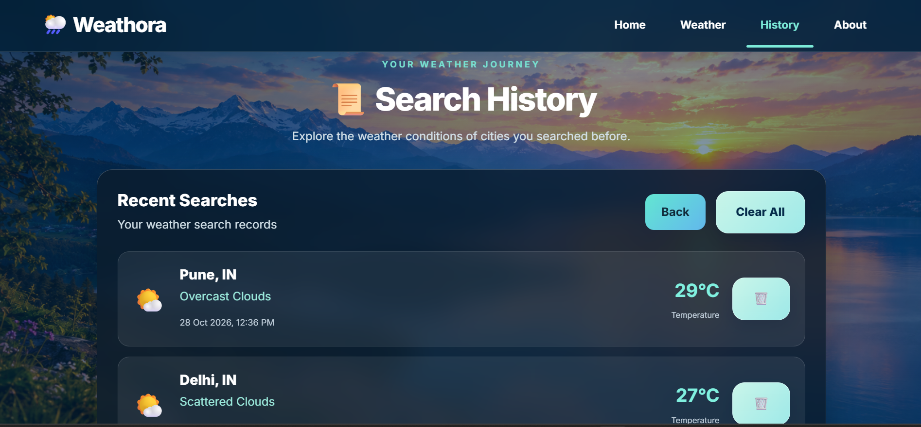
Search History Page

Slide 11
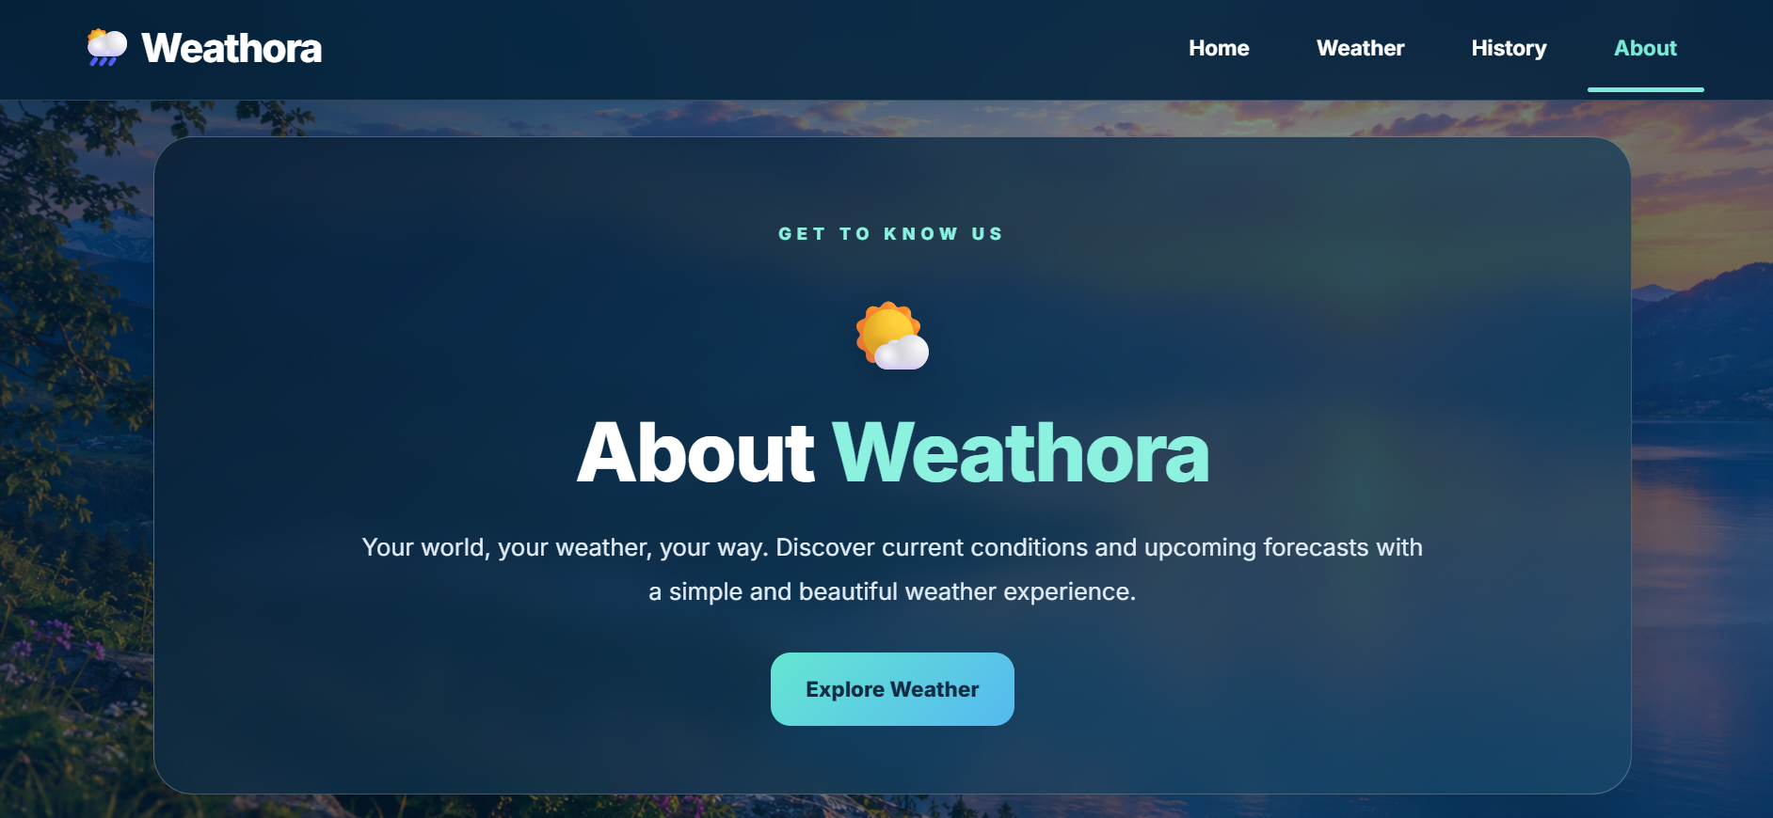
About Page

Slide 12
OpenWeather API Integration
How It Works:
The user enters a city name.
Flask sends a request to the OpenWeather API.
The API returns weather data for the selected city.
Weathora displays the weather information on the website.
Weather Data Retrieved:
City name
Temperature
Humidity
Wind speed
Feels-like temperature

Slide 13
MongoDB Integration & Testing
MongoDB Integration:
Stores users city search history.
Saves search records in the database.
Retrieves previous searches for the history page.
Uses Flask to connect the application to MongoDB.
Testing Performed:
Checked weather search for different cities.
Verified weather details displayed on the page.
Checked whether search history was saved.
Tested the history page.

Slide 14
Conclusion & Future Enhancements
Conclusion:
Weathora is a web-based weather dashboard developed using Python, Flask, the OpenWeather API and MongoDB.
Provides current weather information for different cities.
Displays temperature, humidity, and wind speed.
Stores search history in MongoDB.
Offers a simple and user-friendly interface.
Future Enhancements:
Add a multi-day weather forecast.
Include weather maps and alerts.
Improve mobile responsiveness.
Add more weather-related features.

