Slide 1
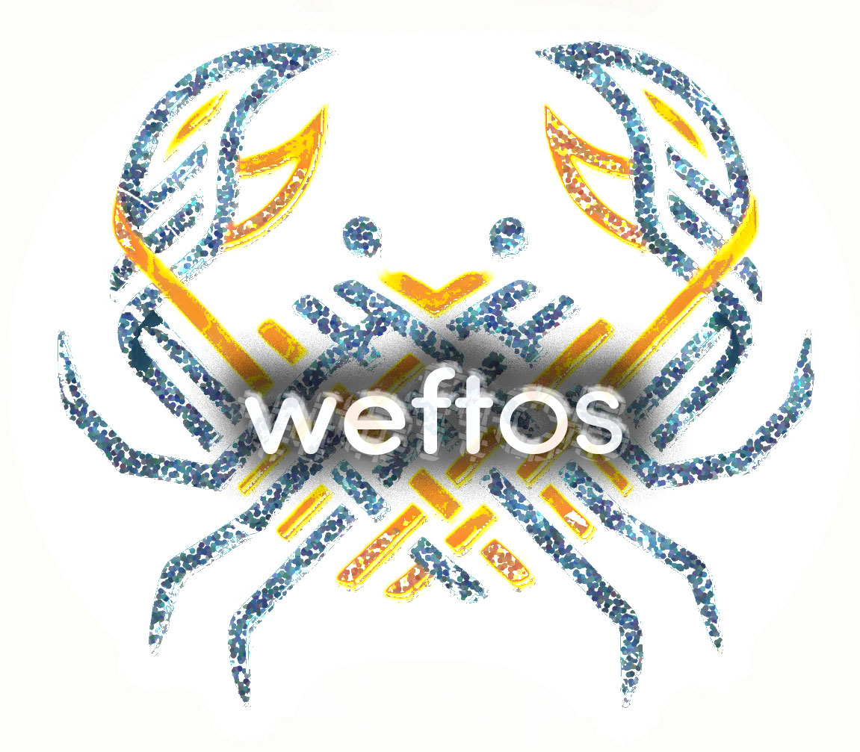
Ask "what-if" of the whole enterprise
QFS × WeftOS - Briefing
QFS can already answer what happened. WeftOS lets QFS ask what would happen if.

Slide 2
De-risked against representative data at QFS scale
We built and ran the end-to-end system against synthetic operational data shaped and sized to match QFS's footprint — stores, orders, labor, inventory, promos, org chart, audits. Known ground truth — the system grades itself. No real QFS data touched yet.
Capability | Measured
Streaming ingest | 180,000 events/sec per worker (~4 workers covers QFS peak)
Scenario query end-to-end | < 1 second, multi-region / multi-brand
Per-shard semantic search | 175–580 µs — 33–107× faster than exhaustive search
Gap-analysis sweep | 4,600 gaps across 500 stores in 0.15 s
Semantic-search recall | ≥ 99 % at default settings (measured, not projected)
Audit trail | BLAKE3 hash-chained, tamper-detectable per entry
Privacy | Employee IDs hashed at ingest; automated PII scan

Slide 3
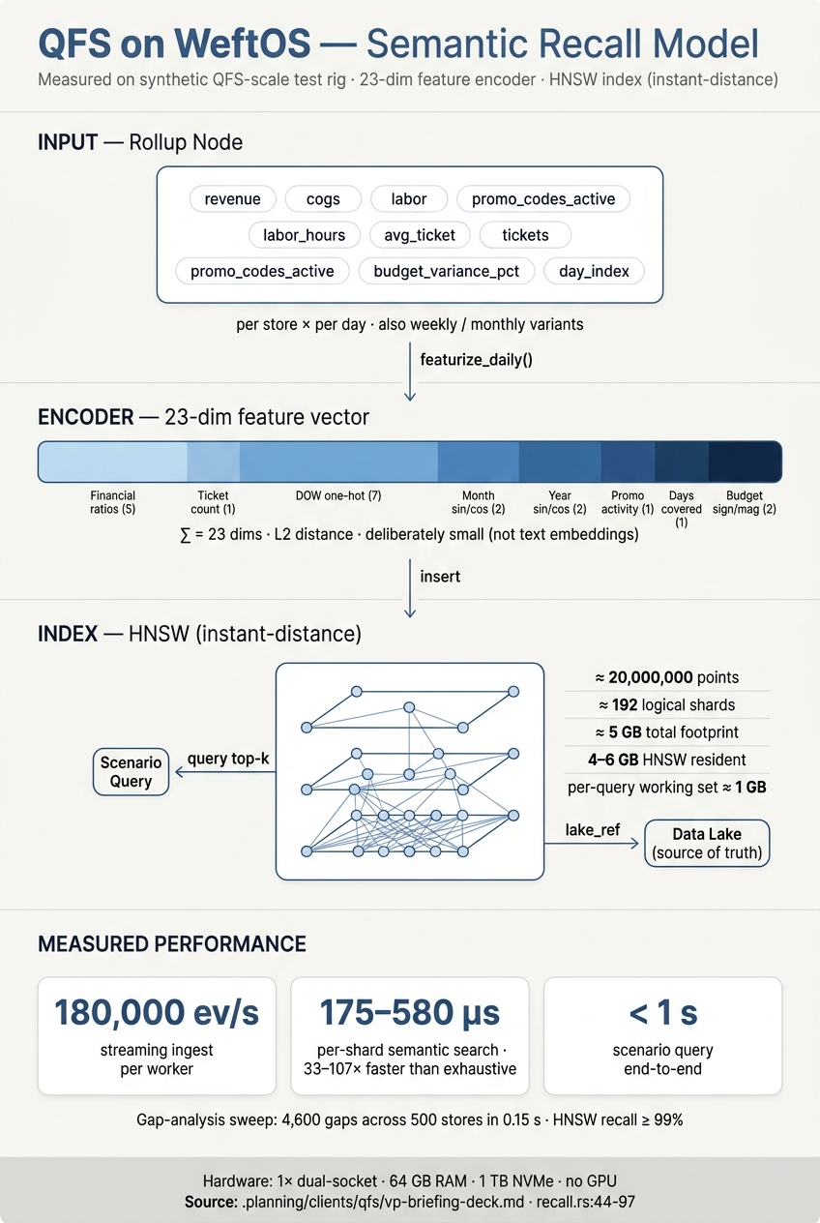
Four things dashboards don't do
Counterfactual reasoning
Ask "if X, then Y" across geography × time × brand × franchisee. Simulated through a causal graph, returned with confidence bands not a brittle point estimate.
Cryptographic provenance
Every data point, analytical step, and decision surface carries a hash-chained audit entry. Blockchain-level integrity guarantees without operating a consensus network.
Governance as code
SOX boundaries, franchisee data-sharing rules, and PII regimes (GDPR / PIPEDA / CCPA / LGPD) enforced at write-time. Violations blocked before they land.
Programmable substrate
Extensible to cryptographic multi-party workflows: franchisee settlement, supply-chain attestation, programmable revenue splits. Adjacent capabilities beyond initial scope.
WeftOS does not replace the data lake. The lake stays authoritative for transactions; WeftOS holds the reasoning layer above it.

Slide 4
Fits on a commodity server. Scales by adding more.
Dimension | Measurement
Total storage, 5-year retention | ~5 GB across ~192 logical shards; hot/warm/cold tiering automatic
HNSW index memory (~20M semantic points) | ~4–6 GB resident; per-query working set ~1 GB
Scenario query end-to-end | < 1 second
Per-shard index build | < 30 seconds
Full cold-start build (sharded, parallel) | < 1 minute wall-clock
Recommended production hardware | Dual-socket server, 64 GB RAM, 1 TB NVMe (overprovisioned). One warm replica.
Specialised hardware needed | None. No GPU dependency. No accelerators.
Not a datacenter conversation. A two-rack-unit conversation.

Slide 5
13 weeks from kick-off to production handover
Specification, ingest, scenario engine, gap analysis, hardening, audit, and privacy are already built and measured end-to-end on synthetic data. The hardest technical risks are behind us.
Phase | Weeks | What lands
Data-lake integration | 1–3 | Streaming read from QFS's lake; operational dashboards on real data
Historical replay | 4–6 | One year of QFS history imported into staged shards
Calibration | 7–9 | Causal edge weights tuned against QFS's observed outcomes
Scenario acceptance | 10–11 | VP-nominated headline scenario passes accuracy threshold
Production rollout | 12–13 | Dashboards, audit stream, runbook handover to QFS ops
Team: 2–3 engineers from us (full-time), one data-lake owner from QFS (part-time).
Needed to start: (1) data-lake read access, (2) any A/B or holdout history, (3) legal sign-off on franchisee boundaries, (4) a nominated first scenario — that becomes the acceptance test.

