Slide 1
C# - Get Funky
Aspects of functional programming in C#

Slide 2
AGENDA
Introduction
Programming paradigms
Goals
Aspects in code
Conclusion

Slide 3
Introduction

Slide 4
whoami
{
name: “Felix Sauer”,
age: 31,
occupation: “Software-Developer”,
employer: “baramundi Software AG”,
passion: “getting funky ”
}

Slide 5
Is this for you?

Slide 6
Is this for you?
YES!

Slide 7
Programming paradigms

Slide 8
Programming paradigms
Programming paradigms are a way to classify programming languages based on their features. Languages can be classified into multiple paradigms.
- https://en.wikipedia.org/wiki/Programming_paradigm

Slide 9
Object Oriented Programming (OOP)
State combined with state-modifying functions
Encapsulation
Inheritance
Composition

Slide 10
Functional Programming
Funk
Composition of functions
Higher order functions
Determinism
Pure functions

Slide 11
Goals

Slide 12
Goals
Readability
Maintainability
Scalability

Slide 13
Aspects in Code

Slide 14
Why C#?
#
Multi-paradigm language
Wide spread
Best of two worlds
Increasing functional features

Slide 15
Arrow Functions

Slide 16
Function
f(x)=x*x

Slide 17
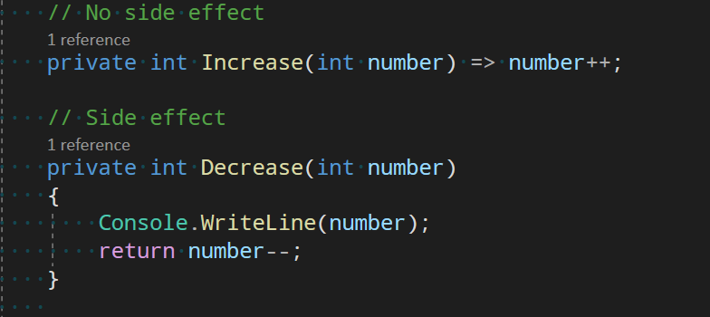
Pure Functions

Slide 18
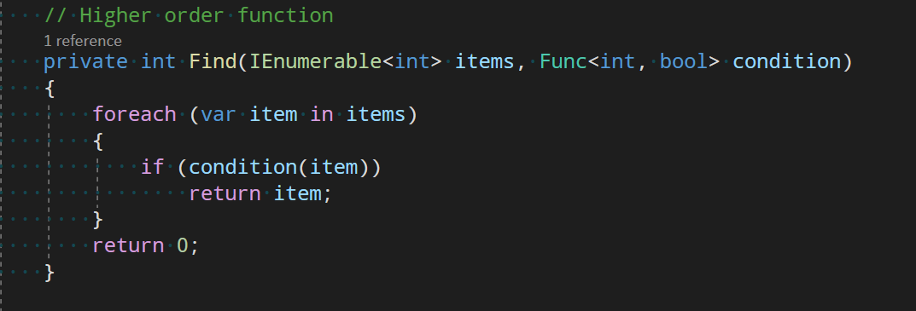
Higher Order Functions

Slide 19
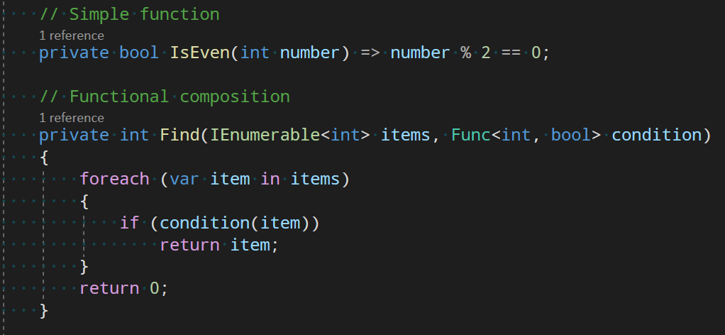
Functional Composition

Slide 20
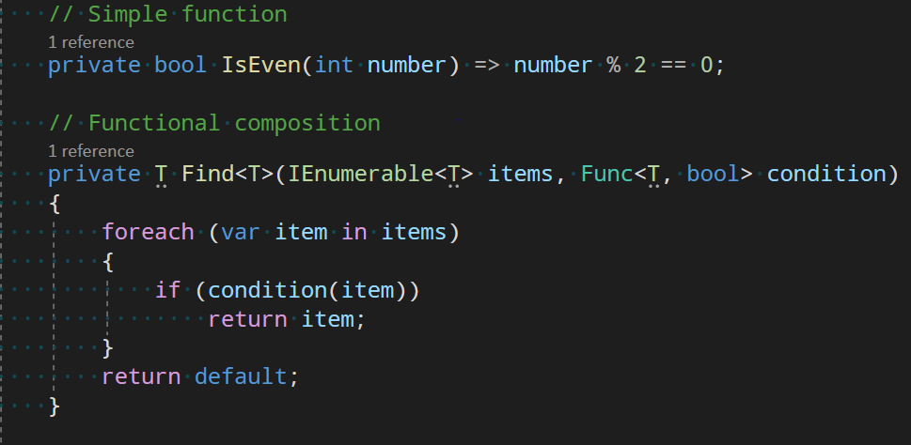
Functional Composition

Slide 21
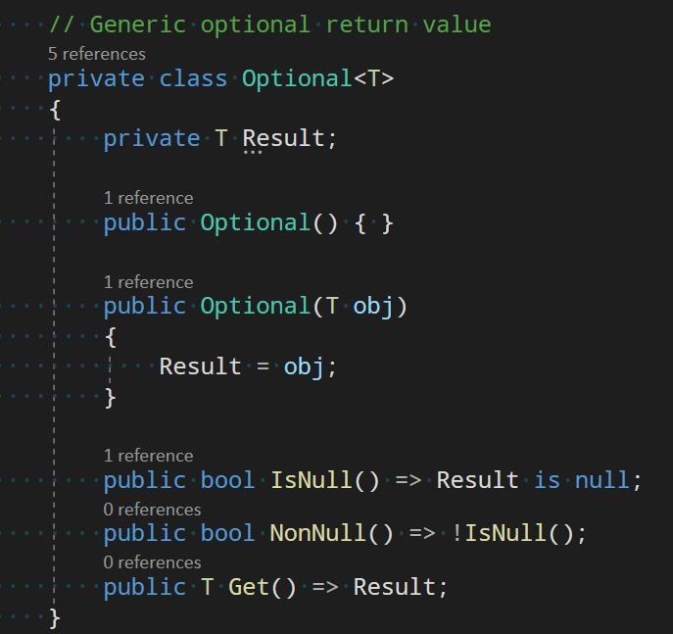
Optionals

Slide 22
Optionals

Slide 23
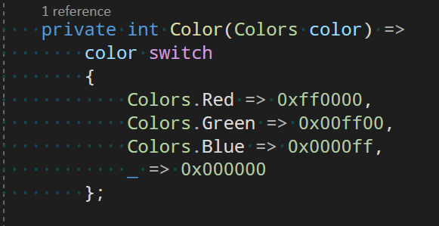
Expressiveness

Slide 24
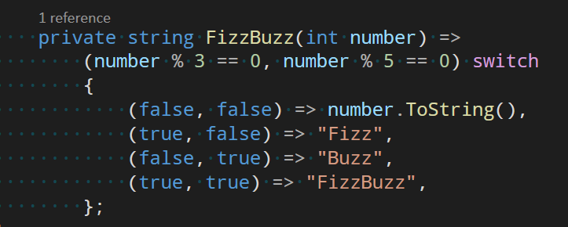
Expressiveness

Slide 25
Expressiveness

Slide 26
Lazyness

Slide 27
Immutability

Slide 28
Map -> Reduce

Slide 29
Map -> Reduce

Slide 30
Map -> Reduce

Slide 31
Conclusion
Expressions over statements
Declarative over imperative
Composition
Pure functions
Pipes
Laziness
Immutability
Small functions

Slide 32
Goals
Readability
Maintainability
Scalability

Slide 33
Stay funky
Felix Sauer
Software-Developer
717
felix.sauer@baramundi.com

