Slide 1
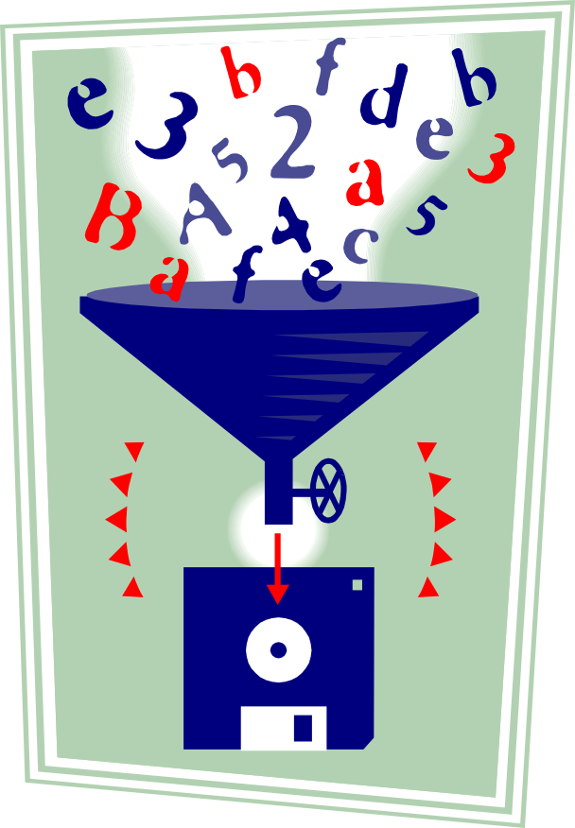
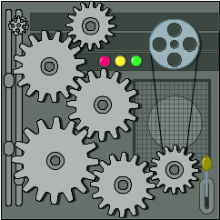

Automatically Grading Programming Assignments with Web-CAT
Stephen H. Edwards
Manuel A. Pérez-Quiñones
Virginia Tech
Dept. of Computer Science
{edwards,perez}@cs.vt.edu
http://web-cat.sourceforge.net/

Slide 2
What is Web-CAT?
A flexible, extendable automated grading system that can support virtually any programming language
Completely web-based submission and feedback
Full support for manual grading too
All grading actions and feedback are controlled by plug-ins
Why did we develop Web-CAT?

Slide 3
More and more educators are adding software testing to their programming courses
Now it’s almost routine
Tools like JUnit, and XUnit frameworks for other languages, make it much easier
Built-in support by many mainstream and educational IDEs makes it much easier
Many instructors have also experimented with automated grading based on such testing frameworks
Here are our experiences in teaching test-driven development with the help of an automated grader over the past 3 years

Slide 4
Why have we added software testing across our programming core?
CS1
Students cannot test their own code
Want a culture shift in student behavior
A single upper-division course would have little impact on practices in other classes
So: Systematically incorporate testing practices across many courses
CS2
Testing
Practices
OO
Design
Data
Struct

Slide 5
Practicing software testing will help students frame and carry out experiments
The problem: too much focus on synthesis and analysis too early in teaching CS
Need to be able to read and comprehend source code
Envision how a change in the code will result in a change in the behavior
Need explicit, continually reinforced practice in hypothesizing about program behavior and then experimentally verifying their hypotheses

Slide 6
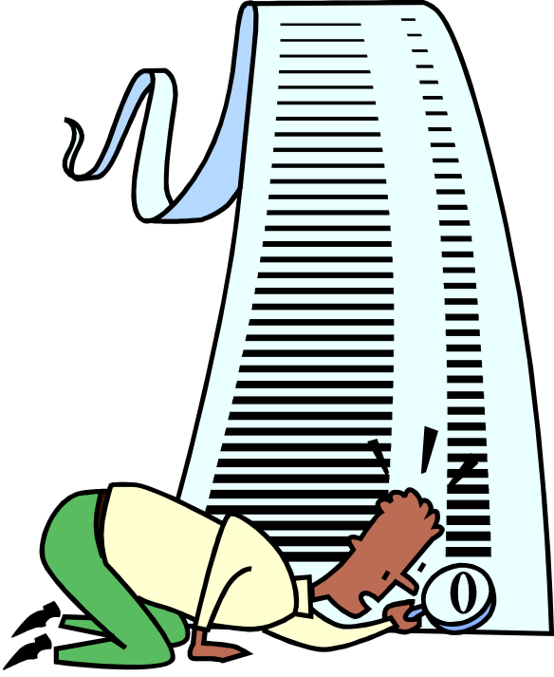
Expect students to apply their testing skills all the time in programming assignments
Expect students to test their own work
Empower students by engaging them in the process of assessing their own programs
Require students to demonstrate the correctness of their own work through testing
Do this consistently across many courses

Slide 7
Test-driven development is very accessible for students
Also called “test-first coding”
Focuses on thorough unit testing at the level of individual methods/functions
“Write a little test, write a little code”
Tests come first, and describe what is expected, then followed by code, which must be revised until all tests pass
Encourages lots of small (even tiny) iterations

Slide 8

Students can apply TDD in assignments and get immediate, useful benefits
Conceptually, easy for students to understand and relate to
Increases confidence in code
Increases understanding of requirements
Preempts “big bang” integration

Slide 9

We use Web-CAT to automatically process student submissions and check their work
Web application written in 100% pure Java
Deployed as a servlet
Built on Apple’s WebObjects
Uses a large-grained plug-in architecture internally, providing for easily extensible data model, UI, and processing features

Slide 10
Web-CAT’s strengths are targeted at broader use
Security: mini-plug-ins for different authentication schemes, global user permissions, and per-course role-based permissions
Portability: 100% pure Java servlet for Web-CAT engine
Extensibility: Completely language-neutral, process-agnostic approach to grading, via site-wide or instructor-specific grading plug-ins
Manual grading: HTML “web printouts” of student submissions can be directly marked up by course staff to provide feedback

Slide 11
Grading plug-ins are the key to process flexibility and extensibility in Web-CAT
Processing for an assignment consists of a “tool chain” or pipeline of one or more grading plug-ins
The instructor has complete control over which plug-ins appear in the pipeline, in what order, and with what parameters
A simple and flexible, yet powerful way for plug-ins to communicate with Web-CAT, with each other
We have a number of existing plug-ins for Java, C++, Scheme, Prolog, Pascal, Standard ML, …
Instructors can write and upload their own plug-ins
Plug-ins can be written in any language executable on the server (we usually use Perl)

Slide 12
The most well-known plug-in is for grading Java assignments that include student tests
ANT-based build of arbitrary Java projects
PMD and Checkstyle static analysis
ANT-based execution of student-written JUnit tests
Carefully designed Java security policy
Clover test coverage instrumentation
ANT-based execution of optional instructor reference tests
Unified HTML web printout
Highly configurable (PMD rules, Checkstyle rules, supplemental jar files, supplemental data files, java security policy, point deductions, and lots more)

Slide 13
Web-CAT supports a variety of languages, and its Java plug-in is aimed at software testing
ANT-based build of arbitrary Java projects
PMD and Checkstyle static analysis
ANT-based execution of student-written JUnit tests
Carefully designed Java security policy
Clover test coverage instrumentation
ANT-based execution of optional instructor reference tests
Unified HTML web printout
Highly configurable (PMD rules, Checkstyle rules, supplemental jar files, supplemental data files, java security policy, point deductions, and lots more)

Slide 14
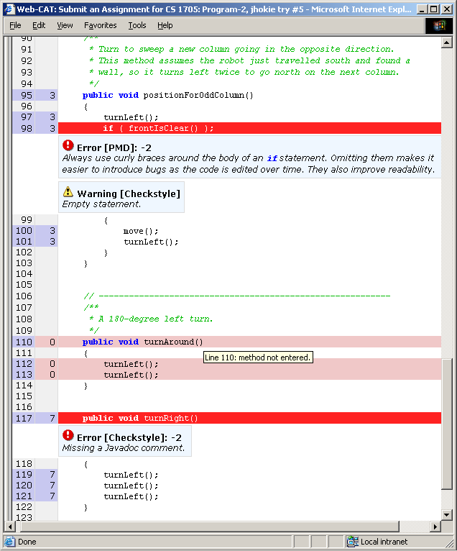
Web-CAT provides timely, constructive feedback on how to improve performance
Indicates where code can be improved
Indicates which parts were not tested well enough
Provides as many “revise/ resubmit” cycles as possible

Slide 15
Assessing student tests is tricky, so we use complementary methods
First, we measure how many of the student’s own tests pass
Second, we instrument student code and measure code coverage while the student’s tests are running
Third, we use instructor-provided reference tests to cross-check the student’s tests
We multiply the percentages together, so students must excel at all three to increase their score

Slide 16
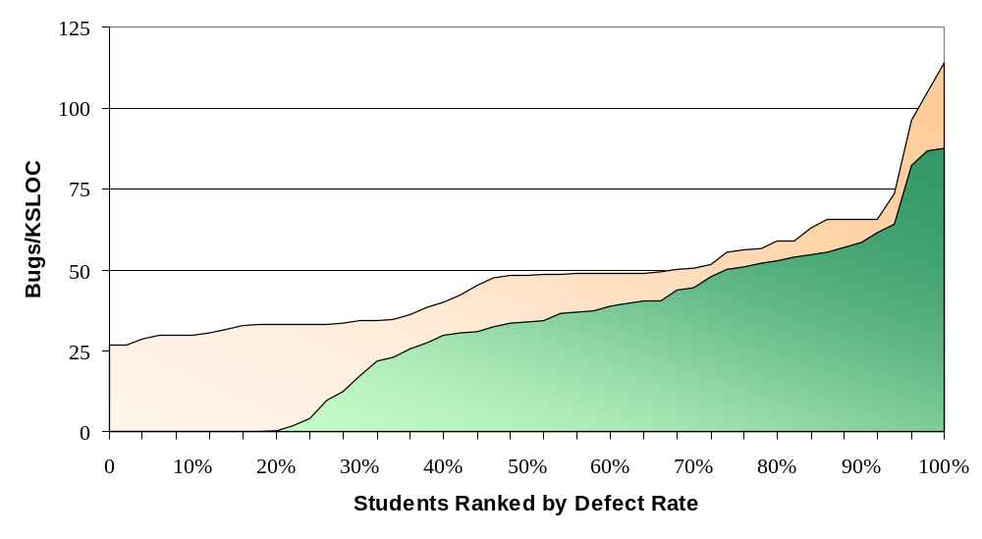
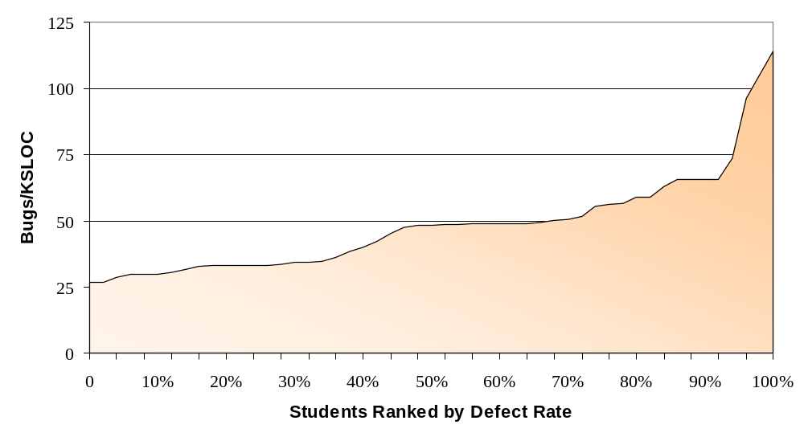
Students improve their code quality when using Web-CAT
Newly written “untested” code
Commerical-quality code

Slide 17
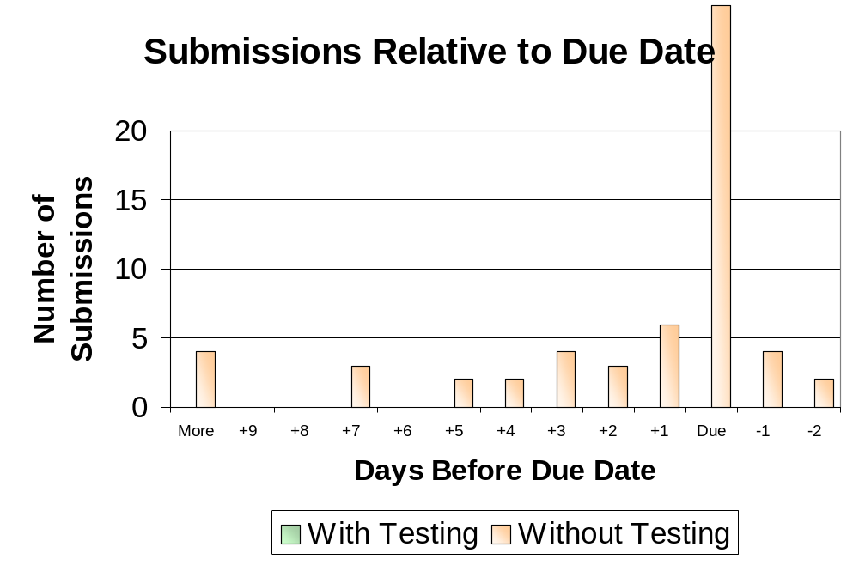
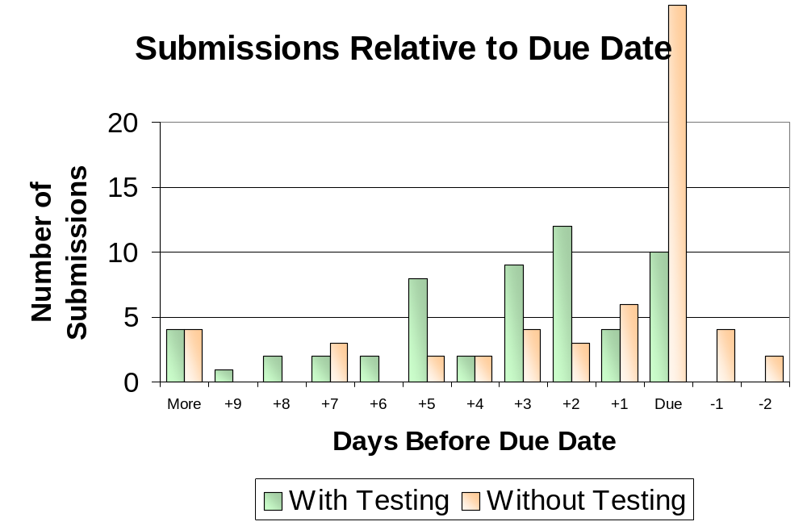
Students start earlier and finish earlier when they use Web-CAT

Slide 18
Let’s get to the hands-on exercises!
All the materials are in your packet and on your CD
We’ll demonstrate some of the basic steps up here

