Slide 1

UI / UX Design
Software Development Class – SMK IDN Madinatul Ilmi
Create By : Rizki Syaputra - www.rizkisangpemimpi.wordpress.com

Slide 2
What is UI ?
UI or User Interface (antarmuka pengguna). UI has relation with users , how to control and operate the system. Many user interfaces have relation with physics example : button, screen, textview, touchscreen, audio control like voice command.
Generally, UI focus on display or screen. Dan how to make relation with UX

Slide 3
What is UX ?
UX or User Experience. Its only focus on feel of users when user use that system or product. Beside that, UX also focus on how to make freshness of UI.
So, UX only for user not for what design want to be

Slide 4
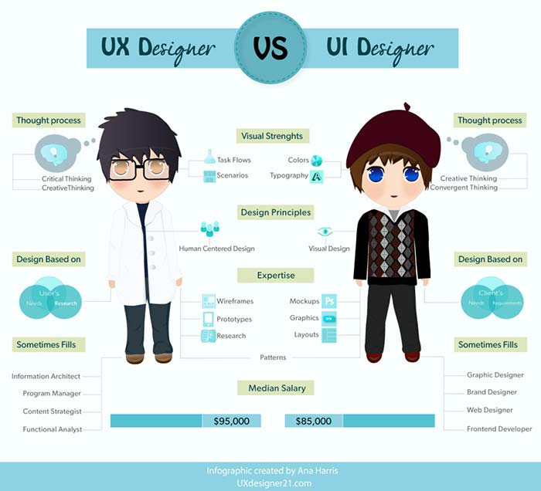

Slide 5
Step by Step to make Apps
Have Idea
Wireframe
Design Apps using sketch, photoshop, or etc
Make apps using Xcode for iOS Apps, Android Studio for Android

Slide 6
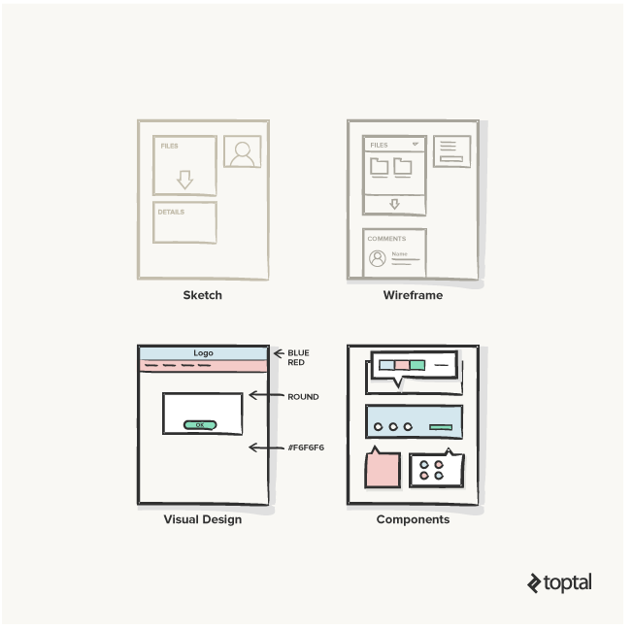
Design Concept

Slide 7
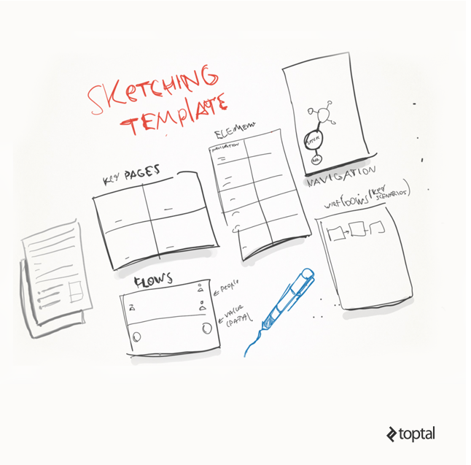
Wireframe

Slide 8
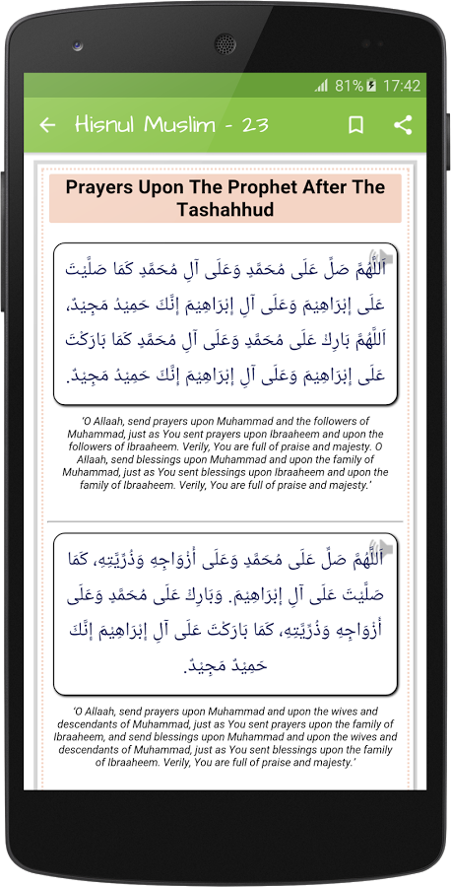
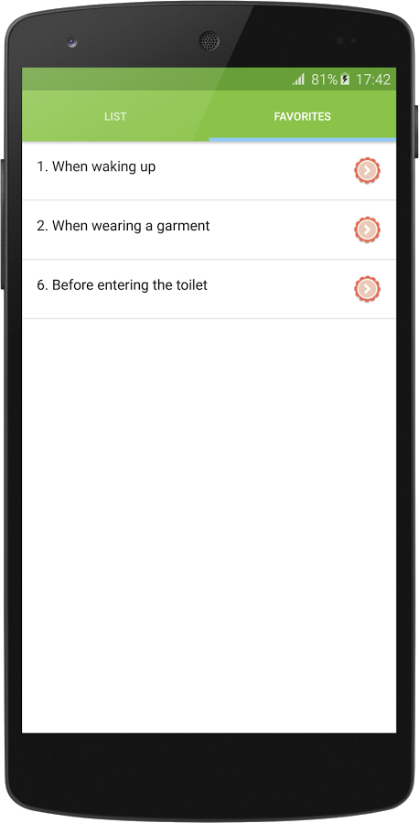
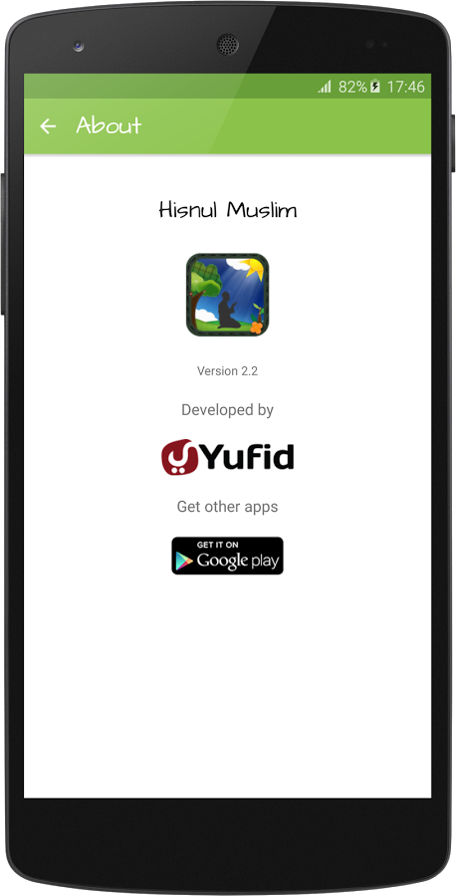

Slide 9
Software
Sketch
Adobe Photoshop
Adobe Ilustrator
Zeplin

Slide 10
Resource Image
Freepik
Flat Icon
Makeappicon

Slide 11
References
https://www.dumetschool.com/blog/Perbedaan-UI-dan-UX
http://www.intraktive.com/article/99-sekilas-tentang-user-experience
https://developer.apple.com/design/resources/
http://learnsketch.com/tutorials

Slide 12
Any Questions ?

