Slide 1












What is ?
What is not ?
Java script library
A Framework
UI render library
Rebass
React Toolbox
UI components build tool
does not solve any structural or architectural problems on the app level.
Base for frameworks and libraries
Reactstrap
React Bootstrap
Semantic UI React
React md
does not define entire application ecosystems. It works in compliance with the use of additional libraries (Redux, React-Router )
React Native Framework
Prime React
Material UI
React Node GUI Project
React Desktop
It just provides a set of methods for better handling front-end not for app’s architecture without global predefined patterns as MVC

Slide 2
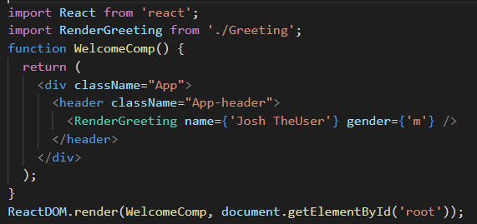
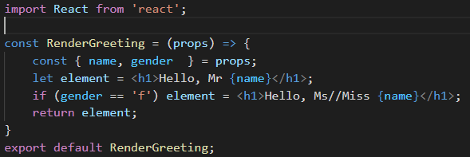
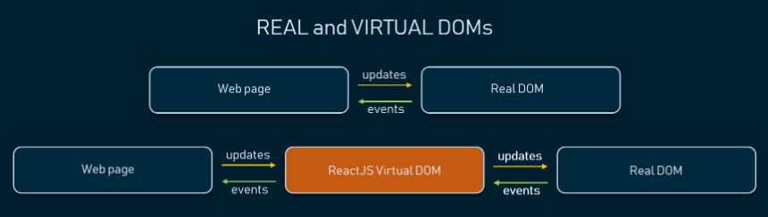
Why using REACT ?
1. Fast Learning Curve
‘Thinking in React’ https://reactjs.org/docs/thinking-in-react.html
2. Reusable Components
3. Fast render with Virtual DOM
Any view changes are first reflected to virtual DOM, then an efficient diff algorithm compares the previous and current states of the virtual DOM and calculates the best way (minimum amount of updates needed) to apply these changes

Slide 3
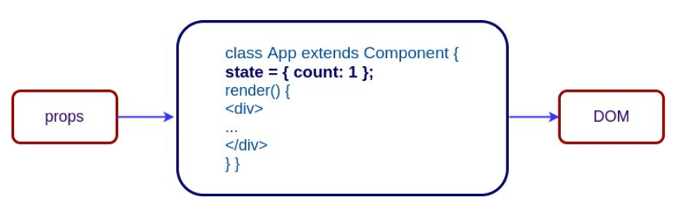
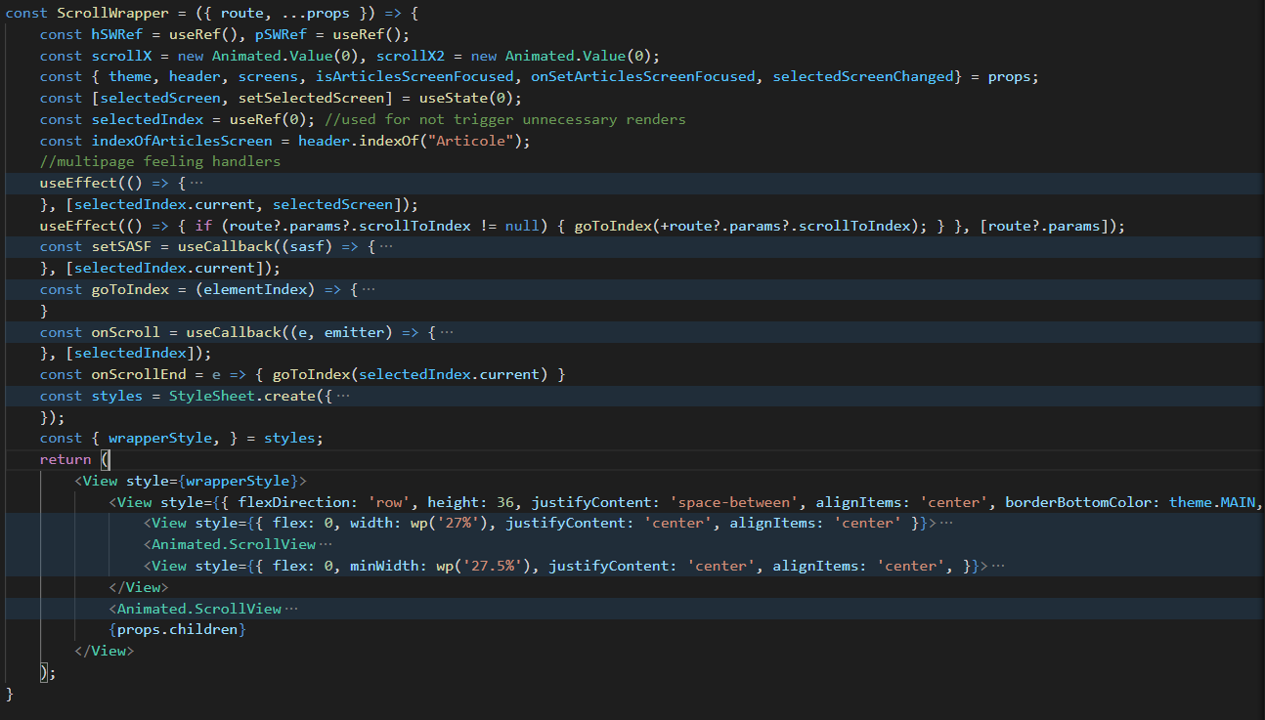
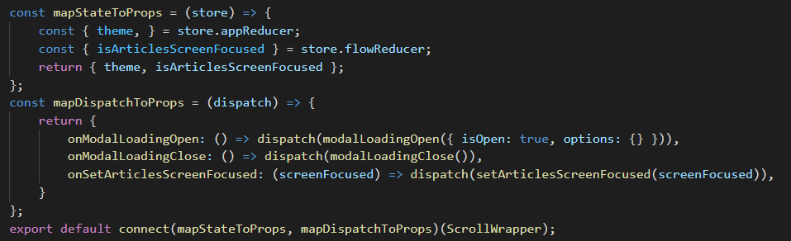
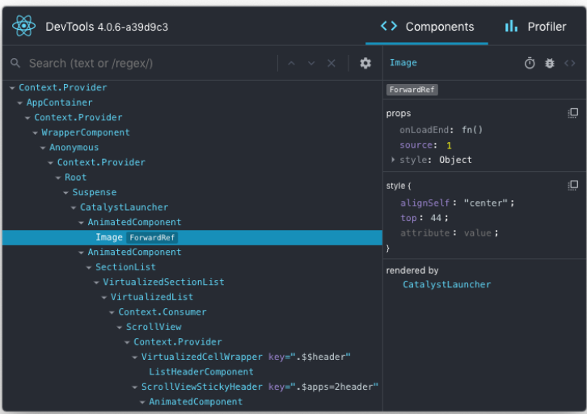
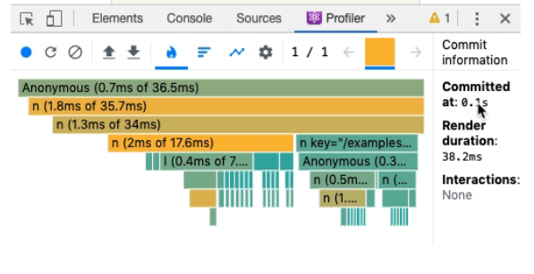
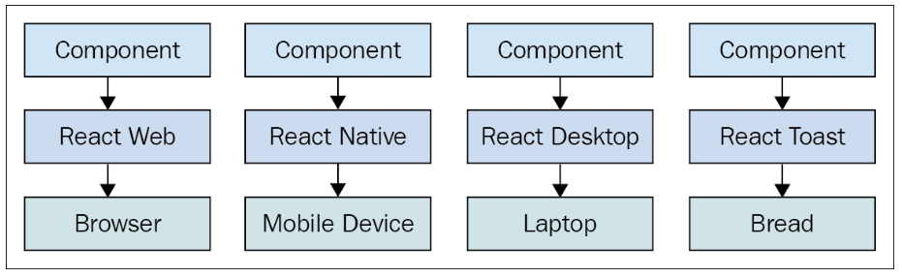
Why using REACT ?
4. Clean Abstraction
One-direction data flow
You only need to understand a component’s life cycles, states and props to master React to accomplish everything you need. React does not dictate any patterns or architecture like MVC/MVVM, after all its only about the view layer and you are free to design your app’s architecture in any way you see fit
5. Convenient state/store containers as React-Redux
6. Great Developer Tools
7. Wide Range of render targets

Slide 4
Cons of REACT ?
1. The pace of development
“Everything is evolving, and some developers
are not comfortable with keeping up with such a pace.”
Alterations now mostly relate to library updates and
adding new improvement features than changing core principles
https://2019.stateofjs.com/front-end-frameworks/
2. Poor documentation
“Some members of the community think that React technologies
are updating and accelerating so fast that there is no time
to write proper instruction.” Therefore not mastering the basics and trying to integrate an extra tool promising to accelerate the work of a library can lead to a real struggle at development level
3.Additional SEO hassle
https://rubygarage.org/blog/seo-for-react-websites

Slide 5
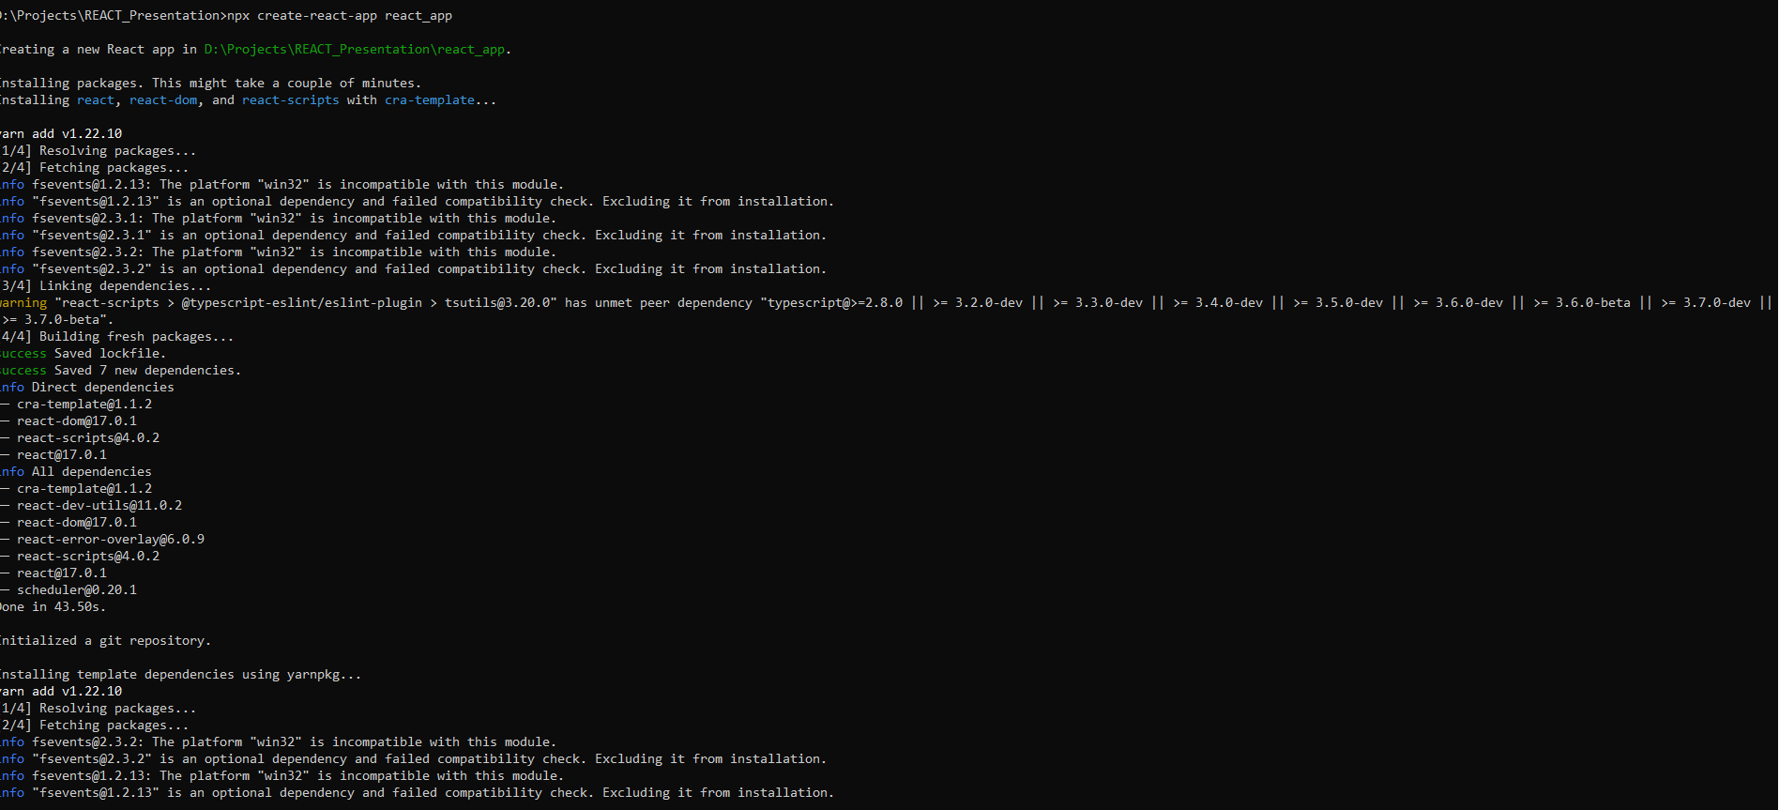
How to start develop using React?
https://reactjs.org/docs/getting-started.html#try-react
https://reactjs.org/docs/create-a-new-react-app.html
Prerequisites:
Node JS environment
any JS IDE (WebStorm,Komodo Edit, VSCode, Atom, Brackets)
installed create-react-app module

Slide 6
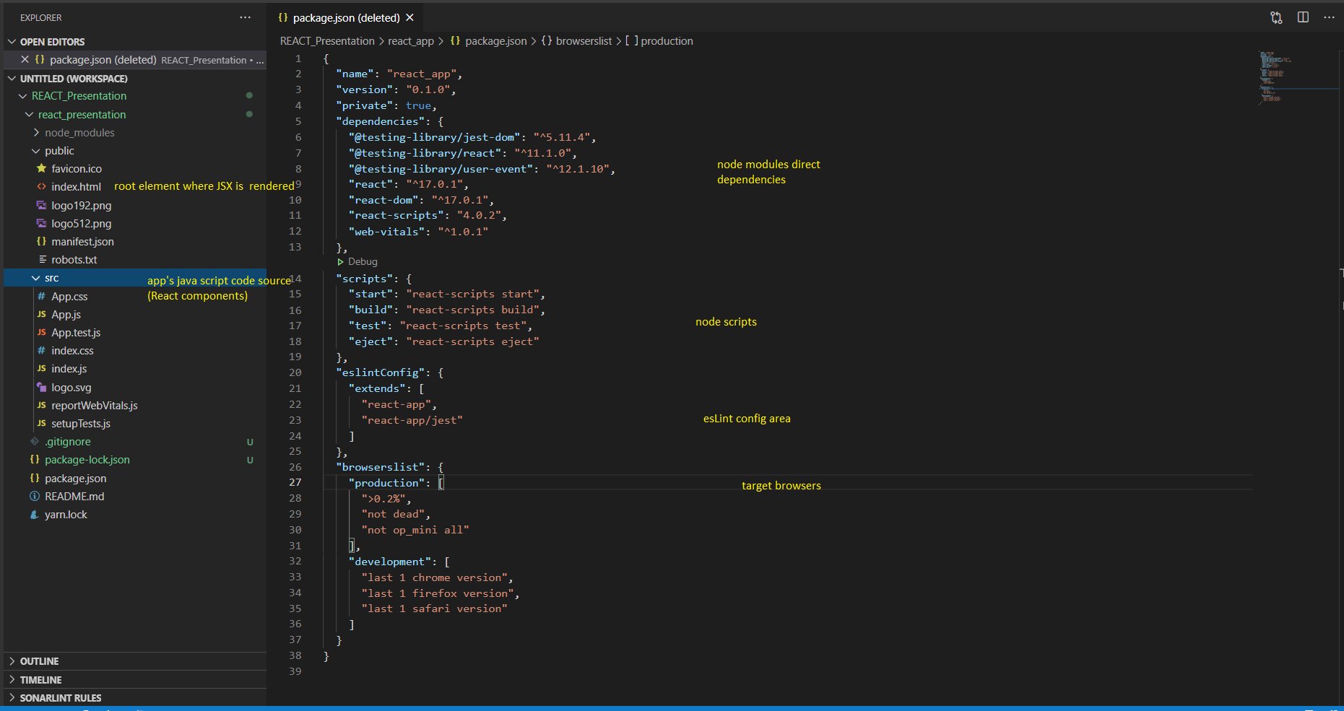
New single page application basic environment

Slide 7
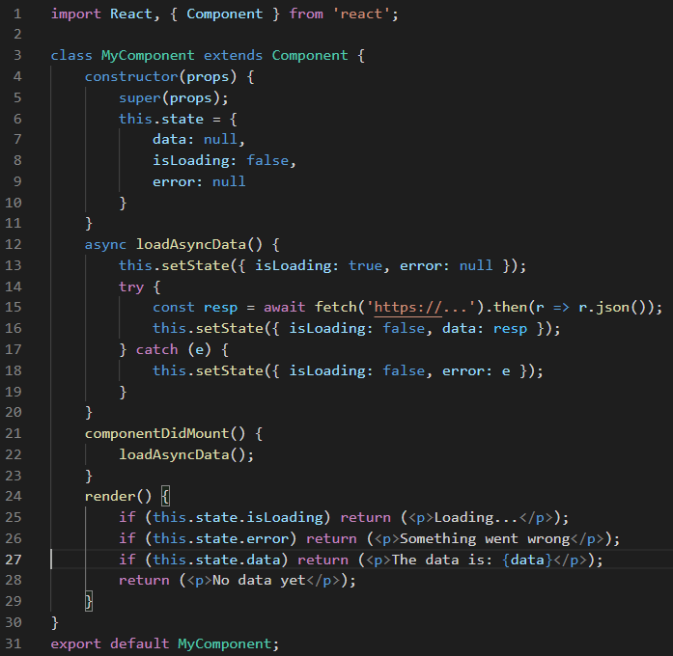
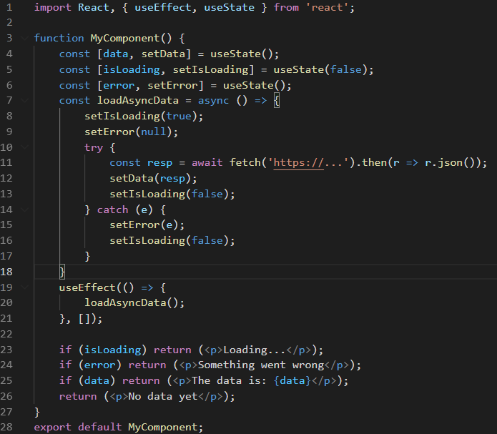
React Components
Class based
Function based

Slide 8
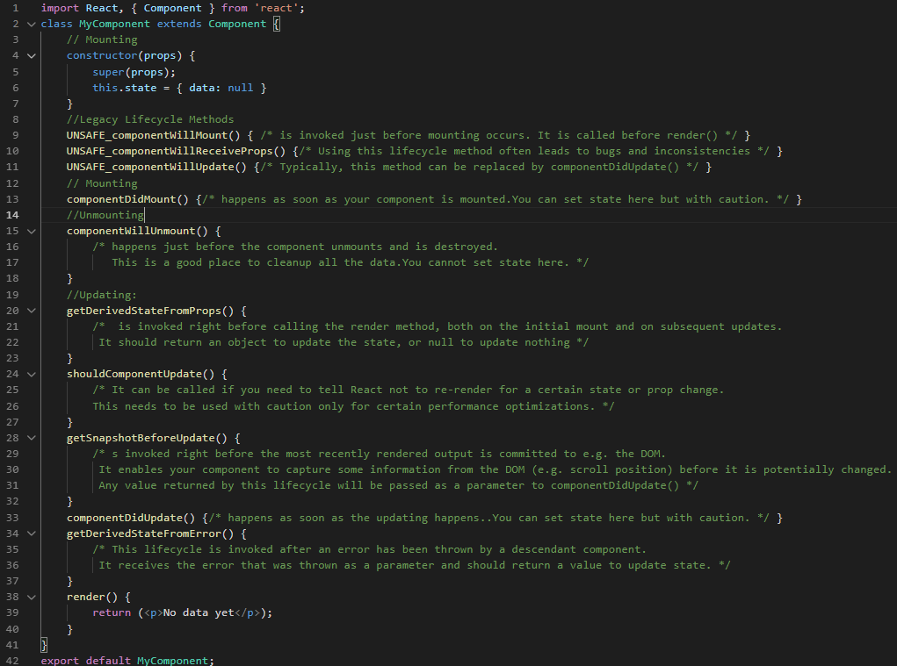
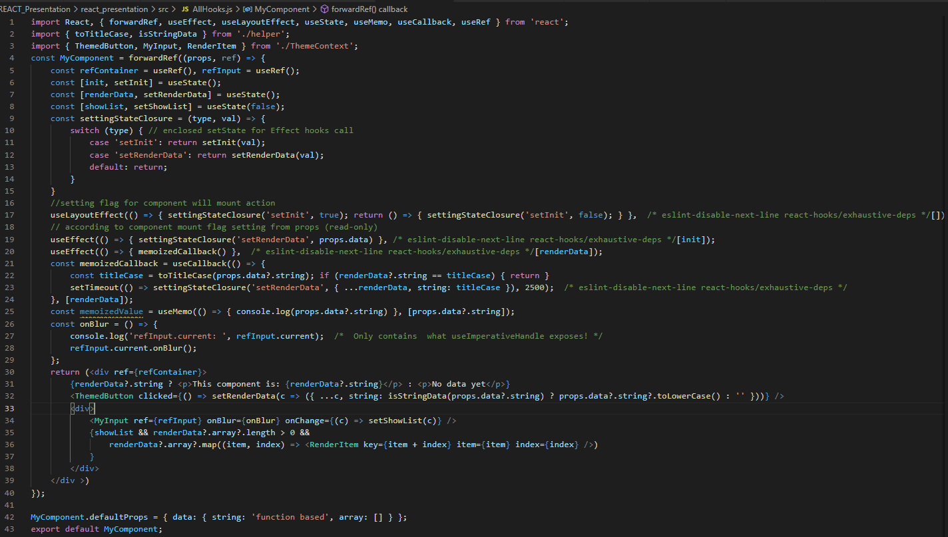
Life Cycle Methods
Hooks

Slide 9
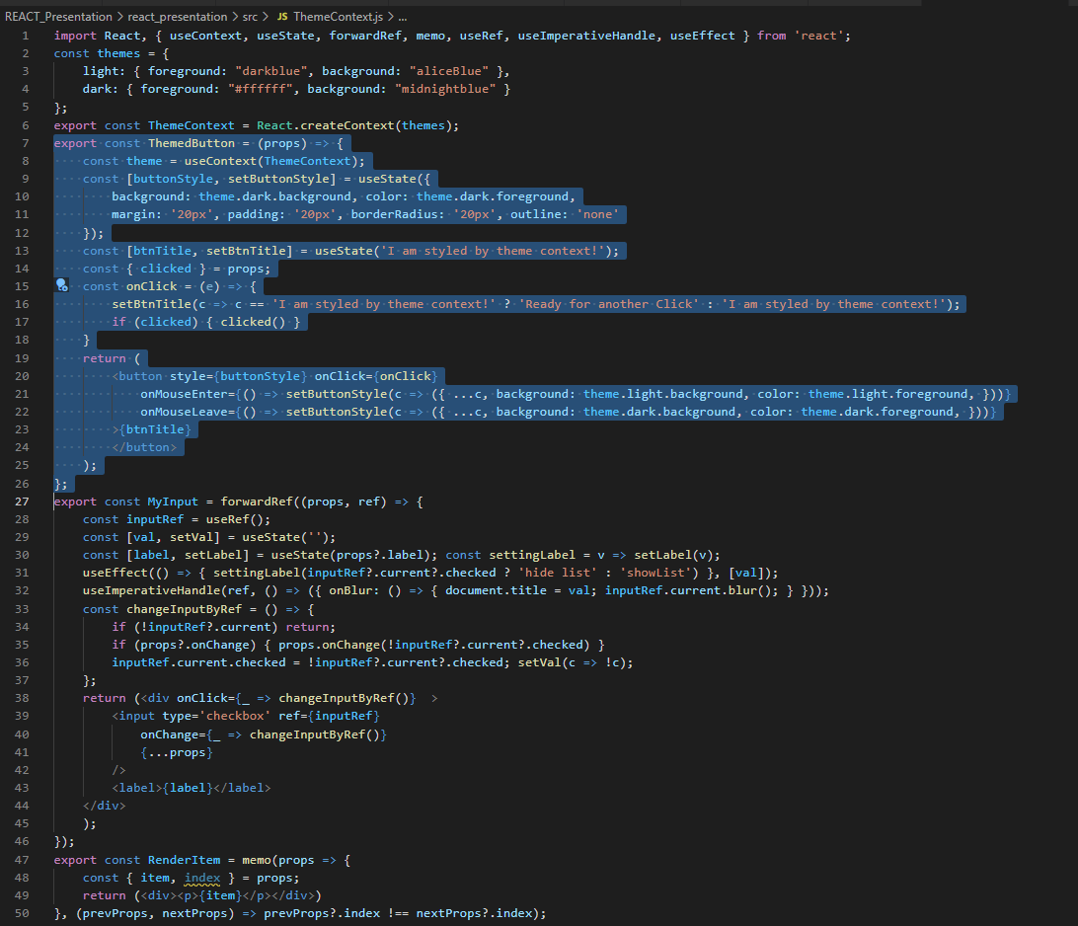
React function based reusable components

Slide 10
Styling
Inline CSS: Dependencies: None / [ radium,aphrodite,emotion]; Difficulty: Easy; Approach: Worst;
Regular CSS: Dependencies: None; Difficulty: Easy; Approach: Okay;
CSS-in-JS: Dependencies: None; Difficulty: Easy; Approach: Okay;
JSS: Dependencies: react-jss; Difficulty: Easy; Approach: Decent;
Styled-Components: Dependencies: styled-components; Difficulty: Medium; Approach: Decent;
CSS Modules: Dependencies: css-loader; Difficulty: Tough (Uses Loader Configuration); Approach: Better;
Sass & SCSS: Dependencies:node-sass; Difficulty:Easy; Approach: Best;
Less: Dependencies:less, less-loader; Difficulty:Easy; Approach: Good;
Stylable: Dependencies: stylable, @stylable/webpack-plugin, react-styleable; Difficulty:Difficult; Approach: Better;

Slide 11
...
The code screenshots mostly are extracted from the project available on
https://github.com/web-dev-s/react_presentation
For running the web app locally just :
>npm install (or yarn install)
>npm start (or yarn start)

