Slide 1
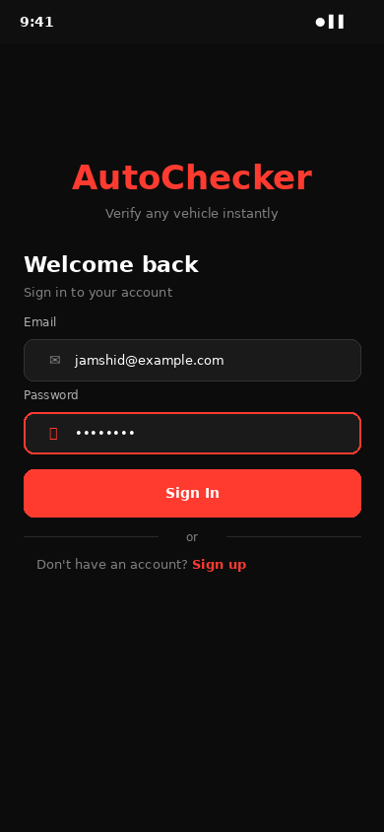
AutoChecker
Verify Any Vehicle. Instantly.
Mobile Application — Final Project Presentation
Team INZOCO
Jahongir Islomov (230033) · UI & Android Dev
Axror Nosirov (230085) · Backend Dev
Jamshid Vakhobov (230165) · Android & API
MODERN WEB & MOBILE APPLICATIONS · 2026

Slide 2
THE PROBLEM
Buying a Used Car is a Gamble
Consumers have no simple, affordable way to verify vehicle history before purchase.
ACC
KM
LAW
APP
Hidden Accident History
Odometer Fraud
Unknown Legal Status
No Verification Tool
Sellers conceal past collisions & damage reports
Mileage rolled back to inflate resale value
Stolen, pledged or arrested vehicles re-sold
Existing tools are expensive or hard to access

Slide 3
OUR SOLUTION
One App. Complete Vehicle History.
A free Android app that lets anyone look up a vehicle's full history in seconds — by plate or VIN.
SEARCH
Instant Search
LANG
Multi-Language
Enter plate or VIN. Get results in under 2 seconds from local DB.
Uzbek, Russian, English — accessible to all local users.
REPORT
Full History
CAM
Accident Report
Accidents, mileage, insurance, legal status & service records.
Document and submit collision data with photos from your phone.
ALERT
Live Alerts
SAVE
Saved Vehicles
Get notified the moment a saved vehicle's status changes.
Bookmark & track vehicles over time using Jetpack DataStore.

Slide 4
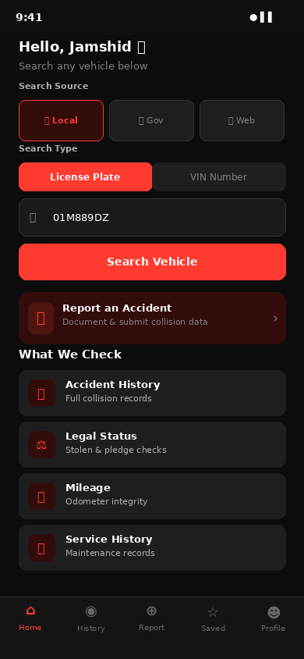
APP SCREENS
Authentication & Home Search
Secure Auth
JWT tokens stored safely in DataStore
Smart Search
Search by License Plate or VIN number
Source Select
Local DB / Gov API / Internet sources
Quick Access
Report accidents directly from home screen
Login Screen
Home / Search Screen
JWT auth · DataStore token cache
Plate & VIN · Source selector

Slide 5
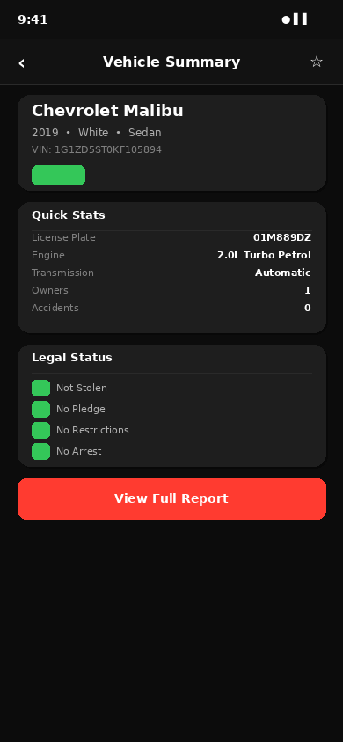
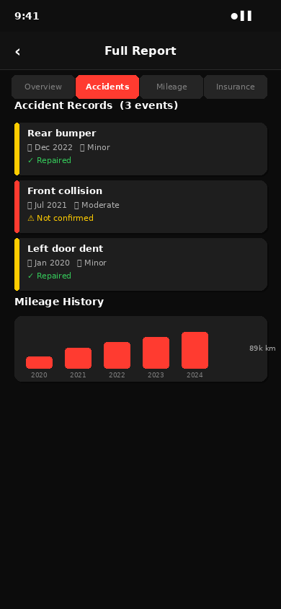
APP SCREENS
Vehicle Summary & Full Report
Status Badge
CLEAN / WARNING / STOLEN at a glance
Legal Checks
Stolen · Pledge · Restrictions · Arrest
Accident History
Full timeline with severity & repair status
Mileage Chart
Year-by-year odometer trend visualization
Vehicle Summary
Full Report
Specs · Legal · Save bookmark
Accidents · Mileage · Insurance

Slide 6
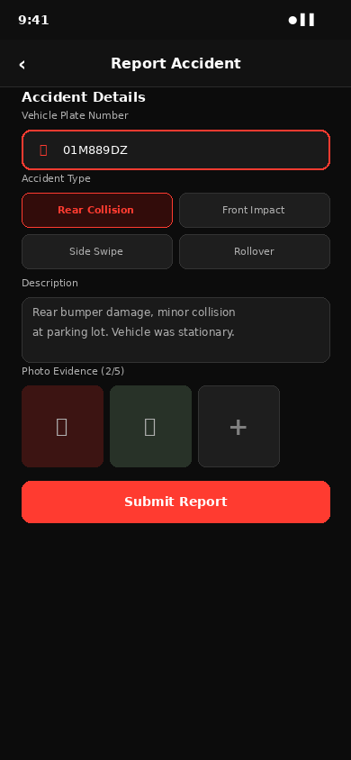
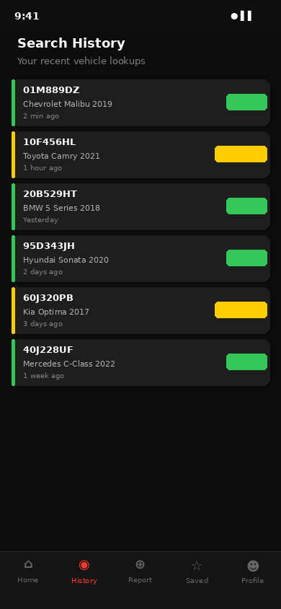
APP SCREENS
Report Accident & Search History
Photo Upload
Up to 5 photos per accident report
Accident Types
Rear · Front · Side · Rollover categories
Full History
Server-side paginated past lookups
Color Coding
Green CLEAN · Yellow WARNING · Red STOLEN
Search History
Paginated · Status color-coded
Report Accident
Plate · Type · Photos · Submit

Slide 7
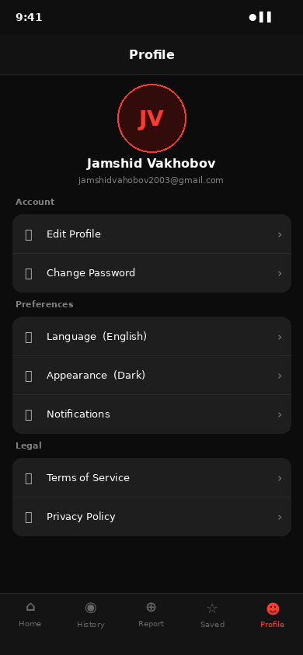
APP SCREENS
Profile, Settings & Saved Vehicles
USER
Edit Profile
Update name, email, and avatar
FAV
Saved Vehicles
Bookmark any vehicle for quick re-check
LANG
Multi-Language
English · Uzbek · Russian supported
STORE
DataStore Cache
DARK
Dark / Light
Persists offline using Jetpack DataStore
Follows system theme with manual override
SYNC
Re-check Anytime
BELL
Notifications
Re-run search on saved vehicles instantly
Alerts when saved vehicle status changes
LEGAL
Terms & Privacy
In-app legal documents and privacy policy
Profile & Settings
Edit · Language · Appearance · Legal

Slide 8
KEY FEATURES
What AutoChecker Delivers
VIN
VIN / Plate Search
ACC
Accident History
LAW
Legal Status Check
Instant lookup via REST API. Results in under 2s from local DB.
Full collision records with severity, repair status & photos.
Stolen vehicles, pledges, restrictions & arrest flags.
KM
Mileage Verification
BELL
Smart Notifications
CAM
Accident Reporting
Odometer history with year-by-year trend chart.
Real-time alerts when saved vehicles update status.
Submit collision reports with photos directly from app.
FAV
Saved Vehicles
LOG
Search History
LANG
Multi-Language
Bookmark & monitor vehicles with Jetpack DataStore.
Full paginated history of all past checks, stored server-side.
Full localization: Uzbek, Russian, and English.

Slide 9
SYSTEM ARCHITECTURE
How It All Works Together
AND
API
DJG
DB
Android Client
REST API Layer
Django Backend
Data Layer
Kotlin · Jetpack Compose Retrofit · DataStore Coroutines · Hilt DI
>
HTTP/HTTPS JWT Authentication JSON Responses
>
Django REST Framework Celery Task Queue Docker Containers
>
PostgreSQL (primary DB) Redis (cache + queue) Media file storage
All components containerized with Docker

Slide 10
TECH STACK
Built With Modern Tools
Frontend (Android)
Backend & Infrastructure
Kotlin
Django REST
Primary language, null-safe, expressive
Python REST API framework
Jetpack Compose
PostgreSQL
Modern declarative UI toolkit
Relational database for vehicle data
Hilt / DI
Redis
Dependency injection framework
Cache layer & Celery message broker
Retrofit
Celery
Type-safe HTTP client for API calls
Async task queue for background jobs
DataStore
Docker
Persistent local key-value storage
Containerized deployment
Coroutines
JWT Auth
Async/await for network operations
Token-based authentication

Slide 11
THE TEAM
Team INZOCO
JI
AN
JV
Jahongir Islomov
Axror Nosirov
Jamshid Vakhobov
ID: 230033
ID: 230085
ID: 230165
UI Designer & Android Dev
Backend Developer
Android Dev & API Lead
• Designed all app screens & UI components
• Built Django REST API endpoints
• Retrofit integration & API testing
• Implemented Jetpack Compose layouts
• PostgreSQL schema & migrations
• Hilt DI setup & architecture
• Material Design 3 theming & dark mode
• Docker containerization & deployment
• Celery async tasks & Redis caching

Slide 12
AutoChecker
Verify Any Vehicle. Instantly.
✓
Protects buyers from fraud and hidden damage
✓
Provides full accident, legal & mileage history
✓
Multi-language: Uzbek, Russian, English
✓
Fully containerized, production-ready backend
✓
Clean architecture: MVVM + Hilt + Coroutines
Thank You!
Team INZOCO · Modern Web & Mobile Applications · 2026

