Slide 1
LINE FOLLOWING
ROBOT CAR
Autonomous Navigation · Bluetooth Remote Control · Live Camera Feed
Ahror Nosirov · Jamshid Vakhobov · Islomov Jaxongir
Arduino SMARS Platform | 2026
Line Following Robot Car — Project Presentation

Slide 2
Project Overview
What we built and why
What is it?
A 3D-printed SMARS robot car that can autonomously follow a black line on a white surface, or be driven manually from a smartphone.
Why we built it?
To explore embedded systems, sensor integration, wireless communication, and real-time control in a single hands-on project.
What makes it special?
Three modes in one compact robot: fully autonomous line tracking, bluetooth remote control, and live ESP32-CAM video streaming.
[AUTO] AUTO MODE
Searches for & follows the line autonomously
[APP] REMOTE MODE
Bluetooth control via mobile app
[CAM] LIVE CAMERA
ESP32-CAM streams real-time video

Slide 3
Components Used
Everything that makes the robot work
ARDUINO UNO
HC-06 BLUETOOTH
The brain of the robot — runs all control logic and coordinates sensors, motors, and communication.
Receives commands from the mobile app for remote control mode.
2× DC MOTORS
ESP32-CAM
Drive the left and right wheels for forward, backward, and turning motion.
Wi-Fi camera module — streams live first-person video to the mobile device.
MOTOR DRIVER
9V KRONA BATTERY
L298N bridge driver — translates Arduino PWM signals into motor power.
Portable power supply for the entire system.
3× IR SENSORS
SMARS CHASSIS
HW-511 infrared modules detect black/white contrast to locate the line (left, center, right).
3D-printed modular chassis with tank-track Mecanum-style wheels.

Slide 4
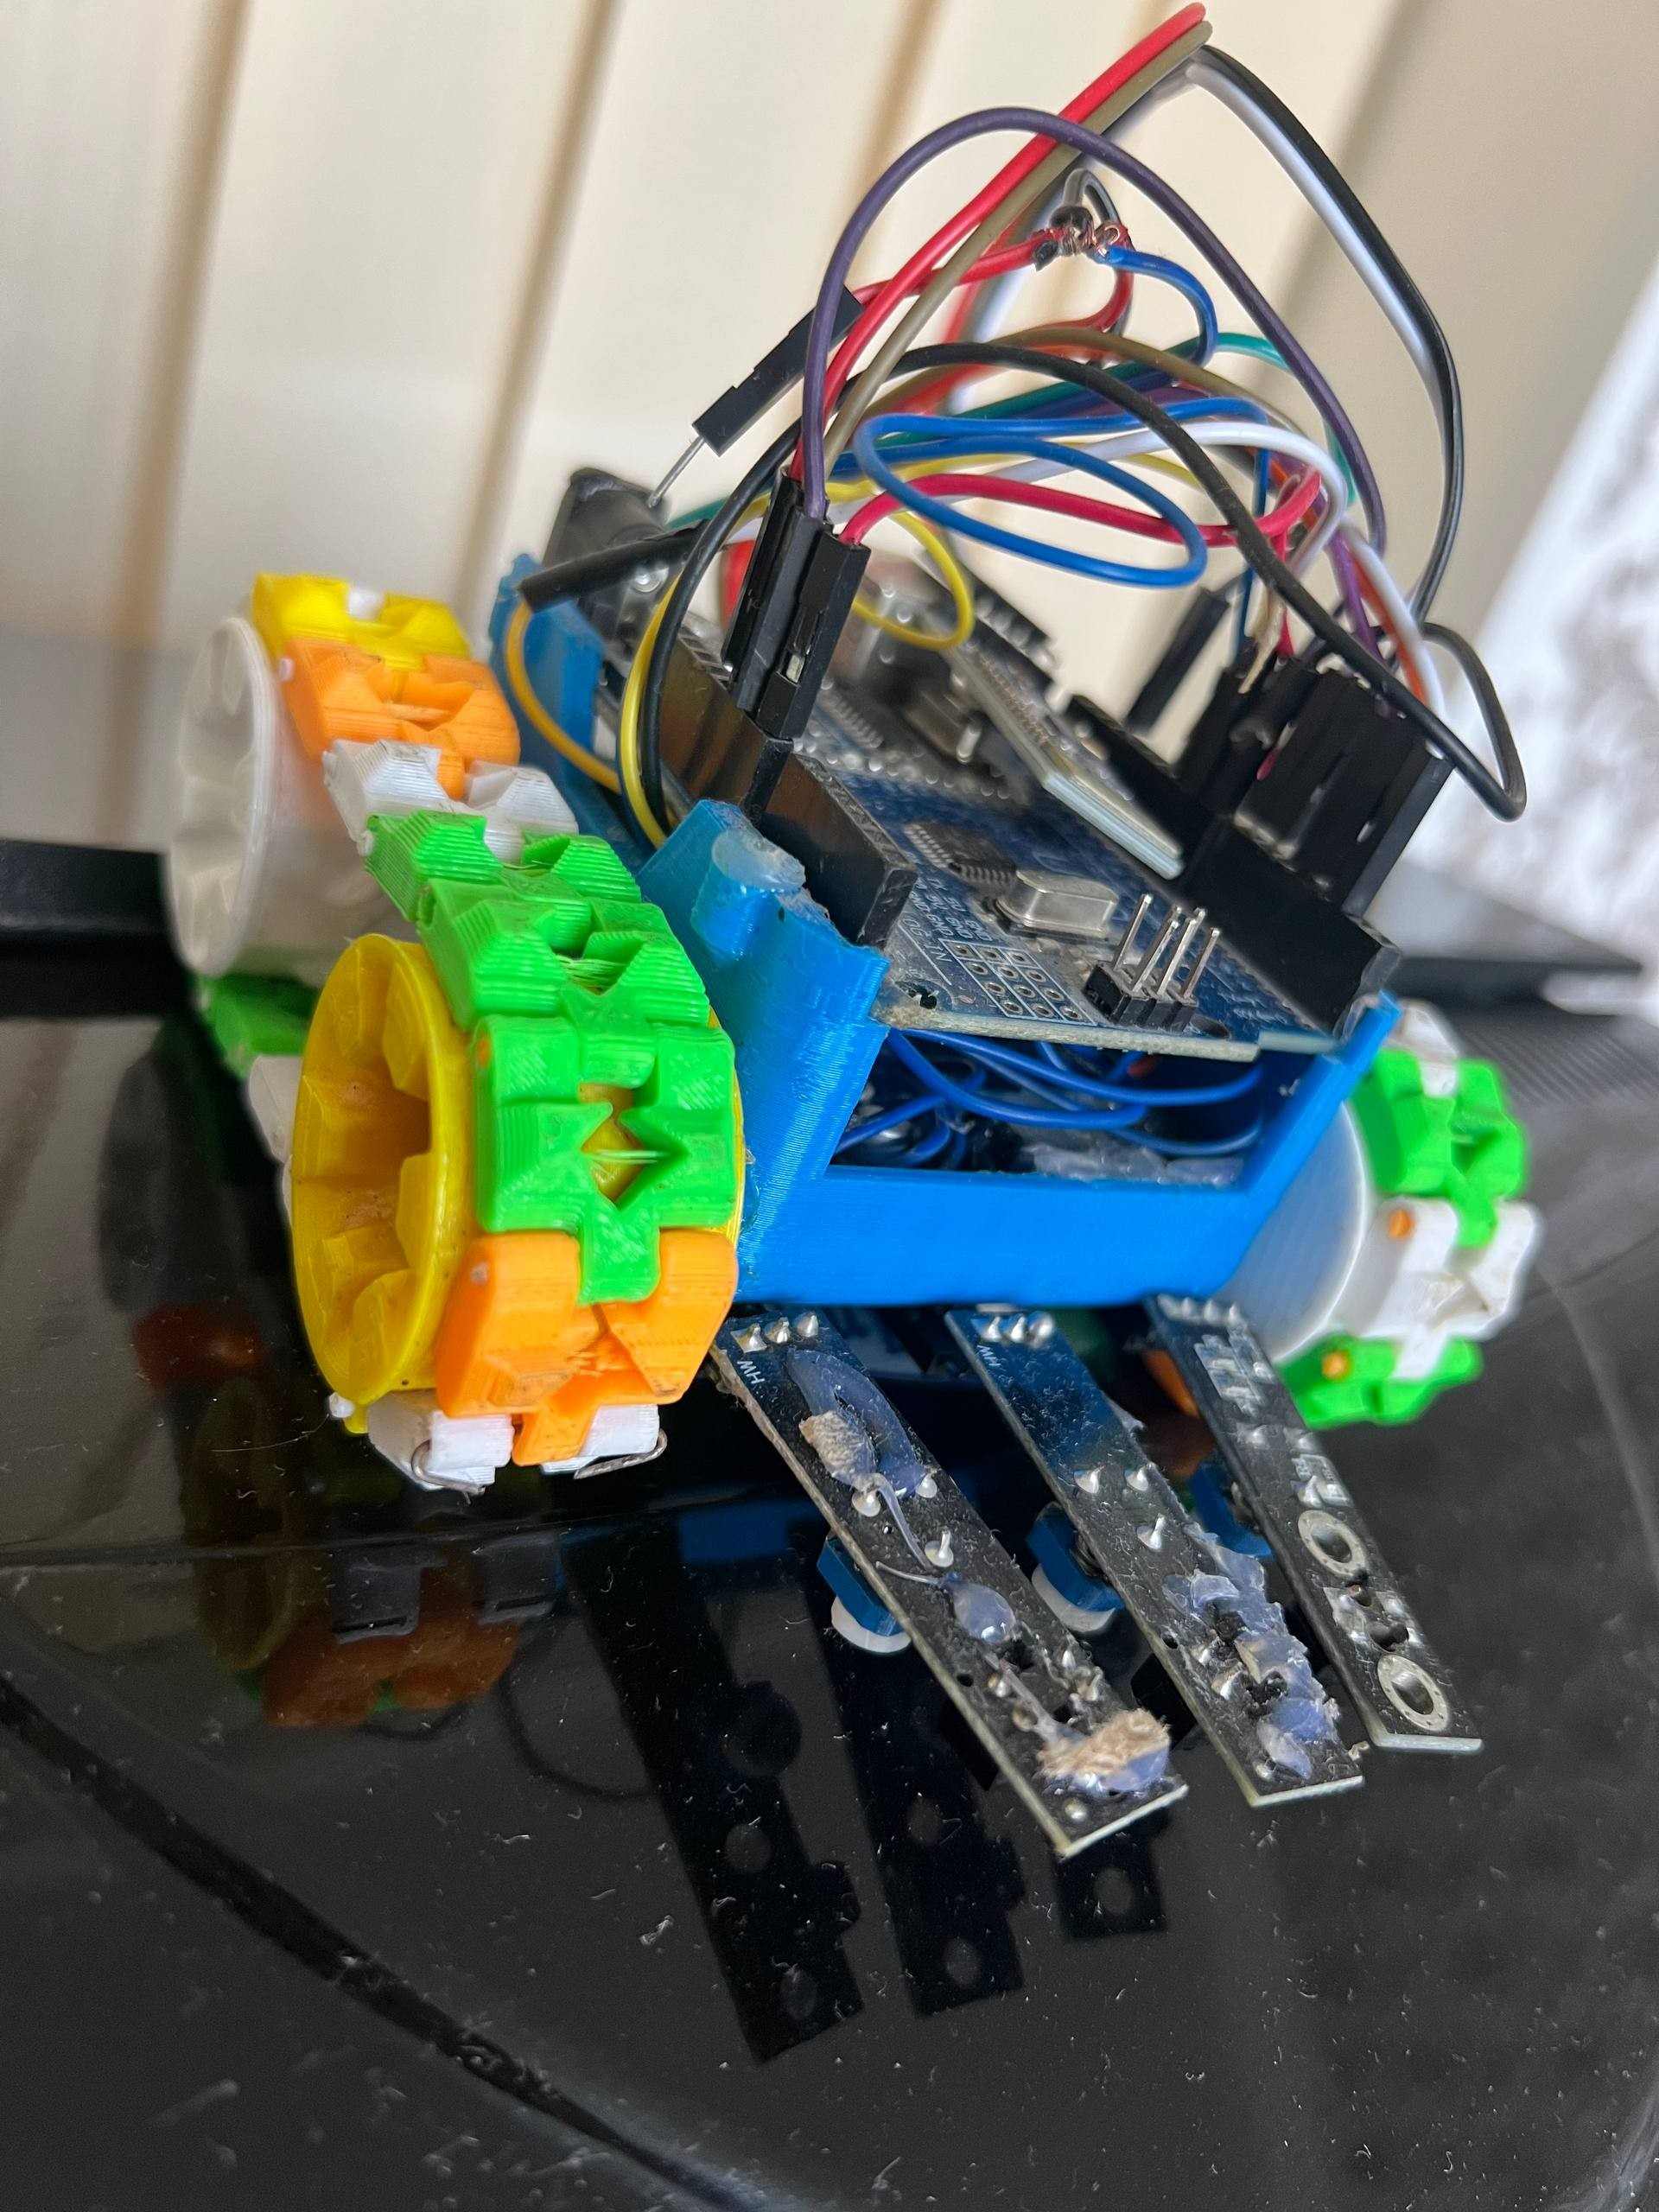
Chassis & Physical Design
SMARS — Screwless Modular Assemblable Robotic System
3D Printed SMARS Chassis
Open-source, fully 3D-printable robot platform designed for modularity.
Colorful Multi-Part Build
Printed in multiple colours (blue, green, yellow, orange, white) using FDM printing.
Tank-Track Wheel System
Custom interlocking track segments provide stable traction on flat surfaces.
Sensor Mount at Front
Three IR sensors mounted in a row at the front-bottom for accurate line detection.
Compact Stacked Layout
Motor driver, Arduino, and Bluetooth module stacked vertically inside the chassis to save space.
INSERT PHOTO
[Insert side/front chassis photo]

Slide 5
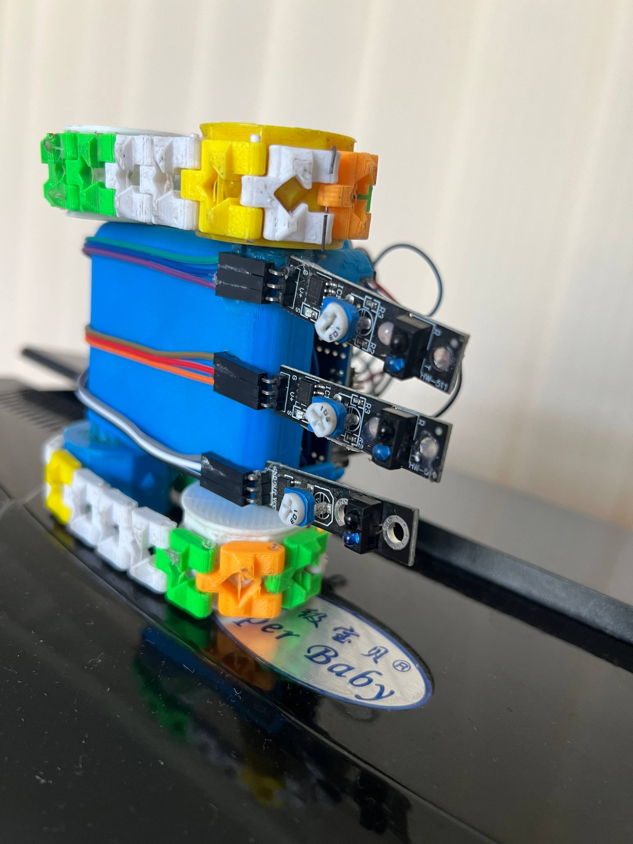
Electronics & Wiring
How all the components connect together
IR Sensors → Arduino
3 HW-511 IR modules → Digital pins D2, D3, D4
Arduino → Motor Driver
PWM pins → L298N IN1/IN2/IN3/IN4 + ENA/ENB
INSERT PHOTO
Motor Driver → Motors
OUT1/OUT2 → Left motor | OUT3/OUT4 → Right motor
[Insert wiring / top-view photo]
HC-06 → Arduino
TX → RX (pin 0) | RX → TX (pin 1)
ESP32-CAM → System
Independent Wi-Fi module powered from 5V rail
9V Battery → Motor Driver
VIN on L298N | 5V regulator output → Arduino & logic

Slide 6
How Line Following Works
IR sensor logic & decision algorithm
IR SENSOR STATES & MOTOR RESPONSE
LEFT
CENTER
RIGHT
→ ACTION
⚫ sees line
⚫ sees line
⚫ sees line
→ Go FORWARD (on line)
⚫ sees line
⚪ off line
⚪ off line
→ Turn LEFT
⚪ off line
⚪ off line
⚫ sees line
→ Turn RIGHT
⚪ off line
⚫ sees line
⚪ off line
→ Go FORWARD
⚪ off line
⚪ off line
⚪ off line
→ SEARCH (slow spin)
Algorithm Flow
Sensor Layout (Front View)
1. Read all 3 IR sensor values (HIGH = white, LOW = black line)
LEFT Sensor
CENTER Sensor
RIGHT Sensor
2. Evaluate combination against look-up table
3. Send PWM speed values to motor driver
← black line on white surface →
4. Loop every ~10 ms for smooth real-time tracking
5. If all sensors lose line → slow spin to search & re-acquire

Slide 7
Operating Modes
Two modes, one robot — switchable from the app
[AUTO] AUTO MODE
[APP] REMOTE MODE
• Activated by tapping AUTO in the mobile app
• Activated by tapping MANUAL in the mobile app
• Robot reads 3 IR sensors continuously
• HC-06 Bluetooth module receives commands
• Steers left/right to stay on the black line
• Commands: Forward, Backward, Left, Right, Stop
OR
• If line is lost, enters search mode (slow rotation) until line is re-found
• App sends single-character codes (F, B, L, R, S)
• Speed is adjustable via the app slider
• Arduino parses command & drives motors accordingly
• Fully hands-free once activated
• IR sensors are ignored in this mode

Slide 8
Mobile App & Bluetooth Control
HC-06 module + Android app
App Interface
Custom Android app with directional buttons, mode switch (Auto/Manual), speed slider, and live camera view.
Bluetooth Connection (HC-06)
HC-06 is a classic Bluetooth 2.0 serial module. Pairs with smartphone like any Bluetooth device. Range: ~10 metres.
Command Protocol
Simple single-byte serial protocol:
F = Forward B = Backward L = Turn Left
R = Turn Right S = Stop A = Auto mode
Response Time
Near real-time response (~50–100 ms latency) — fast enough for smooth manual driving.
Safety
Robot stops automatically if Bluetooth connection is lost.
App Layout (Schematic)
^ FORWARD
< LEFT
[] STOP
RIGHT >
v BACK
AUTO MODE * MANUAL MODE
SPEED: =======O 80%
[CAM] Live Camera Feed (ESP32-CAM stream)

Slide 9
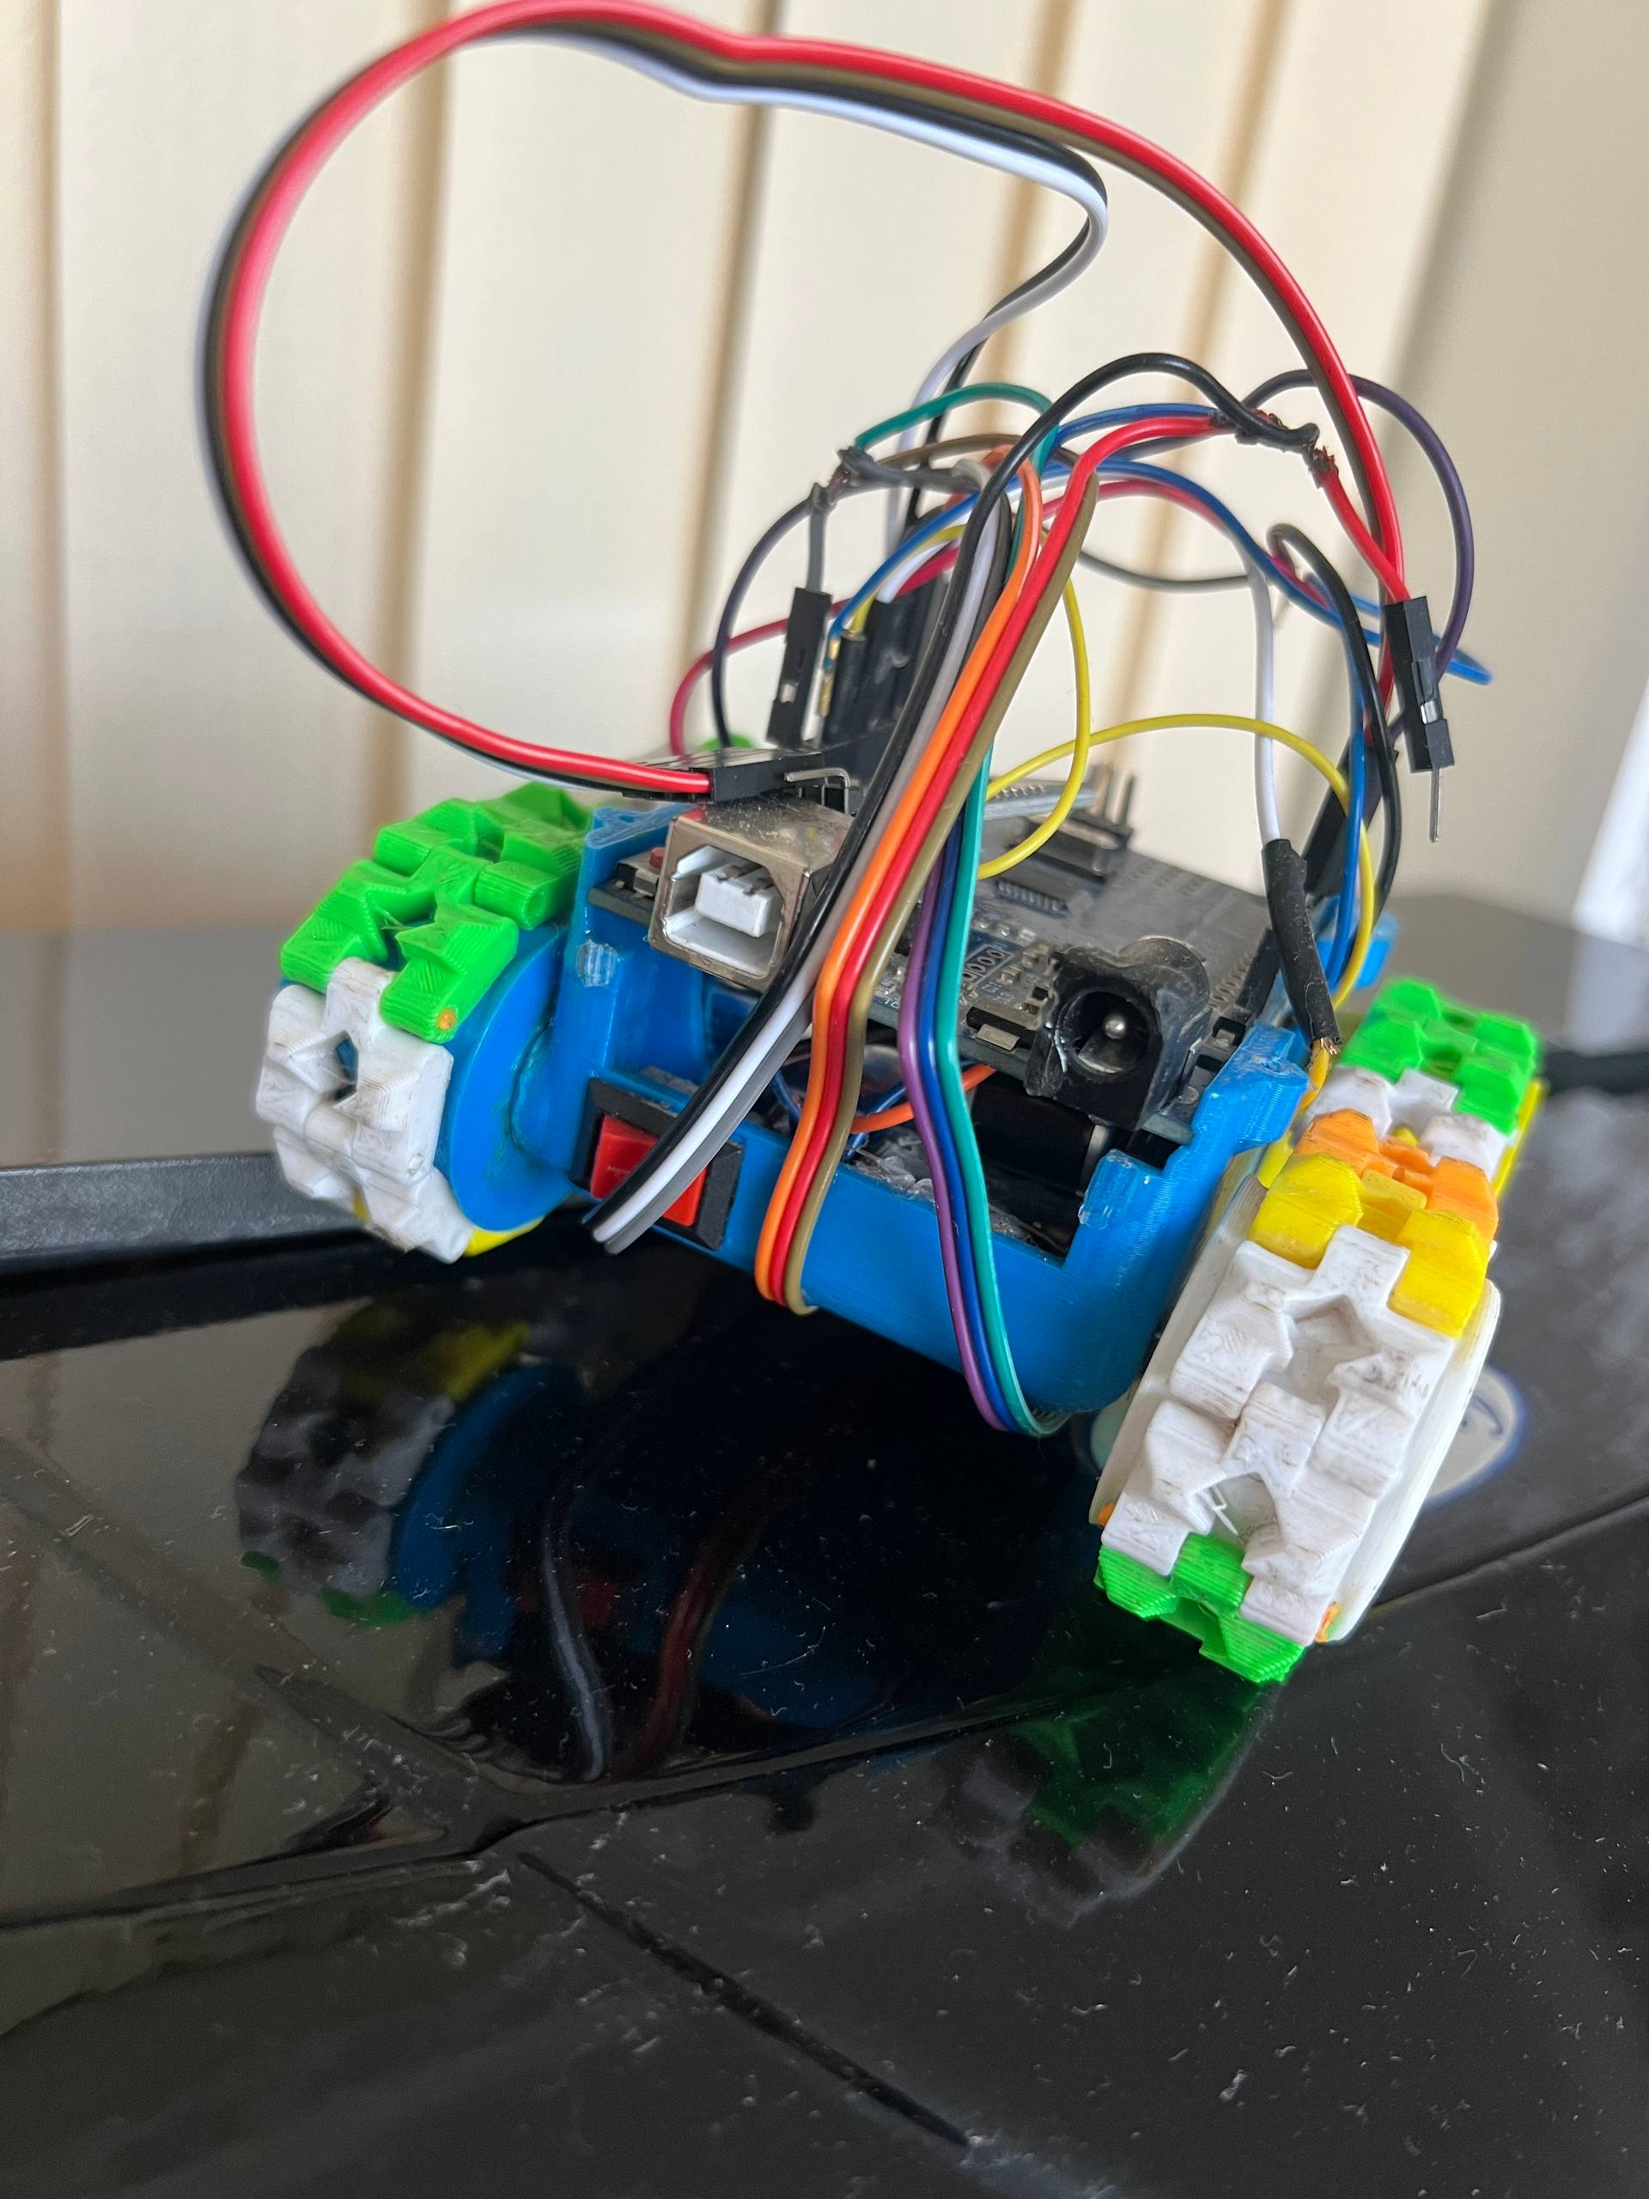
ESP32-CAM Live Video Feed
First-person real-time streaming from the robot
Module: ESP32-CAM
Compact Wi-Fi + camera module with OV2640 image sensor. Operates independently from the Arduino.
Streaming Method
Runs an MJPEG HTTP server over Wi-Fi. The mobile app connects to the ESP32's IP and displays the stream.
Why it's useful
Lets the operator see what the robot sees — useful for remote driving in unknown environments.
Resolution & FPS
Up to 1600×1200 px | ~15–25 fps over local Wi-Fi.
Power
Powered from the 5V regulated rail of the motor driver — no separate battery needed.
* REC
[ Live Camera View ]
[CAM] ESP32-CAM | MJPEG Stream

Slide 10
Building Process
From idea to working robot — step by step
1
2
3
4
>
>
>
Design & Plan
3D Printing
Assembly
Electronics
v
Chose SMARS platform, listed components, drew wiring diagram.
Printed chassis parts in multiple colours using FDM. Track segments, body, mounts.
Assembled chassis, fitted motors, attached wheels/tracks and sensor bracket.
Wired motor driver, IR sensors, HC-06, ESP32-CAM to Arduino. Soldered connections.
5
6
7
>
>
Programming
App Development
Testing & Tuning
Wrote Arduino sketch: line-follow logic, Bluetooth command parser, motor control.
Built Android app with Bluetooth controls, mode switch, and camera view.
Tested on black tape track. Tuned sensor sensitivity, speed, and turn sharpness.

Slide 11
Challenges & Solutions
Problems we faced and how we solved them
! IR Sensor Calibration
OK Added adjustable sensitivity potentiometer on each HW-511 module. Fine-tuned threshold for the test track.
Problem: Sensors gave inconsistent readings on different floor surfaces.
! Wiring Complexity
OK Colour-coded wires, used DuPont connectors, and routed cables along chassis walls.
Problem: Too many wires caused shorts and loose connections inside the cramped chassis.
! Bluetooth Latency
OK Kept command strings short (1 byte). Improved app's send rate to 100 ms polling.
Problem: Occasional lag in remote control made driving imprecise.
! ESP32-CAM Power
OK Powered ESP32-CAM from dedicated 5V output on motor driver board, separate from Arduino.
Problem: Camera module caused Arduino to reset due to current spike on startup.
! Sharp Turns on Track
OK Reduced turn speed via PWM differential and added a small delay at detected curves.
Problem: Robot overshot corners at high speed.

Slide 12
Results & Live Demo
What the robot achieved
3
2
~10m
15–25
IR Sensors for line detection
Operating Modes
Bluetooth range
FPS camera stream
Achievements
OK Successfully follows a black line on white surface at various speeds
OK Smooth mode switching between Auto and Manual from the mobile app
OK Real-time Bluetooth response — commands execute within 50–100 ms
OK ESP32-CAM streams live video without interrupting main robot logic
OK Robot recovers from lost line by entering search / slow-spin mode
OK Robust 3D-printed chassis — survived multiple drops and track tests

Slide 13
Thank You!
Questions & Live Demo
Our Team
Ahror Nosirov
Jamshid Vakhobov
Islomov Jaxongir
Line Following Robot Car - Arduino SMARS - 2026

