Slide 1
GitHub
Essentials of Web Design
CSCI 1210

Slide 2
Code Repositories

Slide 3
Code Repositories
In revision control systems, a repository is a data structure which stores a set of files and directories structure
The whole set of information in the repository may be duplicated on every user's system (or may be maintained on a single server)
Since a project can involve a lot of people, often in different locations, repositories (repos) provide a way to work asynchronously (at different times) on the various parts of the project
Helps prevent one team member’s changes from overwriting another’s and/or breaking the working copy

Slide 4
Code Repositories
Some of the metadata that a repository contains includes, among other things:
A historical record of changes in the repository
A set of commit objects
A set of references to commit objects, called heads

Slide 5
Code Repositories
Repos can be architected in several ways
Probably the most popular is a central repository, from which team members can download the entire code base to their local machine, work on it, and upload their changes
Any conflicts that occur (and conflicts DO occur!) can more easily be resolved by comparing changes – or concurrent changes – to earlier versions of the code

Slide 6
Code Repositories
Versioning is the KEY
Projects are usually developed incrementally
Create a basic working version
Add to repo
Develop features and updates
Add, test

Slide 7
Code Repositories
Versioning is the KEY
If a change breaks something, versioning allows developers to ‘roll back’ to the last working version
Then
Figure out what went wrong

Slide 8
Code Repositories
We will be using GitHub for our semester projects
There are several steps (following) that have to be completed
The responsibility for creating and maintaining the repo is the Team Leader’s
Each team member will create a (free) GitHub account, if you don’t already have one
The Team Lead will create the repo and ensure that all team members can contribute

Slide 9
GitHub
Create a (free) GitHub Account

Slide 10
Sign up for an account
https://github.com/

Slide 11
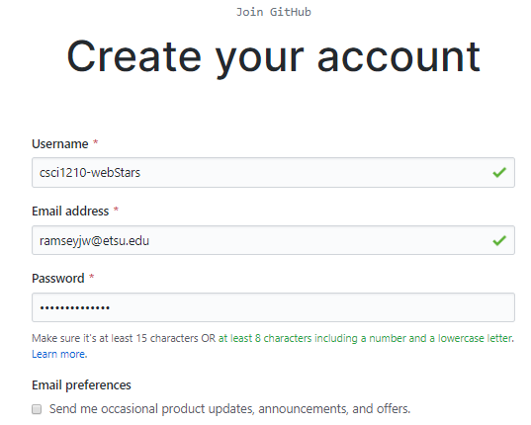
Sign up for an account

Slide 12
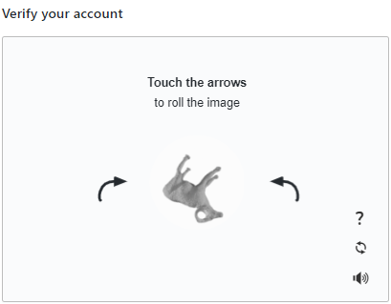
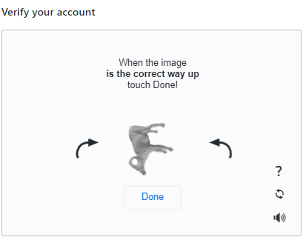
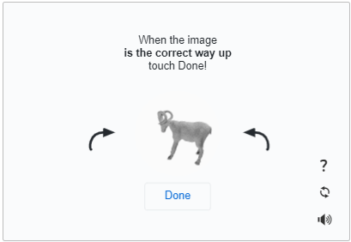
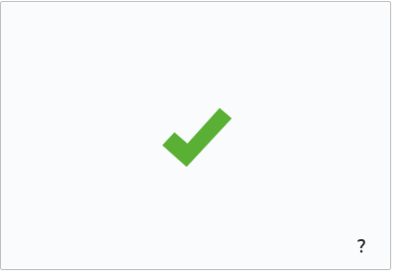
Sign up for an account
1
2
3
4

Slide 13
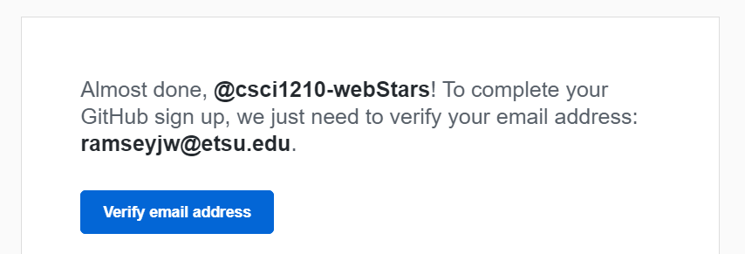
Sign up for an account

Slide 14
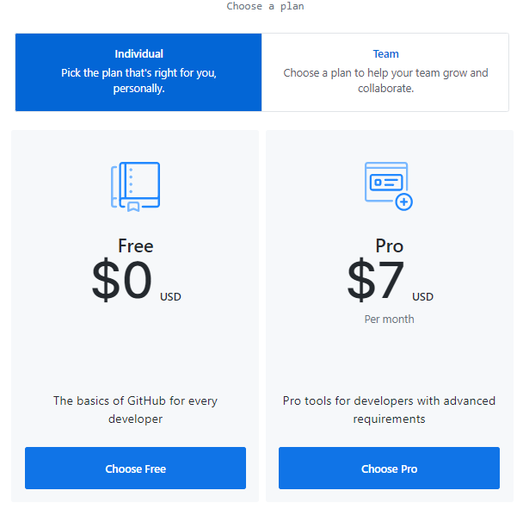
Sign up for an account

Slide 15
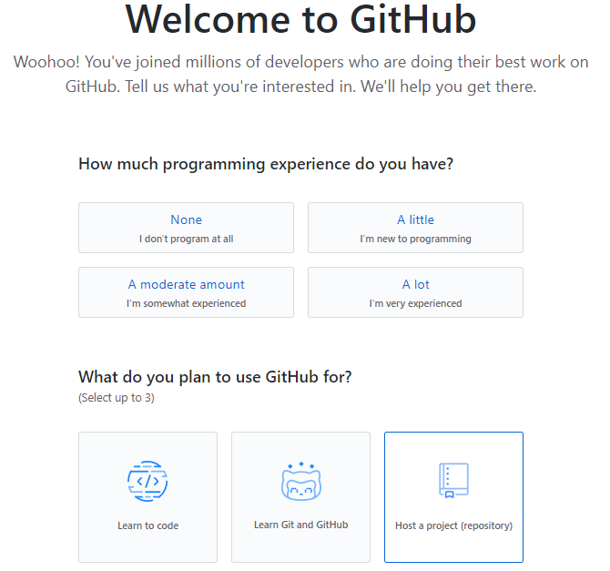
Sign up for an account
WHATEVER

Slide 16
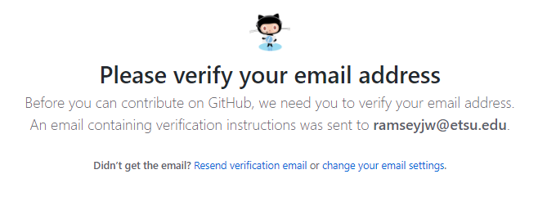
Sign up for an account

Slide 17
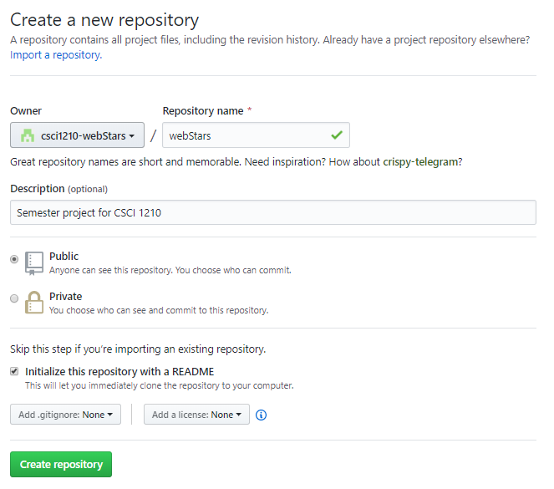
Sign up for an account
USE YOUR TEAM NAME FOR THE REPO NAME
Team Leads will create the repository
Other team members, see below

Slide 18
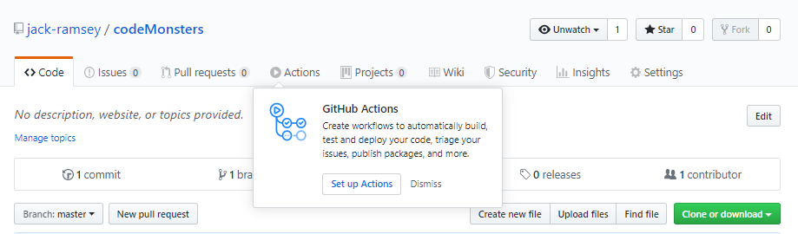
Sign up for an account

Slide 19
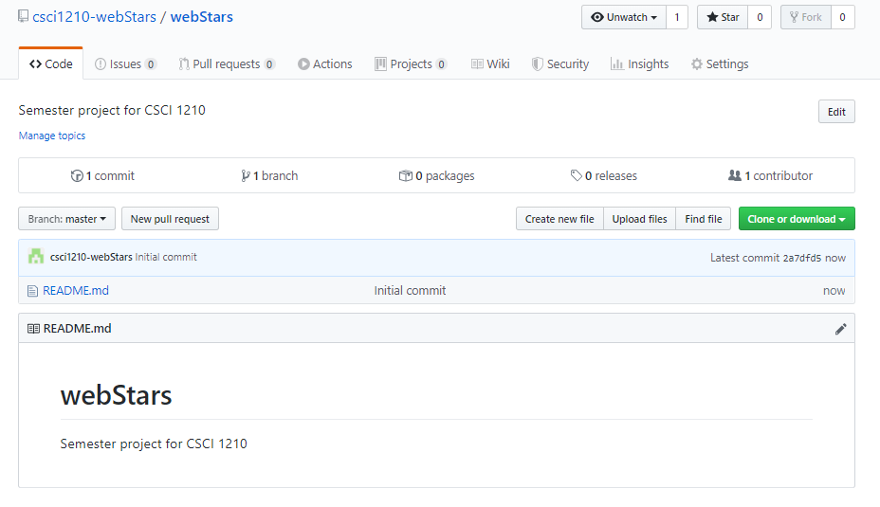
GH Landing Page

Slide 20
GitHub
GitHub can be complex, but there is a desktop application that makes things pretty easy
GitHub Desktop
https://desktop.github.com/

Slide 21
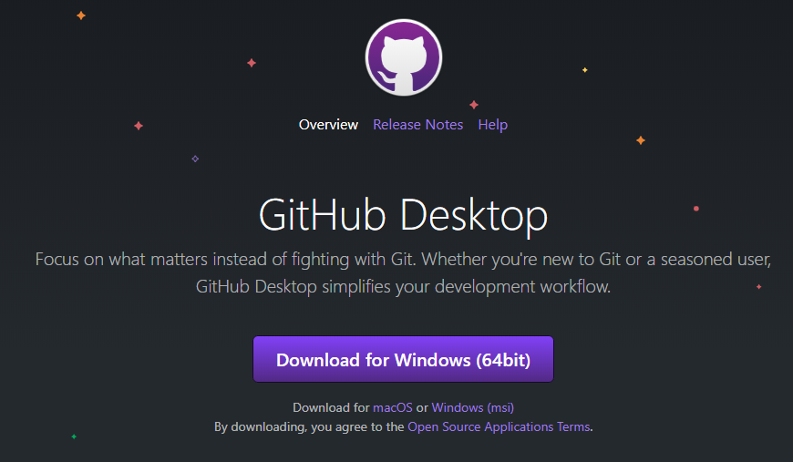
https://desktop.github.com/

Slide 22
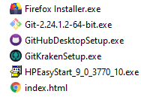
FILE EXPLORER
DOUBLE-CLICK

Slide 23
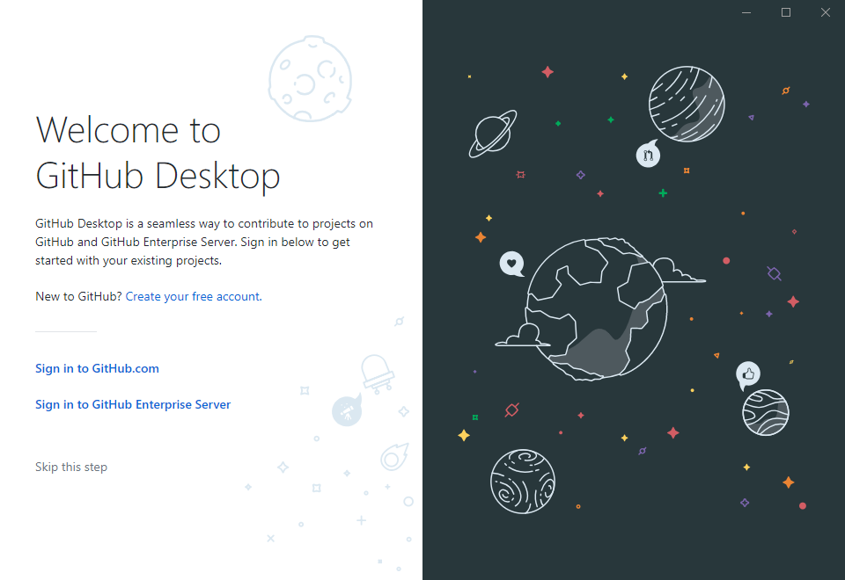

Slide 24
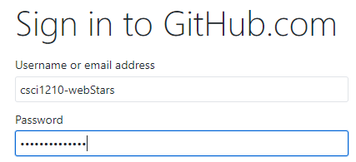
USE YOUR NEW GITHUB ACCOUNT ID / PW, NOT YOUR TEAM’S

Slide 25
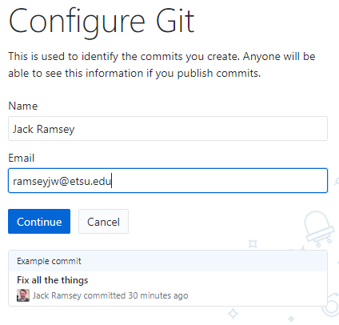
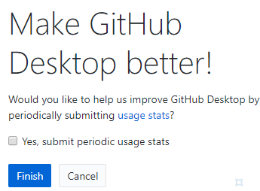

Slide 26
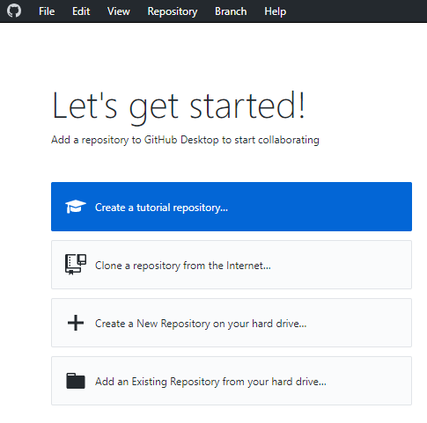

Slide 27
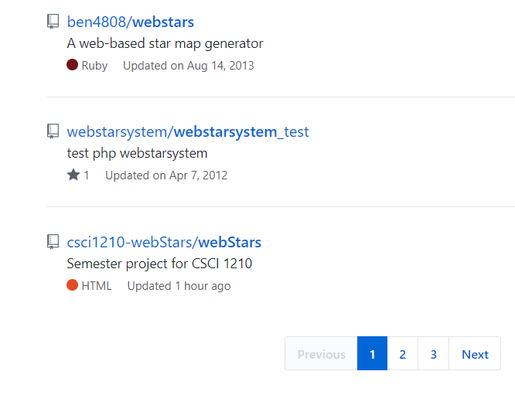
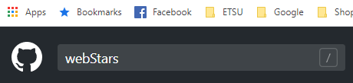
SEARCH ON GITHUB FOR YOUR TEAM’S REPO
ALTERNATIVELY, THE TEAM LEAD, ONCE THE REPO IS CREATED, CAN DISTRIBUTE THE URL TO THE REST OF THE TEAM

Slide 28
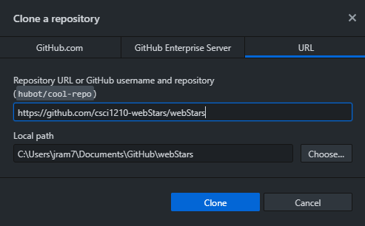


Slide 29
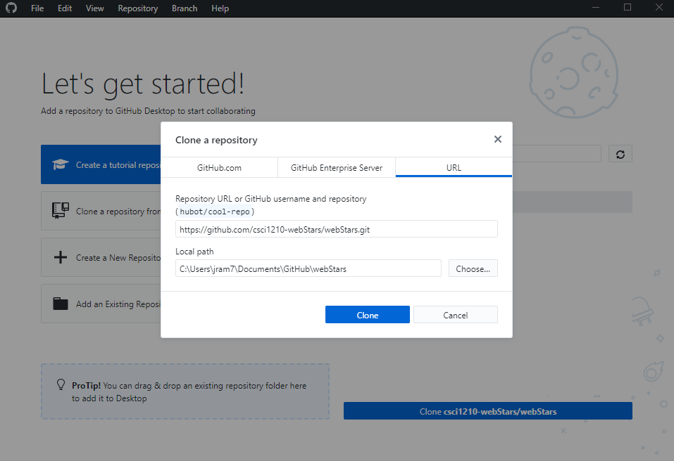
THIS IS THE LOCATION ON YOUR COMPUTER WHERE THE REPO FILES WILL BE SAVED. YOU CAN CHANGE IT IF YOU WANT, BUT REMEMBER WHERE IT IS

Slide 30
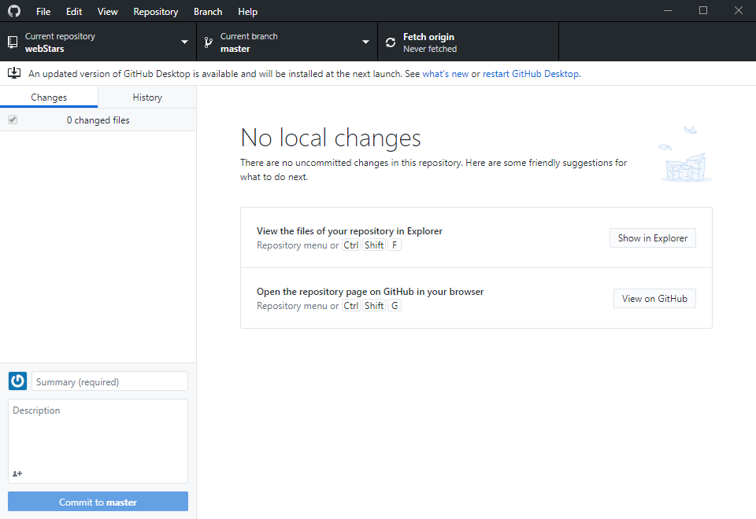

Slide 31
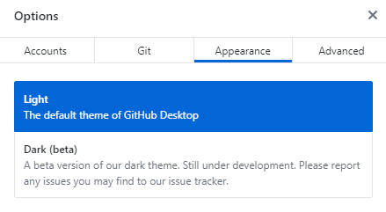
IN CASE YOU’RE WONDERING WHY MY SCREENSHOTS ARE DARK WHILE YOUR DISPLAY IS WHITE, CLICK FILE->OPTIONS
THIS IS PURELY A MATTER OF PREFERENCE

Slide 32
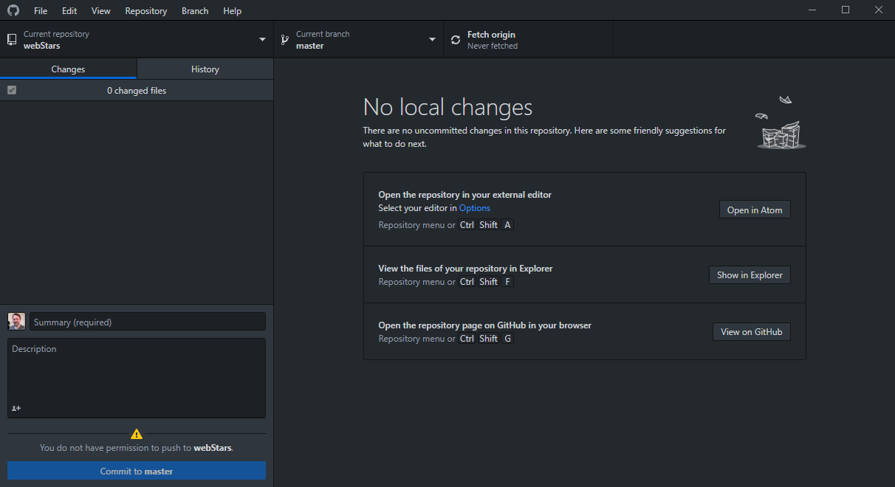

Slide 33
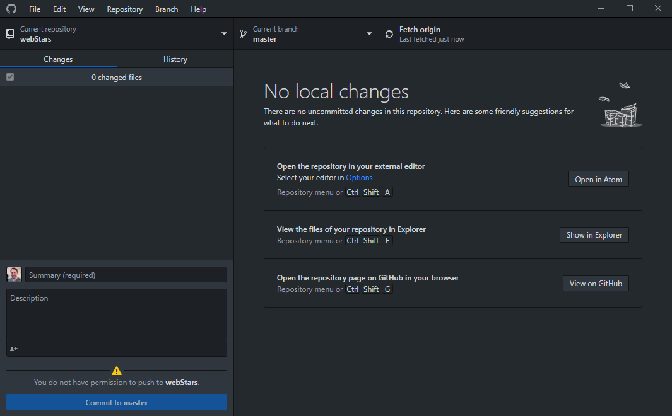
REPO DOWNLOADED. SO FAR, NOTHING’S BEEN CHANGED, SO YOU CAN MINIMIZE THIS WINDOW

Slide 34
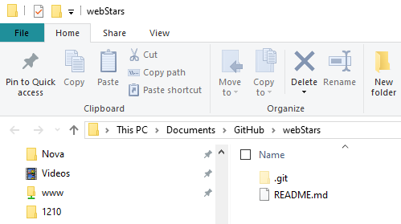
FILE EXPLORER
This is your local copy of the repo, where you’ll create, modify, and save files as you work. You could use a flash drive

Slide 35
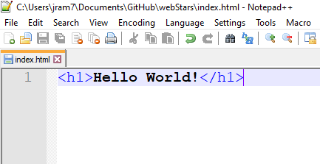
TESTING – CREATE A FILE
SAVE IT TO YOUR LOCAL DIRECTORY

Slide 36
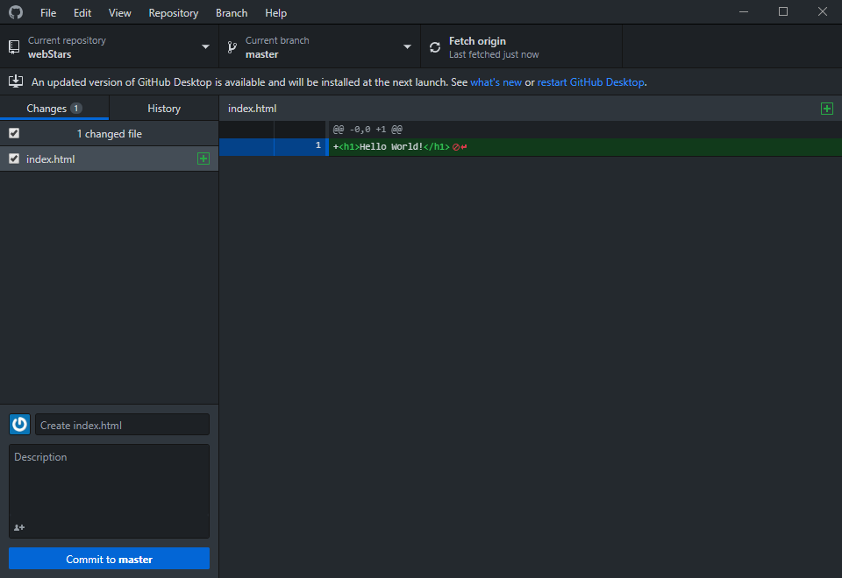
GITHUB DESKTOP DETECTS THE NEW FILE

Slide 37
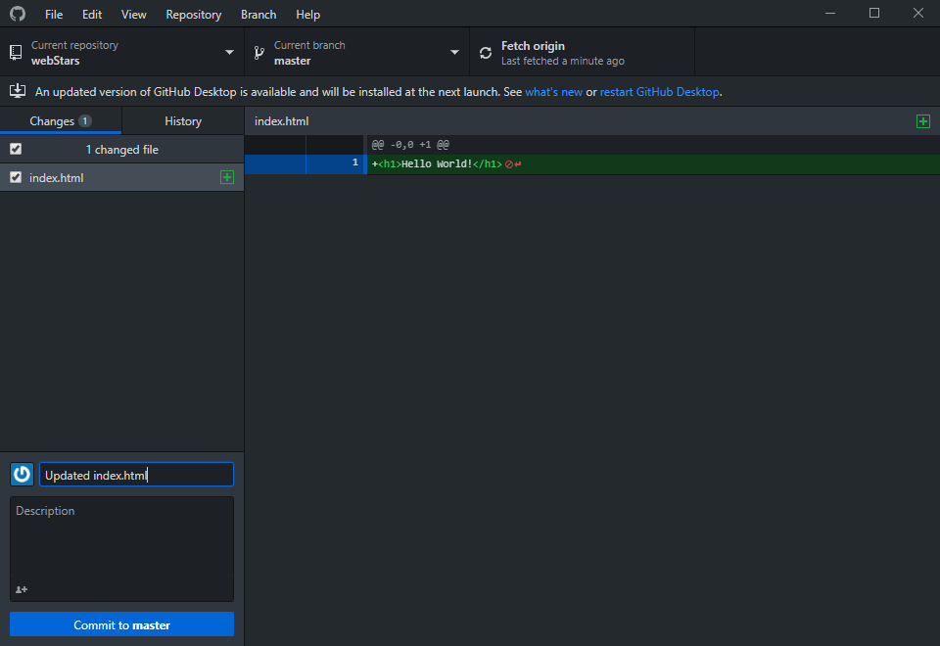
TO UPLOAD IT TO THE REPO, YOU HAVE TO ADD A SUMMARY (AND ADDITIONAL INFO – OPTIONAL)
THEN, CLICK ‘COMMIT TO MASTER’

Slide 38
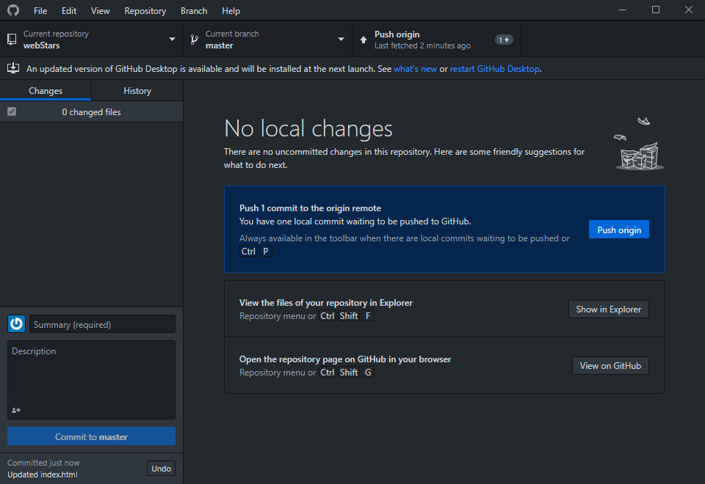
THEN, PUSH THE CHANGES TO THE REPO

Slide 39
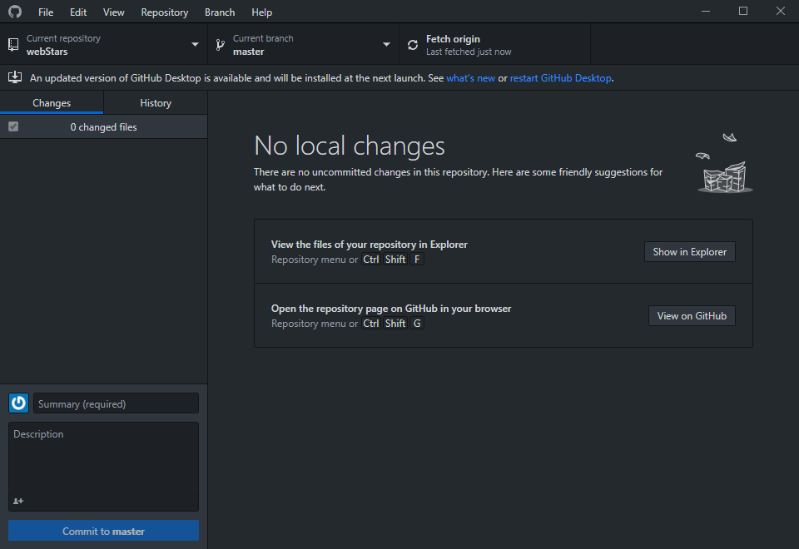
…AND YOU’RE DONE FOR NOW

Slide 40
When you go back to do more work…
Someone else on your team may have made changes and/or additions and uploaded them to the repo
So, first thing you have to do is pull a new copy of the repo to your computer

Slide 41
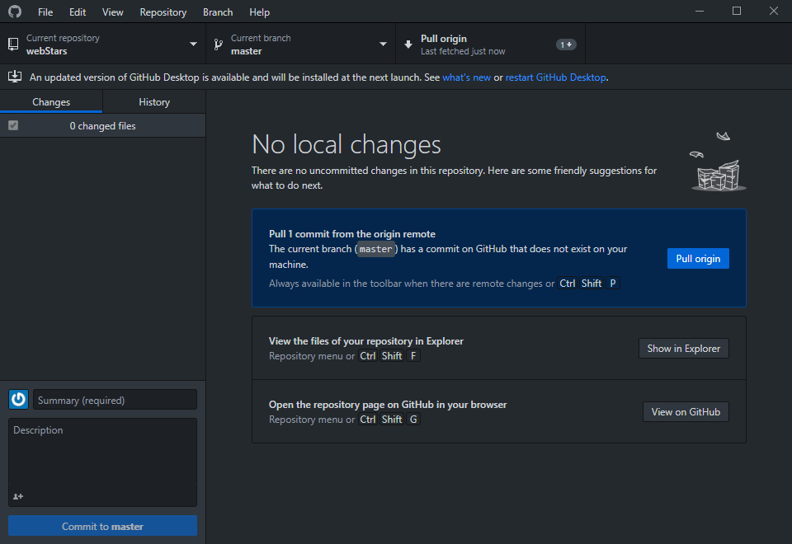

Slide 42
When you go back to do more work…
If you don’t see the ‘pull prompt,’ pull anyway:

Slide 43
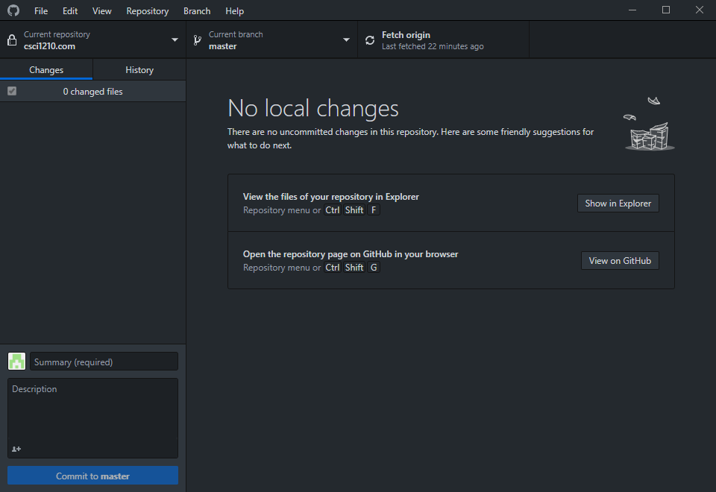

Slide 44
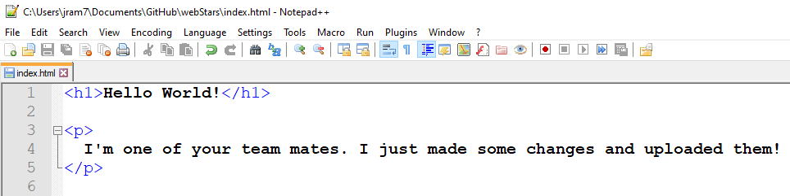
So, one of your teammates made a change…
The changes will be reflected in your local copy
after you’ve pulled them

Slide 45
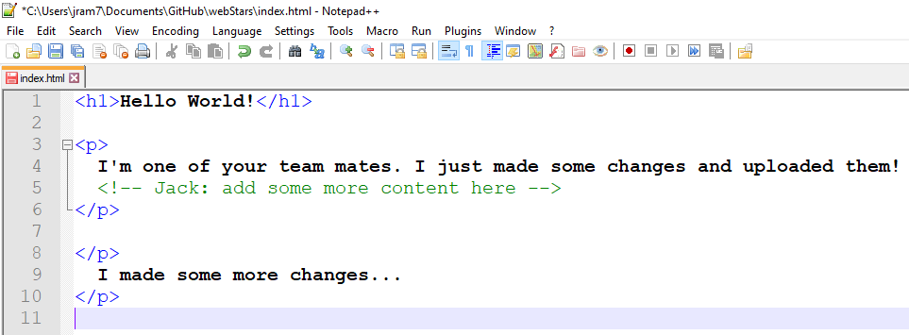
You can use comments to communicate with your team

Slide 46
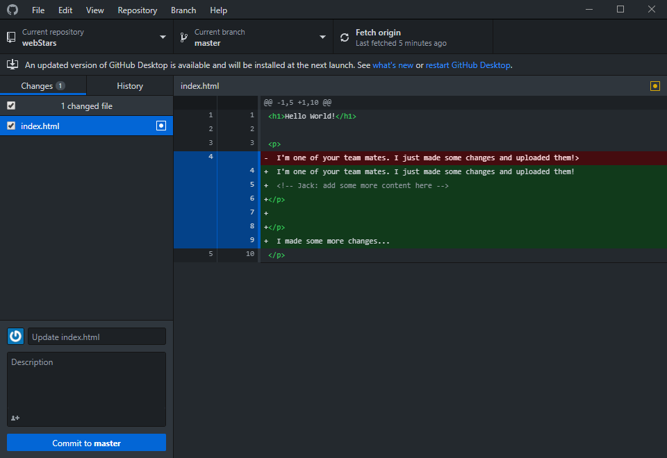
GITHUB SHOWS YOU THE CHANGES THAT WERE MADE

Slide 47
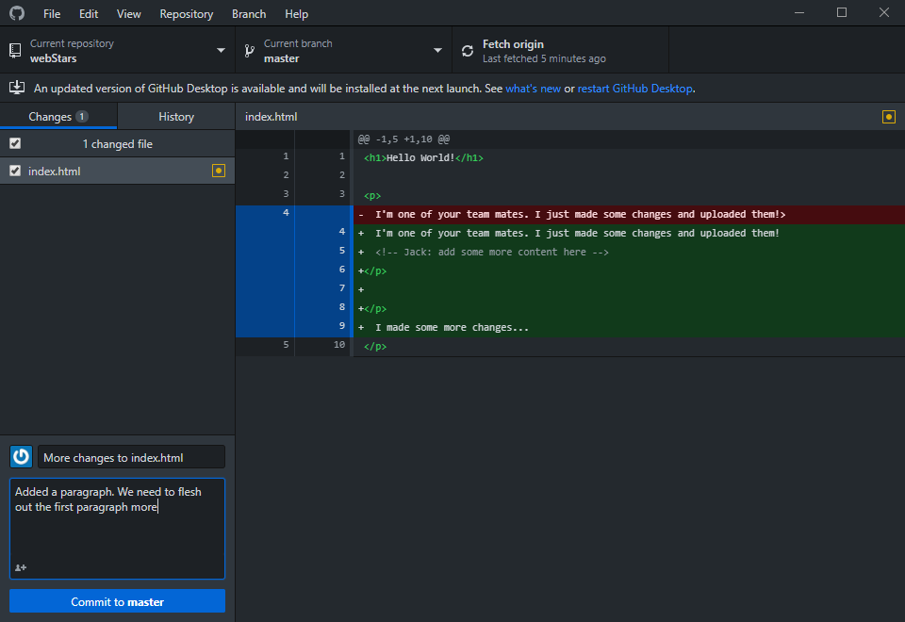
BEFORE YOU CAN UPLOAD, YOU STILL HAVE
TO INCLUDE A SUMMARY

Slide 48
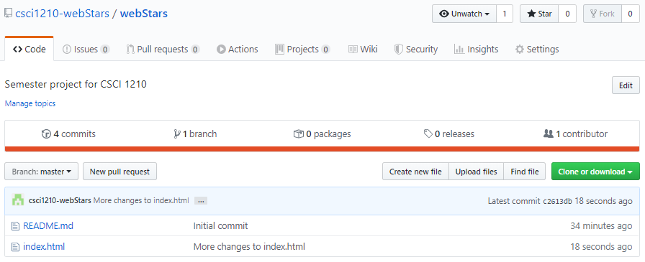
ON THE GITHUB WEBSITE, YOU CAN VIEW THE FILES
AND HISTORY OF THE PROJECT

Slide 49
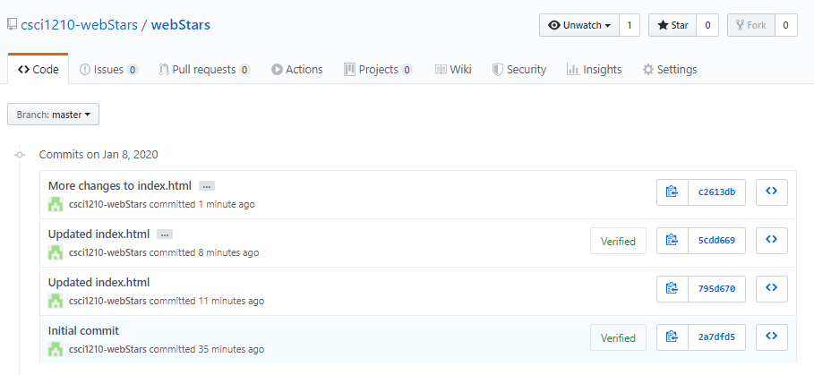
VIEW EACH COMMIT – THIS IS WHY THE SUMMARIES
ARE REQUIRED; TO TRACK CHANGES

Slide 50
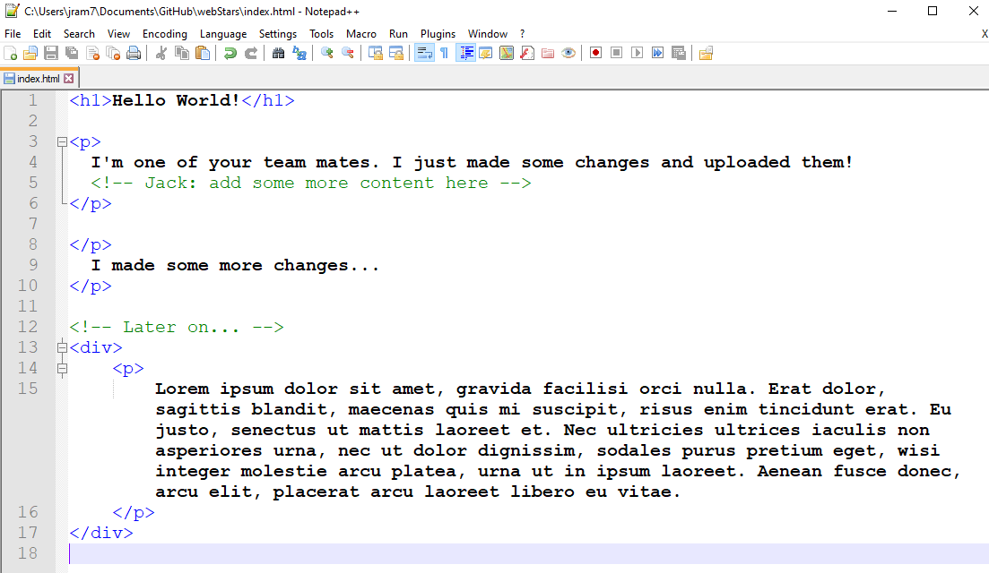

Slide 51
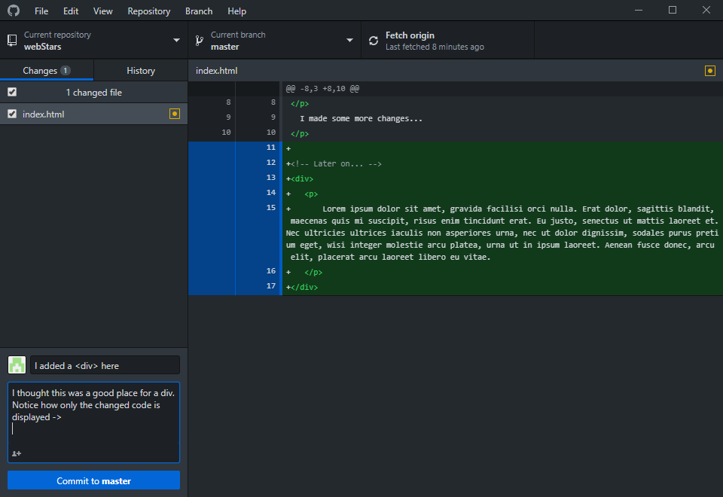
SO YOU MAKE SOME ADDITIONS AND
UPLOAD THEM…

Slide 52
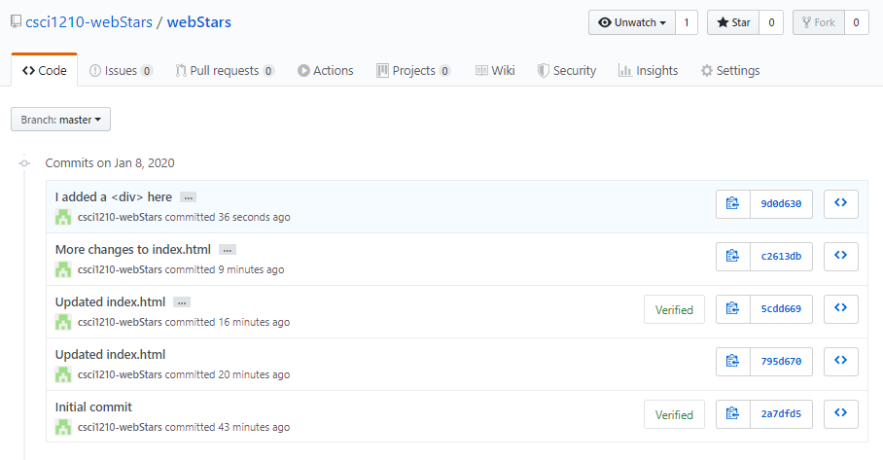
YOU CAN VIEW THE DETAILS OF EACH COMMIT BY
CLICKING IT

Slide 53
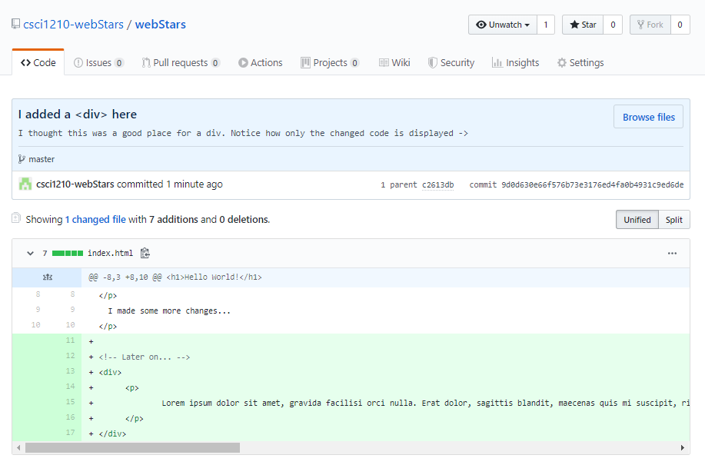

Slide 54
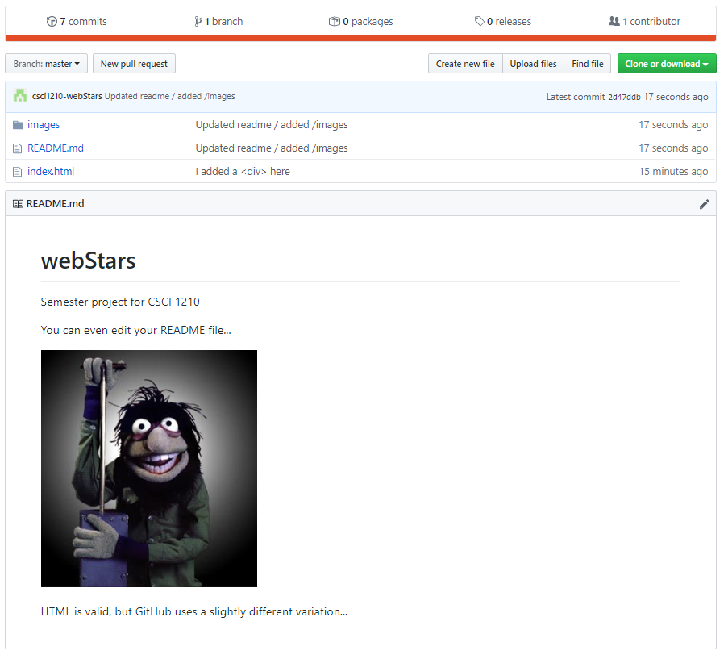
YOU CAN ALSO UPDATE THE README FILE

Slide 55
Code Repositories
This chart shows the workflow you’ll follow when working on your project. It’s important to remember that once you’ve made changes, they have to be uploaded to the repository so everyone will be able to access your work
START
PULL REPO
MAKE EDITS
SAVE LOCAL
COMMIT
ADD SUMMARY
‘COMMIT TO MASTER’
PUSH
PUSH CHANGES TO REPO

Slide 56


Copyrights
Presentation prepared by and copyright of John Ramsey, East Tennessee State University, Department of Computing . (ramseyjw@etsu.edu)
Microsoft, Windows, Excel, Outlook, and PowerPoint are registered trademarks of Microsoft Corporation.
IBM, DB2, DB2 Universal Database, System i, System i5, System p, System p5, System x, System z, System z10, System z9, z10, z9, iSeries, pSeries, xSeries, zSeries, eServer, z/VM, z/OS, i5/OS, S/390, OS/390, OS/400, AS/400, S/390 Parallel Enterprise Server, PowerVM, Power Architecture, POWER6+, POWER6, POWER5+, POWER5, POWER, OpenPower, PowerPC, BatchPipes, BladeCenter, System Storage, GPFS, HACMP, RETAIN, DB2 Connect, RACF, Redbooks, OS/2, Parallel Sysplex, MVS/ESA, AIX, Intelligent Miner, WebSphere, Netfinity, Tivoli and Informix are trademarks or registered trademarks of IBM Corporation.
Linux is the registered trademark of Linus Torvalds in the U.S. and other countries.
Oracle is a registered trademark of Oracle Corporation.
HTML, XML, XHTML and W3C are trademarks or registered trademarks of W3C®, World Wide Web Consortium, Massachusetts Institute of Technology.
Java is a registered trademark of Sun Microsystems, Inc.
JavaScript is a registered trademark of Sun Microsystems, Inc., used under license for technology invented and implemented by Netscape.
SAP, R/3, SAP NetWeaver, Duet, PartnerEdge, ByDesign, SAP Business ByDesign, and other SAP products and services mentioned herein as well as their respective logos are trademarks or registered trademarks of SAP AG in Germany and other countries.
Business Objects and the Business Objects logo, BusinessObjects, Crystal Reports, Crystal Decisions, Web Intelligence, Xcelsius, and other Business Objects products and services mentioned herein as well as their respective logos are trademarks or registered trademarks of Business Objects S.A. in the United States and in other countries. Business Objects is an SAP company.
ERPsim is a registered copyright of ERPsim Labs, HEC Montreal.
Other products mentioned in this presentation are trademarks of their respective owners.

