Slide 1

SCRATCH

Slide 2

SETUP
https://downloads.scratch.mit.edu/desktop/Scratch%20Setup.exe

Slide 3
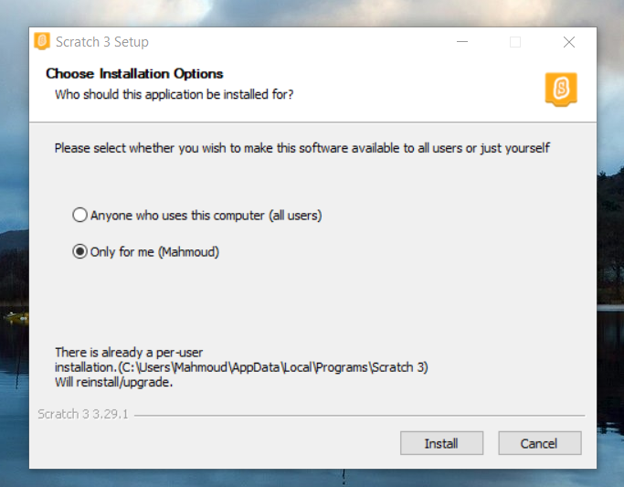

Slide 4
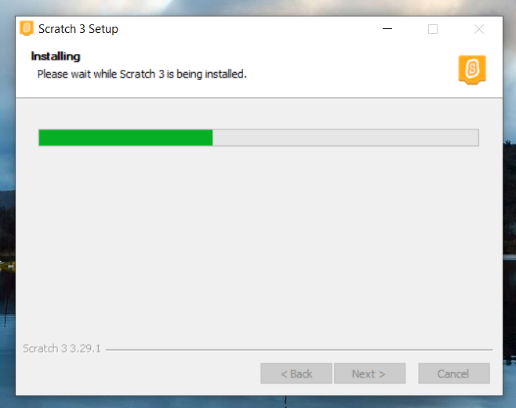

Slide 5
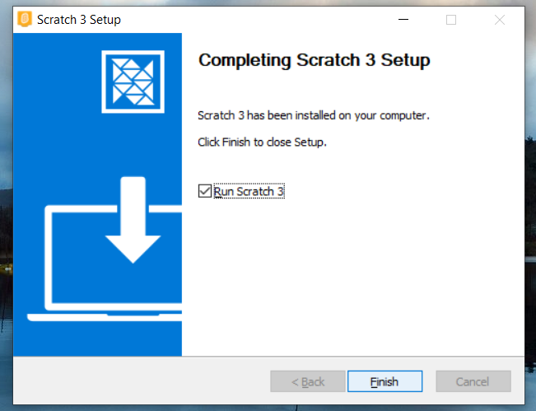

Slide 6
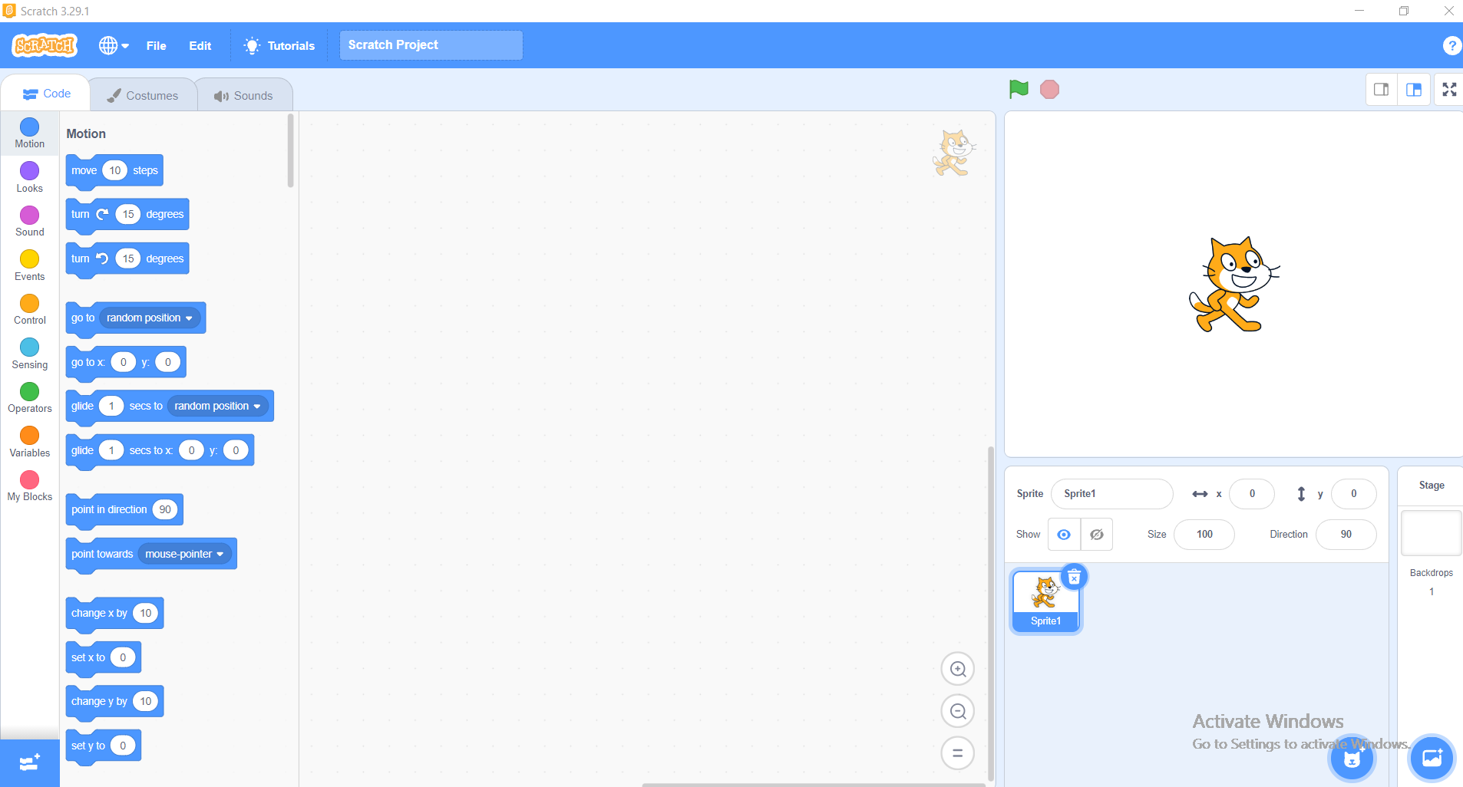
Interface Details

Slide 7
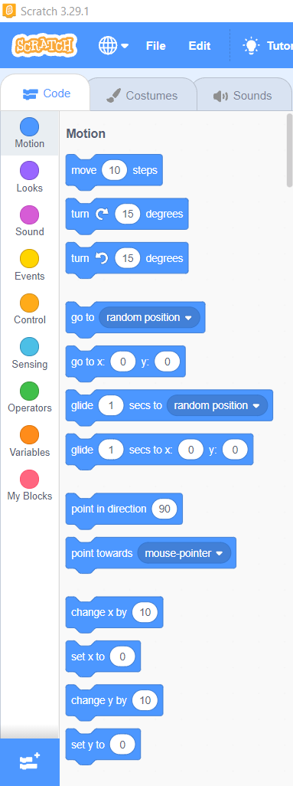
The Code

Slide 8
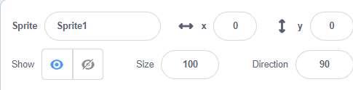
The Control Panel

Slide 9

Off / On

Slide 10

To Change Sprites or Backdrops

Slide 11
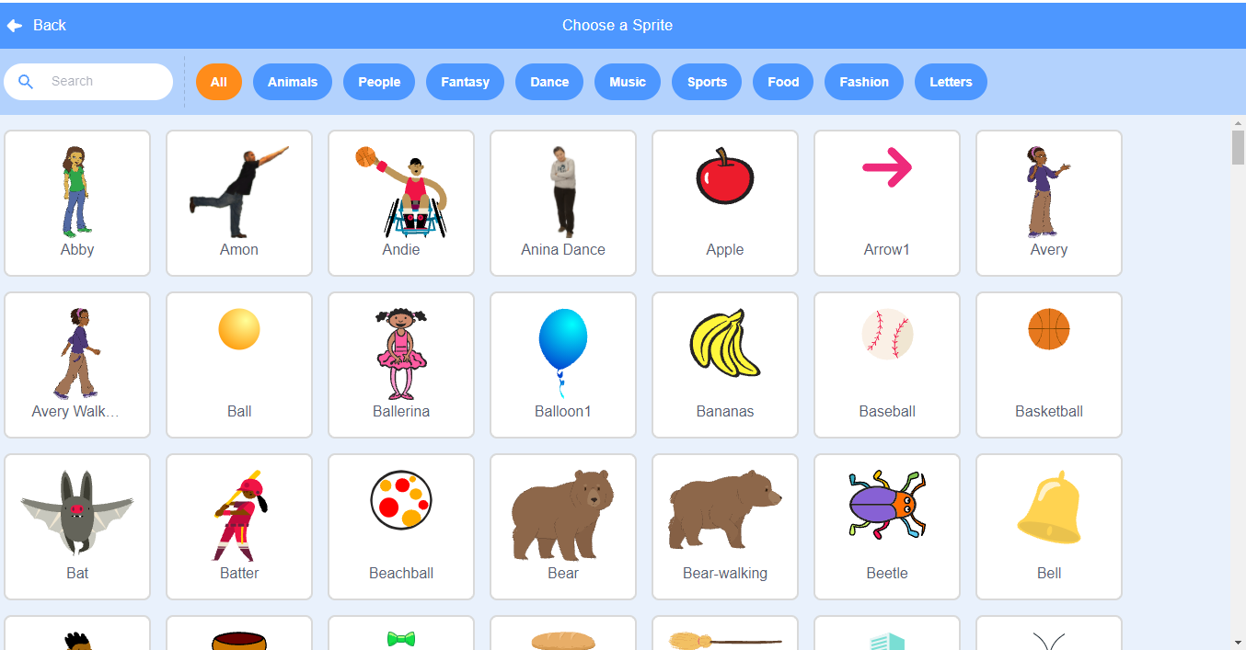

Slide 12
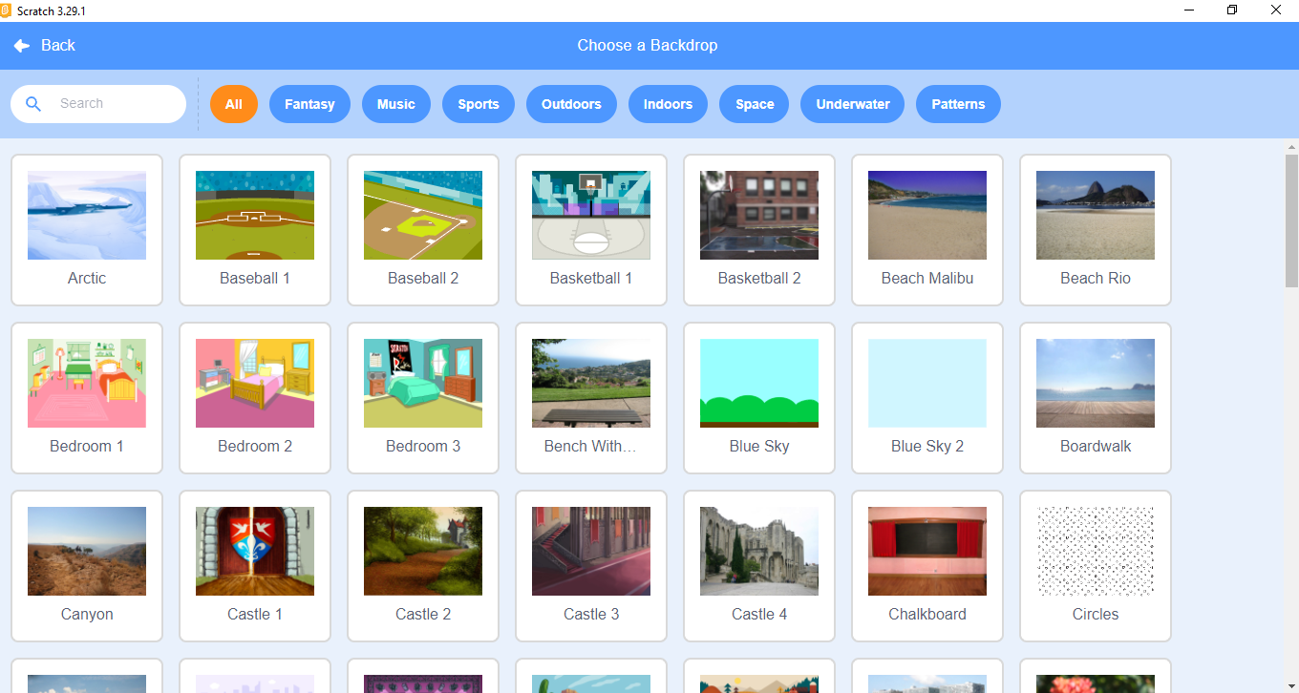

Slide 13
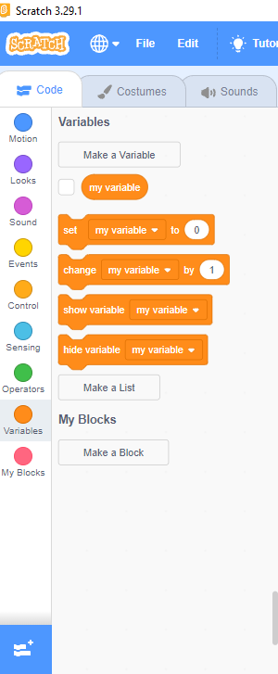
Variables

Slide 14
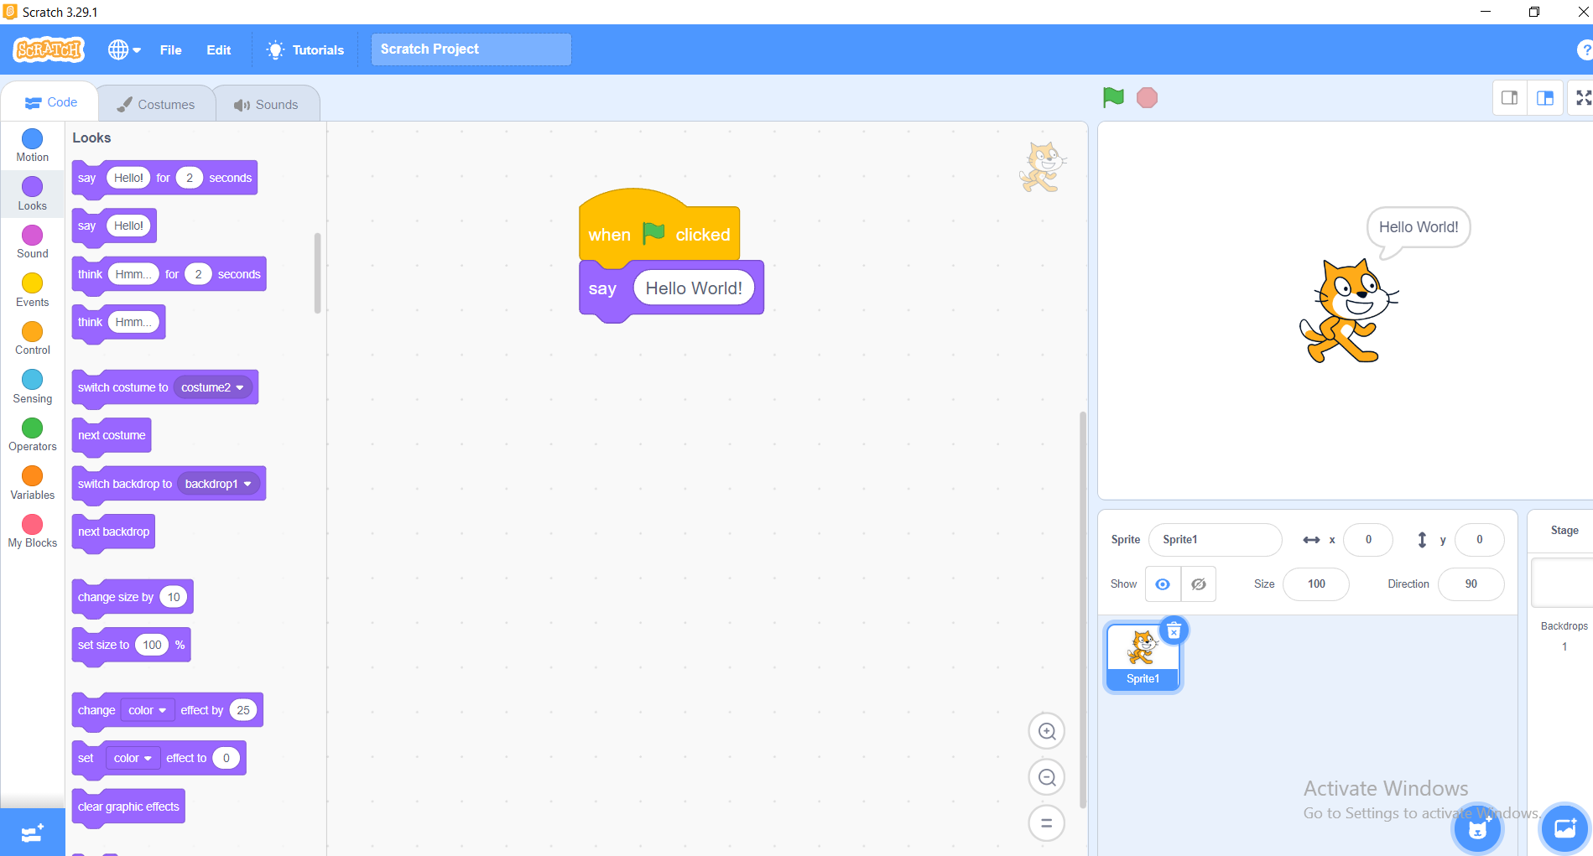
Our First Program

Slide 15
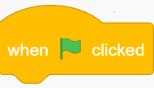
Must Be On The Top Of The Code To Run The Program

Slide 16

It is a Function To Say “Hello World!”

Slide 17


