Slide 1

Features and Updates
Native UTF-8 support
Innovative user interface to simplify everyday tasks
Enhanced Photo Gallery 2.0
Windows-style control panel interface
Easy-to-follow wizards
Powerful and lightweight WYSIWIG
New toolbar panel
New installation packages

Slide 2
New Toolbar Panel
Windows Vista style
“Start” button
Quick access to any system application
Recently visited pages
Favorites
Dynamic resource load (AJAX)

Slide 3
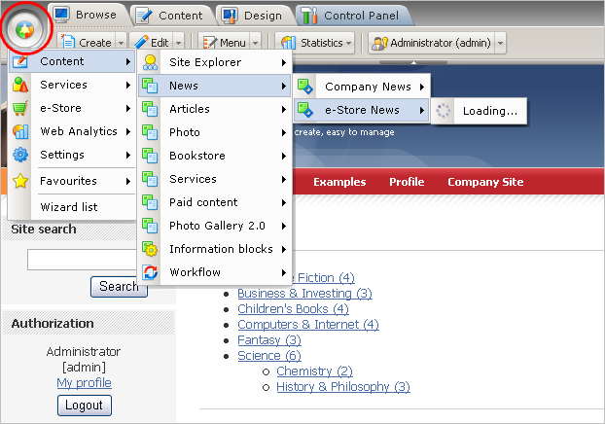
Vista-like Start Button in Menu
The Start button provides a quick access to all site management tools.
Now there is no need to open Control Panel to reach the needed Bitrix Site Manager tool.

Slide 4
Edit-in-place Content Management
The Editor Mode enables you to perform content management operations from the Public section:
Creating and editing of both static and dynamic content:
pages;
news, catalogs;
site menu;
forms;
more…
WYSIWIG editor is simplified and greatly speeded up

Slide 5
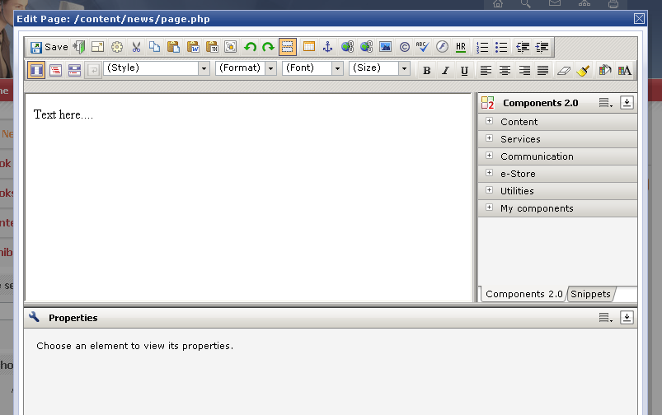
Creating a Page in Editor Mode
A simple and user-friendly wizard enables content editors to create a page in any site section and make it available from the site menu.
Content editors can also add news, catalog, and other content blocks on the page.

Slide 6
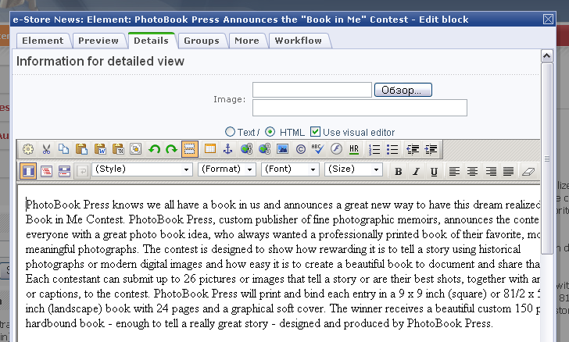
News Editing in Editor Mode
Content editors can add news on pages with the help of a wizard.

Slide 7
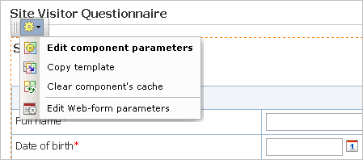
Developer Mode
The Developer Mode combines operations on the site setup:
components settings,
component template editing,
and other.

Slide 8

Native UTF-8 Support
Bitrix Site Manager can be installed with UTF-8 support that enables you to work comfortably in many languages.
UTF-8 support allows creating and fully supporting various language packages in Arabic, Chinese, Japanese, and other languages.

Slide 9

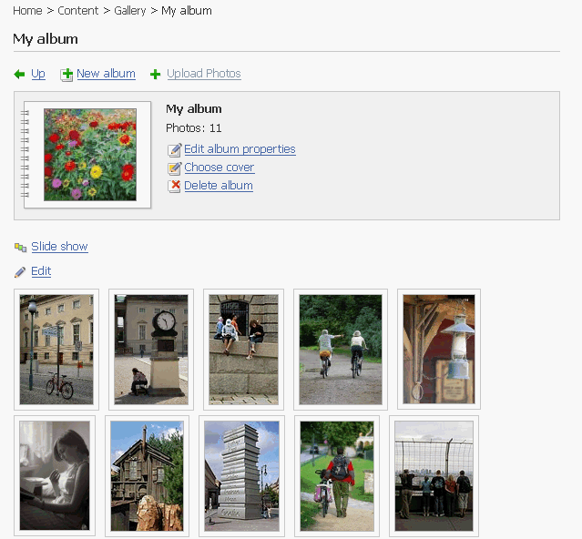
Photo Gallery 2.0
Photo Gallery 2.0 presents a bunch of improvements in new version. Important features include:
Multi-user support
Improved user interface
Multiple photo upload
Private and public photo galleries
Commenting, ratings
Slide show
Thumbnail and full image views
Tag clouds, and more.

Slide 10
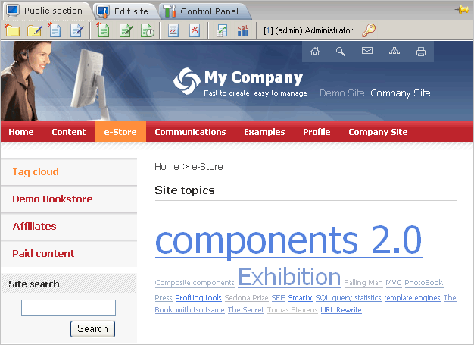
Web2.0 Tools
Extended AJAX support in components
Improved tag clouds
Web services (SOAP)
Social networking features (forum, blogs communities)
Adaptive user interface

