Slide 1
Data Mining: Concepts and Techniques — Chapter 5 —
Jiawei Han
Department of Computer Science
University of Illinois at Urbana-Champaign
www.cs.uiuc.edu/~hanj
©2006 Jiawei Han and Micheline Kamber, All rights reserved
*
Data Mining: Concepts and Techniques
‹#›

Slide 2
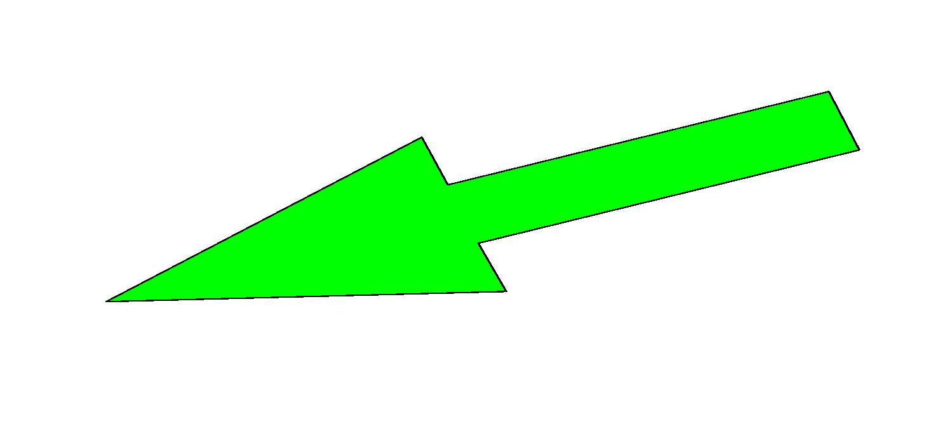
Chapter 5: Mining Frequent Patterns, Association and Correlations
Basic concepts and a road map
Efficient and scalable frequent itemset mining methods
Mining various kinds of association rules
From association mining to correlation analysis
Constraint-based association mining
Summary
*
Data Mining: Concepts and Techniques
‹#›

Slide 3
What Is Frequent Pattern Analysis?
Frequent pattern: a pattern (a set of items, subsequences, substructures, etc.) that occurs frequently in a data set
Motivation: Finding inherent regularities in data
What products were often purchased together?— Bread and Jam?
What are the subsequent purchases after buying a PC?
What kinds of DNA are sensitive to this new drug?
Can we automatically classify web documents?
Applications
Basket data analysis, cross-marketing, catalog design, sale campaign analysis, Web log (click stream) analysis, and DNA sequence analysis.
*
Data Mining: Concepts and Techniques
‹#›

Slide 4
Why Is Freq. Pattern Mining Important?
Discloses an intrinsic and important property of data sets
Forms the foundation for many essential data mining tasks
Association, correlation, and causality analysis
Sequential, structural (e.g., sub-graph) patterns
Pattern analysis in spatiotemporal, multimedia, time-series, and stream data
Classification: associative classification
Cluster analysis: frequent pattern-based clustering
Data warehousing: iceberg cube and cube-gradient
Semantic data compression
Broad applications
*
Data Mining: Concepts and Techniques
‹#›

Slide 5
Basic Concepts: Frequent Patterns and Association Rules
Transaction-id | Items bought
10 | A, B, D
20 | A, C, D
30 | A, D, E
40 | B, E, F
50 | B, C, D, E, F
Itemset X = {x₁, …, x_{k}}
Find all the rules X 🡪 Y with minimum support and confidence
support, s, probability that a transaction contains X ∪ Y
confidence, c, conditional probability that a transaction having X also contains Y
Customer
buys both
Customer
buys jam
Let sup_{min} = 50%, conf_{min} = 50%
Freq. Pat.: {A:3, B:3, D:4, E:3, AD:3}
Association rules:
A 🡪 D (60%, 100%)
D 🡪 A (60%, 75%)
Customer
buys bread
*
Data Mining: Concepts and Techniques
‹#›

Slide 6
Closed Patterns and Max-Patterns
A long pattern contains a combinatorial number of sub-patterns, e.g., {a₁, …, a₁₀₀} contains (₁₀₀¹) + (₁₀₀²) + … + (₁¹₀⁰₀⁰) = 2¹⁰⁰ – 1 = 1.27*10³⁰ sub-patterns!
Solution:
Mine closed patterns and max-patterns instead
An itemset X is closed if X is frequent and there exists no super-pattern Y כ X, with the same support as X
An itemset X is a max-pattern if X is frequent and there exists no frequent super-pattern Y כ X
Closed pattern is a lossless compression of freq. patterns
Reducing the # of patterns and rules
*
Data Mining: Concepts and Techniques
‹#›

Slide 7
Closed Patterns and Max-Patterns
Exercise. DB = {<a₁, …, a₁₀₀>, < a₁, …, a₅₀>}
Min_sup = 1.
What is the set of closed itemset?
<a₁, …, a₁₀₀>: 1
< a₁, …, a₅₀>: 2
What is the set of max-pattern?
<a₁, …, a₁₀₀>: 1
What is the set of all patterns?
!!
*
Data Mining: Concepts and Techniques
‹#›

Slide 8
Frequent pattern mining can be classified in various ways, based on the following criteria:
Based on the completeness of patterns to be mined
Based on the levels of abstraction involved in the rule set
Based on the number of data dimensions involved in the rule
Based on the types of values handled in the rule
Based on the kinds of rules to be mined
Based on the kinds of patterns to be mined
*
Data Mining: Concepts and Techniques
‹#›

Slide 9
Chapter 5: Mining Frequent Patterns, Association and Correlations
Basic concepts and a road map
Efficient and scalable frequent itemset mining methods
Mining various kinds of association rules
From association mining to correlation analysis
Constraint-based association mining
Summary
*
Data Mining: Concepts and Techniques
‹#›

Slide 10
Scalable Methods for Mining Frequent Patterns
The downward closure property of frequent patterns
Any subset of a frequent itemset must be frequent
Scalable mining methods: Three major approaches
Apriori
Freq. pattern growth
Vertical data format approach
*
Data Mining: Concepts and Techniques
‹#›

Slide 11
Apriori: A Candidate Generation-and-Test Approach
Apriori pruning principle: If there is any itemset which is infrequent, its superset should not be generated/tested! (Agrawal & Srikant @VLDB’94, Mannila, et al. @ KDD’ 94)
Method:
Initially, scan DB once to get frequent 1-itemset
Generate length (k+1) candidate itemsets from length k frequent itemsets
Test the candidates against DB
Terminate when no frequent or candidate set can be generated
*
Data Mining: Concepts and Techniques
‹#›

Slide 12
Apriori Algorithm
the algorithm uses prior knowledge of frequent itemset properties
employs an iterative approach known as a level-wise search, where k-itemsets are used to explore (k+1)-itemsets
First, the set of frequent 1-itemsets is found by scanning the database to accumulate the count for each item, and collecting those items that satisfy minimum support.
*
Data Mining: Concepts and Techniques
‹#›

Slide 13
Apriori property
Apriori property: All nonempty subsets of a frequent itemset must also be frequent.
By definition, if an itemset I does not satisfy the minimum support threshold, min sup, then I is not frequent; that is, P(I) < min sup. If an item A is added to the itemset I, then the resulting itemset (i.e., I [A]) cannot occur more frequently than I. Therefore, I [A] is not frequent either; that is, P(I [A]) < min sup.
This property belongs to a special category of properties called antimonotone in the sense that if a set cannot pass a test, all of its supersets will fail the same test as well.
*
Data Mining: Concepts and Techniques
‹#›

Slide 14
The Apriori Algorithm—An Example
Sup_{min} = 2
Itemset | sup
{A} | 2
{B} | 3
{C} | 3
{D} | 1
{E} | 3
Database TDB
Itemset | sup
{A} | 2
{B} | 3
{C} | 3
{E} | 3
L₁
C₁
Tid | Items
10 | A, C, D
20 | B, C, E
30 | A, B, C, E
40 | B, E
1st scan
C₂
Itemset | sup
{A, B} | 1
{A, C} | 2
{A, E} | 1
{B, C} | 2
{B, E} | 3
{C, E} | 2
C₂
Itemset
{A, B}
{A, C}
{A, E}
{B, C}
{B, E}
{C, E}
L₂
Itemset | sup
{A, C} | 2
{B, C} | 2
{B, E} | 3
{C, E} | 2
2nd scan
C₃
Itemset
{B, C, E}
L₃
Itemset | sup
{B, C, E} | 2
3rd scan
*
Data Mining: Concepts and Techniques
‹#›

Slide 15
The Apriori Algorithm
Pseudo-code:
C_{k}: Candidate itemset of size k
L_{k} : frequent itemset of size k
L₁ = {frequent items};
for (k = 1; L_{k} !=∅; k++) do begin
C_{k+1} = candidates generated from L_{k};
for each transaction t in database do
increment the count of all candidates in C_{k+1} that are contained in t
L_{k+1} = candidates in C_{k+1} with min_support
end
return ∪_{k} L_{k};
*
Data Mining: Concepts and Techniques
‹#›

Slide 16
Important Details of Apriori
How to generate candidates?
Step 1: self-joining L_{k}
Step 2: pruning
How to count supports of candidates?
Example of Candidate-generation
L₃={abc, abd, acd, ace, bcd}
Self-joining: L₃*L₃
abcd from abc and abd
acde from acd and ace
Pruning:
acde is removed because ade is not in L₃
C₄={abcd}
*
Data Mining: Concepts and Techniques
‹#›

Slide 17
How to Generate Candidates?
Suppose the items in L_{k-1} are listed in an order
Step 1: self-joining L_{k-1}
insert into C_{k}
select p.item₁, p.item₂, …, p.item_{k-1}, q.item_{k-1}
from L_{k-1} p, L_{k-1} q
where p.item₁=q.item₁, …, p.item_{k-2}=q.item_{k-2}, p.item_{k-1} < q.item_{k-1}
Step 2: pruning
forall itemsets c in C_{k} do
forall (k-1)-subsets s of c do
if (s is not in L_{k-1}) then delete c from C_{k}
*
Data Mining: Concepts and Techniques
‹#›

Slide 18
How to Count Supports of Candidates?
Why counting supports of candidates a problem?
The total number of candidates can be very huge
One transaction may contain many candidates
Method:
Candidate itemsets are stored in a hash-tree
Leaf node of hash-tree contains a list of itemsets and counts
Interior node contains a hash table
Subset function: finds all the candidates contained in a transaction
*
Data Mining: Concepts and Techniques
‹#›

Slide 19

Generating Association Rules from Frequent Itemsets
Where support count (A UB) is the number of transactions containing the itemsets A U B, and support count(A) is the number of transactions containing the itemset A.
For each frequent itemset l, generate all nonempty subsets of l.
For every nonempty subset s of l, output the rule “s => (l - s)” if support count(l) / support count(s) >= min conf, where min conf is the minimum confidence threshold.
Because the rules are generated from frequent itemsets, each one automatically satisfies minimum support.
Frequent itemsets can be stored ahead of time in hash tables along with their counts so that they can be accessed quickly.
*
Data Mining: Concepts and Techniques
‹#›

Slide 20
Generating association rules
Suppose the data contain the frequent itemset
l = {I1, I2, I5}. What are the association rules that can be generated from l ?
The nonempty subsets of l are {I1, I2}, {I1, I5}, {I2, I5}, {I1}, {I2}, and {I5}.
The resulting association rules are listed with its confidence:
*
Data Mining: Concepts and Techniques
‹#›

Slide 21
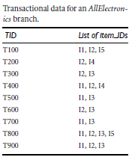
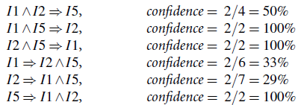
*
Data Mining: Concepts and Techniques
‹#›

Slide 22
Challenges of Frequent Pattern Mining
Challenges
Multiple scans of transaction database
Huge number of candidates
Tedious workload of support counting for candidates
Improving Apriori: general ideas
Reduce passes of transaction database scans
Shrink number of candidates
Facilitate support counting of candidates
*
Data Mining: Concepts and Techniques
‹#›

Slide 23
Improving the Efficiency of Apriori
Hash-based technique : A hash-based technique can be used to reduce the size of the candidate k-itemsets, Ck, for k > 1.
Transaction reduction (reducing the number of transactions scanned in future iterations):
A transaction that does not contain any frequent k-itemsets cannot contain any frequent (k+1)-itemsets.
Partitioning (partitioning the data to find candidate itemsets): A partitioning technique can be used that requires just two database scans to mine the frequent itemsets
*
Data Mining: Concepts and Techniques
‹#›

Slide 24
Sampling (mining on a subset of the given data): The basic idea of the sampling approach is to pick a random sample S of the given data D, and then search for frequent itemsets in S instead of D.
Dynamic itemset counting (adding candidate itemsets at different points during a scan):
A dynamic itemset counting technique was proposed in which the database is partitioned into blocks marked by start points.
*
Data Mining: Concepts and Techniques
‹#›

Slide 25
Bottleneck of Frequent-pattern Mining
Multiple database scans are costly
Mining long patterns needs many passes of scanning and generates lots of candidates
To find frequent itemset i₁i₂…i₁₀₀
# of scans: 100
# of Candidates: (₁₀₀¹) + (₁₀₀²) + … + (₁¹₀⁰₀⁰) = 2¹⁰⁰-1 = 1.27*10³⁰ !
Bottleneck: candidate-generation-and-test
Can we avoid candidate generation?
*
Data Mining: Concepts and Techniques
‹#›

Slide 26
Mining Frequent Patterns Without Candidate Generation
Frequent-pattern growth, or simply FP-growth, which adopts a divide-and-conquer strategy as follows.
First, it compresses the database representing frequent items into a frequent-pattern tree, or FP-tree, which retains the itemset association information.
It then divides the compressed database into a set of conditional databases (a special kind of projected database), each associated with one frequent item or “pattern fragment,” and mines each such database separately.
*
Data Mining: Concepts and Techniques
‹#›

Slide 27
Construct FP-tree from a Transaction Database
TID Items bought (ordered) frequent items
100 {f, a, c, d, g, i, m, p} {f, c, a, m, p}
200 {a, b, c, f, l, m, o} {f, c, a, b, m}
300 {b, f, h, j, o, w} {f, b}
400 {b, c, k, s, p} {c, b, p}
500 {a, f, c, e, l, p, m, n} {f, c, a, m, p}
min_support = 3
{}
Header Table
Item frequency head
f 4
c 4
a 3
b 3
m 3
p 3
Scan DB once, find frequent 1-itemset (single item pattern)
Sort frequent items in frequency descending order, f-list
Scan DB again, construct FP-tree
f:4
c:1
c:3
b:1
b:1
a:3
p:1
m:2
b:1
F-list=f-c-a-b-m-p
p:2
m:1
*
Data Mining: Concepts and Techniques
‹#›

Slide 28
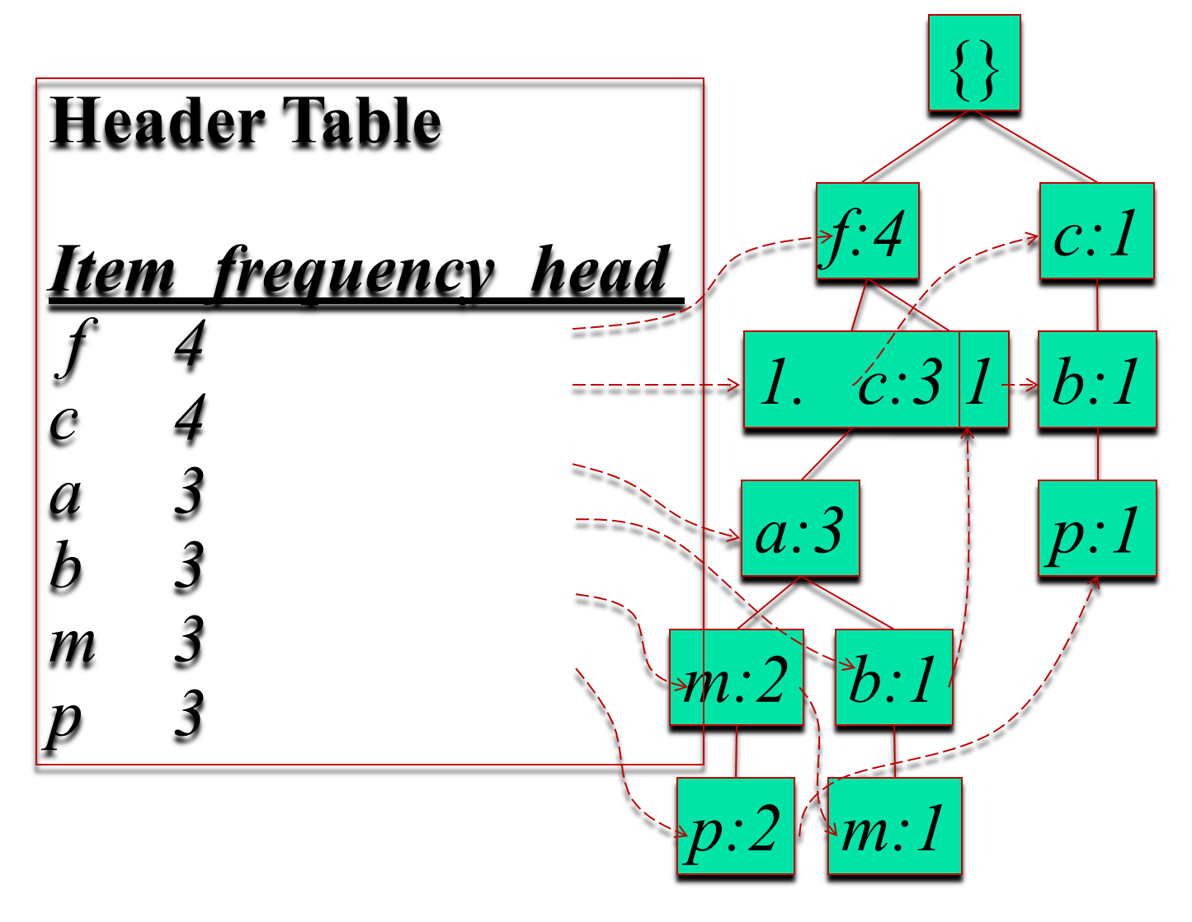
*
Data Mining: Concepts and Techniques
‹#›

Slide 29
Partition Patterns and Databases
Frequent patterns can be partitioned into subsets according to f-list
F-list=f-c-a-b-m-p
Patterns containing p
Patterns having m but no p
…
Patterns having c but no a nor b, m, p
Pattern f
Completeness and non-redundency
*
Data Mining: Concepts and Techniques
‹#›

Slide 30
Find Patterns Having P From P-conditional Database
Starting at the frequent item header table in the FP-tree
Traverse the FP-tree by following the link of each frequent item p
Accumulate all of transformed prefix paths of item p to form p’s conditional pattern base
{}
Header Table
Item frequency head
f 4
c 4
a 3
b 3
m 3
p 3
f:4
c:1
Conditional pattern bases
item cond. pattern base
c f:3
a fc:3
b fca:1, f:1, c:1
m fca:2, fcab:1
p fcam:2, cb:1
c:3
b:1
b:1
a:3
p:1
m:2
b:1
p:2
m:1
*
Data Mining: Concepts and Techniques
‹#›

Slide 31
From Conditional Pattern-bases to Conditional FP-trees
For each pattern-base
Accumulate the count for each item in the base
Construct the FP-tree for the frequent items of the pattern base
m-conditional pattern base:
fca:2, fcab:1
{}
Header Table
Item frequency head
f 4
c 4
a 3
b 3
m 3
p 3
f:4
c:1
All frequent patterns relate to m
m,
fm, cm, am,
fcm, fam, cam,
fcam
{}
c:3
b:1
b:1
🡲
f:3
🡲
a:3
p:1
m:2
b:1
c:3
p:2
m:1
a:3
m-conditional FP-tree
*
Data Mining: Concepts and Techniques
‹#›

Slide 32
Recursion: Mining Each Conditional FP-tree
{}
{}
Cond. pattern base of “am”: (fc:3)
f:3
c:3
f:3
am-conditional FP-tree
c:3
{}
Cond. pattern base of “cm”: (f:3)
a:3
f:3
m-conditional FP-tree
cm-conditional FP-tree
{}
Cond. pattern base of “cam”: (f:3)
f:3
cam-conditional FP-tree
*
Data Mining: Concepts and Techniques
‹#›

Slide 33
An FP-tree is then constructed as follows.
First, create the root of the tree, labeled with“null.”
Scan database D a second time.
The items in each transaction are processed in L order (i.e., sorted according to descending support count), and a branch is created for each transaction.
*
Data Mining: Concepts and Techniques
‹#›

Slide 34
Transactional Data
TID | List of Items
T100 | I₁, I₂, I₅
T200 | I₂, I₄
T300 | I₂, I₃
T400 | I₁, I₂, I₄
T500 | I₁, I₃
T600 | I₂, I₃
T700 | I₁, I₃
T800 | I₁, I₂, I₃, I₅
T900 | I₁, I₂, I₃
*
Data Mining: Concepts and Techniques
‹#›

Slide 35
For example, the scan of the first transaction,
“T100: I₂, I₁, I₅ ,”
which contains three items (I₂, I₁, I₅ in L order), leads to the construction of the first branch of the tree with three nodes, {I₂: 1}, {I₁:1}, and {I₅: 1}, where I₂ is linked as a child of the root, I₁ is linked to I₂, and I₅ is linked to I₁.
*
Data Mining: Concepts and Techniques
‹#›

Slide 36
The second transaction, T200, contains the items I2 and I4 in L order, which would result in a branch where I2 is linked to the root and I4 is linked to I2. However, this branch would share a common prefix, I2, with the existing path for T100.
Therefore, we instead increment the count of the I2 node by 1, and create a newnode, {I4: 1},which is linked as a child of {I2: 2}. In general,when considering the branch to be added for a transaction, the count of each node along a common prefix is incremented by 1, and nodes for the items following the prefix are created and linked accordingly.
*
Data Mining: Concepts and Techniques
‹#›

Slide 37
To facilitate tree traversal, an item header table is built so that each item points to its occurrences in the tree via a chain of node-links.
The tree obtained after scanning all of the transactions is shown in Figure with the associated node-links.
In this way, the problem of mining frequent patterns in databases is transformed to that of mining the FP-tree.
*
Data Mining: Concepts and Techniques
‹#›

Slide 38
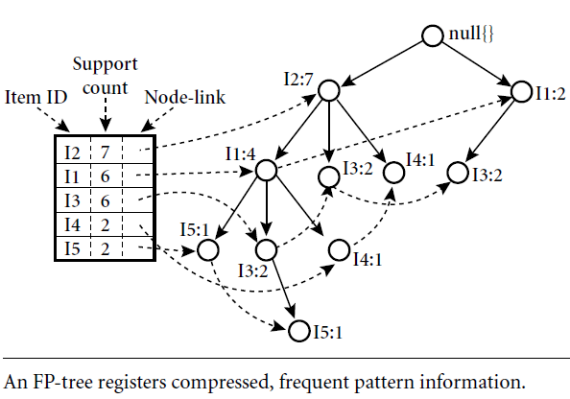
*
Data Mining: Concepts and Techniques
‹#›

Slide 39

Mining the FP-tree by creating conditional (sub)pattern bases.
Item | Conditional Pattern Base | Conditional FP-tree | Frequent Patterns Generated
I₅ | {I2, I1 : 1}, {I2, I1, I3: 1} | {I2: 2, I1:2} | {I2, I5: 2}, {I1, I5: 2}, {I2, I1, I5: 2}
I₄ | {I2, I1 : 1}, {I2 : 1} | {I2: 2} | {I2, I4: 2}
I₃ | {I2, I1: 2}, {I2 : 2}, {I1 : 2} | {I2: 4, I1:2}, {I1: 2} | {I2, I3: 4}, {I1, I3: 4}, {I2, I1, I3: 2}
I₁ | {I2: 4} | {I2: 4} | {I2, I1: 4}
*
Data Mining: Concepts and Techniques
‹#›

Slide 40
The FP-tree is mined as follows.
Start from each frequent length-1 pattern (as an initial suffix pattern), construct its conditional pattern base (a “subdatabase,” which consists of the set of prefix paths in the FP-tree co-occurring with the suffix pattern), then construct its (conditional) FP-tree, and perform mining recursively on such a tree.
We first consider I5, which is the last item in L, rather than the first. The reason for starting at the end of the list will become apparent as we explain the FP-tree mining process.
I5 occurs in two branches of the FP-tree of Figure 5.7. (The occurrences of I5 can easily be found by following its chain of node-links.)
The paths formed by these branches are {I2, I1, I5: 1} and {I2, I1, I3, I5: 1}.
*
Data Mining: Concepts and Techniques
‹#›

Slide 41
Therefore, considering I5 as a suffix, its corresponding two prefix paths are {I2, I1: 1} and {I2, I1, I3: 1}, which form its conditional pattern base.
Its conditional FP-tree contains only a single path, {I2: 2, I1: 2}; I3 is not included because its support count of 1 is less than the minimum support count.
The single path generates all the combinations of frequent patterns: {I2, I5: 2}, {I1, I5: 2}, {I2, I1, I5: 2}.
*
Data Mining: Concepts and Techniques
‹#›

Slide 42
For I4, its two prefix paths form the conditional pattern base, { {I2 I1: 1}, {I2: 1} }, which generates a single-node conditional FP-tree, {I2:2}, and derives one frequent pattern, {I2,I4:2}. Notice that although I5 follows I4 in the first branch, there is no need to include I5 in the analysis here because any frequent pattern involving I5 is analysed in the examination of I5.
*
Data Mining: Concepts and Techniques
‹#›

Slide 43
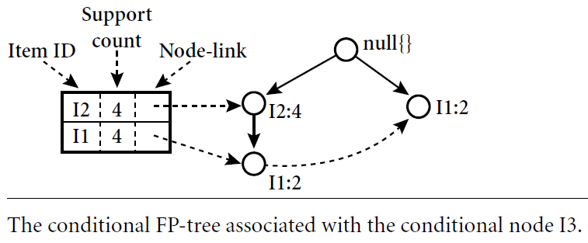
Similar to the above analysis, I3’s conditional pattern base is { {I2, I1:2}, {I2: 2},{I1: 2}}.
Its conditional FP-tree has two branches, {I2:4,I1: 2} and {I1: 2}, as shown in Figure, which generates the set of patterns,
{ {I2,I3:4}, {I1, I3: 4}, {I2, I1, I3: 2} }
*
Data Mining: Concepts and Techniques
‹#›

Slide 44
Finally, I1’s conditional pattern base is {I2: 4}, whose FP-tree contains only one node, {I2: 4}, which generates one frequent pattern,
{I2, I1: 4}.
*
Data Mining: Concepts and Techniques
‹#›

Slide 45
Example Question
A database has five transactions.
Let min sup = 60% and min con f = 80%.
TID items bought
T100 {M, O, N, K, E, Y}
T200 {D, O, N, K, E, Y }
T300 {M, A, K, E}
T400 {M, U, C, K, Y}
T500 {C, O, O, K, I ,E}
Find all frequent itemsets using Apriori and FP-growth, respectively.
*
Data Mining: Concepts and Techniques
‹#›

Slide 46
The FP-growth algorithm for discovering frequent itemsets without candidate generation
Algorithm: FP growth.
Mine frequent itemsets using an FP-tree by pattern fragment growth.
Input:
D, a transaction database;
min sup, the minimum support count threshold.
Output: The complete set of frequent patterns.
*
Data Mining: Concepts and Techniques
‹#›

Slide 47
Method:
The FP-tree is constructed in the following steps:
Scan the transaction database D once. Collect F, the set of frequent items, and their support counts. Sort F in support count descending order as L, the list of frequent items.
*
Data Mining: Concepts and Techniques
‹#›

Slide 48
Create the root of an FP-tree, and label it as “null.”
For each transaction Trans in D do the following.
Select and sort the frequent items in Trans according to the order of L. Let the sorted frequent item list in Trans be [p/P], where p is the first element and P is the remaining list.
Call insert tree([p/P], T), which is performed as follows.
If T has a child N such that N.item-name=p.item-name, then increment N ’s count by 1; else create a new node N, and let its count be 1, its parent link be linked to T, and its node-link to the nodes with the same item-name via the node-link structure.
If P is nonempty, call insert tree(P, N) recursively.
*
Data Mining: Concepts and Techniques
‹#›

Slide 49
2. The FP-tree is mined by calling FP growth(FP tree, null), which is implemented as follows.
procedure FP growth(Tree, α)
(1) if Tree contains a single path P then
(2) for each combination (denoted as β) of the nodes in the path P
(3) generate pattern β U α with support_count = minimum support count o f nodes in β;
(4) else for each a_{i} in the header of Tree {
(5) generate pattern β = a_{i} U α with support_count = a_{i .}support count;
(6) construct b’s conditional pattern base and then b’s conditional FP tree Tree_{β};
(7) if Tree_{β} != 0 then
(8) call FP_growth(Tree_{β} , β); }
*
Data Mining: Concepts and Techniques
‹#›

Slide 50
Mining Frequent Patterns With FP-trees
Idea: Frequent pattern growth
Recursively grow frequent patterns by pattern and database partition
Method
For each frequent item, construct its conditional pattern-base, and then its conditional FP-tree
Repeat the process on each newly created conditional FP-tree
Until the resulting FP-tree is empty, or it contains only one path—single path will generate all the combinations of its sub-paths, each of which is a frequent pattern
*
Data Mining: Concepts and Techniques
‹#›

Slide 51
Benefits of the FP-tree Structure
Completeness
Preserve complete information for frequent pattern mining
Never break a long pattern of any transaction
Compactness
Reduce irrelevant info—infrequent items are gone
Items in frequency descending order: the more frequently occurring, the more likely to be shared
Never be larger than the original database (not count node-links and the count field)
For Connect-4 DB, compression ratio could be over 100
*
Data Mining: Concepts and Techniques
‹#›

Slide 52
Scaling FP-growth by DB Projection
FP-tree cannot fit in memory?—DB projection
First partition a database into a set of projected DBs
Then construct and mine FP-tree for each projected DB
Parallel projection vs. Partition projection techniques
Parallel projection is space costly
*
Data Mining: Concepts and Techniques
‹#›

Slide 53
Why Is FP-Growth the Winner?
Divide-and-conquer:
decompose both the mining task and DB according to the frequent patterns obtained so far
leads to focused search of smaller databases
Other factors
no candidate generation, no candidate test
compressed database: FP-tree structure
no repeated scan of entire database
basic ops—counting local freq items and building sub FP-tree, no pattern search and matching
*
Data Mining: Concepts and Techniques
‹#›

Slide 54
Mining Frequent Itemsets Using Vertical Data Format
Both the Apriori and FP-growth methods mine frequent patterns from a set of transactions in TID-itemset format (that is, {TID : itemset}), where TID is a transaction-id and itemset is the set of items bought in transaction TID.
This data format is known as horizontal data format.
Alternatively, data can also be presented in item-TID set format (that is, {item : TID set}), where item is an item name, and TID set is the set of transaction identifiers containing the item.
This format is known as vertical data format.
*
Data Mining: Concepts and Techniques
‹#›

Slide 55
Vertical Data Format
TID | List of Items
T100 | I₁, I₂, I₅
T200 | I₂, I₄
T300 | I₂, I₃
T400 | I₁, I₂, I₄
T500 | I₁, I₃
T600 | I₂, I₃
T700 | I₁, I₃
T800 | I₁, I₂, I₃, I₅
T900 | I₁, I₂, I₃
Vertical data format, which is the essence of the ECLAT (Equivalence CLASS Transformation) algorithm developed by Zaki [Zak00].
The vertical data format of the transaction data set D
Itemset | TID-set
I1 | {T100, T400, T500, T700, T800, T900}
I2 | {T100, T200, T300, T400, T600, T800, T900}
I3 | {T300, T500, T600, T700, T800, T900}
I4 | {T200, T400}
I5 | {T100, T800}
*
Data Mining: Concepts and Techniques
‹#›

Slide 56
Mining can be performed on this data set by intersecting the TID sets of every pair of frequent single items.
*
Data Mining: Concepts and Techniques
‹#›

Slide 57
The 2-itemsets in vertical data format
The minimum support count is 2. Because every single item is frequent , there are 10 intersections performed in total, which lead to 8 nonempty 2-itemsets. The itemsets {I1, I4} and {I3, I5} each contain only one transaction, they do not belong to the set of frequent 2-itemsets.
itemset | TID set
{I₁, I₂} | {T100, T400, T800, T900}
{I₁, I₃} | {T500, T700, T800, T900}
{I₁, I₄} | {T400}
{I₁, I₅ } | {T100, T800}
{I₂, I₃ } | {T300, T600, T800, T900}
{I₂, I₄} | {T200, T400}
{I₂, I₅} | {T100, T800}
{I₃, I₅} | {T800}
*
Data Mining: Concepts and Techniques
‹#›

Slide 58
The 3-itemsets in vertical data format
Based on the Apriori property, a given 3-itemset is a candidate 3-itemset only if every one of its 2-itemset subsets is frequent.
The candidate generation process here will generate only two 3-itemsets: {I1, I2, I3} and {I1, I2, I5}.
By intersecting the TID sets of any two corresponding 2-itemsets of these candidate 3-itemsets,
there are only two frequent 3-itemsets: {I1, I2, I3: 2} and {I1, I2, I5: 2}.
itemset | TID set
{I₁, I_{2,} I₃ } | {T800, T900}
{I₁, I₂, I₅} | {T100, T800}
*
Data Mining: Concepts and Techniques
‹#›

Slide 59
Vertical Data Format
First, we transform the horizontally formatted data to the vertical format by scanning the data set once.
The support count of an itemset is simply the length of the TID set of the itemset. Starting with k = 1, the frequent k-itemsets can be used to construct the candidate (k+1)-itemsets based on the Apriori property.
The computation is done by intersection of the TID sets of the frequent k-itemsets to compute the TID sets of the corresponding (k+1)-itemsets.
This process repeats, with k incremented by 1 each time, until no frequent itemsets or no candidate itemsets can be found.
Another merit of this method is that there is no need to scan the database to find the support of (k+1) itemsets (for k >=1).
*
Data Mining: Concepts and Techniques
‹#›

Slide 60
Mining Closed Frequent Itemsets
Frequent itemset mining may generate a huge number of frequent itemsets, especially when the min_sup threshold is set low or when there exist long patterns in the data set.
Closed frequent itemsets can substantially reduce the number of patterns generated in frequent itemset mining while preserving the complete information regarding the set of frequent itemsets.
From the set of closed frequent itemsets, we can easily derive the set of frequent itemsets and their support.
*
Data Mining: Concepts and Techniques
‹#›

Slide 61
A recommended methodology is to search for closed frequent itemsets directly during the mining process is to prune the search space as soon as we can identify the case of closed itemsets during mining.
*
Data Mining: Concepts and Techniques
‹#›

Slide 62
Pruning strategies include the following:
Itemmerging: If every transaction containing a frequent itemset X also contains an itemset Y but not any proper superset of Y, then X UY forms a frequent closed itemset and there is no need to search for any itemset containing X but no Y.
The projected conditional database for prefix itemset {I5:2} is { {I2, I1},{I2, I1, I3} }, from which we can see that each of its transactions contains itemset {I2, I1} but no proper superset of {I2, I1}. Itemset {I2, I1} can be merged with {I5} to form the closed itemset, {I5, I2, I1: 2}, and we do not need to mine for closed itemsets that contain I5 but not {I2, I1}. �
Data Mining: Concepts and Techniques
‹#›

Slide 63
Suppose a transaction database has only two transactions: {(a1, a2, : : : , a100), (a1, a2, : : : , a50)}, and the minimum support count is min sup =2.
The projection on the first item, a1, derives the frequent itemset, {a1, a2, : : : , a50:2}, based on the itemset merging optimization.
Because support({a2}) = support({a1, a2, : : : , a50})=2, and {a2} is a proper subset of {a1, a2, : : : , a50}, there is no need to examine a2 and its projected database.
Similar pruning can be done for a3, : : : , a50 as well. Thus the mining of closed frequent itemsets in this data set terminates after mining a1’s projected database.`
2. Sub-itemset pruning: If a frequent itemset X is a proper subset of an already found frequent closed itemset Y and support count(X) = support count(Y), then X and all of X’s descendants in the set enumeration tree cannot be frequent closed itemsets and thus can
be pruned.
*
Data Mining: Concepts and Techniques
‹#›

Slide 64
3. Item skipping: In the depth-first mining of closed itemsets, at each level, there will be a prefix itemset X associated with a header table and a projected database. If a local frequent item p has the same support in several header tables at different levels, we can safely prune p from the header tables at higher levels.
*
Data Mining: Concepts and Techniques
‹#›
Notes:
‹#›

Slide 65
Example, the transaction database above having only two transactions:
{(a1, a2, : : : , a100i, ha1, a2, : : : , a50)}, where min sup=2. Because a2 in a1’s projected database has the same support as a2 in the global header table, a2 can be pruned from the global header table. Similar pruning can be done for a3, : : : , a50. There is no need to mine anything more after mining a1’s projected database.
*
Data Mining: Concepts and Techniques
‹#›

Slide 66
Another important optimization is to perform efficient checking of a newly derived frequent itemset to see whether it is closed.
When a new frequent itemset is derived, it is necessary to perform two kinds of closure checking:
(1) superset checking, which checks if this new frequent itemset is a superset of some already found closed itemsets with the same support, and
(2) subset checking, which checks whether the newly found itemset is a subset of an already found closed itemset with the same support.
*
Data Mining: Concepts and Techniques
‹#›

Slide 67
Chapter 5: Mining Frequent Patterns, Association and Correlations
Basic concepts and a road map
Efficient and scalable frequent itemset mining methods
Mining various kinds of association rules
From association mining to correlation analysis
Constraint-based association mining
Summary
*
Data Mining: Concepts and Techniques
‹#›

Slide 68
Mining Various Kinds of Association Rules
Mining multilevel association
Miming multidimensional association
Mining quantitative association
Mining interesting correlation patterns
Data Mining: Concepts and Techniques
‹#›

Slide 69
Mining Multilevel Association Rules
Association rules generated from mining data at multiple levels of abstraction are called multiple-level or multilevel association rules.
Multilevel association rules can be mined efficiently using concept hierarchies under a support-confidence framework.
In general, a top-down strategy is employed, where counts are accumulated for the calculation of frequent itemsets at each concept level, starting at the concept level 1 and working downward in the hierarchy toward the more specific concept levels, until no more frequent itemsets can be found.
*
Data Mining: Concepts and Techniques
‹#›

Slide 70
Using uniform minimum support for all levels
uniform support
Milk
[support = 10%]
Level 1
min_sup = 5%
Level 2
min_sup = 5%
2% Milk
[support = 6%]
Skim Milk
[support = 4%]
*
Data Mining: Concepts and Techniques
‹#›

Slide 71
Using uniform minimum support for all levels
When a uniform minimum support threshold is used, the search procedure is simplified.
The method is also simple in that users are required to specify only one min_sup threshold.
An Apriori-like optimization technique can be adopted, based on the knowledge that an ancestor is a superset of its descendants: The search avoids examining itemsets containing any item whose ancestors do not have minimum support.
*
Data Mining: Concepts and Techniques
‹#›

Slide 72
The uniform support approach, however, has some difficulties.
It is unlikely that items at lower levels of abstraction will occur as frequently as those at higher levels of abstraction.
If the minimum support threshold is set too high, it could miss some meaningful associations occurring at low abstraction levels.
If the threshold is set too low, it may generate many uninteresting associations occurring at high abstraction levels.
*
Data Mining: Concepts and Techniques
‹#›

Slide 73
Using reduced minimum support at lower levels
Each level of abstraction has its own minimum support threshold.
The deeper the level of abstraction, the smaller the corresponding threshold is.
uniform support
reduced support
Level 1
min_sup = 5%
Milk
[support = 10%]
Level 1
min_sup = 5%
Level 2
min_sup = 5%
2% Milk
[support = 6%]
Skim Milk
[support = 4%]
Level 2
min_sup = 3%
*
Data Mining: Concepts and Techniques
‹#›

Slide 74
Using item or group-based minimum support
Because users or experts often have insight as to which groups are more important than others, it is sometimes more desirable to set up user-specific, item, or group based minimal support thresholds when mining multilevel rules.
*
Data Mining: Concepts and Techniques
‹#›

Slide 75
Mining Multiple-Level Association Rules
Items often form hierarchies
Flexible support settings
Items at the lower level are expected to have lower support
Exploration of shared multi-level mining
uniform support
reduced support
Level 1
min_sup = 5%
Milk
[support = 10%]
Level 1
min_sup = 5%
Level 2
min_sup = 5%
2% Milk
[support = 6%]
Skim Milk
[support = 4%]
Level 2
min_sup = 3%
*
Data Mining: Concepts and Techniques
‹#›

Slide 76
Multi-level Association: Redundancy Filtering
Some rules may be redundant due to “ancestor” relationships between items.
Example
milk ⇒ wheat bread [support = 8%, confidence = 70%]
2% milk ⇒ wheat bread [support = 2%, confidence = 72%]
We say the first rule is an ancestor of the second rule.
A rule is redundant if its support is close to the “expected” value, based on the rule’s ancestor.
The second rule here is not interesting because it does not give any additional information and is less general than the other
*
Data Mining: Concepts and Techniques
‹#›

Slide 77
Mining Multi-Dimensional Association
Single-dimensional rules:
buys(X, “milk”) ⇒ buys(X, “bread”)
Considering each database attribute or warehouse dimension as a predicate, we can therefore mine association rules containing multiple predicates
Multi-dimensional rules: ≥ 2 dimensions or predicates
Inter-dimension assoc. rules (no repeated predicates)
age(X,”19-25”) ∧ occupation(X,“ student”) ⇒ buys(X, “coke”)
hybrid-dimension assoc. rules (repeated predicates)
age(X,”19-25”) ∧ buys(X, “popcorn”) ⇒ buys(X, “coke”)
*
Data Mining: Concepts and Techniques
‹#›

Slide 78
Categorical Attributes: finite number of possible values, no ordering among values—data cube approach
Quantitative Attributes: numeric, implicit ordering among values—discretization, clustering, and gradient approaches
Techniques for mining multidimensional association rules can be categorized into two basic approaches regarding the treatment of quantitative attributes.
*
Data Mining: Concepts and Techniques
‹#›

Slide 79
Mining Multi-Dimensional Association
First approach, quantitative attributes are discretized using predefined concept hierarchies.
This discretization occurs before mining.
This is referred to as mining multidimensional association rules using static discretization of quantitative attributes.
*
Data Mining: Concepts and Techniques
‹#›

Slide 80
Mining Multi-Dimensional Association
Second approach, quantitative attributes are discretized or clustered into “bins” based on the distribution of the data.
These bins may be further combined during the mining process.
The discretization process is dynamic and established so as to satisfy some mining criteria, such as maximizing the confidence of the rules mined.
This approach are also referred to as (dynamic) quantitative association rules.
*
Data Mining: Concepts and Techniques
‹#›

Slide 81
Mining Multi-Dimensional Association
In multidimensional association rule mining we search for frequent predicate sets rather than searching for frequent itemsets .
A k-predicate set is a set containing k conjunctive predicates.
For instance, the set of predicates
{age, occupation, buys} is a 3-predicate set.
Similar to the notation used for itemsets, we use the notation L_{k} to refer to the set of frequent k-predicate sets.
*
Data Mining: Concepts and Techniques
‹#›

Slide 82
Mining Multidimensional Association Rules Using Static Discretization of Quantitative Attributes
Quantitative attributes, in this case, are discretized before mining using predefined concept hierarchies or data discretization techniques, where numeric values are replaced by interval labels.
The transformed multidimensional data may be used to construct a data cube.
It is possible that a data cube containing the dimensions that are of interest to the usermay already exist, fully materialized. If this is the case, we can simply fetch the corresponding aggregate values and return the rules needed using a rule generation algorithm.
*
Data Mining: Concepts and Techniques
‹#›

Slide 83
Mining Quantitative Association Rules
Quantitative association rules are multidimensional association rules in which the numeric attributes are dynamically discretized during the mining process so as to satisfy some mining criteria, such as maximizing the confidence or compactness of the rules mined.
*
Data Mining: Concepts and Techniques
‹#›
Notes:
‹#›

Slide 84
Techniques can be categorized by how numerical attributes, such as age or salary are treated
Static discretization based on predefined concept hierarchies (data cube methods)
Dynamic discretization based on data distribution (quantitative rules, e.g., Agrawal & Srikant@SIGMOD96)
Clustering: Distance-based association (e.g., Yang & Miller@SIGMOD97)
one dimensional clustering then association
Deviation: (such as Aumann and Lindell@KDD99)
Sex = female => Wage: mean=$7/hr (overall mean = $9)
*
Data Mining: Concepts and Techniques
‹#›

Slide 85
Static Discretization of Quantitative Attributes
Discretized prior to mining using concept hierarchy.
Numeric values are replaced by ranges.
In relational database, finding all frequent k-predicate sets will require k or k+1 table scans.
Data cube is well suited for mining.
The cells of an n-dimensional
cuboid correspond to the
predicate sets.
Mining from data cubes can be much faster.
()
(age)
(income)
(buys)
(age, income)
(age,buys)
(income,buys)
(age,income,buys)
*
Data Mining: Concepts and Techniques
‹#›

Slide 86
Quantitative Association Rules
Proposed by Lent, Swami and Widom ICDE’97
Numeric attributes are dynamically discretized
Such that the confidence or compactness of the rules mined is maximized
2-D quantitative association rules: A_{quan1} ∧ A_{quan2} ⇒ A_{cat}
Cluster adjacent association rules to form general rules using a 2-D grid
*
Data Mining: Concepts and Techniques
‹#›

Slide 87
A system called ARCS uses approach that maps pairs of quantitative attributes onto a 2-D grid for tuples satisfying a given categorical attribute condition.
The grid is then searched for clusters of points from which the association rules are generated.
*
Data Mining: Concepts and Techniques
‹#›

Slide 88
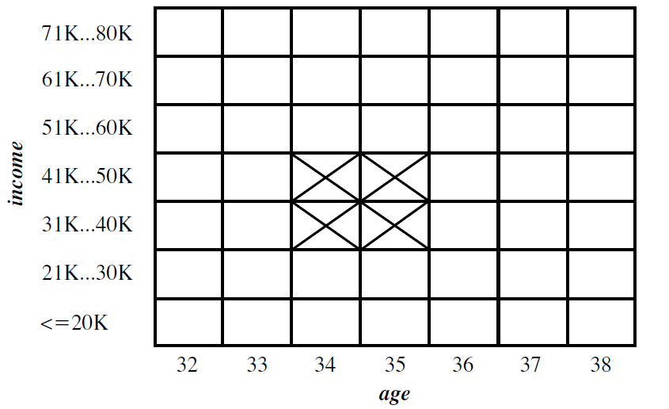
Example
age(X,”34-35”) ∧ income(X,”30-50K”)
⇒ buys(X,”high resolution TV”)
*
Data Mining: Concepts and Techniques
‹#›

Slide 89
Chapter 5: Mining Frequent Patterns, Association and Correlations
Basic concepts and a road map
Efficient and scalable frequent itemset mining methods
Mining various kinds of association rules
From association mining to correlation analysis
Constraint-based association mining
Summary
*
Data Mining: Concepts and Techniques
‹#›

Slide 90
Interestingness Measure: Correlations (Lift)
play basketball ⇒ eat cereal [40%, 66.7%] is misleading
The overall % of students eating cereal is 75% > 66.7%.
play basketball ⇒ not eat cereal [20%, 33.3%] is more accurate, although with lower support and confidence
The support and confidence measures are insufficient at filtering out uninteresting association rules. To tackle this weakness, a correlation measure can be used to augment the support-confidence framework for association rules. This leads to correlation rules of the form
A=>B [support, confidence. correlation].
That is, a correlation rule is measured not only by its support and confidence but also by the correlation between itemsets A and B.
*
Data Mining: Concepts and Techniques
‹#›

Slide 91
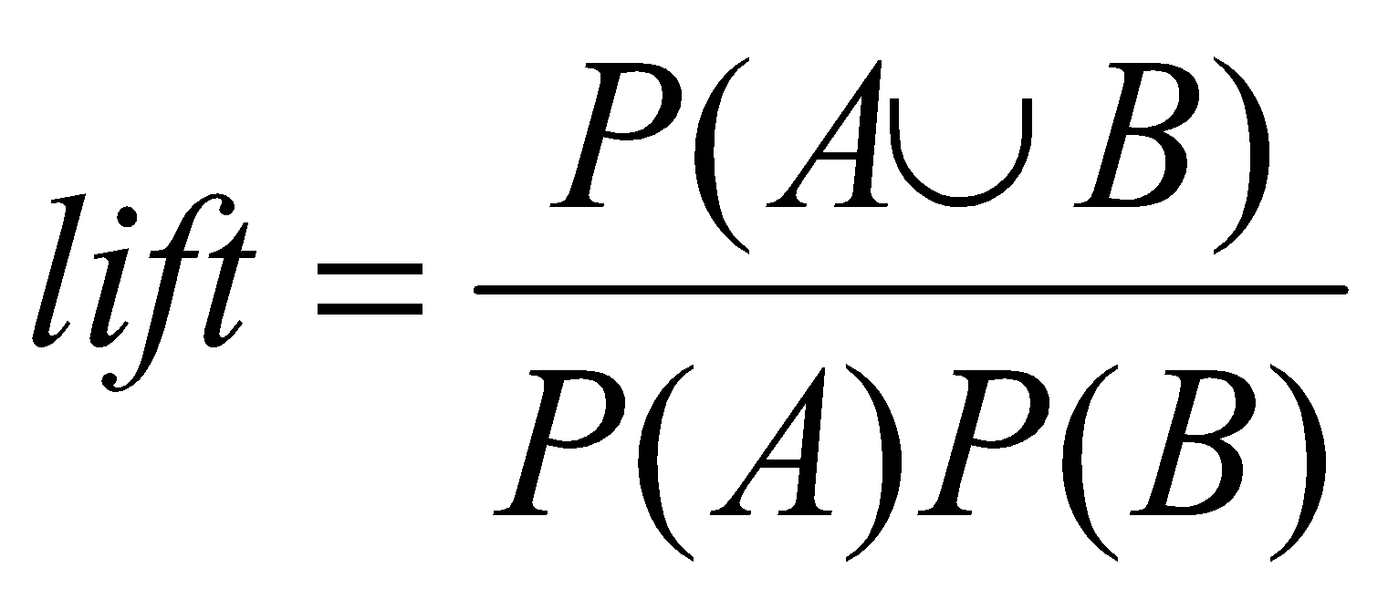
Interestingness Measure: Correlations (Lift)
Measure of dependent/correlated events: lift
Lift is a simple correlation measure that the occurrence of itemset A is independent of the occurrence of itemset B if P(A U B) = P(A)P(B); otherwise, itemsets A and B are dependent and correlated as events.
The lift between the occurrence of A and B can be measured by computing
*
Data Mining: Concepts and Techniques
‹#›

Slide 92
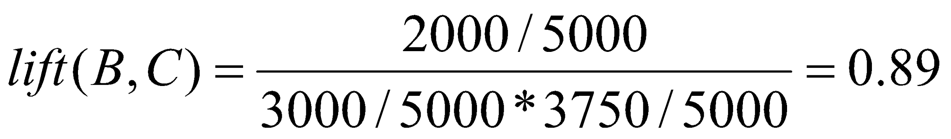
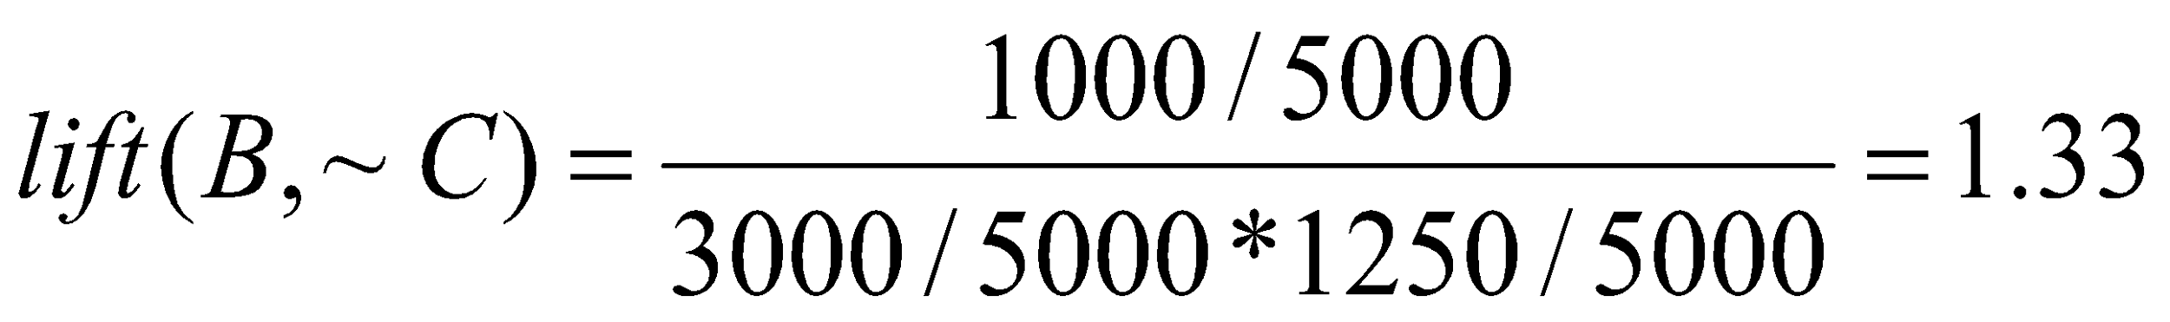
Interestingness Measure: Correlations (Lift)
 | Basketball | Not basketball | Sum (row)
Cereal | 2000 | 1750 | 3750
Not cereal | 1000 | 250 | 1250
Sum(col.) | 3000 | 2000 | 5000
*
Data Mining: Concepts and Techniques
‹#›

Slide 93
Interestingness Measure: Correlations (Lift)
If the resulting value is less than 1, then the occurrence of A is negatively correlated with the occurrence of B.
If the resulting value is greater than 1, then A and B are positively correlated, meaning that the occurrence of one implies the occurrence of the other.
If the resulting value is equal to 1, then A and B are independent and there is no correlation between them.
*
Data Mining: Concepts and Techniques
‹#›

Slide 94
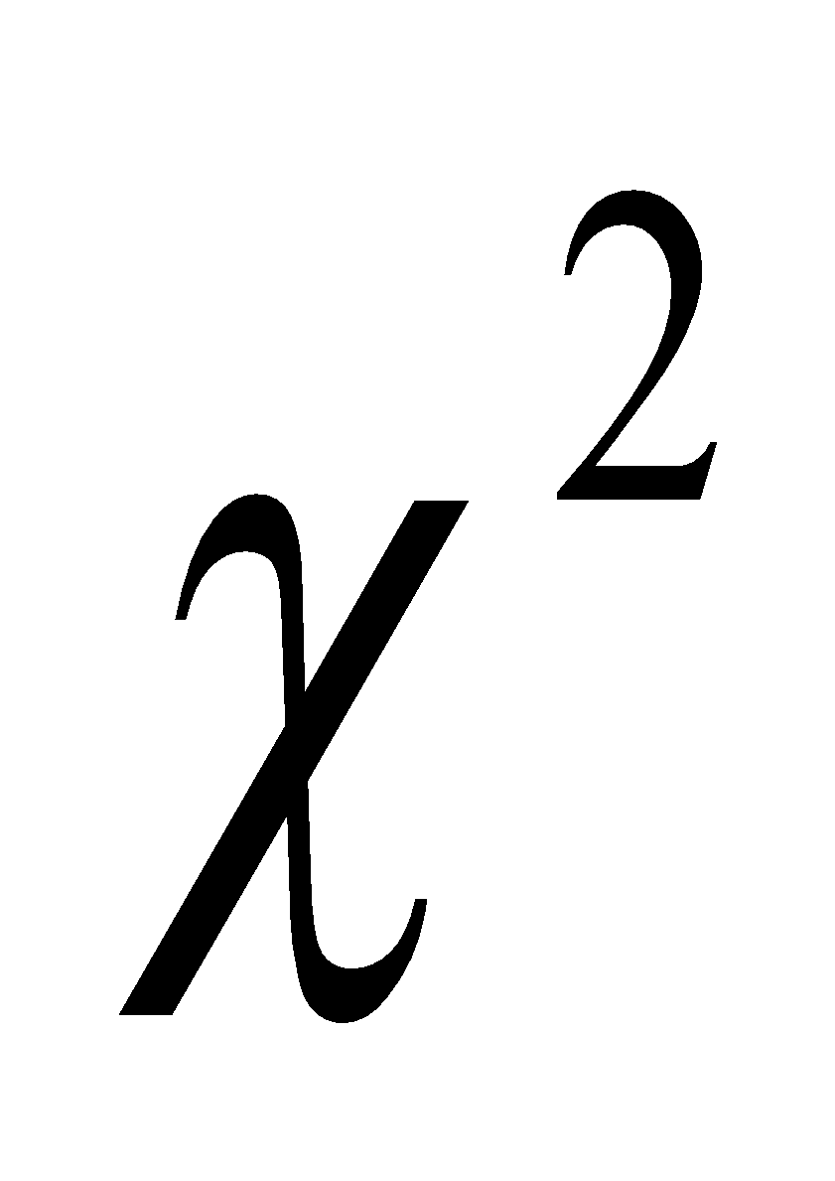
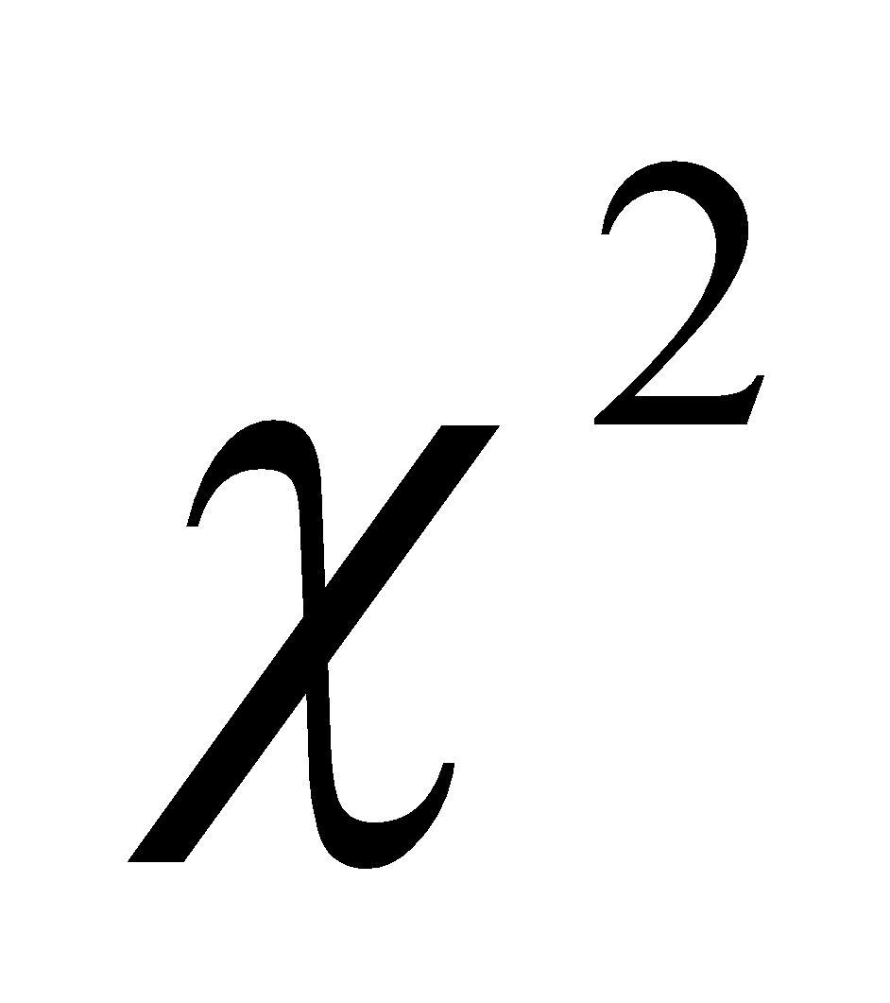
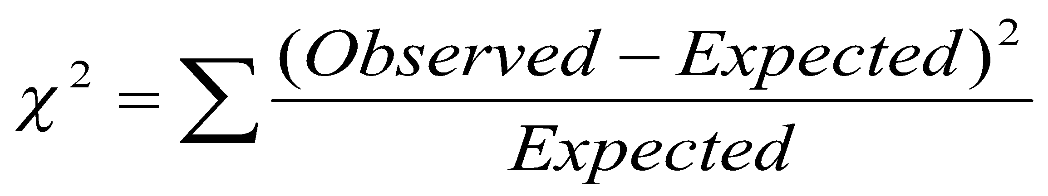
Interestingness Measure: Correlations ( )
The second correlation measure is the measure. To compute the value, we take the squared difference between the observed and expected value for a slot (A and B pair) in the contingency table, divided by the expected value.
*
Data Mining: Concepts and Techniques
‹#›

Slide 95
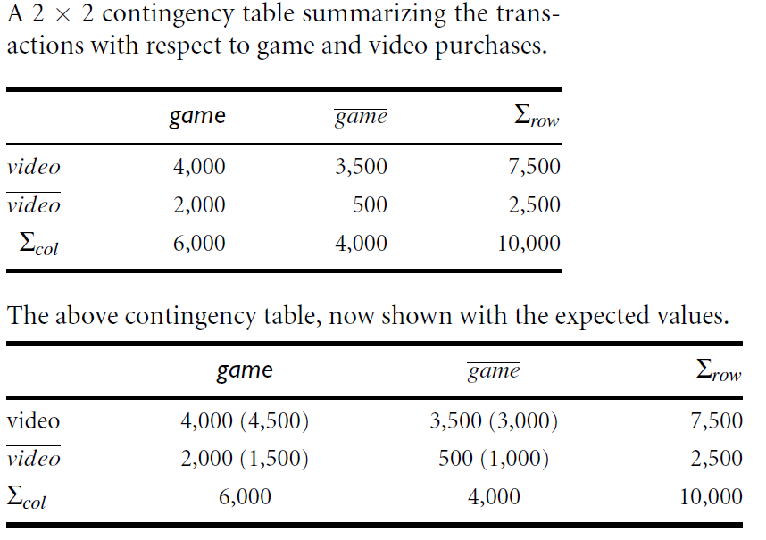
*
Data Mining: Concepts and Techniques
‹#›

Slide 96
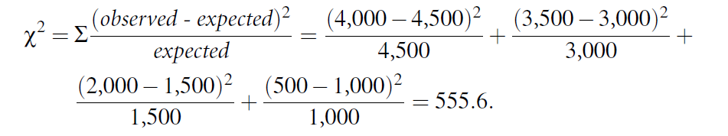
Interestingness Measure: Correlations ( )
Because the X² value is greater than one, and the observed value of the slot (game, video) = 4,000, which is less than the expected value 4,500, buying game and buying video are
negatively correlated.
This is consistent with the conclusion derived from the analysis of the lift measure
*
Data Mining: Concepts and Techniques
‹#›

Slide 97
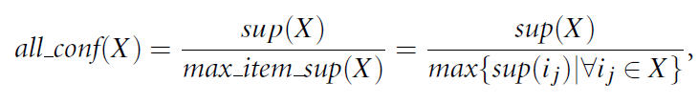
Correlation measures, all confidence and cosine
Given an itemset X = {i₁, i₂, : : : , i_{k}}, the all confidence of X is defined as the maximum (single) item support of all the items in X, and hence is called the max item sup of the itemset X.
The all confidence of X is the minimal confidence among the set of rules i_{j} ->X -i_{j}, where i_{j} is an element of X.
*
Data Mining: Concepts and Techniques
‹#›

Slide 98

Correlation measures, all confidence and cosine
*
Data Mining: Concepts and Techniques
‹#›

Slide 99
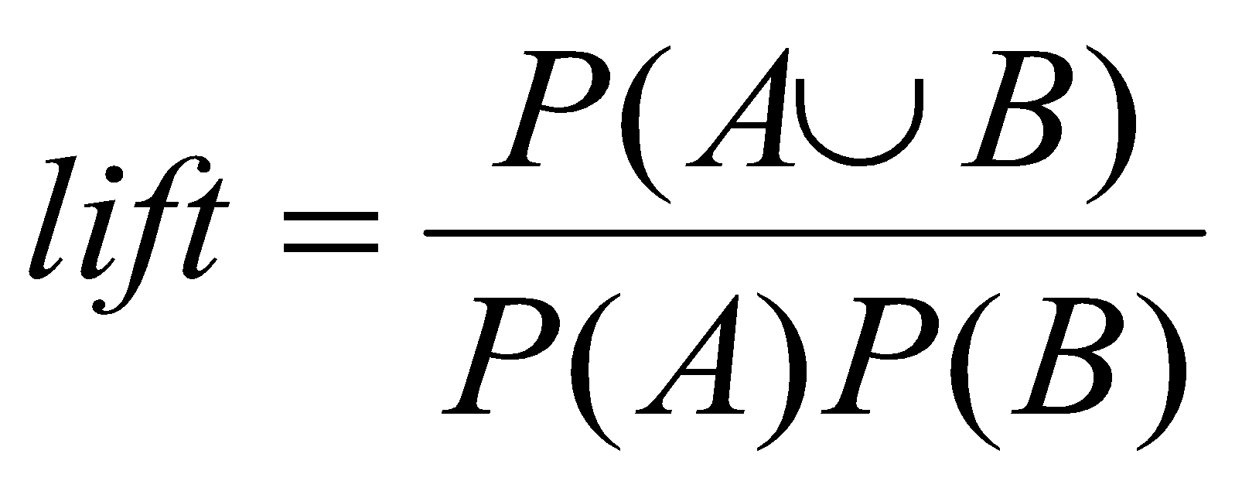
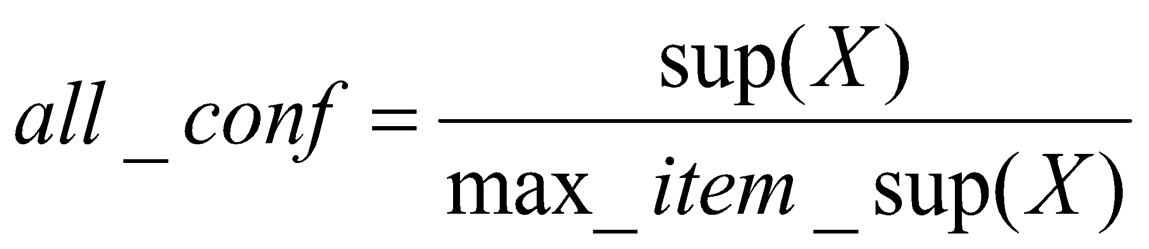
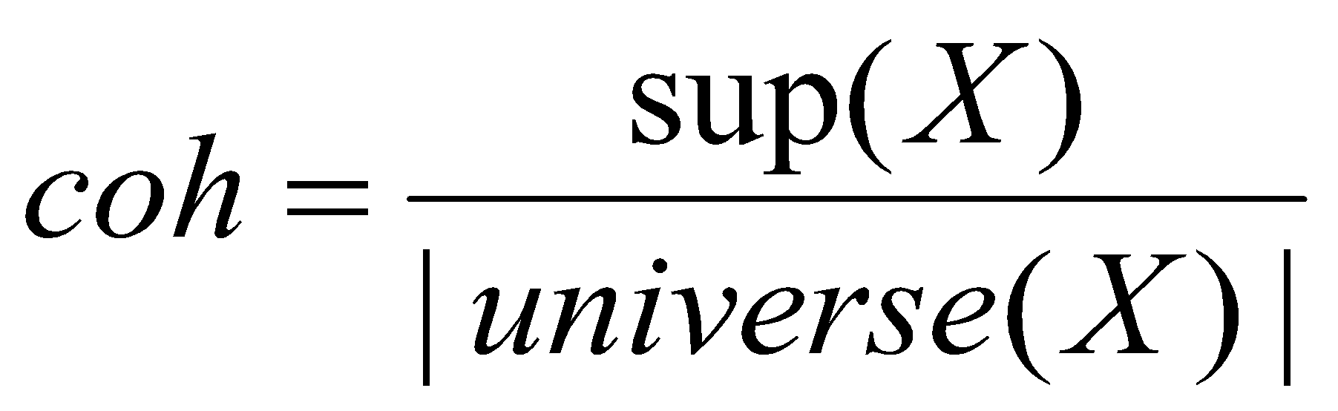
Are lift and χ² Good Measures of Correlation?
“Buy walnuts ⇒ buy milk [1%, 80%]” is misleading
if 85% of customers buy milk
Support and confidence are not good to represent correlations
So many interestingness measures? (Tan, Kumar, Sritastava @KDD’02)
 | Milk | No Milk | Sum (row)
Coffee | m, c | ~m, c | c
No Coffee | m, ~c | ~m, ~c | ~c
Sum(col.) | m | ~m | Σ
DB | m, c | ~m, c | m~c | ~m~c | lift | all-conf | coh | χ2
A1 | 1000 | 100 | 100 | 10,000 | 9.26 | 0.91 | 0.83 | 9055
A2 | 100 | 1000 | 1000 | 100,000 | 8.44 | 0.09 | 0.05 | 670
A3 | 1000 | 100 | 10000 | 100,000 | 9.18 | 0.09 | 0.09 | 8172
A4 | 1000 | 1000 | 1000 | 1000 | 1 | 0.5 | 0.33 | 0
*
Data Mining: Concepts and Techniques
‹#›

Slide 100
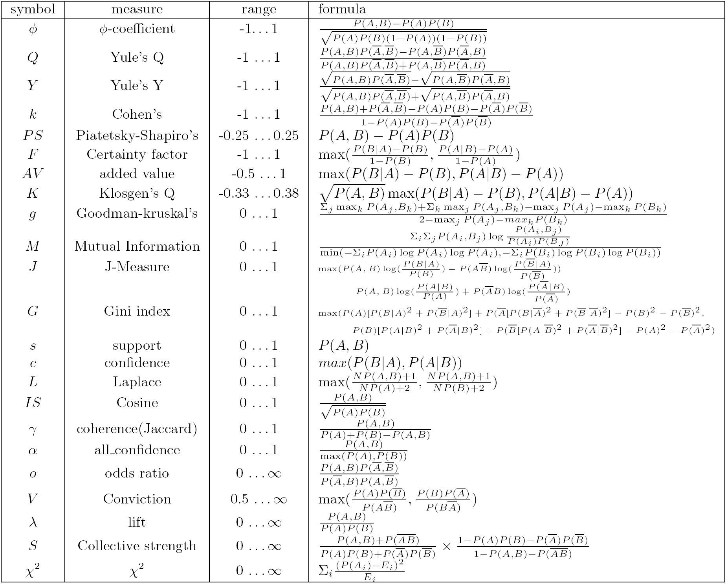
Which Measures Should Be Used?
lift and χ² are not good measures for correlations in large transactional DBs
all-conf or coherence could be good measures (Omiecinski@TKDE’03)
Both all-conf and coherence have the downward closure property
Efficient algorithms can be derived for mining (Lee et al. @ICDM’03sub)
*
Data Mining: Concepts and Techniques
‹#›

Slide 101
Chapter 5: Mining Frequent Patterns, Association and Correlations
Basic concepts and a road map
Efficient and scalable frequent itemset mining methods
Mining various kinds of association rules
From association mining to correlation analysis
Constraint-based association mining
Summary
*
Data Mining: Concepts and Techniques
‹#›

Slide 102
Constraint-based (Query-Directed) Mining
Finding all the patterns in a database autonomously? — unrealistic!
The patterns could be too many but not focused!
Data mining should be an interactive process
User directs what to be mined using a data mining query language (or a graphical user interface)
Constraint-based mining
User flexibility: provides constraints on what to be mined
System optimization: explores such constraints for efficient mining—constraint-based mining
*
Data Mining: Concepts and Techniques
‹#›

Slide 103
Constraint-Based Association Mining
A data mining process may uncover thousands of rules –
which end up being unrelated or uninteresting to the users.
Users have a good sense of which “direction” of mining may lead to interesting patterns and the “form” of the patterns or rules they would like to find.
Thus, a good heuristic is to have the users specify such intuition or expectations as constraints to confine the search space.
This strategy is known as constraint-based mining.
*
Data Mining: Concepts and Techniques
‹#›

Slide 104
Constraint-Based Association Mining
The constraints can include the following:
Knowledge type constraints: These specify the type of knowledge to be mined, such as association or correlation.
Data constraints: These specify the set of task-relevant data.
Dimension/level constraints: These specify the desired dimensions (or attributes) of the data, or levels of the concept hierarchies, to be used in mining.
Interestingness constraints: These specify thresholds on statistical measures of rule interestingness, such as support, confidence, and correlation.
Rule constraints: These specify the form of rules to be mined. Such constraints may be expressed as meta rules (rule templates), as the maximum or minimum number of predicates that can occur in the rule antecedent or consequent, or as relationships among attributes, attribute values, and/or aggregates.
*
Data Mining: Concepts and Techniques
‹#›

Slide 105
rule constraints focus the mining task.
This form of constraint-based mining allows users to describe the rules that they would like to uncover, thereby making the data mining process more effective.
In addition, a sophisticated mining query optimizer can be used to exploit the constraints specified by the user, thereby making the mining process more efficient.
Constraint-based mining encourages interactive exploratory mining and analysis.
*
Data Mining: Concepts and Techniques
‹#›

Slide 106
A Classification of Constraints
Monotone
Antimonotone
Strongly
convertible
Succinct
Convertible
anti-monotone
Convertible
monotone
Inconvertible
*
Data Mining: Concepts and Techniques
‹#›

Slide 107
Anti-Monotonicity in Constraint Pushing
TDB (min_sup=2)
Anti-monotonicity
When an intemset S violates the constraint, so does any of its superset
sum(S.Price) ≤ v is anti-monotone
sum(S.Price) ≥ v is not anti-monotone
Example. C: range(S.profit) ≤ 15 is anti-monotone
Itemset ab violates C
So does every superset of ab
TID | Transaction
10 | a, b, c, d, f
20 | b, c, d, f, g, h
30 | a, c, d, e, f
40 | c, e, f, g
Item | Profit
a | 40
b | 0
c | -20
d | 10
e | -30
f | 30
g | 20
h | -10
*
Data Mining: Concepts and Techniques
‹#›

Slide 108
Monotonicity for Constraint Pushing
TDB (min_sup=2)
Monotonicity
When an intemset S satisfies the constraint, so does any of its superset
sum(S.Price) ≥ v is monotone
min(S.Price) ≤ v is monotone
Example. C: range(S.profit) ≥ 15
Itemset ab satisfies C
So does every superset of ab
TID | Transaction
10 | a, b, c, d, f
20 | b, c, d, f, g, h
30 | a, c, d, e, f
40 | c, e, f, g
Item | Profit
a | 40
b | 0
c | -20
d | 10
e | -30
f | 30
g | 20
h | -10
*
Data Mining: Concepts and Techniques
‹#›

Slide 109
Succinctness
Succinctness:
Given A_{1,} the set of items satisfying a succinctness constraint C, then any set S satisfying C is based on A₁ , i.e., S contains a subset belonging to A₁
Idea: Without looking at the transaction database, whether an itemset S satisfies constraint C can be determined based on the selection of items
min(S.Price) ≤ v is succinct
sum(S.Price) ≥ v is not succinct
Optimization: If C is succinct, C is pre-counting pushable
*
Data Mining: Concepts and Techniques
‹#›

Slide 110
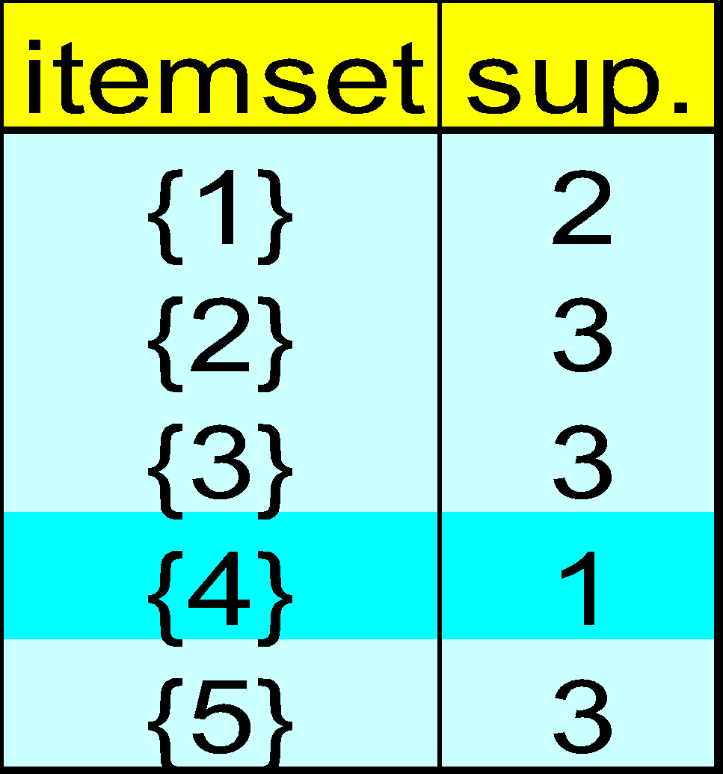
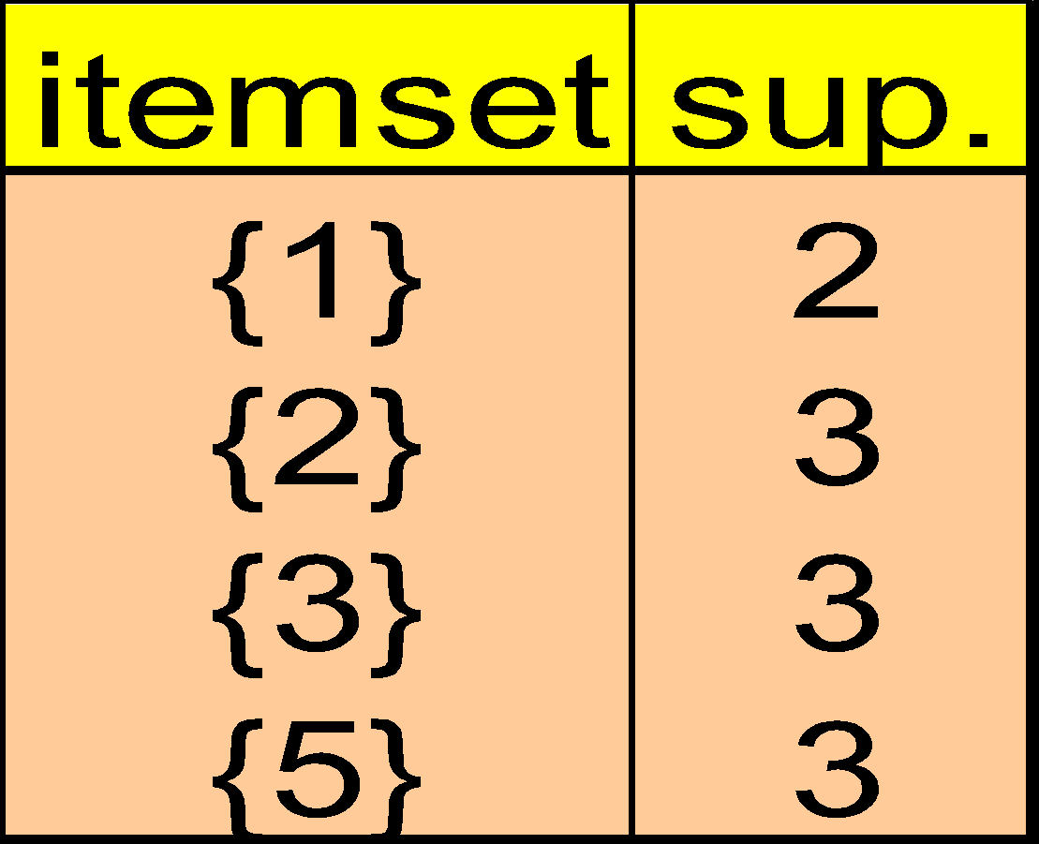
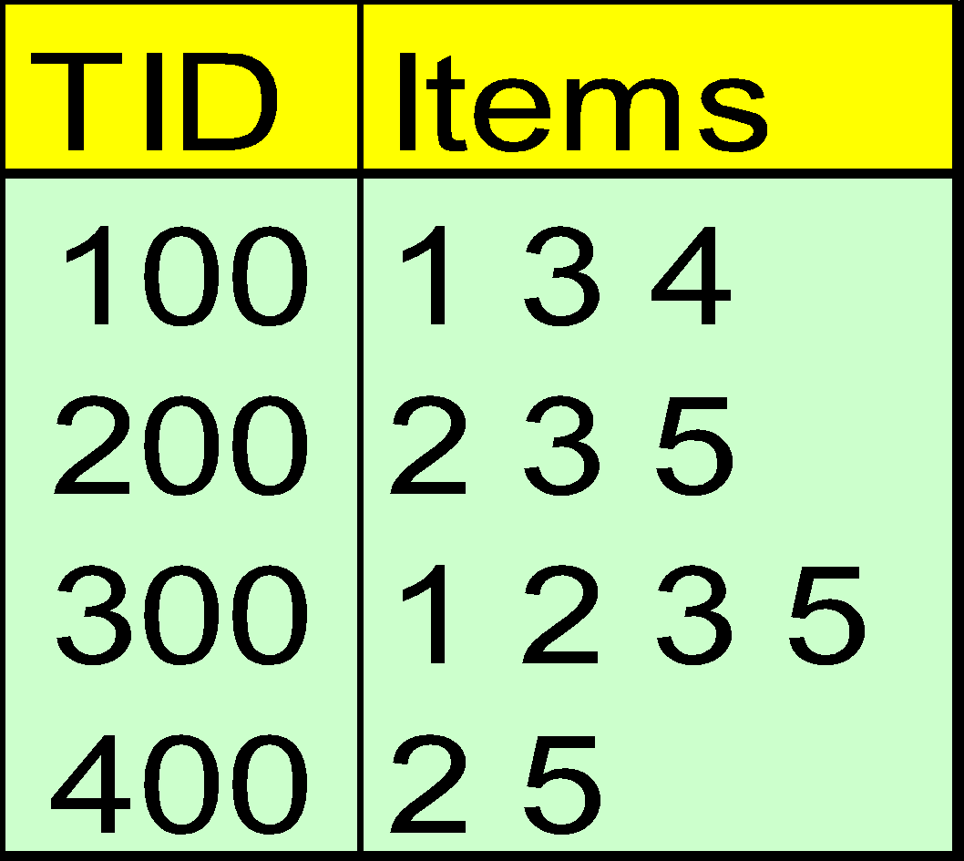
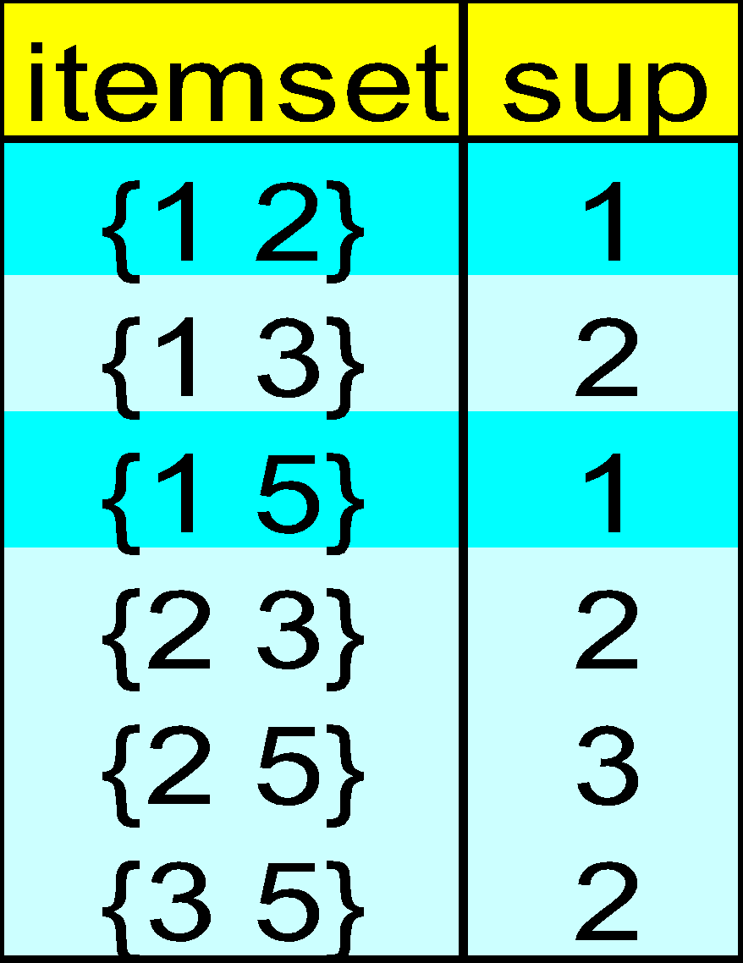
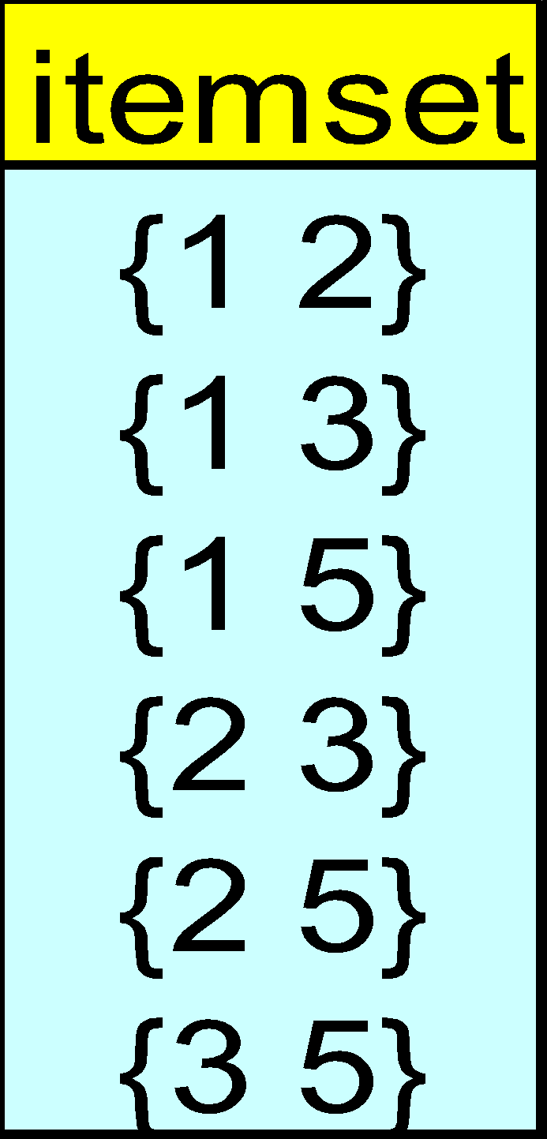
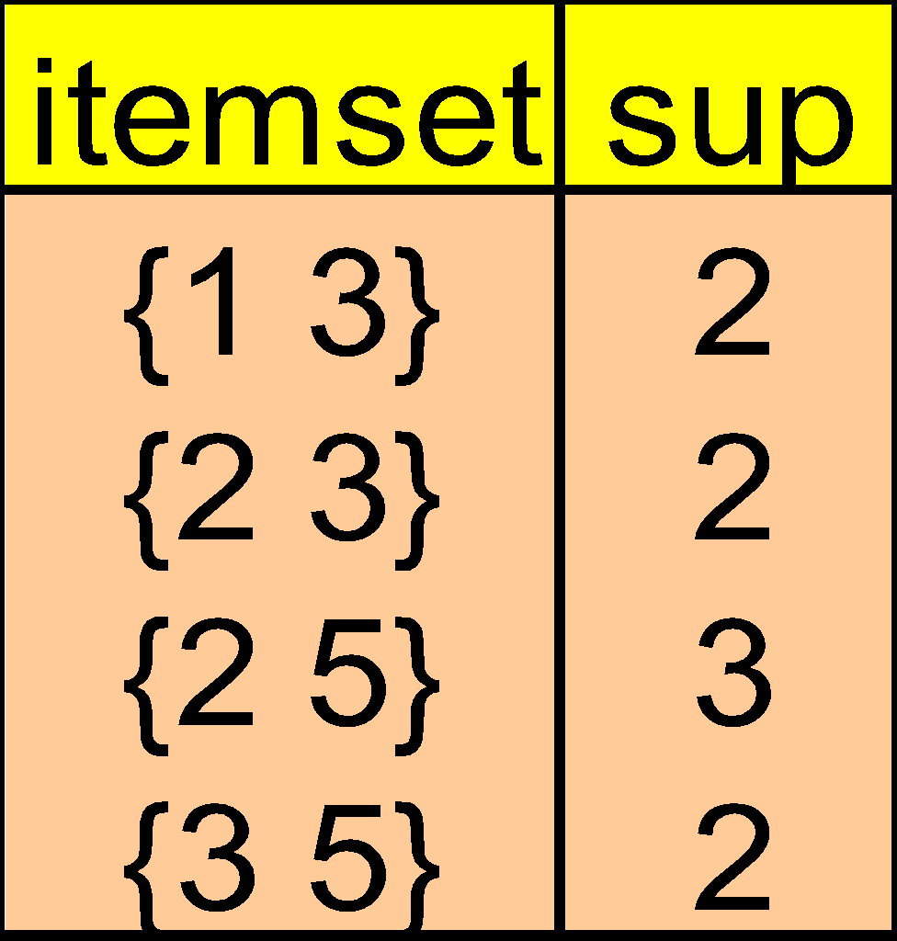
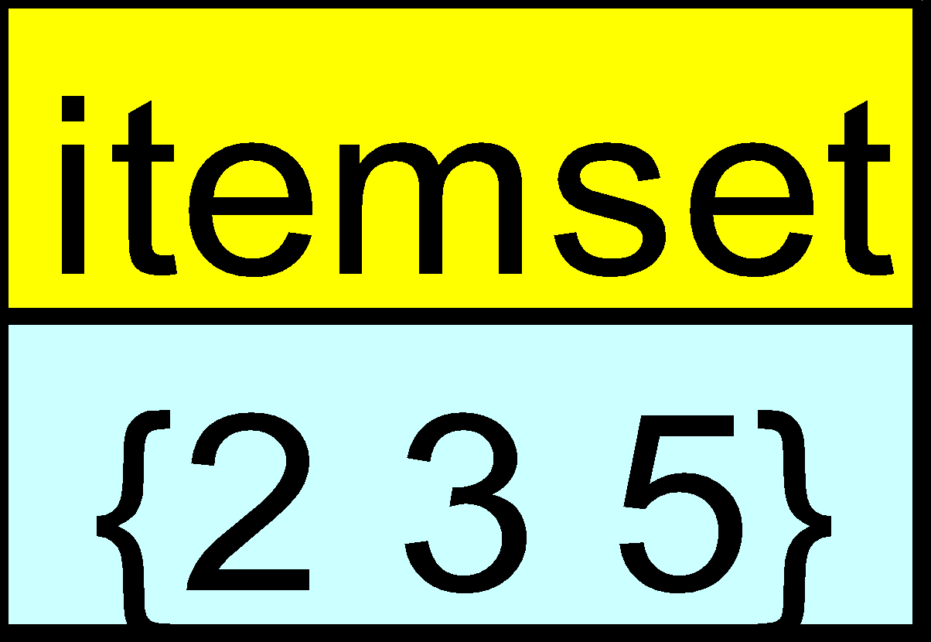
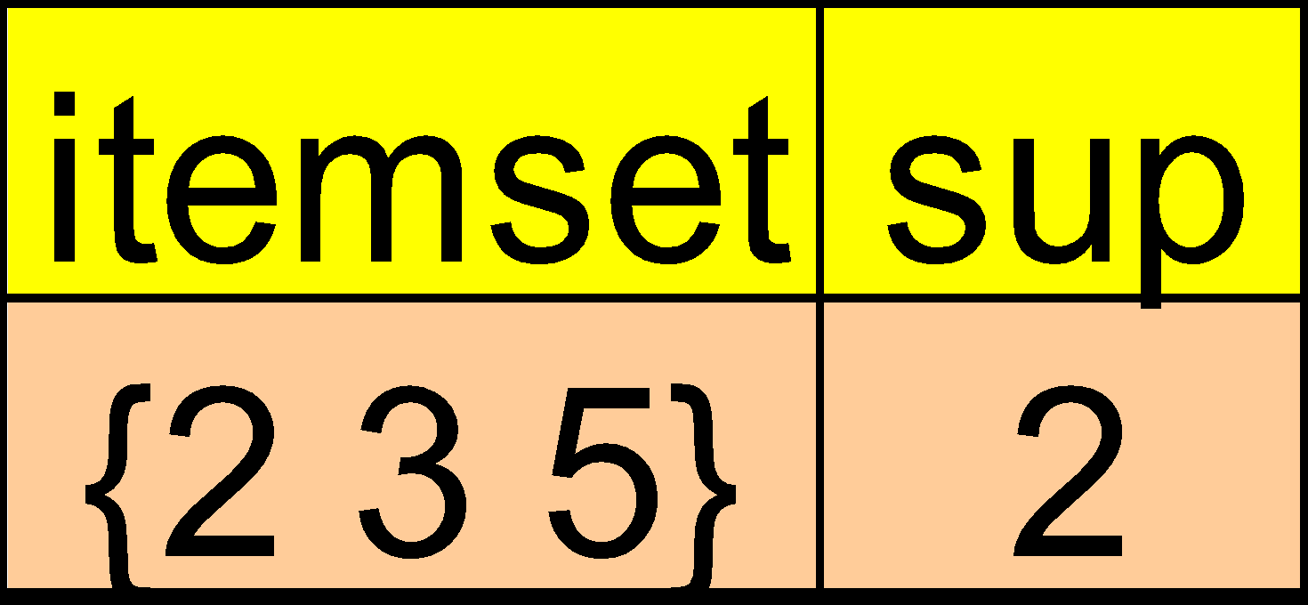
The Apriori Algorithm — Example
Database D
L₁
C₁
Scan D
C₂
C₂
L₂
Scan D
C₃
Scan D
L₃
*
Data Mining: Concepts and Techniques
‹#›

Slide 111
Naïve Algorithm: Apriori + Constraint
Database D
L₁
C₁
Scan D
C₂
C₂
L₂
Scan D
C₃
Scan D
L₃
Constraint:
Sum{S.price} < 5
*
Data Mining: Concepts and Techniques
‹#›

Slide 112
The Constrained Apriori Algorithm: Push an Anti-monotone Constraint Deep
Database D
L₁
C₁
Scan D
C₂
C₂
L₂
Scan D
C₃
Scan D
L₃
Constraint:
Sum{S.price} < 5
*
Data Mining: Concepts and Techniques
‹#›

Slide 113
The Constrained Apriori Algorithm: Push a Succinct Constraint Deep
Database D
L₁
C₁
Scan D
C₂
C₂
L₂
Scan D
not immediately
to be used
C₃
Scan D
L₃
Constraint:
min{S.price } <= 1
*
Data Mining: Concepts and Techniques
‹#›

Slide 114
Converting “Tough” Constraints
TDB (min_sup=2)
Convert tough constraints into anti-monotone or monotone by properly ordering items
Examine C: avg(S.profit) ≥ 25
Order items in value-descending order
<a, f, g, d, b, h, c, e>
If an itemset afb violates C
So does afbh, afb*
It becomes anti-monotone!
TID | Transaction
10 | a, b, c, d, f
20 | b, c, d, f, g, h
30 | a, c, d, e, f
40 | c, e, f, g
Item | Profit
a | 40
b | 0
c | -20
d | 10
e | -30
f | 30
g | 20
h | -10
*
Data Mining: Concepts and Techniques
‹#›

Slide 115
Strongly Convertible Constraints
avg(X) ≥ 25 is convertible anti-monotone w.r.t. item value descending order R: <a, f, g, d, b, h, c, e>
If an itemset af violates a constraint C, so does every itemset with af as prefix, such as afd
avg(X) ≥ 25 is convertible monotone w.r.t. item value ascending order R⁻¹: <e, c, h, b, d, g, f, a>
If an itemset d satisfies a constraint C, so does itemsets df and dfa, which having d as a prefix
Thus, avg(X) ≥ 25 is strongly convertible
Item | Profit
a | 40
b | 0
c | -20
d | 10
e | -30
f | 30
g | 20
h | -10
*
Data Mining: Concepts and Techniques
‹#›

Slide 116
Can Apriori Handle Convertible Constraint?
A convertible, not monotone nor anti-monotone nor succinct constraint cannot be pushed deep into the an Apriori mining algorithm
Within the level wise framework, no direct pruning based on the constraint can be made
Itemset df violates constraint C: avg(X)>=25
Since adf satisfies C, Apriori needs df to assemble adf, df cannot be pruned
But it can be pushed into frequent-pattern growth framework!
Item | Value
a | 40
b | 0
c | -20
d | 10
e | -30
f | 30
g | 20
h | -10
*
Data Mining: Concepts and Techniques
‹#›

Slide 117
Mining With Convertible Constraints
Item | Value
a | 40
f | 30
g | 20
d | 10
b | 0
h | -10
c | -20
e | -30
C: avg(X) >= 25, min_sup=2
List items in every transaction in value descending order R: <a, f, g, d, b, h, c, e>
C is convertible anti-monotone w.r.t. R
Scan TDB once
remove infrequent items
Item h is dropped
Itemsets a and f are good, …
Projection-based mining
Imposing an appropriate order on item projection
Many tough constraints can be converted into (anti)-monotone
TDB (min_sup=2)
TID | Transaction
10 | a, f, d, b, c
20 | f, g, d, b, c
30 | a, f, d, c, e
40 | f, g, h, c, e
*
Data Mining: Concepts and Techniques
‹#›

Slide 118
Handling Multiple Constraints
Different constraints may require different or even conflicting item-ordering
If there exists an order R s.t. both C₁ and C₂ are convertible w.r.t. R, then there is no conflict between the two convertible constraints
If there exists conflict on order of items
Try to satisfy one constraint first
Then using the order for the other constraint to mine frequent itemsets in the corresponding projected database
*
Data Mining: Concepts and Techniques
‹#›

Slide 119
What Constraints Are Convertible?
Constraint | Convertible anti-monotone | Convertible monotone | Strongly convertible
avg(S) ≤ , ≥ v | Yes | Yes | Yes
median(S) ≤ , ≥ v | Yes | Yes | Yes
sum(S) ≤ v (items could be of any value, v ≥ 0) | Yes | No | No
sum(S) ≤ v (items could be of any value, v ≤ 0) | No | Yes | No
sum(S) ≥ v (items could be of any value, v ≥ 0) | No | Yes | No
sum(S) ≥ v (items could be of any value, v ≤ 0) | Yes | No | No
……
*
Data Mining: Concepts and Techniques
‹#›

Slide 120
Constraint-Based Mining—A General Picture
Constraint | Antimonotone | Monotone | Succinct
v ∈ S | no | yes | yes
S ⊇ V | no | yes | yes
S ⊆ V | yes | no | yes
min(S) ≤ v | no | yes | yes
min(S) ≥ v | yes | no | yes
max(S) ≤ v | yes | no | yes
max(S) ≥ v | no | yes | yes
count(S) ≤ v | yes | no | weakly
count(S) ≥ v | no | yes | weakly
sum(S) ≤ v ( a ∈ S, a ≥ 0 ) | yes | no | no
sum(S) ≥ v ( a ∈ S, a ≥ 0 ) | no | yes | no
range(S) ≤ v | yes | no | no
range(S) ≥ v | no | yes | no
avg(S) θ v, θ ∈ { =, ≤, ≥ } | convertible | convertible | no
support(S) ≥ ξ | yes | no | no
support(S) ≤ ξ | no | yes | no
*
Data Mining: Concepts and Techniques
‹#›

Slide 121
Chapter 5: Mining Frequent Patterns, Association and Correlations
Basic concepts and a road map
Efficient and scalable frequent itemset mining methods
Mining various kinds of association rules
From association mining to correlation analysis
Constraint-based association mining
Summary
*
Data Mining: Concepts and Techniques
‹#›

Slide 122
Frequent-Pattern Mining: Summary
Frequent pattern mining—an important task in data mining
Scalable frequent pattern mining methods
Apriori (Candidate generation & test)
Projection-based (FPgrowth, CLOSET+, ...)
Vertical format approach (CHARM, ...)
Mining a variety of rules and interesting patterns
Constraint-based mining
Mining sequential and structured patterns
Extensions and applications
*
Data Mining: Concepts and Techniques
‹#›

Slide 123
Frequent-Pattern Mining: Research Problems
Mining fault-tolerant frequent, sequential and structured patterns
Patterns allows limited faults (insertion, deletion, mutation)
Mining truly interesting patterns
Surprising, novel, concise, …
Application exploration
E.g., DNA sequence analysis and bio-pattern classification
“Invisible” data mining
*
Data Mining: Concepts and Techniques
‹#›

Slide 124
Ref: Basic Concepts of Frequent Pattern Mining
(Association Rules) R. Agrawal, T. Imielinski, and A. Swami. Mining association rules between sets of items in large databases. SIGMOD'93.
(Max-pattern) R. J. Bayardo. Efficiently mining long patterns from databases. SIGMOD'98.
(Closed-pattern) N. Pasquier, Y. Bastide, R. Taouil, and L. Lakhal. Discovering frequent closed itemsets for association rules. ICDT'99.
(Sequential pattern) R. Agrawal and R. Srikant. Mining sequential patterns. ICDE'95
*
Data Mining: Concepts and Techniques
‹#›

Slide 125
Ref: Apriori and Its Improvements
R. Agrawal and R. Srikant. Fast algorithms for mining association rules. VLDB'94.
H. Mannila, H. Toivonen, and A. I. Verkamo. Efficient algorithms for discovering association rules. KDD'94.
A. Savasere, E. Omiecinski, and S. Navathe. An efficient algorithm for mining association rules in large databases. VLDB'95.
J. S. Park, M. S. Chen, and P. S. Yu. An effective hash-based algorithm for mining association rules. SIGMOD'95.
H. Toivonen. Sampling large databases for association rules. VLDB'96.
S. Brin, R. Motwani, J. D. Ullman, and S. Tsur. Dynamic itemset counting and implication rules for market basket analysis. SIGMOD'97.
S. Sarawagi, S. Thomas, and R. Agrawal. Integrating association rule mining with relational database systems: Alternatives and implications. SIGMOD'98.
*
Data Mining: Concepts and Techniques
‹#›

Slide 126
Ref: Depth-First, Projection-Based FP Mining
R. Agarwal, C. Aggarwal, and V. V. V. Prasad. A tree projection algorithm for generation of frequent itemsets. J. Parallel and Distributed Computing:02.
J. Han, J. Pei, and Y. Yin. Mining frequent patterns without candidate generation. SIGMOD’ 00.
J. Pei, J. Han, and R. Mao. CLOSET: An Efficient Algorithm for Mining Frequent Closed Itemsets. DMKD'00.
J. Liu, Y. Pan, K. Wang, and J. Han. Mining Frequent Item Sets by Opportunistic Projection. KDD'02.
J. Han, J. Wang, Y. Lu, and P. Tzvetkov. Mining Top-K Frequent Closed Patterns without Minimum Support. ICDM'02.
J. Wang, J. Han, and J. Pei. CLOSET+: Searching for the Best Strategies for Mining Frequent Closed Itemsets. KDD'03.
G. Liu, H. Lu, W. Lou, J. X. Yu. On Computing, Storing and Querying Frequent Patterns. KDD'03.
*
Data Mining: Concepts and Techniques
‹#›

Slide 127
Ref: Vertical Format and Row Enumeration Methods
M. J. Zaki, S. Parthasarathy, M. Ogihara, and W. Li. Parallel algorithm for discovery of association rules. DAMI:97.
Zaki and Hsiao. CHARM: An Efficient Algorithm for Closed Itemset Mining, SDM'02.
C. Bucila, J. Gehrke, D. Kifer, and W. White. DualMiner: A Dual-Pruning Algorithm for Itemsets with Constraints. KDD’02.
F. Pan, G. Cong, A. K. H. Tung, J. Yang, and M. Zaki , CARPENTER: Finding Closed Patterns in Long Biological Datasets. KDD'03.
*
Data Mining: Concepts and Techniques
‹#›

Slide 128
Ref: Mining Multi-Level and Quantitative Rules
R. Srikant and R. Agrawal. Mining generalized association rules. VLDB'95.
J. Han and Y. Fu. Discovery of multiple-level association rules from large databases. VLDB'95.
R. Srikant and R. Agrawal. Mining quantitative association rules in large relational tables. SIGMOD'96.
T. Fukuda, Y. Morimoto, S. Morishita, and T. Tokuyama. Data mining using two-dimensional optimized association rules: Scheme, algorithms, and visualization. SIGMOD'96.
K. Yoda, T. Fukuda, Y. Morimoto, S. Morishita, and T. Tokuyama. Computing optimized rectilinear regions for association rules. KDD'97.
R.J. Miller and Y. Yang. Association rules over interval data. SIGMOD'97.
Y. Aumann and Y. Lindell. A Statistical Theory for Quantitative Association Rules KDD'99.
*
Data Mining: Concepts and Techniques
‹#›

Slide 129
Ref: Mining Correlations and Interesting Rules
M. Klemettinen, H. Mannila, P. Ronkainen, H. Toivonen, and A. I. Verkamo. Finding interesting rules from large sets of discovered association rules. CIKM'94.
S. Brin, R. Motwani, and C. Silverstein. Beyond market basket: Generalizing association rules to correlations. SIGMOD'97.
C. Silverstein, S. Brin, R. Motwani, and J. Ullman. Scalable techniques for mining causal structures. VLDB'98.
P.-N. Tan, V. Kumar, and J. Srivastava. Selecting the Right Interestingness Measure for Association Patterns. KDD'02.
E. Omiecinski. Alternative Interest Measures for Mining Associations. TKDE’03.
Y. K. Lee, W.Y. Kim, Y. D. Cai, and J. Han. CoMine: Efficient Mining of Correlated Patterns. ICDM’03.
*
Data Mining: Concepts and Techniques
‹#›

Slide 130
Ref: Mining Other Kinds of Rules
R. Meo, G. Psaila, and S. Ceri. A new SQL-like operator for mining association rules. VLDB'96.
B. Lent, A. Swami, and J. Widom. Clustering association rules. ICDE'97.
A. Savasere, E. Omiecinski, and S. Navathe. Mining for strong negative associations in a large database of customer transactions. ICDE'98.
D. Tsur, J. D. Ullman, S. Abitboul, C. Clifton, R. Motwani, and S. Nestorov. Query flocks: A generalization of association-rule mining. SIGMOD'98.
F. Korn, A. Labrinidis, Y. Kotidis, and C. Faloutsos. Ratio rules: A new paradigm for fast, quantifiable data mining. VLDB'98.
K. Wang, S. Zhou, J. Han. Profit Mining: From Patterns to Actions. EDBT’02.
*
Data Mining: Concepts and Techniques
‹#›

Slide 131
Ref: Constraint-Based Pattern Mining
R. Srikant, Q. Vu, and R. Agrawal. Mining association rules with item constraints. KDD'97.
R. Ng, L.V.S. Lakshmanan, J. Han & A. Pang. Exploratory mining and pruning optimizations of constrained association rules. SIGMOD’98.
M.N. Garofalakis, R. Rastogi, K. Shim: SPIRIT: Sequential Pattern Mining with Regular Expression Constraints. VLDB’99.
G. Grahne, L. Lakshmanan, and X. Wang. Efficient mining of constrained correlated sets. ICDE'00.
J. Pei, J. Han, and L. V. S. Lakshmanan. Mining Frequent Itemsets with Convertible Constraints. ICDE'01.
J. Pei, J. Han, and W. Wang, Mining Sequential Patterns with Constraints in Large Databases, CIKM'02.
*
Data Mining: Concepts and Techniques
‹#›

Slide 132
Ref: Mining Sequential and Structured Patterns
R. Srikant and R. Agrawal. Mining sequential patterns: Generalizations and performance improvements. EDBT’96.
H. Mannila, H Toivonen, and A. I. Verkamo. Discovery of frequent episodes in event sequences. DAMI:97.
M. Zaki. SPADE: An Efficient Algorithm for Mining Frequent Sequences. Machine Learning:01.
J. Pei, J. Han, H. Pinto, Q. Chen, U. Dayal, and M.-C. Hsu. PrefixSpan: Mining Sequential Patterns Efficiently by Prefix-Projected Pattern Growth. ICDE'01.
M. Kuramochi and G. Karypis. Frequent Subgraph Discovery. ICDM'01.
X. Yan, J. Han, and R. Afshar. CloSpan: Mining Closed Sequential Patterns in Large Datasets. SDM'03.
X. Yan and J. Han. CloseGraph: Mining Closed Frequent Graph Patterns. KDD'03.
*
Data Mining: Concepts and Techniques
‹#›

Slide 133
Ref: Mining Spatial, Multimedia, and Web Data
K. Koperski and J. Han, Discovery of Spatial Association Rules in Geographic Information Databases, SSD’95.
O. R. Zaiane, M. Xin, J. Han, Discovering Web Access Patterns and Trends by Applying OLAP and Data Mining Technology on Web Logs. ADL'98.
O. R. Zaiane, J. Han, and H. Zhu, Mining Recurrent Items in Multimedia with Progressive Resolution Refinement. ICDE'00.
D. Gunopulos and I. Tsoukatos. Efficient Mining of Spatiotemporal Patterns. SSTD'01.
*
Data Mining: Concepts and Techniques
‹#›

Slide 134
Ref: Mining Frequent Patterns in Time-Series Data
B. Ozden, S. Ramaswamy, and A. Silberschatz. Cyclic association rules. ICDE'98.
J. Han, G. Dong and Y. Yin, Efficient Mining of Partial Periodic Patterns in Time Series Database, ICDE'99.
H. Lu, L. Feng, and J. Han. Beyond Intra-Transaction Association Analysis: Mining Multi-Dimensional Inter-Transaction Association Rules. TOIS:00.
B.-K. Yi, N. Sidiropoulos, T. Johnson, H. V. Jagadish, C. Faloutsos, and A. Biliris. Online Data Mining for Co-Evolving Time Sequences. ICDE'00.
W. Wang, J. Yang, R. Muntz. TAR: Temporal Association Rules on Evolving Numerical Attributes. ICDE’01.
J. Yang, W. Wang, P. S. Yu. Mining Asynchronous Periodic Patterns in Time Series Data. TKDE’03.
*
Data Mining: Concepts and Techniques
‹#›

Slide 135
Ref: Iceberg Cube and Cube Computation
S. Agarwal, R. Agrawal, P. M. Deshpande, A. Gupta, J. F. Naughton, R. Ramakrishnan, and S. Sarawagi. On the computation of multidimensional aggregates. VLDB'96.
Y. Zhao, P. M. Deshpande, and J. F. Naughton. An array-based algorithm for simultaneous multidi-mensional aggregates. SIGMOD'97.
J. Gray, et al. Data cube: A relational aggregation operator generalizing group-by, cross-tab and sub-totals. DAMI: 97.
M. Fang, N. Shivakumar, H. Garcia-Molina, R. Motwani, and J. D. Ullman. Computing iceberg queries efficiently. VLDB'98.
S. Sarawagi, R. Agrawal, and N. Megiddo. Discovery-driven exploration of OLAP data cubes. EDBT'98.
K. Beyer and R. Ramakrishnan. Bottom-up computation of sparse and iceberg cubes. SIGMOD'99.
*
Data Mining: Concepts and Techniques
‹#›

Slide 136
Ref: Iceberg Cube and Cube Exploration
J. Han, J. Pei, G. Dong, and K. Wang, Computing Iceberg Data Cubes with Complex Measures. SIGMOD’ 01.
W. Wang, H. Lu, J. Feng, and J. X. Yu. Condensed Cube: An Effective Approach to Reducing Data Cube Size. ICDE'02.
G. Dong, J. Han, J. Lam, J. Pei, and K. Wang. Mining Multi-Dimensional Constrained Gradients in Data Cubes. VLDB'01.
T. Imielinski, L. Khachiyan, and A. Abdulghani. Cubegrades: Generalizing association rules. DAMI:02.
L. V. S. Lakshmanan, J. Pei, and J. Han. Quotient Cube: How to Summarize the Semantics of a Data Cube. VLDB'02.
D. Xin, J. Han, X. Li, B. W. Wah. Star-Cubing: Computing Iceberg Cubes by Top-Down and Bottom-Up Integration. VLDB'03.
*
Data Mining: Concepts and Techniques
‹#›

Slide 137
Ref: FP for Classification and Clustering
G. Dong and J. Li. Efficient mining of emerging patterns: Discovering trends and differences. KDD'99.
B. Liu, W. Hsu, Y. Ma. Integrating Classification and Association Rule Mining. KDD’98.
W. Li, J. Han, and J. Pei. CMAR: Accurate and Efficient Classification Based on Multiple Class-Association Rules. ICDM'01.
H. Wang, W. Wang, J. Yang, and P.S. Yu. Clustering by pattern similarity in large data sets. SIGMOD’ 02.
J. Yang and W. Wang. CLUSEQ: efficient and effective sequence clustering. ICDE’03.
B. Fung, K. Wang, and M. Ester. Large Hierarchical Document Clustering Using Frequent Itemset. SDM’03.
X. Yin and J. Han. CPAR: Classification based on Predictive Association Rules. SDM'03.
*
Data Mining: Concepts and Techniques
‹#›

Slide 138
Ref: Stream and Privacy-Preserving FP Mining
A. Evfimievski, R. Srikant, R. Agrawal, J. Gehrke. Privacy Preserving Mining of Association Rules. KDD’02.
J. Vaidya and C. Clifton. Privacy Preserving Association Rule Mining in Vertically Partitioned Data. KDD’02.
G. Manku and R. Motwani. Approximate Frequency Counts over Data Streams. VLDB’02.
Y. Chen, G. Dong, J. Han, B. W. Wah, and J. Wang. Multi-Dimensional Regression Analysis of Time-Series Data Streams. VLDB'02.
C. Giannella, J. Han, J. Pei, X. Yan and P. S. Yu. Mining Frequent Patterns in Data Streams at Multiple Time Granularities, Next Generation Data Mining:03.
A. Evfimievski, J. Gehrke, and R. Srikant. Limiting Privacy Breaches in Privacy Preserving Data Mining. PODS’03.
*
Data Mining: Concepts and Techniques
‹#›

Slide 139
Ref: Other Freq. Pattern Mining Applications
Y. Huhtala, J. Kärkkäinen, P. Porkka, H. Toivonen. Efficient Discovery of Functional and Approximate Dependencies Using Partitions. ICDE’98.
H. V. Jagadish, J. Madar, and R. Ng. Semantic Compression and Pattern Extraction with Fascicles. VLDB'99.
T. Dasu, T. Johnson, S. Muthukrishnan, and V. Shkapenyuk. Mining Database Structure; or How to Build a Data Quality Browser. SIGMOD'02.
*
Data Mining: Concepts and Techniques
‹#›

Slide 140

*
Data Mining: Concepts and Techniques
‹#›

