Slide 1

Notes:
We are PlaneView – Our team is special as we represent a diverse range of backgrounds from developers to teachers and management specialists. This means we have been able to create a concept which tackles many issues using one web based platform.
We came together as we were all passionate about improving educational resources and user experience.
As our initial ideas developed we realised that our educational tool has uses far beyond the classroom and that the data we collect could influence research, environmental issues and even animal welfare.
Our product will be driven by user demand and has the potential to develop alongside their requirements.

Slide 2

Current Problems
Problem 1: Children find it difficult to conceptualize ideas about day and night, time zones and seasons in other countries.
Problem 2: Currently there is a gap in the market for linking educational and entertainment resources on inflight experiences
Notes:
Problem 1: conceptualisation difficulties
Live aerial footage combined with information about countries and their current climatic conditions would allow pupils to compare their situation with others across the globe in real- time. This allows them to visualise how while they are awake other countries are sleeping or experiencing radical climate differences
Problem 2: Airlines currently provide a range of in flight entertainments however existing information about the planes position fails to include information about the places that the aircraft passes.
Our product fills a gap in the market and the data it collects offers many business opportunities for customers beyond our current target audience.

Slide 3
Our Solution
Overlay to Open source maps
Real time footage from plane
Centralised platform
Link to existing live footage from the ground
Information on landmarks that the flight passes
Link to additional learning and information resources
Notes:
When you open PlaneView from a ground based server you will first be able to select a flight to track. For in-flight users the PlaneView package will automatically connect with that aircraft’s data.
Once a flight is selected you will be able to see the live images from that aircraft and this is overlaid onto maps and images of the local area. This allows viewing of the country even on cloudy days.
From the map, users will be able to select cities and landmarks to access additional information.
Links to existing real-time ground cameras will allow live coverage of the area where available.
The aircraft button allows you to rotate the image allowing 360 degree views from the air.
Links to additional information sites allow additional features such as language learning.
If a user simply wants to view the flight all overlays can be switched off to allow clear views of the spectacles enroute

Slide 4
Demo
Notes:
When you open PlaneView from a ground based server you will first be able to select a flight to track. For in-flight users the PlaneView package will automatically connect with that aircraft’s data.
Once a flight is selected you will be able to see the live images from that aircraft and this is overlaid onto maps and images of the local area. This allows viewing of the country even on cloudy days.
From the map, users will be able to select cities and landmarks to access additional information.
Links to existing real-time ground cameras will allow live coverage of the area where available.
The aircraft button allows you to rotate the image allowing 360 degree views from the air.
Links to additional information sites allow additional features such as language learning.
If a user simply wants to view the flight all overlays can be switched off to allow clear views of the spectacles enroute

Slide 5
Impact
Current Target Users
Schools
Passengers
General Public
Current Impact
- One resource for area information
- Real time images improve understanding of key concepts
-Individuals can track views from flights of interest
Potential Users
Air-traffic
Academic | Geologist | Ecologist
Met-office
Animal Couriers
Potential Impact
Mass data collection – enhances research and continuous monitoring
Lead to improvements in animal welfare during transit
PlaneView
Notes:
[present clockwise]
PlaneView will change the approach to learning about countries whether in a school, at home or whilst flying over them. Real time data allows live comparisons between countries on one platform, this has not been done before. It allows difficult concepts such as timezones and environmental differences to be easily visualise.
Currently our project has a small scale impact, however, if data is being continuously collected from regular flightpaths this mass data collection has many potential uses.
Air traffic
Academics can monitor changes in the landscape such as area of waterbodies and developments in land use.
Weather information can be tracked
And, potential real time images of animals in the aircraft hold can lead to improvements in animal welfare.
For more potential uses consult our booklet where we highlight the potential customer base for our fully developed product.

Slide 6
What we need
Stage 1: Live footage from commercial flights
Stage 1 & 2: Permissions to link existing ground footage to our platform
Stage 2: Install sensors and cameras to additional flights and areas
Notes:
Current on ground footage benefit public and school use – But not in sufficient resolution for additional users such as behavioural sciences who might need to observe individual animal responses on the ground

Slide 7
Impact Statement
Vision:
To provide innovative real-time footage on every aircraft in the world, that will enhance education, environment monitoring and animal welfare.
Mission:
To produce a real-time interactive educational tool, which links live images from the air and ground with information from the local area.

Slide 8


Slide 9
The Future… (18 months plan)
0-6 Months
Stage 1: Develop full working prototype
Development team:
Back-end developers
Front-end developers
7-12 Months
Contact potential partners and further development
-Partnership with British language council, UNESCO, Language Learning schools, Museums
13-18 Months
Stage2: Invest in hardware, develop social media links.
- install further cameras on planes and on the ground
- Social Media interaction (linking a users previous life events and memories as they pass relevant countries)
-PlaneView takes off! Version 1.0 available to market
-Revenue stream starts!
-Sale of advertising space
-Grants and funding from tourist information and NGOs
-Sell advertising space to social media companies

Slide 10


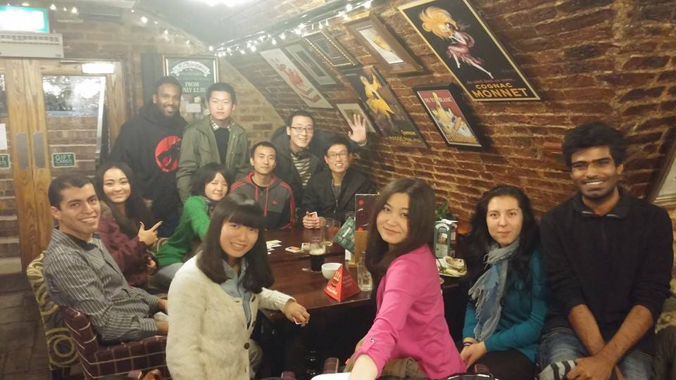

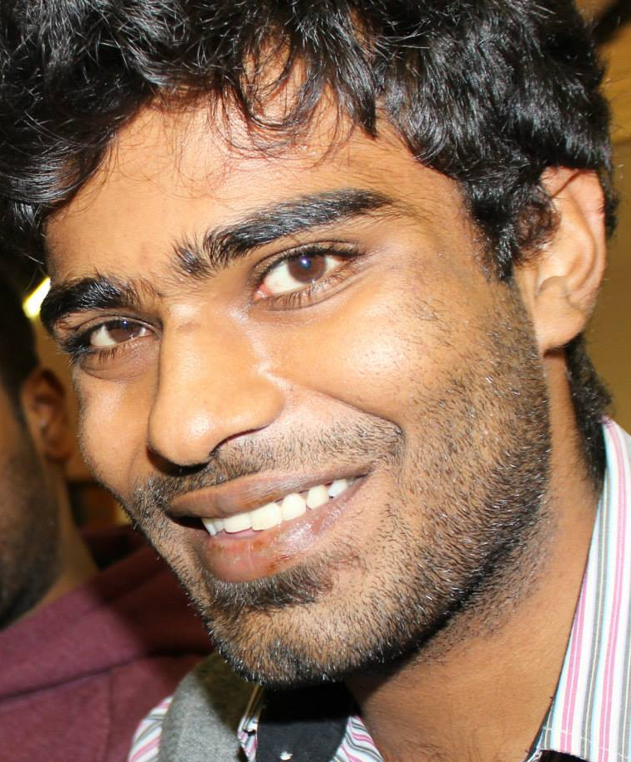
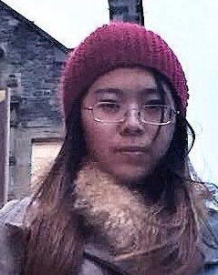
PlaneView Team
Kenny Chelikuzhiyil
Backend
Developer
Malek
El- Qallali
Innovation Management
Analyst
Bruno Orozco
Backend
Developer
Sarah
Spooner
Educator
Vivek Warriar
Frontend
Developer
Yu
Xie
Designer
Yuhan
Zhou
Frontend
Developer

