Slide 1
Graphical Log Analyzer
Lindsey Lack
16 October 2002

Slide 2
Project Goal
Examine the suitability of X3D/VRML for use in developing a graphical log visualization tool
  IDS, System Logs, etc
Emphasis on coding features / interoperability potential
  Not on determining the most effective visual representation

Slide 3
Initial Attempt
Using Script Nodes
  Didn’t work since code in the browser wouldn’t talk with code outside the browser
  Unless I used the network to send messages

Slide 4
JVM Issue With ScriptNodes
Java UI
Browser UI
X
GUI
Thread
GUI
Thread
Browser
X
Script
Node
JVM1
JVM2 (In Browser)
Network

Slide 5
EAI (External Authoring Interface)
Ended up using EAI
  Combines Applet interface with VRML window in same Browser
Used Cortona 3.1 and the “original” eai classes
  Vrml.external.*, in plywood.jar

Slide 6
EAI
Single Web Page
Applet UI
Browser UI
EAI/GUI
Browser
JVM1 (In Browser)

Slide 7
EAI Techniques
getBrowser
  Connect with world
createVrmlFromString
  Create objects
getEventIn (addChildren,translation)
  Send objects into world
  Compile objects
  Move objects
Implemented EventOutObserver
  Capture callbacks

Slide 8
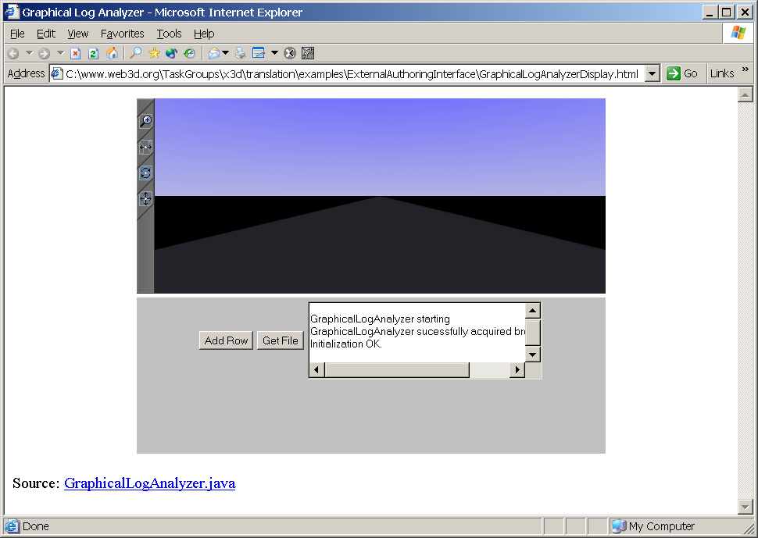
Demo

Slide 9
Advantages
Potential to hold massive amounts of information in a scene
Visual perspective has a natural benefits (more detail for more recent events)
Scene “storage”
  When registering for callback, send object: stores object

