Slide 1
A Study of X3D LocalFog
Sungmin Kwon lucidaim@gmail.com
Don Brutzman brutzman@nps.edu
26 JUL 2018

Slide 2
Common Misconception
Misconception: LocalFog is viewpoint centric.
➔ No. Position of LocalFog can be decided separately
from viewpoint.
Actually LocalFog is located in the scene, and not bound.
➔ LocalFog effects occur around the local transformation
center, rather than bound to the viewer.
http://www.web3d.org/x3d/tooltips/X3dTooltips.html#LocalFog

Slide 3
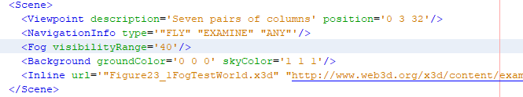
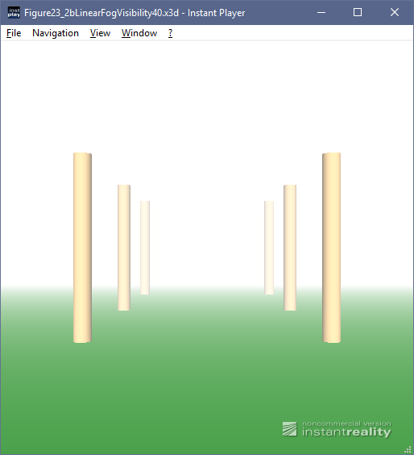
Base Example: Fog
Figure23_2bLinearFogVisibility40.x3d
http://www.web3d.org/x3d/content/examples/Vrml2Sourcebook/Chapter23Fog/Figure23_2bLinearFogVisibility40Index.html

Slide 4
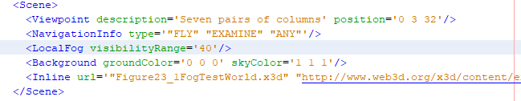
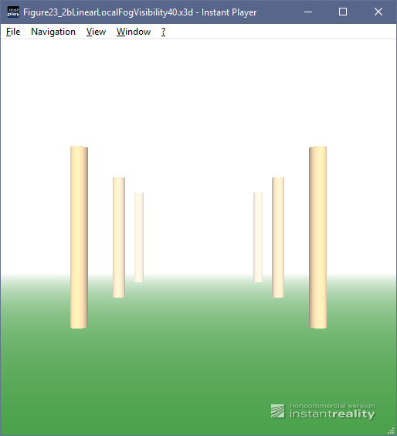
LocalFog Example
Let’s change slightly Fog node into LocalFog node…

Slide 5
Test Results of X3D Viewers for LocalFog
 | Fog node | LocalFog node
Firefox + X_ITE Player | OK | Partial support
Instant Player | OK | Partial support
Firefox + X3DOM Player | OK | No rendering
Xj3D | OK | Fails

Slide 6
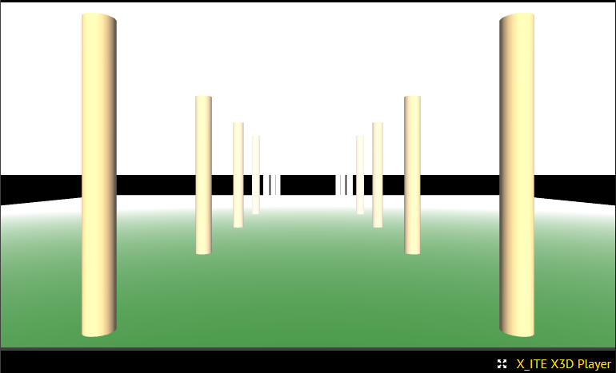
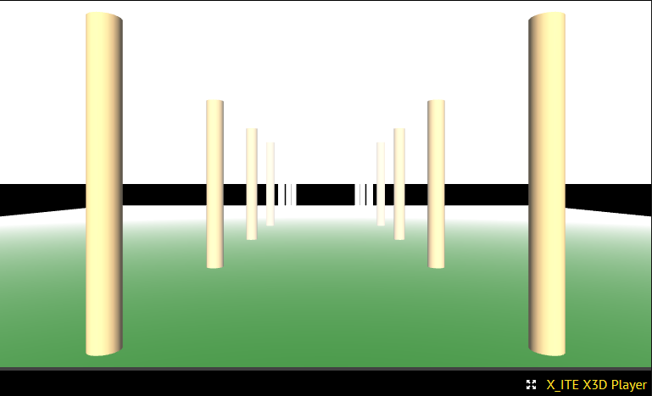
Firefox + X_ITE Player
LocalFog node works, initially...
<Fog node>
<LocalFog node>

Slide 7
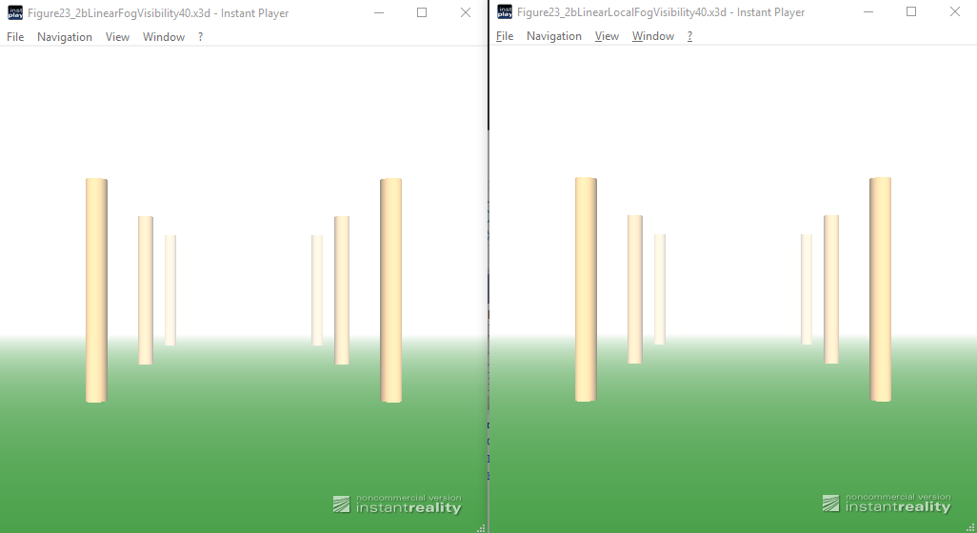
Instant Player
LocalFog node works, initially...
<Fog node>
<LocalFog node>

Slide 8
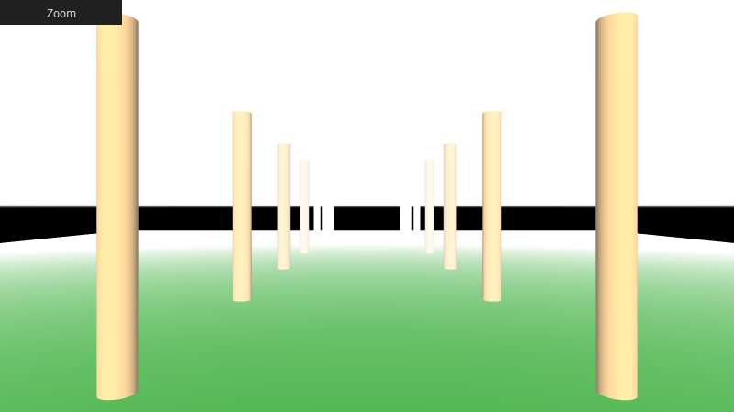
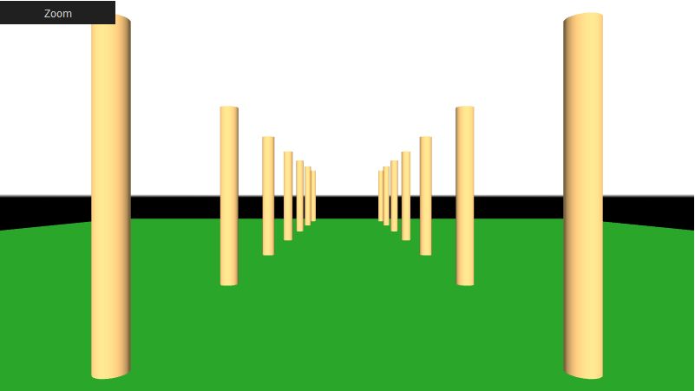
Firefox + X3DOM Player
LocalFog node doesn’t render.
<Fog node>
<LocalFog node>

Slide 9
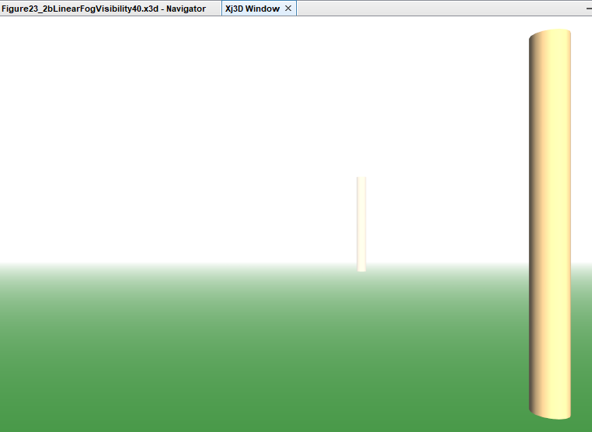
Xj3D
It fails on scene having LocalFog node.
No display
<Fog node>
<LocalFog node>

Slide 10
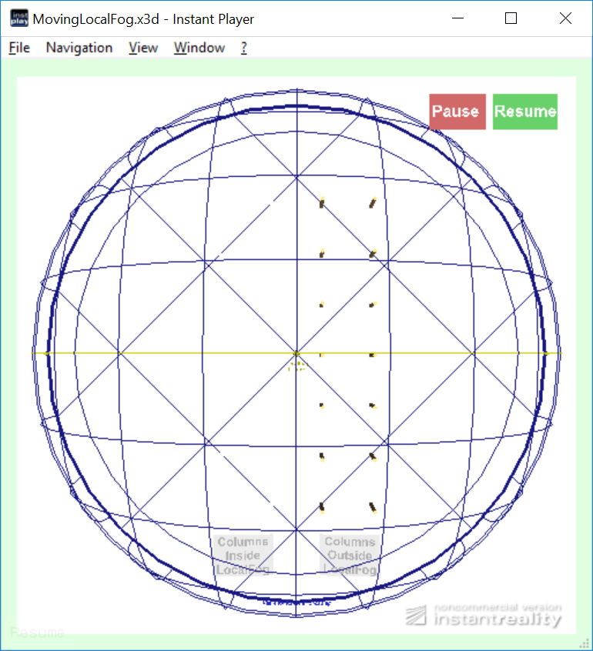
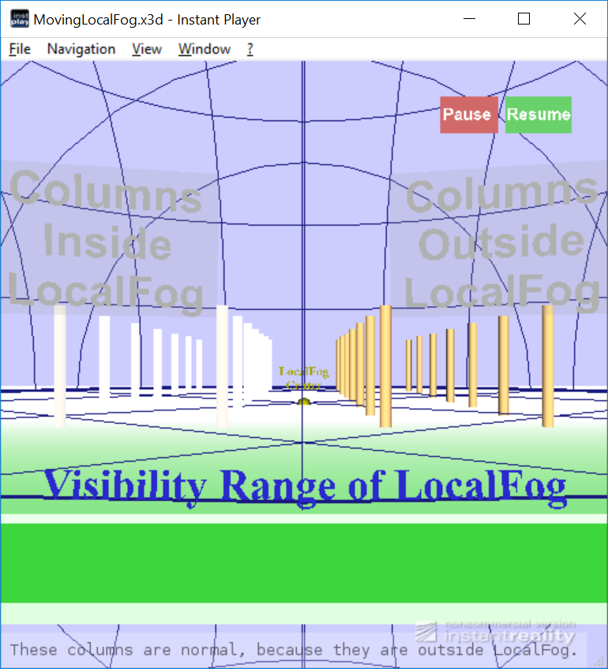
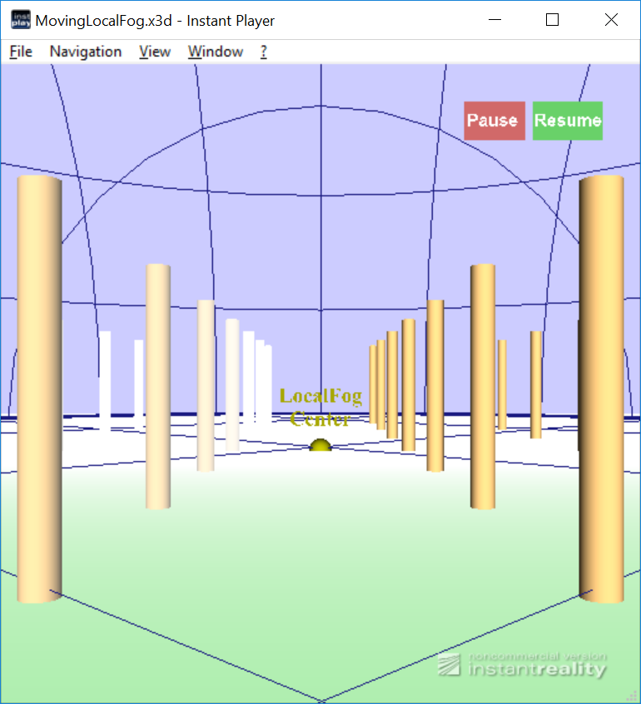
LocalFogEffectsTest.x3d
Test Scene of LocalFog node includes animation
Moving LocalFog: fogType = Linear and visibilityRange = 40m
Fog attenuation correctly varies depending on transformation position of LocalFog, not current view.
Columns on right side are outside of the LocalFog scene subgraph and correctly remain unaffected, thus helping scalability.
However, parent Transform animation results are inconsistent.

Slide 11
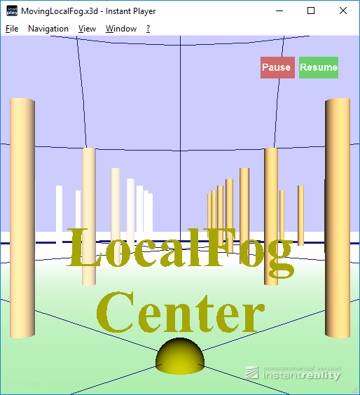
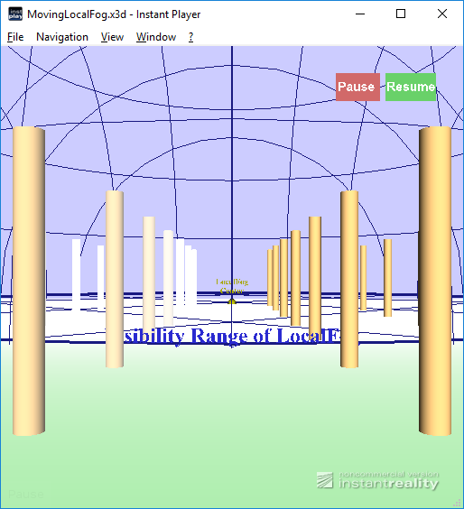
Browser test: Instant Player
LocalFog initially works, but effect doesn’t move when the parent transformation hierarchy is animating.
Effects on left columns should vary when center moves.
<Close LocalFog>
<Far LocalFog>

Slide 12
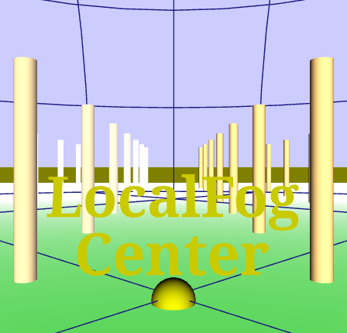
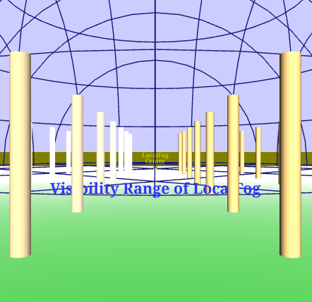
Browser test: Firefox + X_ITE Player
Similar to Instant Player: renders but no animation.
(Other browser tests didn’t work with X_ITE Player.)
<Close LocalFog>
<Far LocalFog>

Slide 13
LocalFog Test Conclusions
Implementations of X_ITE and Instant Player are both good, but still need animation support.
Other browsers need to implement LocalFog.
 | Fog node | LocalFog node | Transformation of LocalFog node
Firefox + X_ITE Player | OK | Partial support | Not supported
Instant Player | OK | Partial support | Not supported
Firefox + X3DOM Player | OK | No rendering | No rendering
Xj3D | OK | Fails | Fails

