Slide 1
BugFix for Extrusion Node at Xj3D Viewer
Sungmin Kwon
Oct. 31 ~ Nov. 9

Slide 2
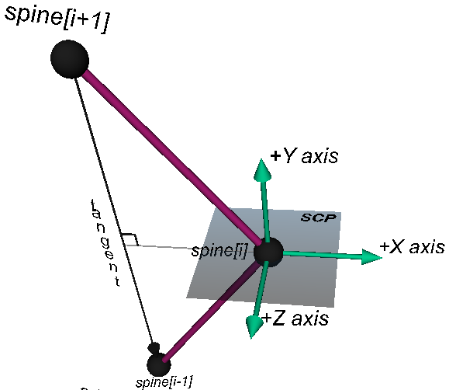
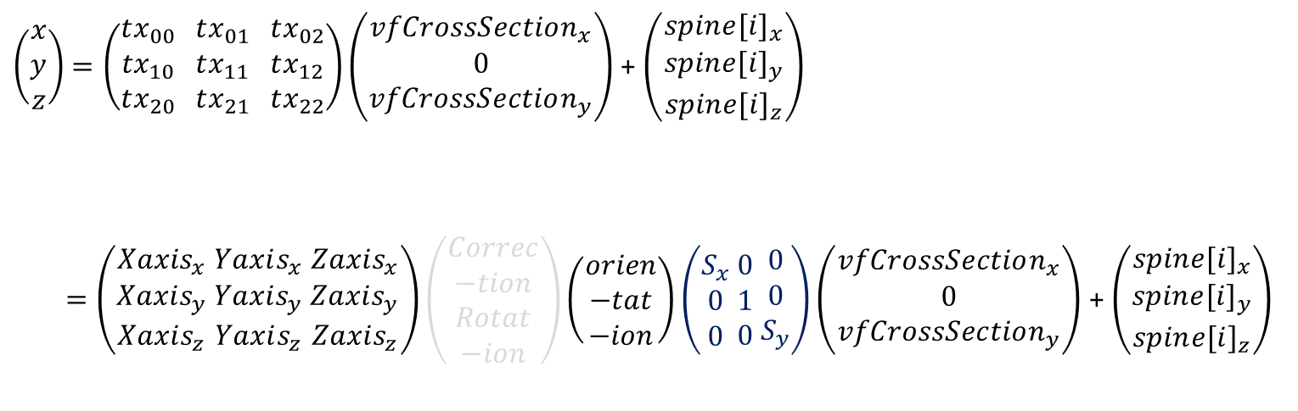
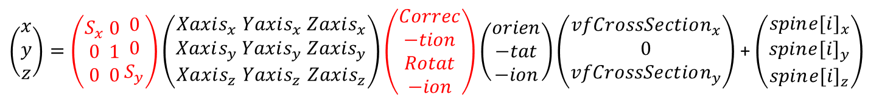
Break down TRANSFORM matrix defined in calculateSCP()
Bug #1 –
Incorrect definition of Zaxis
$\left(\begin{aligned}x \\ y \\ z\end{aligned}\right)$ $=\left(\begin{aligned}tx_{00} \\ tx_{10} \\ tx_{20}\end{aligned} \begin{aligned}tx_{01} \\ tx_{11} \\ tx_{21}\end{aligned} \begin{aligned}tx_{02} \\ tx_{12} \\ tx_{22}\end{aligned}\right)\left(\begin{aligned}vfCrossSection_{x} \\ 0 \\ vfCrossSection_{y}\end{aligned}\right)$+ $\left(\begin{aligned}spin{e[i]}_{x} \\ spin{e[i]}_{y} \\ spin{e[i]}_{z}\end{aligned}\right)$
$=\left(\begin{aligned}Xaxis_{x} \\ Xaxis_{y} \\ Xaxis_{z}\end{aligned} \begin{aligned}Yaxis_{x} \\ Yaxis_{y} \\ Yaxis_{z}\end{aligned} \begin{aligned}Zaxis_{x} \\ Zaxis_{y} \\ Zaxis_{z}\end{aligned}\right)\left(\begin{aligned}Correc \\ −tion \\ Rotat \\ −ion\end{aligned}\right)\left(\begin{aligned}orien \\ −tat \\ −ion\end{aligned}\right)\left(\begin{aligned}S_{x} \\ 0 \\ 0\end{aligned} \begin{aligned}0 \\ 1 \\ 0\end{aligned} \begin{aligned}0 \\ 0 \\ S_{y}\end{aligned}\right)\left(\begin{aligned}vfCrossSection_{x} \\ 0 \\ vfCrossSection_{y}\end{aligned}\right)$+ $\left(\begin{aligned}spin{e[i]}_{x} \\ spin{e[i]}_{y} \\ spin{e[i]}_{z}\end{aligned}\right)$
Bug #5 –
Missing Normalization of Zaxis in a case
Bug #3 –
Incorrect Matrix Initialization
Convert (SCP points) to
Local Extrusion domain
Defined at SCP domain
Defined at Local Extrusion domain.
Bug #2 –
Incorrect Matrix Ordering
Bug #4 –
Not sure of this matrix
Old Xj3D Viewer :
$\left(\begin{aligned}x \\ y \\ z\end{aligned}\right)=\left(\begin{aligned}S_{x} \\ 0 \\ 0\end{aligned} \begin{aligned}0 \\ 1 \\ 0\end{aligned} \begin{aligned}0 \\ 0 \\ S_{y}\end{aligned}\right)\left(\begin{aligned}Xaxis_{x} \\ Xaxis_{y} \\ Xaxis_{z}\end{aligned} \begin{aligned}Yaxis_{x} \\ Yaxis_{y} \\ Yaxis_{z}\end{aligned} \begin{aligned}Zaxis_{x} \\ Zaxis_{y} \\ Zaxis_{z}\end{aligned}\right)\left(\begin{aligned}Correc \\ −tion \\ Rotat \\ −ion\end{aligned}\right)\left(\begin{aligned}orien \\ −tat \\ −ion\end{aligned}\right)\left(\begin{aligned}vfCrossSection_{x} \\ 0 \\ vfCrossSection_{y}\end{aligned}\right)$+ $\left(\begin{aligned}spin{e[i]}_{x} \\ spin{e[i]}_{y} \\ spin{e[i]}_{z}\end{aligned}\right)$

Slide 3
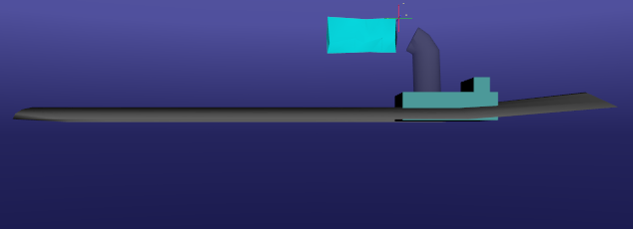
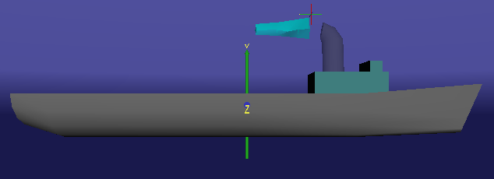
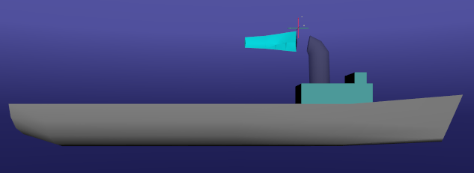
Result of BugFix #1~#3
Old Xj3D Viewer 2.1
Instantreality
New

Slide 4
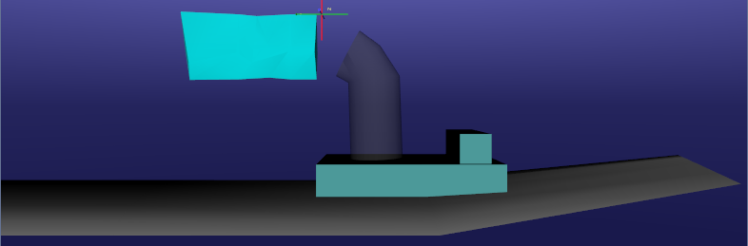
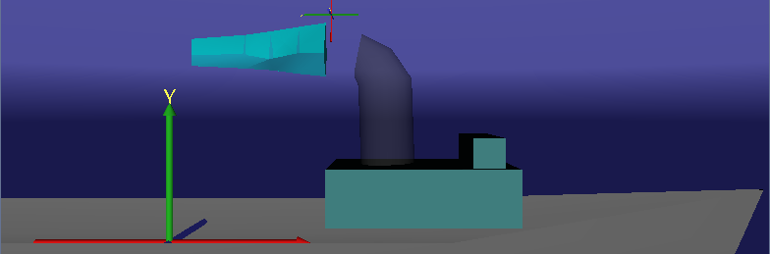
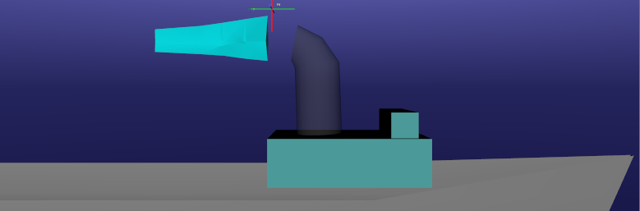
Result of BugFix #1~#3
Old Xj3D Viewer 2.1
Instantreality
New
New

Slide 5
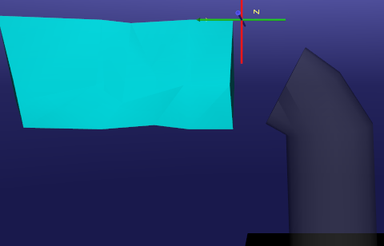
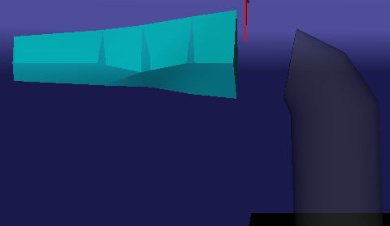
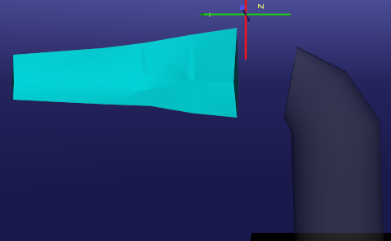
Result of BugFix #1~#3
Old Xj3D Viewer 2.1
Instantreality
New

Slide 6
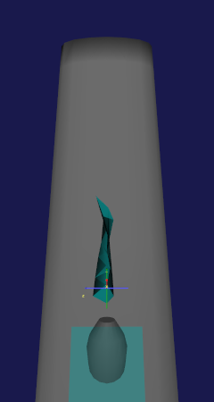
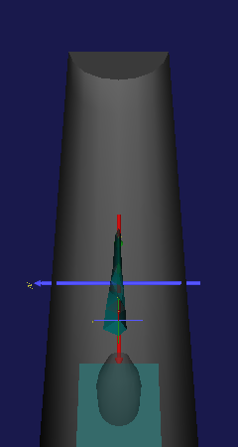
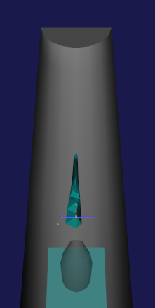
Result of BugFix #1~#3
Old Xj3D Viewer 2.1
Instantreality
New

Slide 7
BugFix #4 – Remove prior partial incomplete bugfix : createCorrectionRotations(z) Method remains in place but is now ignored and deprecated.

Slide 8
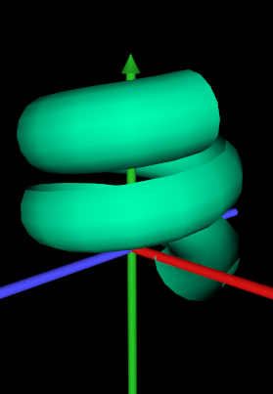
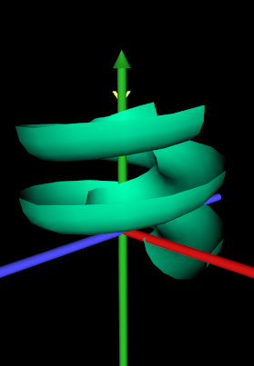
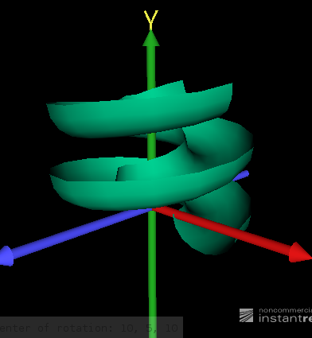
Result of BugFix #4
Old Xj3D Viewer 2.1
With
createCorrectionRotations(z)
Instantreality
New one
Without prior bugfix
createCorrectionRotations(z)
Figure15.11ExtrudedPlaygroundSlideWithAxes.x3d

Slide 9
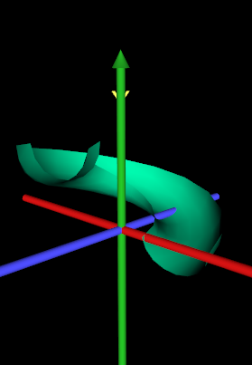
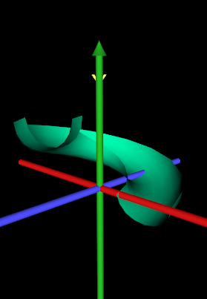
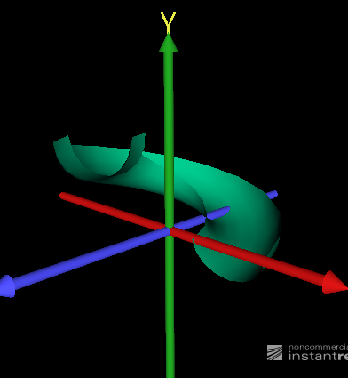
Result of BugFix #4
Old Xj3D Viewer 2.1
With
createCorrectionRotations(z)
But fixed only incorrect initialization
Instantreality
New one
Without prior bugfix
createCorrectionRotations(z)
Figure15.11ExtrudedPlaygroundSlideSimpleWithAxes.x3d

Slide 10
Bug #5 – Add normalization of z axis in case of closed spine Solution : add norm(z[0]); OGLExtrusion.java calculateSCP ()

Slide 11
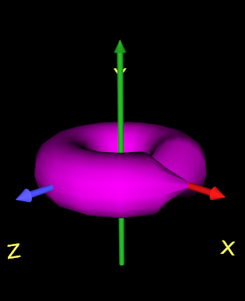
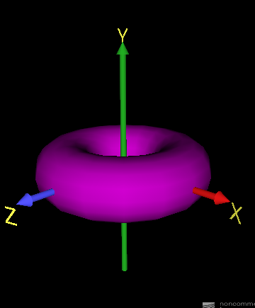

Result of BugFix #5
Bug #6 –
Incorrect shading of seam
Old Xj3D Viewer 2.1
Instantreality
New one

Slide 12
Bug #6 – Combined normal for Closed Spine to avoid incorrect shading of seam Solution : Coordinate Index of last cross section ⬅ Coordinate index of 1st cross section when computing combined normals OGLExtrusion.java createIndicesTriangleArray ()

Slide 13
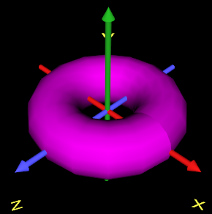
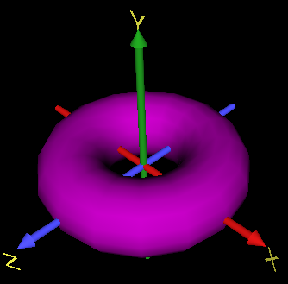
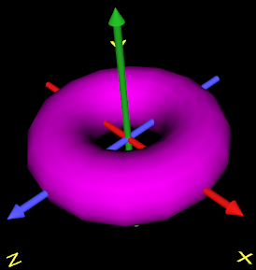
Result of BugFix #6
Old Xj3D Viewer 2.1
Instantreality
New one

Slide 14
Bug #7 – Shading 2 Solution : Split Wall Face / Cap Face from calculating normal vector average GeometryUtils.java buildConvexPolygons() : buildConcavePolygons() : create and set FaceType generateNormals() : use FaceType

Slide 15
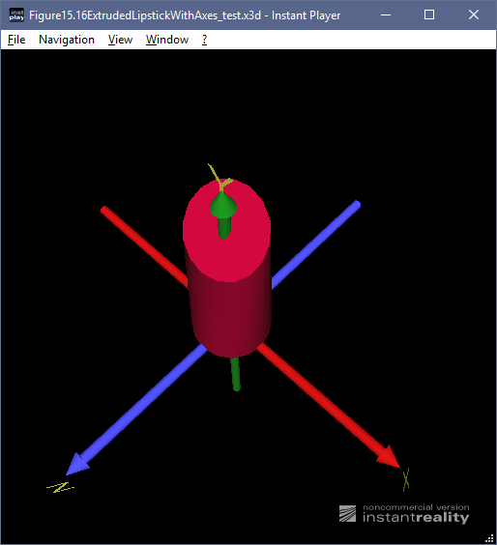
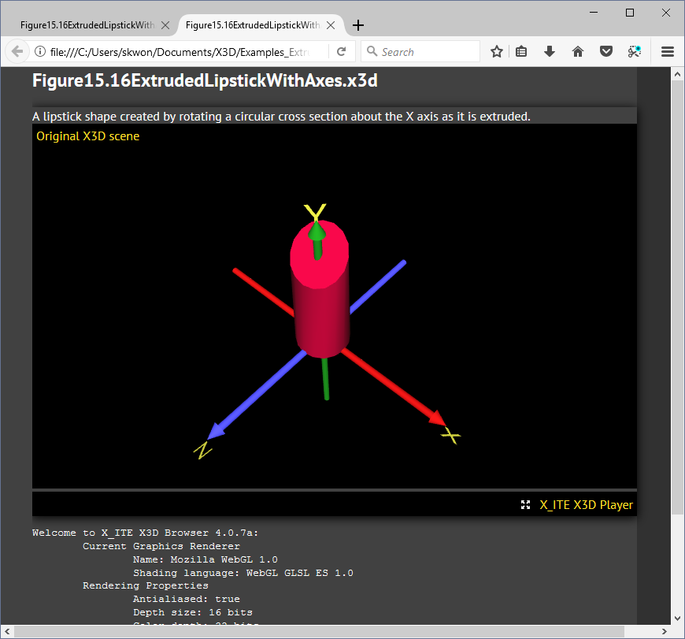
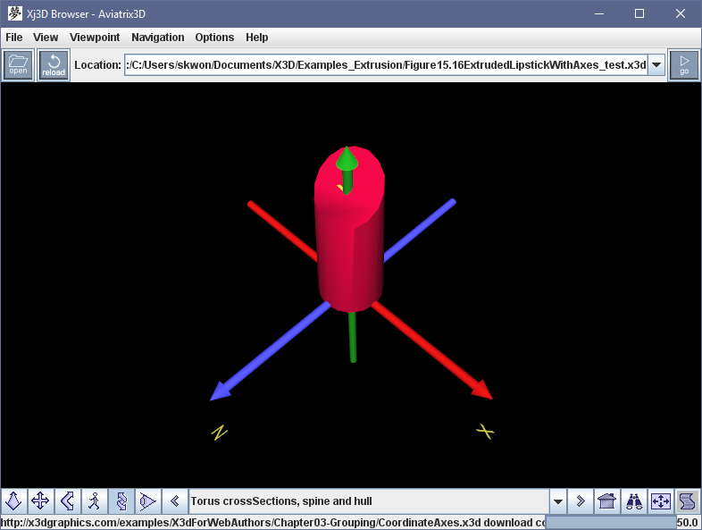
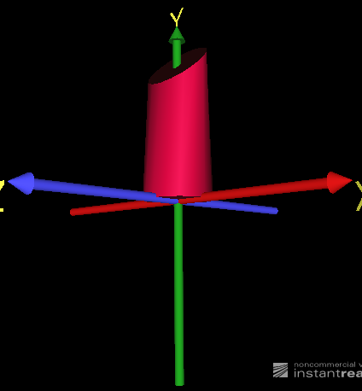
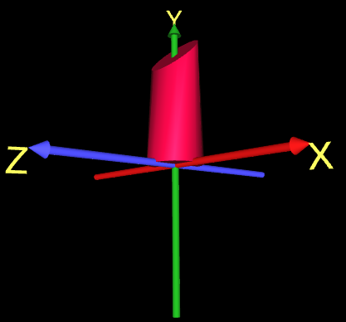
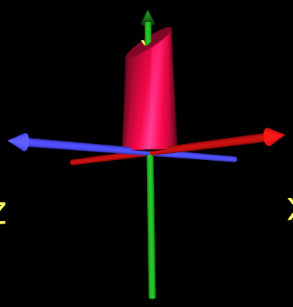
creaseAngle is improperly applied.
Bug #7 –
Incorrect average of normals
If creaseAngle = 0.9 (51.6 deg)
Instantreality
X_ITE
Old Xj3D Viewer 2.1

Slide 16
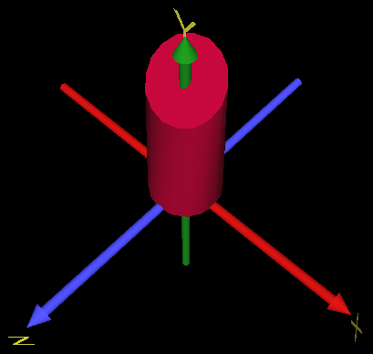
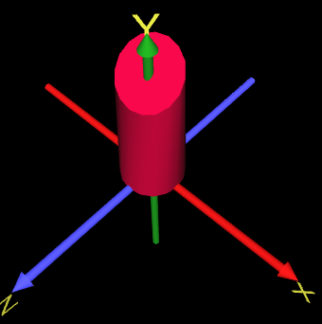
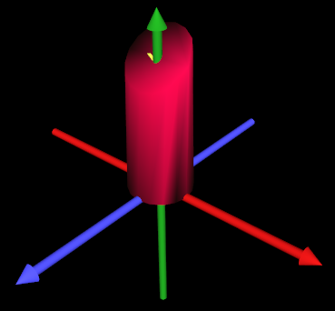
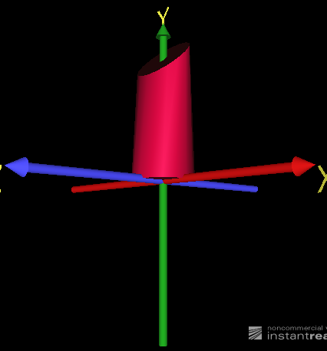
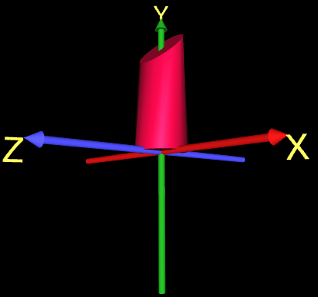
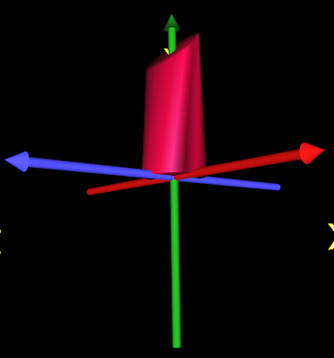
Exaggerating the issue
Bug #7 –
Incorrect average of normals
creaseAngle = 2.7 (154.7 deg)
Instantreality
X_ITE
Old Xj3D Viewer 2.1

Slide 17
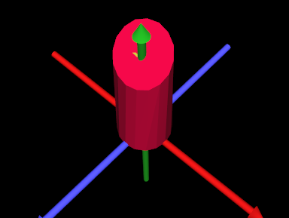
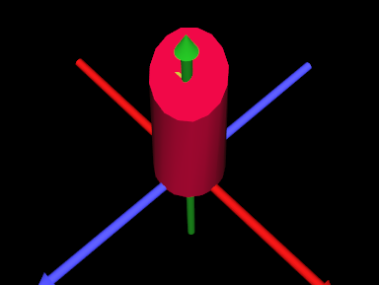
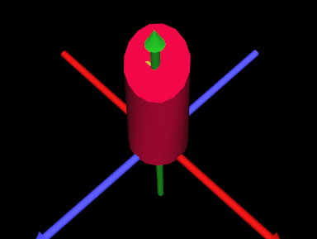
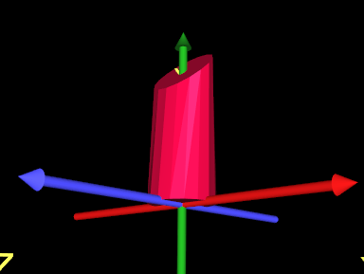
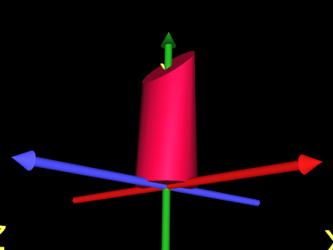
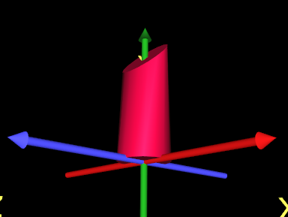
Correction : Make end-cap edges always sharp rendered. TODO : Check specs.
New Xj3D Viewer
New Xj3D Viewer
New Xj3D Viewer
creaseAngle = 0.1 (5.7 deg)
creaseAngle = 0.9 (154.7 deg)
creaseAngle = 2.7 (154.7 deg)

